Slide 1

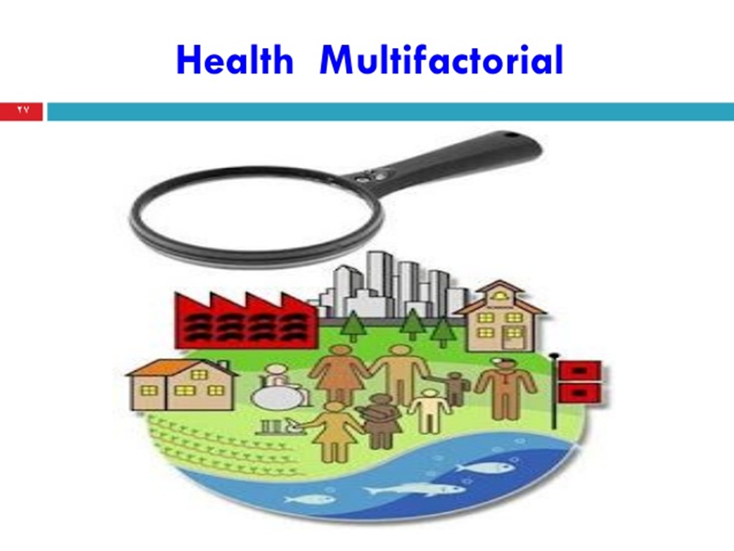
Primary health care
Dr. Amina Elsaid
Community Medicine

Slide 2
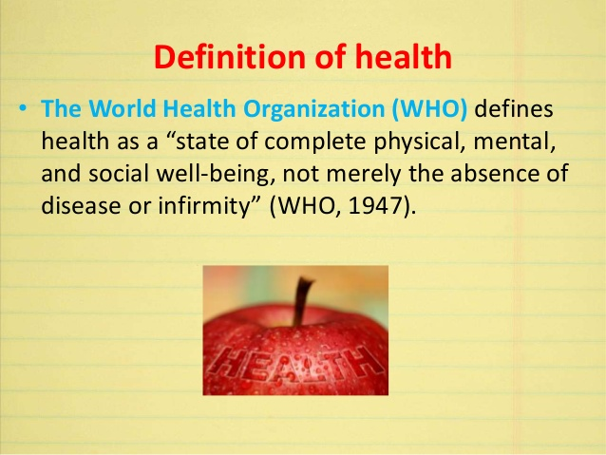

Slide 3
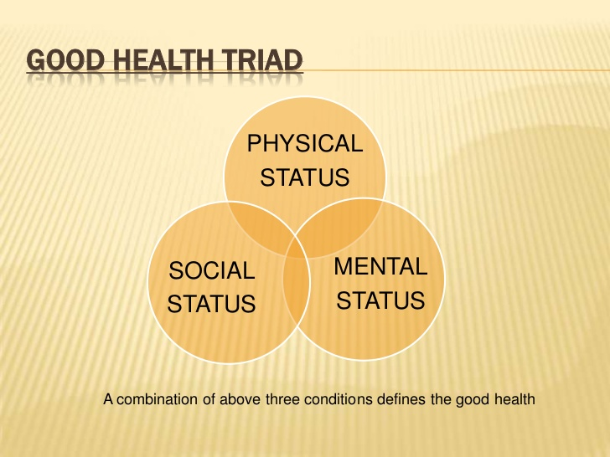

Slide 4
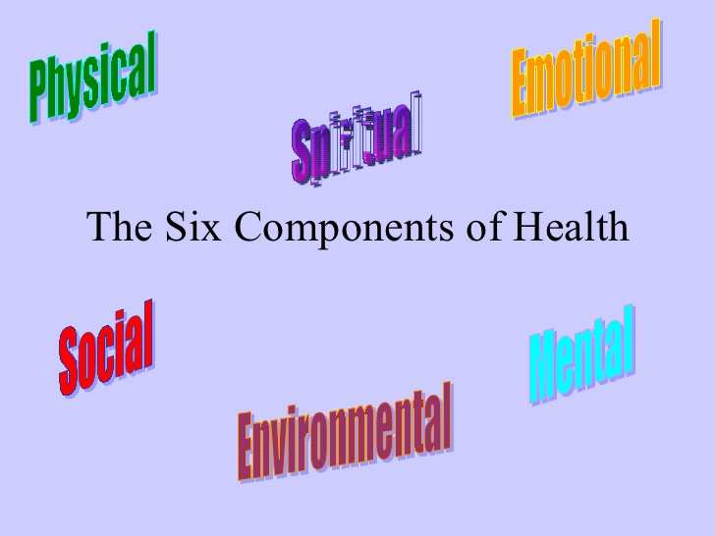

Slide 5
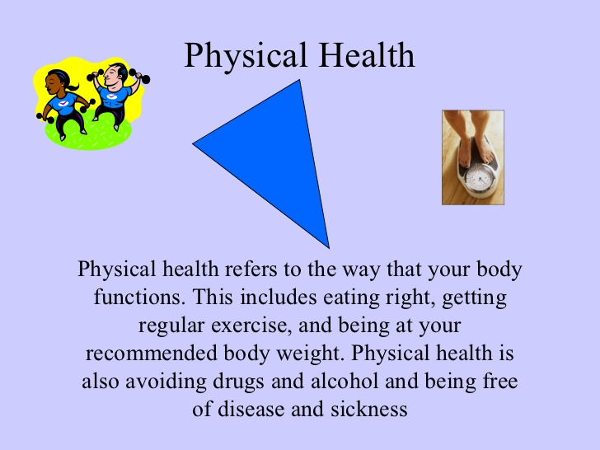

Slide 6
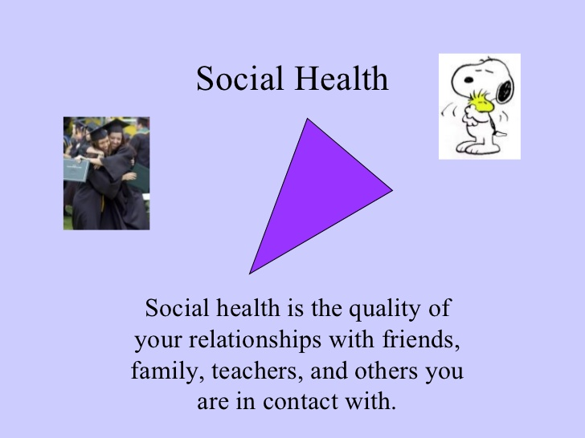

Slide 7


Slide 8
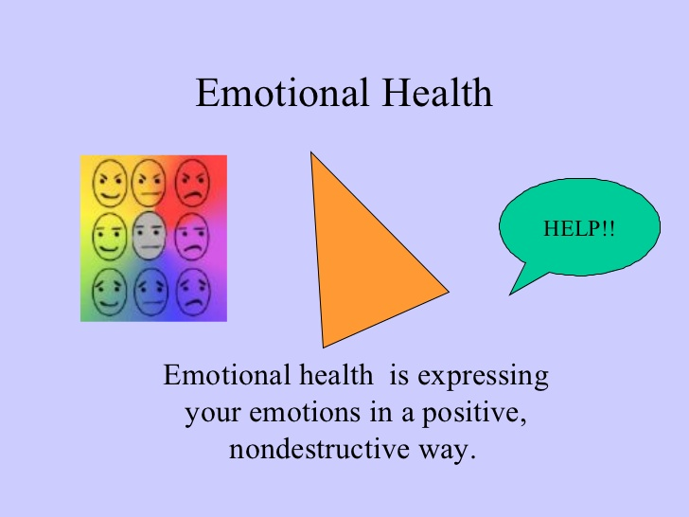

Slide 9
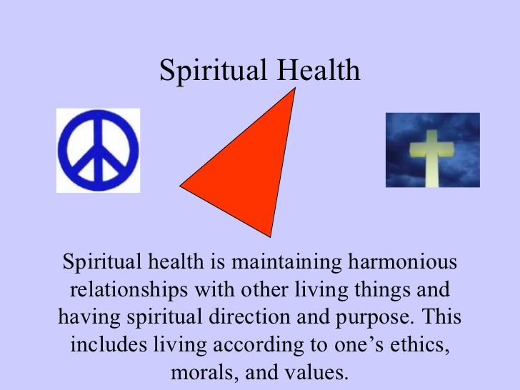

Slide 10
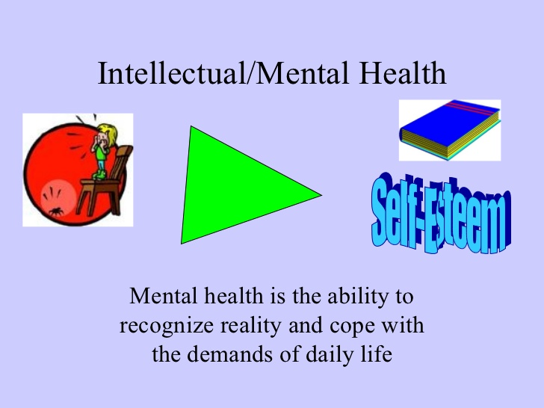

Slide 11
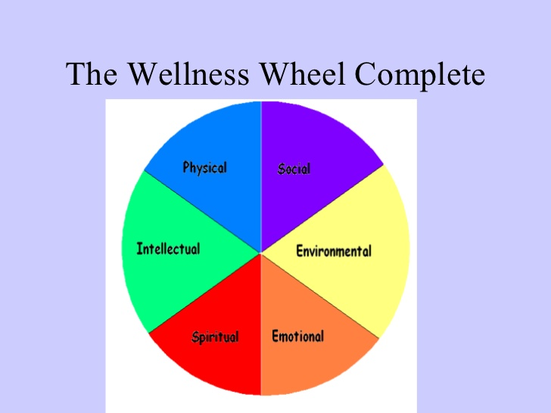

Slide 12
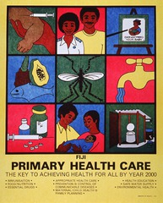

Slide 13
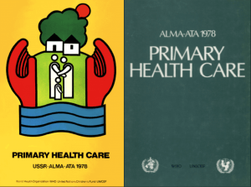
PHC
This approach came into existence
in 1798, following
the international conference
at Alma-Ata (USSR)
The Alma-Ata conference defined primary health care
as Primary health care is essential health care made universally accessible to individuals and acceptable to them, through their full participation and at the cost the community and country can afford
The primary health care is equally valid for all the countries from the most to the least developed. It has been accepted as integral part of the country’s health system.

Slide 14
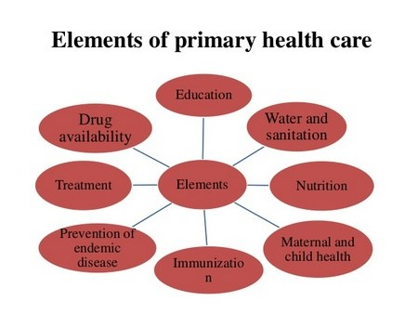

Slide 15
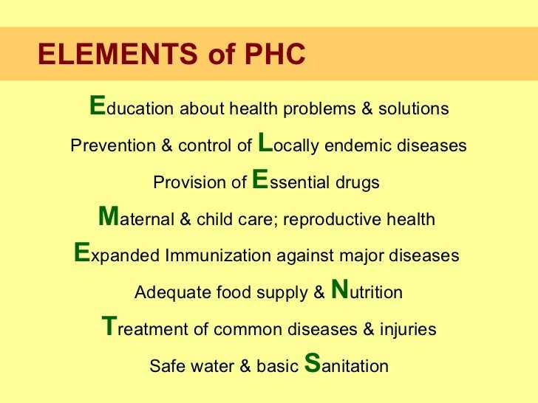

Slide 16
Primary Health Care (PHC)
Is the method and instrument to deliver essential health care
Comprehensively
Continuously and
In an appropriately accessible way to all individuals in the community at affordable cost.
Comprehensive : including at least 8 elements
Continuous care : from birth to death
Accessible care : Geographical . Accessibility (3 km radius )
Social Accessibility ( to local community)
Functionality Accessibility, Delivery of
good quality health care.

Slide 17
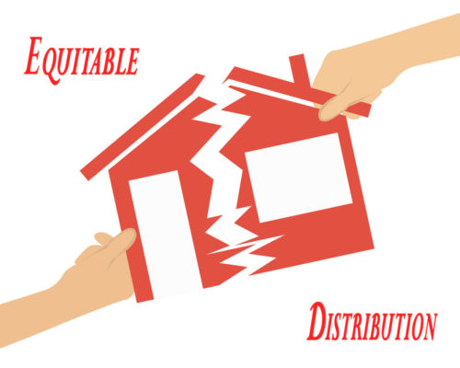

Principles of PHC
1- Equitable Distribution
-Health services to all population and in every area
Increase No. of health centers
Improvement of transportation

Slide 18
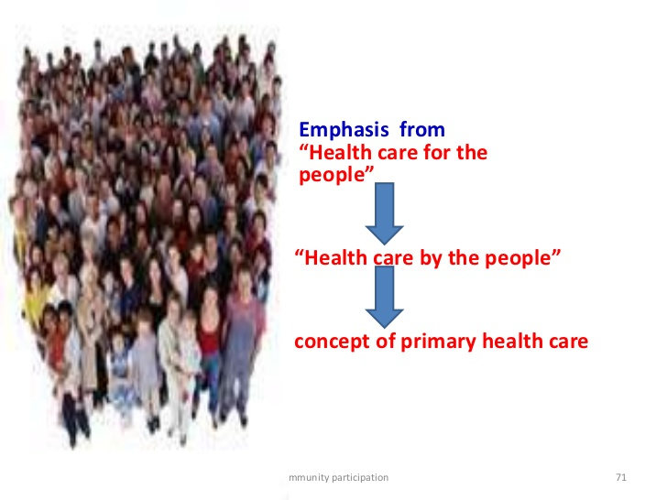
2- Community Participation
Identify health problems and seeking solutions
Self care
Participation in planning and implementation and maintenance

Slide 19
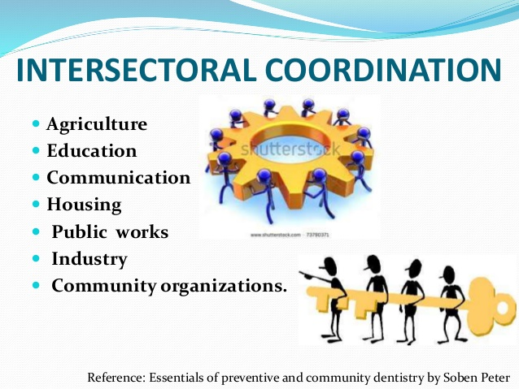
3- Intersectoral coordination
Improvement and protection of the health of community depends upon their socio-cultural and environmental conditions as
1- role of municipality in environmental sanitation.
2- role of ministry of Agriculture in provision of water – supply and food production and control of zoonosis.

Slide 20
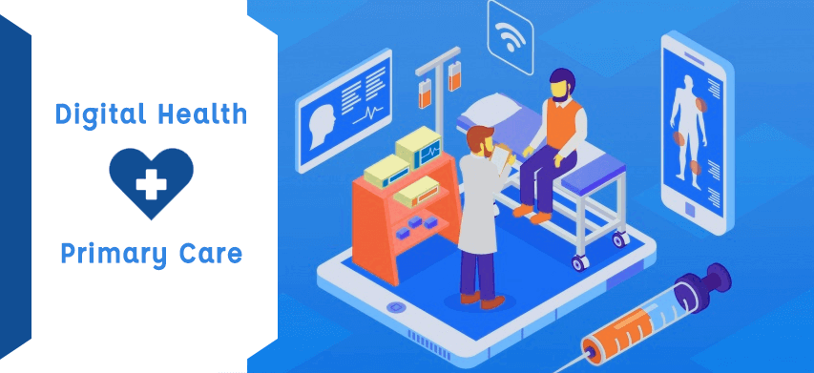
4-Appropriate technology
Material and methods accessible to the community for its health needs and development

Slide 21
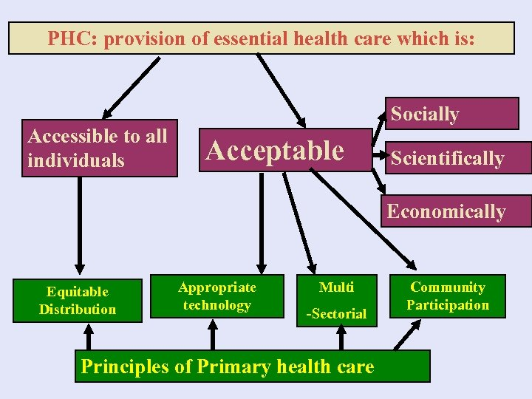

Slide 22
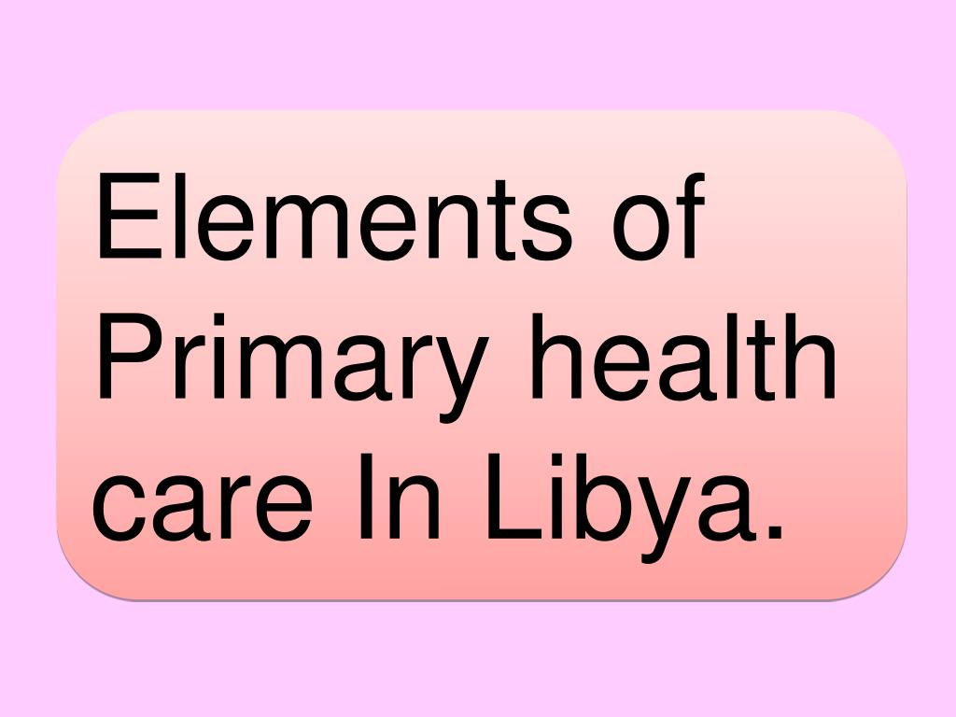
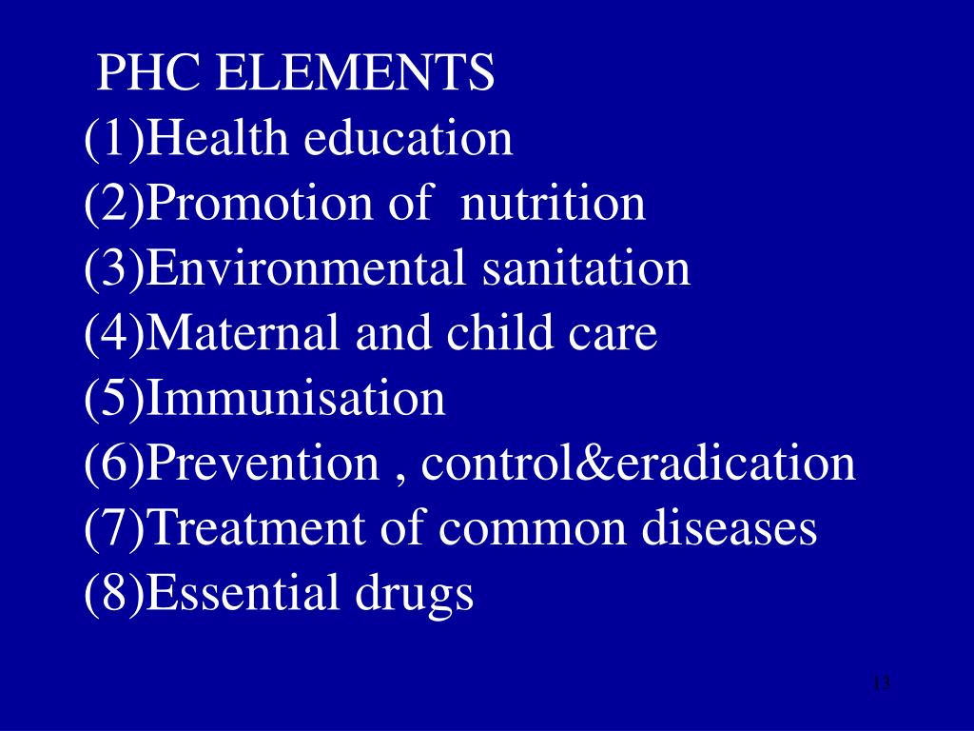
Elements of PHC
Addition 4 Elements
1- Mental health
2- Occupational health
3- Health for elderly and handicapped and rehabilitation
4- School health

Slide 23
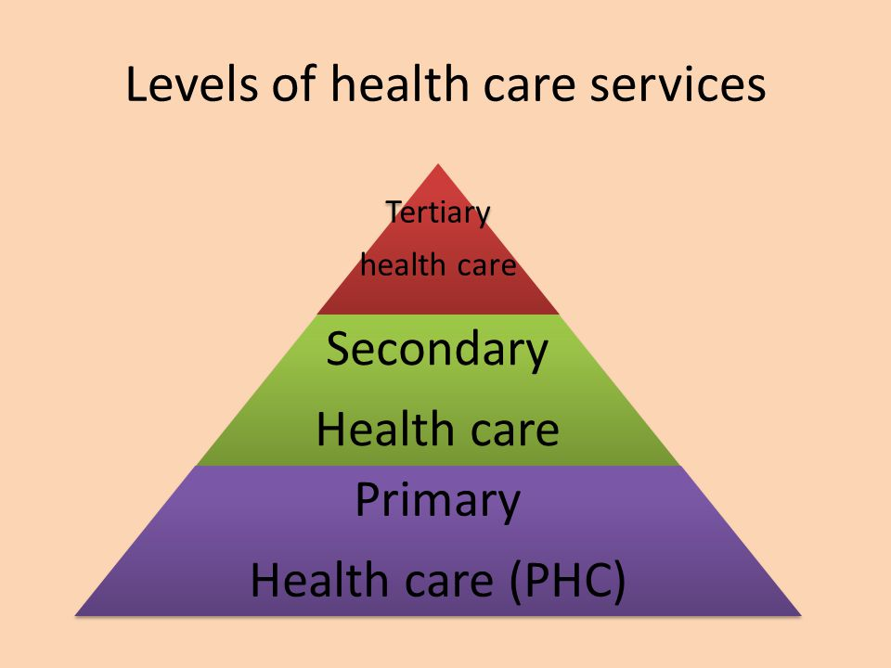
Health care services in Libya

Slide 24
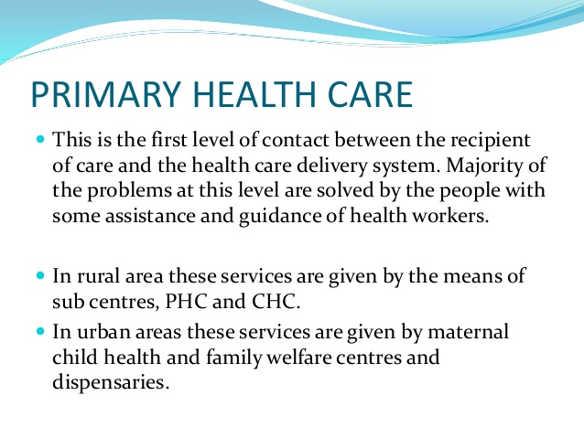

Slide 25
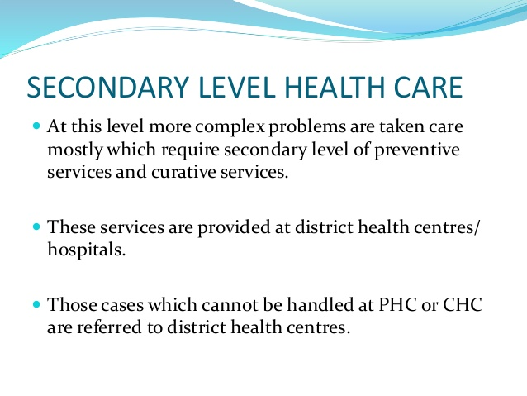

Slide 26
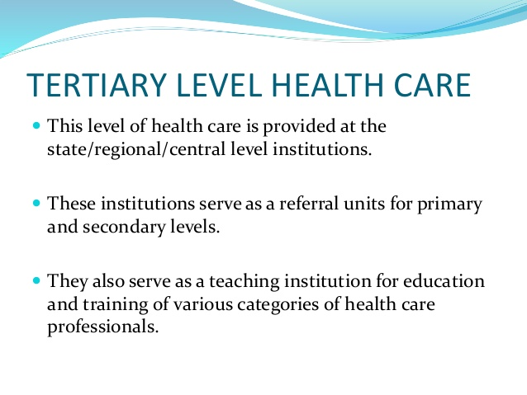

Slide 27
There is three types of health care institutions;
-Sub-Centre (SC) for a population of 3000-5000,
-Primary Health Centre (PHC) for 20000 to 30000 people -Community Health Centre (CHC) as referral center for every four PHCs covering a population of 80,000 to 100000

Slide 28


