Slide 1

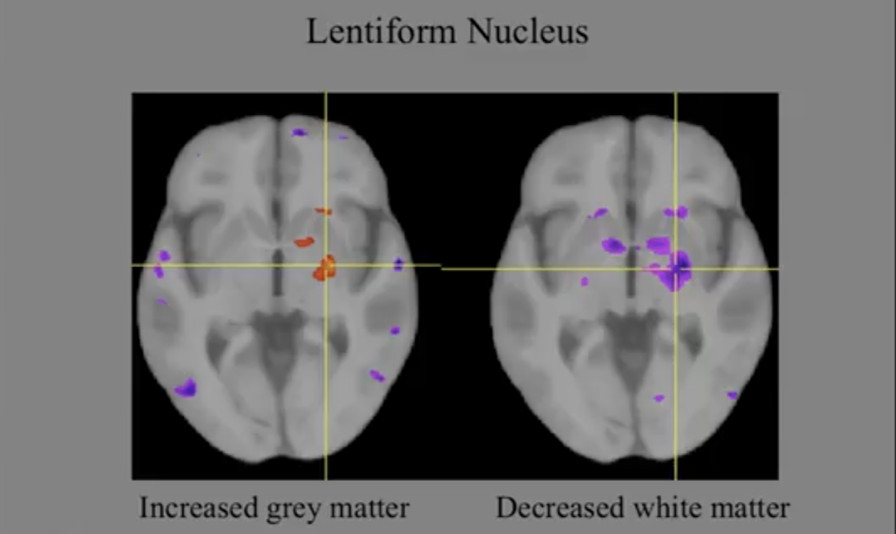
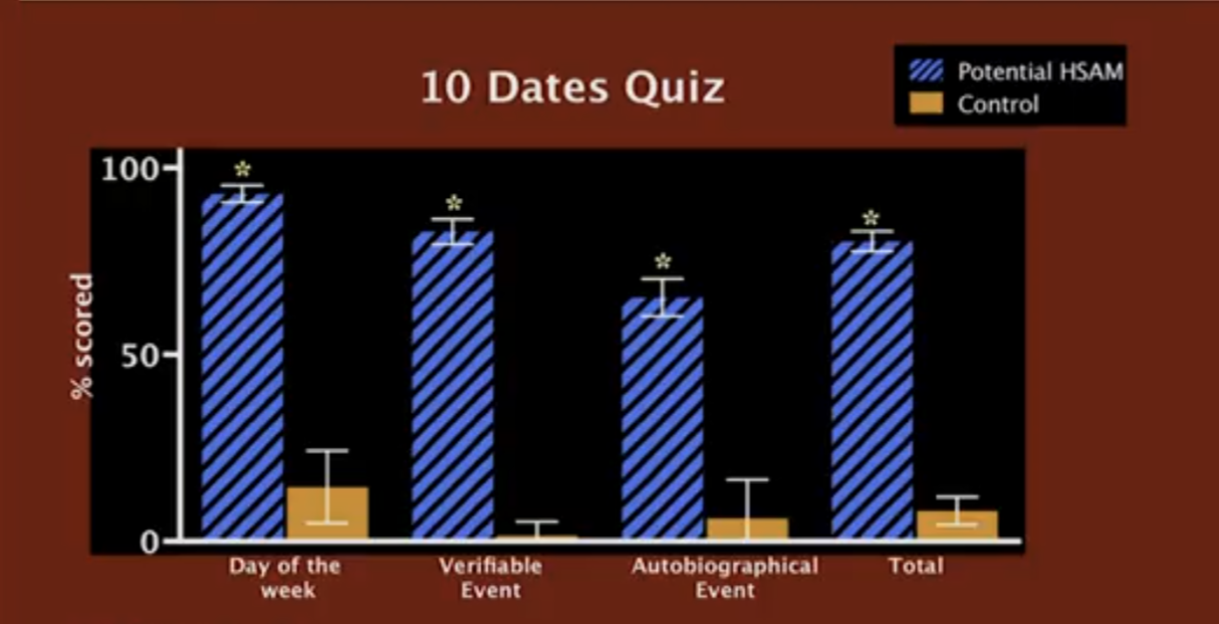
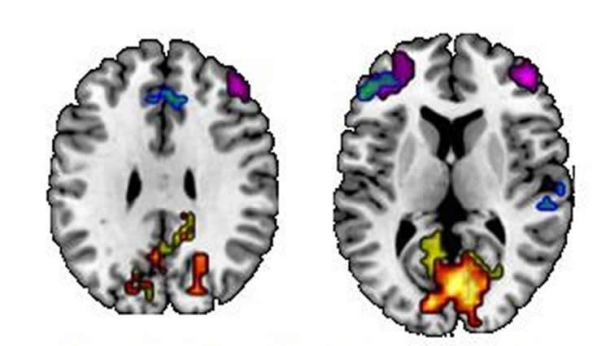
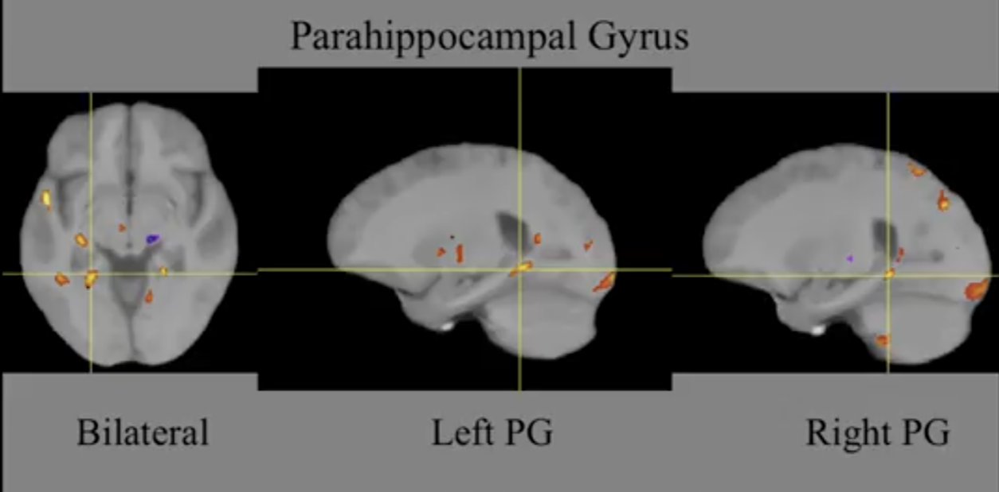
The Perfect Memory
Haitham soliman 2nd year student
Faculty of basic medical science
Libyan International Medical University
Introduction
Normal vs. abnormal
It’s relation to obsessive compulsive disorder
What is memory and the normal style of the memory:
The memory is an active processing system , that receive , store and retrieve the information[₁]. By normal mechanism of the brain the memory can be received , stored and retrieved , while the brain regions incorporate together to perform the mechanism or the function of receiving information and retrieve them later as a memory as in “fig 1” . By a disorder of these brain regions may lead to disorders as a result of the loss of incorporation between these regions , such as HSAM or thyperthymesia this disorder is the ability to recall any detail of episodic or semantic memory without any effort , also the information may be meaningless [⁴], [⁵].
According to 10 date quiz :
To know the difference between normal people and HSAM’s , a number of quizzes was made by Dr. James McGaugh and his teem mate to differentiate the normal from the abnormal , some people claimed that they have HSAM , by 30 date quiz a lot of people was rolled out , then they took the best of them into 10 date quiz asking them questions about events , days of week , recognition of people faces and their autobiographical memory [⁴], [⁵], itself the result shown in “fig 2”.
Lentiform nucleus found in the caudate nucleus as in “fig 4” , responsible in the connection of grey matter and involved in memory process this region also clearly obvious in OCD cases (obsessive compulsive disorder) , that’s why the OCD may be involved in HSAM[₃].
“fig 4” figure 4 shows the lentiform nucleus
Found in the region of caudate nucleus that is posterior
To the thalamus , it’s a lens-shaped mass of grey matter, also seen in
People who have OCD.
Conclusion
“fig 2” HSAM: in blue
normal people: in orange
The result was very high as expected for HSAM apporx. the total was 92%
Normal people didn’t remember the details approx. the total was 15-20%
In conclusion , all the results show, that the hyperthymestic people have a differences between normal people in the
1- brain structure
2- retrieving the information (Autobiographical memory).
HSAM cannot be considered as a gift , because the HSAM patients remember only their own autobiographical memory [⁴], [⁵] , also during the Quiz they forgot some of the questions but they didn’t forget the answers [⁵].
It is also not considered as a disease because the patients don’t have physical symptoms , they may be depressed only.
Dr. James McGaugh , Dr. Parker and Dr. Cahill said , if we fully understood the mechanism of HSAM w can treat amnesia with the same mechanism [₃] , [⁵].
Normal vs. abnormal according to MRI scanning
“fig1” figure 1, the colors indicate the brain region that Connected to the medial temporal lobes. Blue/green/purple indicate ,regions that important in semantic memory (facts) And regions in red\orange\yellow related to episodic memory trait (detailed events)
Some abnormality found in the connection between the hippocampus and amygdala to the temporal lobe according to the MRI scanning by the department of neurology in university of Vanderbilt [⁴], [₃], [₂] .
As “fig 3” parahippocampal gyrus which found to be hyperactive ,according to the MRI imaging in HSAM’s volunteer[₂].
Some abnormality found in the connection between the hippocampus and amygdala to the temporal lobe according to the MRI scanning by the department of neurology in university of Vanderbilt
As “fig 3” parahippocampal gyrus which found to be hyperactive according to studies in UC Irvine and MRI imaging in HSAM volunteer
The theory behind this disorder
It’s hard to understand the mechanism of HSAM or hyperthymeisa because it’s very complex [⁴], [⁵] , but according to studies in University of California Irvine by Dr. James McGaugh the possible causes of this disorder that is the patients keep thinking about their past without concerning the present or the future [⁴], [⁵] , also another psychological disorder called obsessive compulsive disorder may be involved with HSAM[₃].
According to studies by Dr. Elizabith Parker and her colleagues speculated that may be caused by defect in frontostratial circuit that could be involved in executive function [⁴], [⁵] , also MRI studies in university of Vanderbilt at department of neurology , that area in sub-cortical region of the brain called amygdala found to be enlarged (hypertrophy) 20% more than normal size , that enhance the connection between amygdala and hippocampus region , that responsible for emotional and social processing of memory[₂].
References
1-Guyton, Arthur, and John Hall. "Textbook of medical physiology, 11th." (2006)
2-van Bree, Tanne. "DIGITAL HYPERTHYMESIA ON THE CONSEQUENCES OF LIVING WITH PERFECT MEMORY." Editor: Liisa Janssens Language editor: Floor Soesbergen Design: Bob van Dijk, Petra Huijgens, Thiërry Tetenburg Print: Akxifo, Poeldijk (2016): 2
3-Gottlieb, J. (2018). Consciousness and the limits of memory. Synthese, 1-27.
4- Ally, Brandon A., Erin P. Hussey, and Manus J. Donahue. "A case of hyperthymesia: Rethinking the role of the amygdala in autobiographical memory." Neurocase 19.2 (2013): 166-181.
5- Parker, Elizabeth S., Larry Cahill, and James L. McGaugh. "A case of unusual autobiographical remembering." Neurocase12.1 (2006): 35-49.
“fig 3” this is the parahippocampal gyrus is a grey matter plays important
Role in memory accessing, found around the hippocampal region in the subcortical region , found to be having a high activity in HSAM brain

