Slide 1
The Ocular trauma
Dr. Raja S. Bengharbia

Slide 2
Contents
2.Orbital blow-out fractures
Haematoma
Margin laceration
Canalicular laceration
3.Blunt trauma
1.Eyelid
4.Penetrating trauma
7.Radiation injuries
6.Chemical injuries
5.Intraocular FBs

Slide 3
THE EYE LID

Slide 4
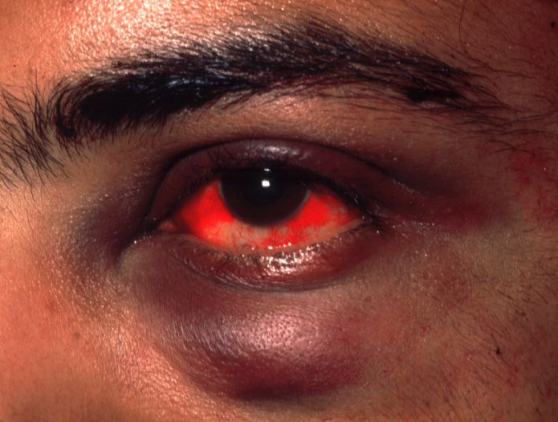
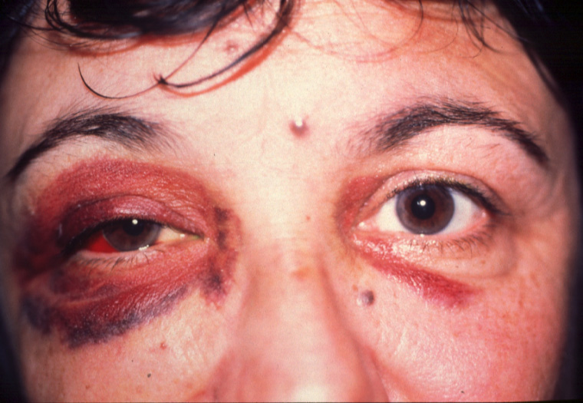
Eyelid haematoma
Bilateral eyelid haematoma
LE lower eyelid haematoma

Slide 5
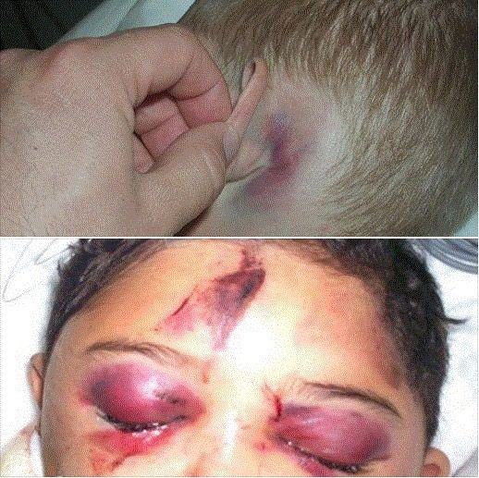
Associated trauma to globe or orbit
-Orbital roof fracture if associated with subconjunctival haemorrhage without visible posterior limit
-Basal skull fracture - bilateral ring haematomas (‘panda eyes’).

Slide 6
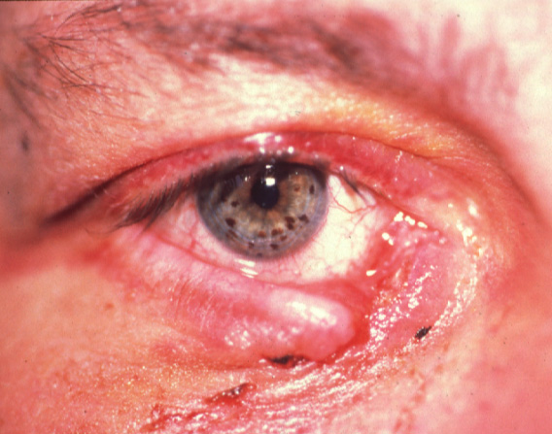
Eyelid laceration
Superficial.
Lid margin.
Laceration with mild tissue loss.
Laceration with extensive tissue loss.
Canalicular laceration.

Slide 7
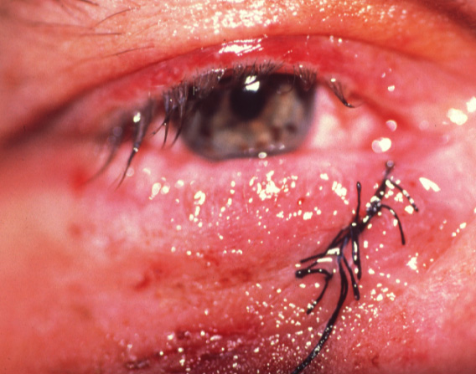
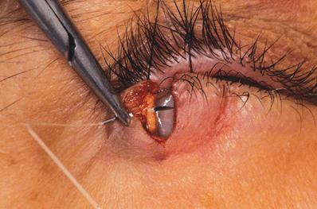
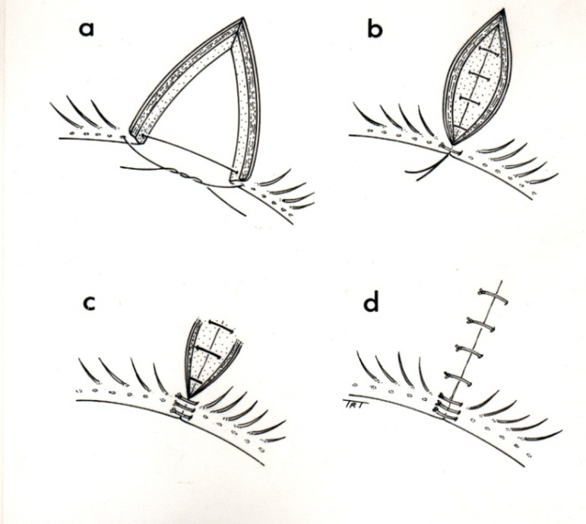
Lid margin laceration repair

Slide 8
Canalicular laceration
Repair within 24 hours.
Locate and approximate ends of laceration.
Bridge defect with silicone tubing.
Leave in situ for about 3 months.

Slide 9
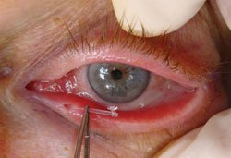
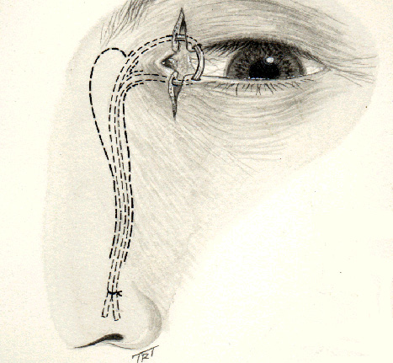
Lower canalicular laceration repair

Slide 10
Orbital blow-out fractures

Slide 11
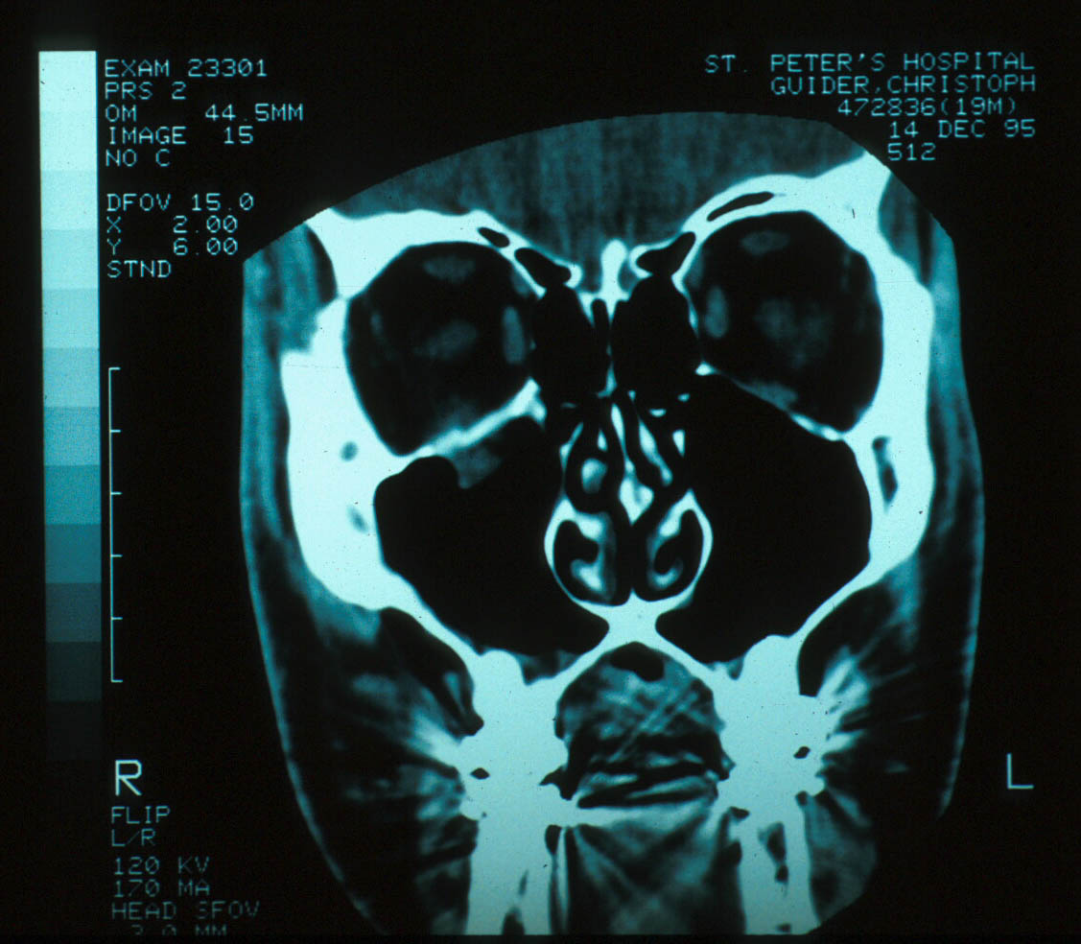

Slide 12
Physiology of blowout fractures:
The bony defect is filled with soft tissue and fat the orbit.
Alters support mechanisms for EOM.
EOM can become entrapped.
Direct muscle damage can result.
Common causes of orbital fractures :
Falling.
Aggression & fighting .
Sporting events.

Slide 13
Pathogenesis of orbital floor blow-out fracture
When an external force is applied to the orbital cavity from an object whose diameter is larger than the orbit , the orbital contents are retropulsed & compressed.
The consequent sudden rise in intraorbital pressure is transmitted to the wall of the orbit which leads to fractures of thin bony wall.

Slide 14
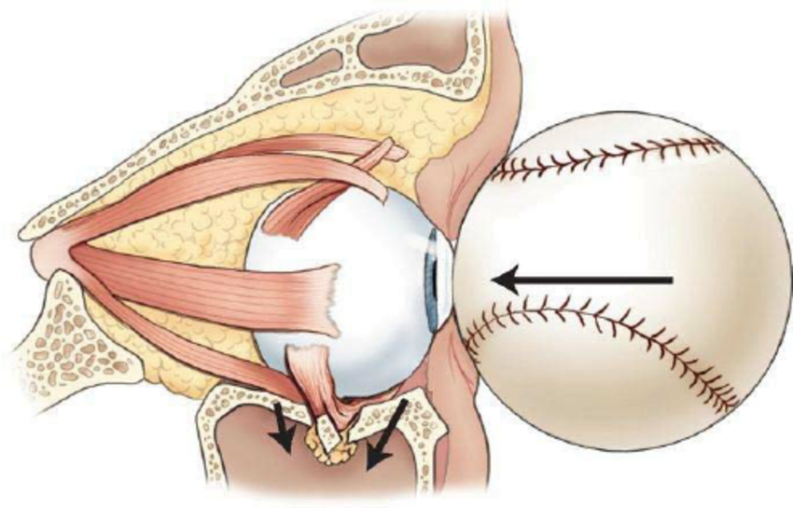
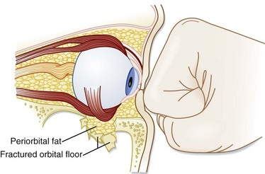
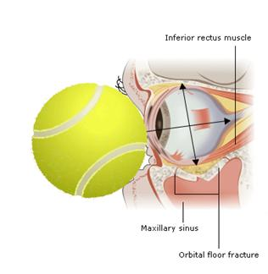

Slide 15
Physical exam :
Inspection.
Palpation.
Ophthalmologic exam:
Vision.
EOM movements.
Forced ductions test.
Exophthalmometry.
Internal exam.

Slide 16
Common Symptoms:
Diplopia.
Pain with eye movement (ophthalmoplegia).

Slide 17
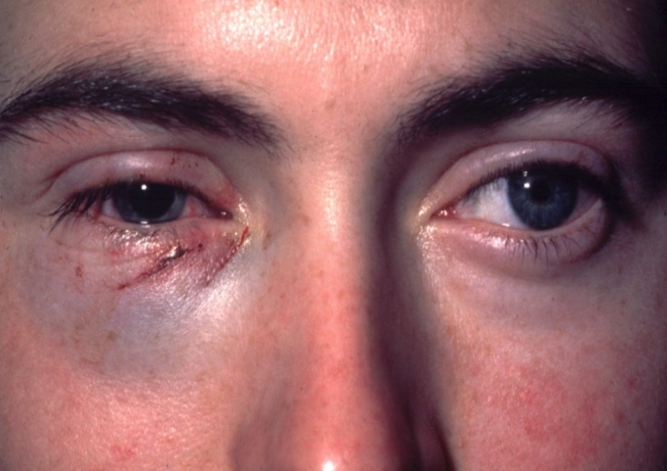
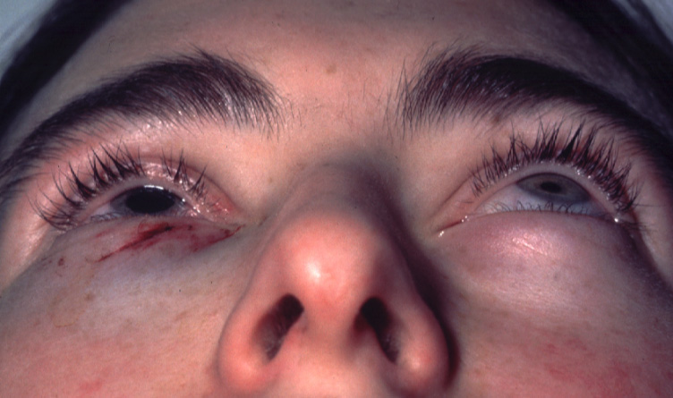
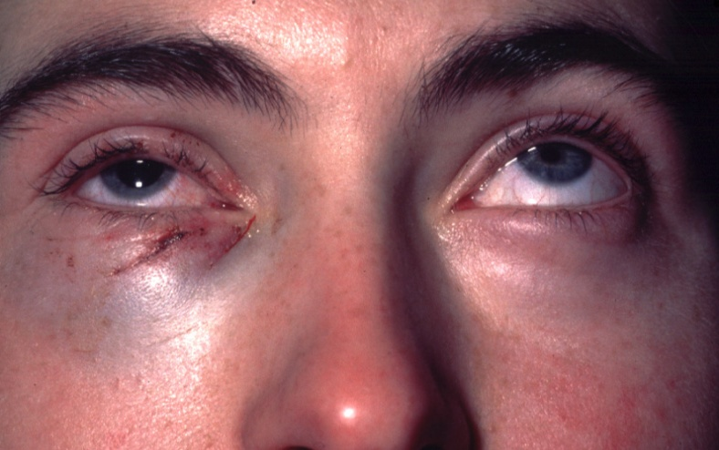
Signs of blow-out fracture
Periocular ecchymosis and oedema.
Impaired EOM.
Hypoesthesia in V2 distribution.
Intraorbital emphysema.
Enophthalmos.
Periocular ecchymosis & Enophthalmos
Impaired EOM

Slide 18
Injuries associated with blowout fractures:
Dislocated lens.
Angle recession & Secondary glaucoma.
Ruptured globe.
Retrobulbar hemmorhage
Vitreous hemorrhage.
Hyphema.
Retinal detachment

Slide 19
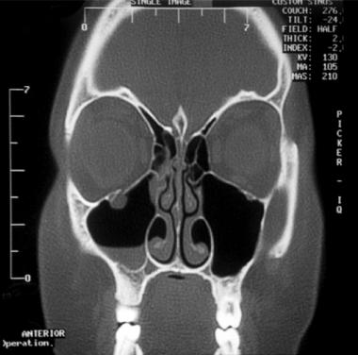
Investigations of orbital floor blow-out fracture
Coronal CT scan
Right blow-out fracture with
‘tear-drop’ sign

Slide 20
Treatment options:
Non surgical:
Initial management:
Ice on affected area for 48 hrs.
Elevation of Head On Bed.
Use of nasal decongestants.
Broad spectrum antibiotics like Augmentin.
Oral steroids to prevent fibrosis
No nose blowing.
Surgical:
Absolute indications for surgical repair:
Diplopia.
Enophthalmos > 2mm.
Large fracture.
Contraindications to surgery:
Hyphema ,Globe perforation and RD.
Only seeing eye.
Medically unstable patients.
Timing of surgery:
Usually 7-10 days after trauma.

Slide 21
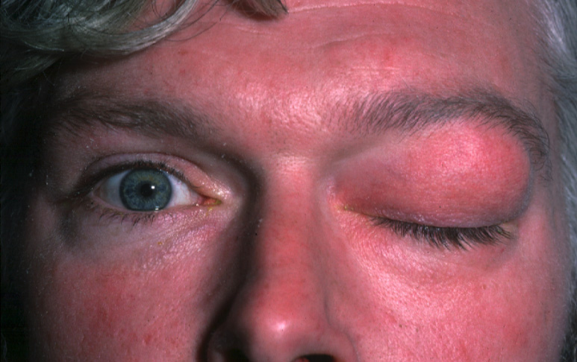
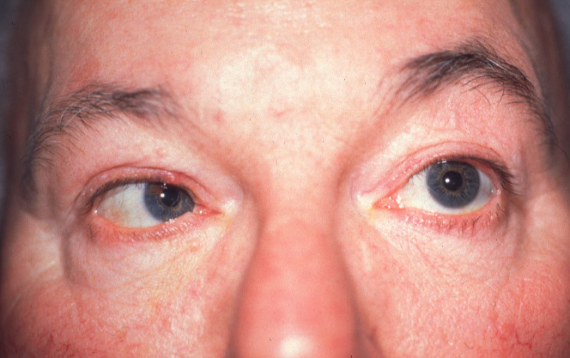
Medial wall blow-out fracture
Ophthalmoplegia - adduction and abduction if medial rectus muscle is entrapped

Slide 22
Blunt trauma

Slide 23
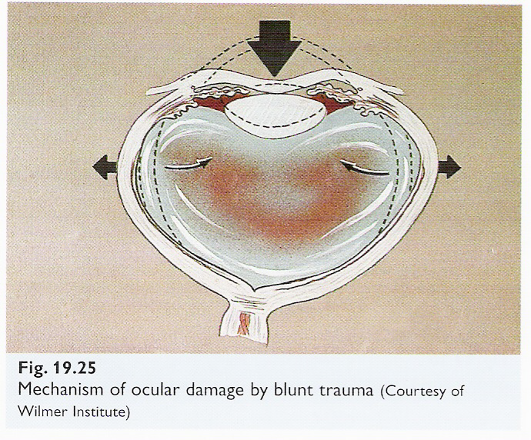
Blunt trauma:
Most common cause of blunt trauma are injuries from ball
Anteroposterior compression with expansion in equatorial plane
Transient increase in IOP.
Ocular damage can be in anterior or posterior segment.

Slide 24
Anterior segment complications of blunt trauma
Cornea : Corneal abrasion - Acute corneal oedema - Descemet membrane folds resolve spontaneously - Descemet tears .
Hyphaema : Complications: Raised IOP , Angle recession , Corneal staining , Rebleeding.
  Anterior Uvea: Vossius ring.

Slide 25
Pupil : Damage to iris sphincter – Traumatic mydriasis.
Iridodialysis .
Angle recession
Lens ; Rosette shaped Cataract , Lens subluxation & dislocation.

Slide 26
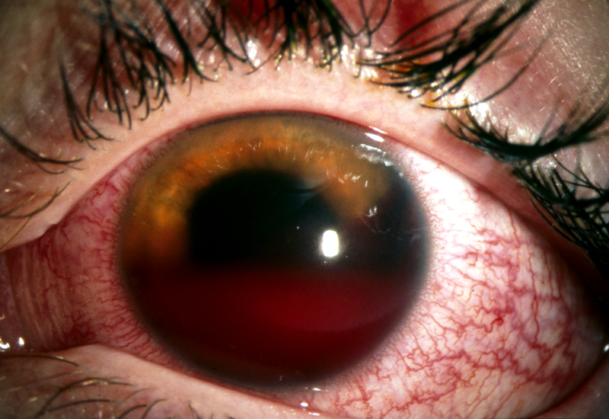
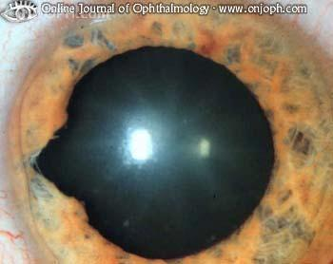
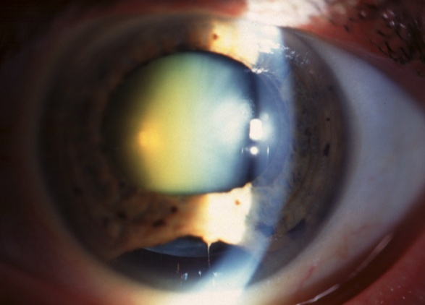
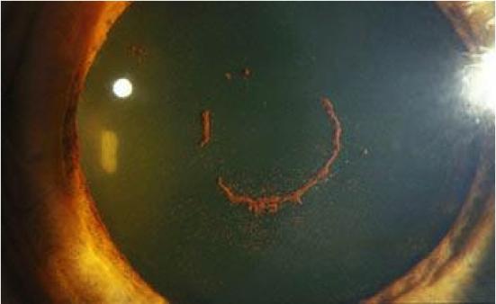
Hyphaema
Sphincter tear
Iridodialysis
Vossius ring

Slide 27
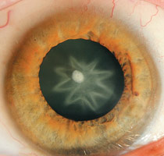
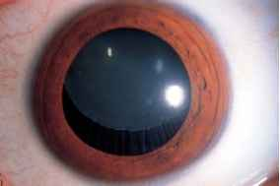
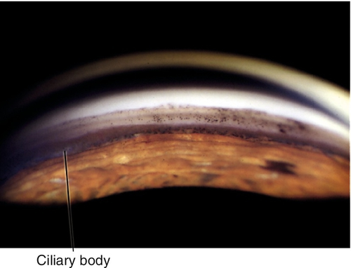
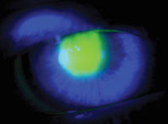
Cataract stellate- or rosette-shaped
Lens subluxation
Angle recession
Corneal abrasion

Slide 28
Posterior segment complications of blunt trauma :
Damage to the retina (commotio retinae).
Choroid (choroidal rupture).
Optic nerve (optic nerve evulsion) alone or in combination Optic neuropathy.
Traumatic macular holes.
Retinal detachment or dialysis.
Rupture globe.

Slide 29
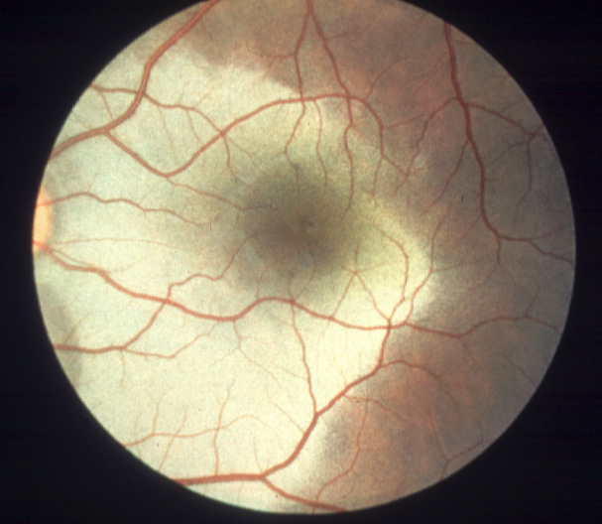
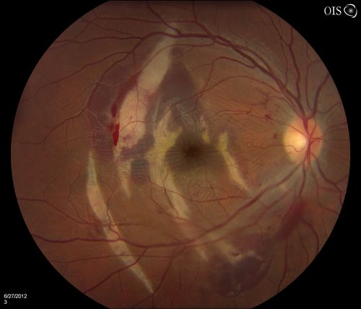
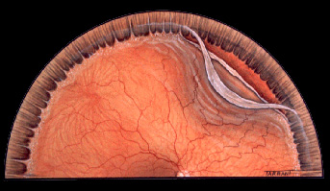
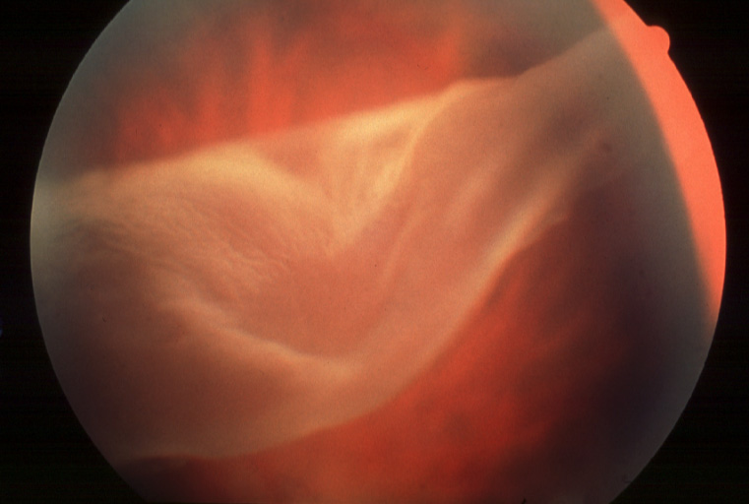
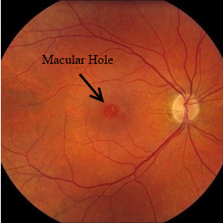
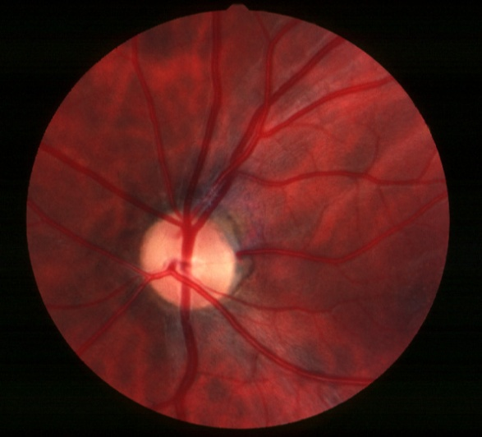
Commotio retinae
Choroidal rupture and
haemorrhage
Avulsion of vitreous base
and retinal dialysis
Equatorial tears
Macular hole
Optic neuropathy

Slide 30
Penetrating injury

Slide 31
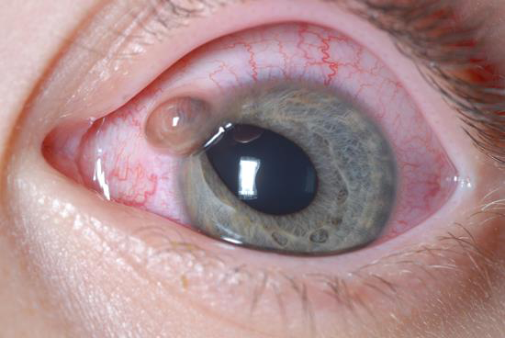
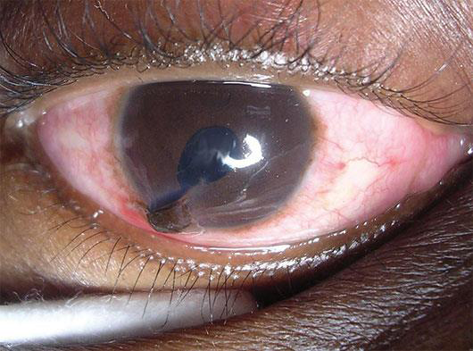
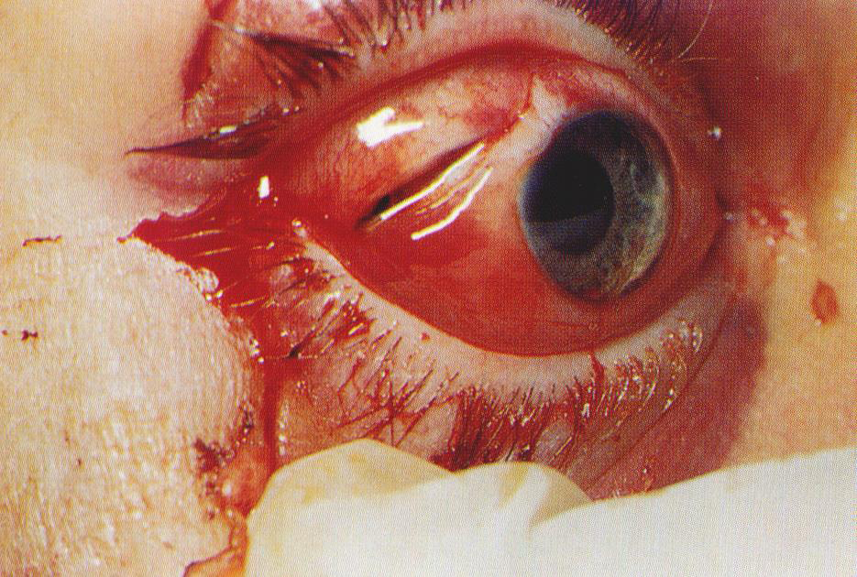
Open eye injury:

Slide 32
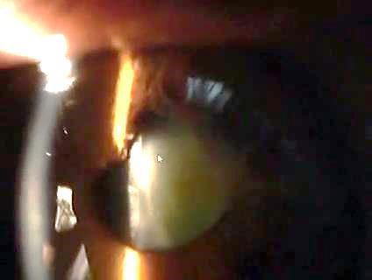

Slide 33
Effects of Penetrating ocular injuries
Mechanical effects :
Laceration of the conjunctiva.
Corneal lacerations with flat anterior chamber.
Vitreous haemorrage.
Rupture of globe & uveal tissues damage & prolapse.
Retinal tears and detachments & macular scarring.
Cataract and glaucoma.
Intra ocular foreign bodies complications.

Slide 34
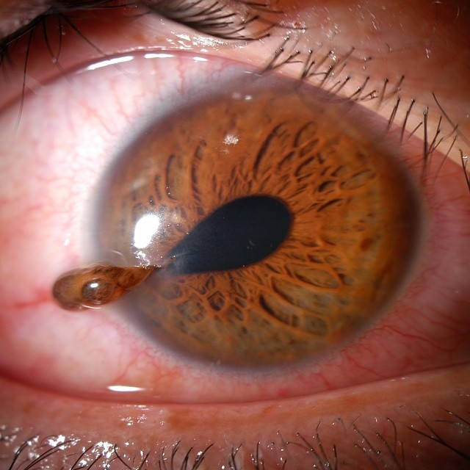
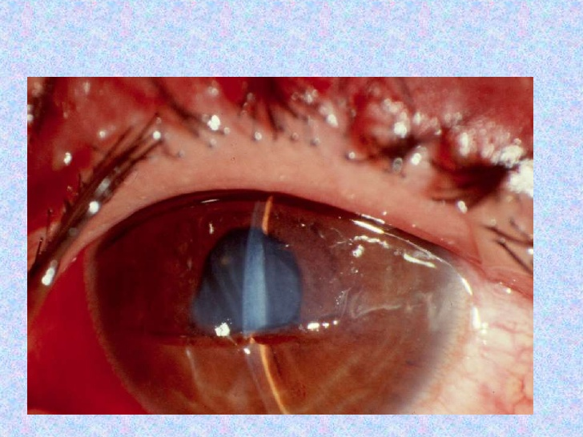
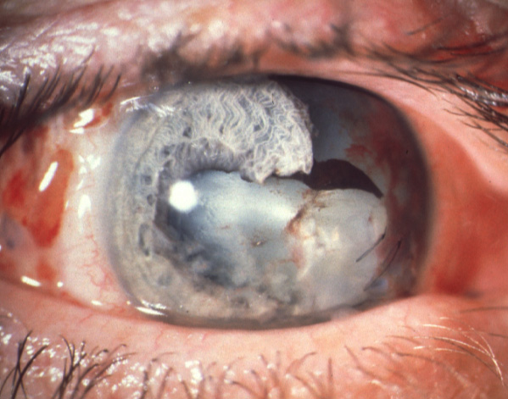
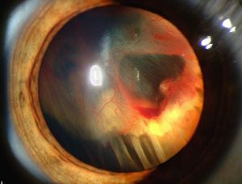
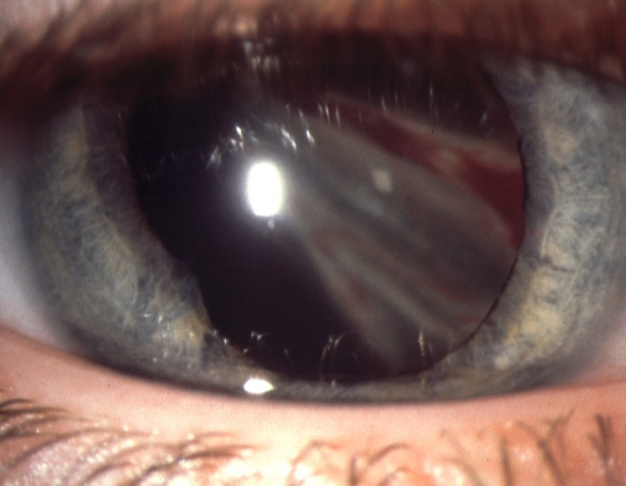
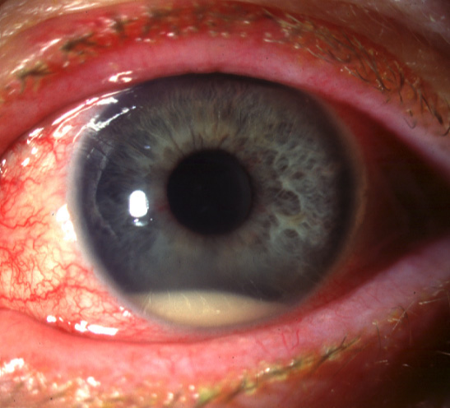
Complication of penetrating injury
Flat anterior chamber
Uveal prolapse
Damage to lens and iris
Vitreous haemorrhage
Tractional RD
Endophthalmitis

Slide 35
Management:
Complete ocular examination;
R/O IOFB
Slit lamp examination…
Seidal test:

Slide 36
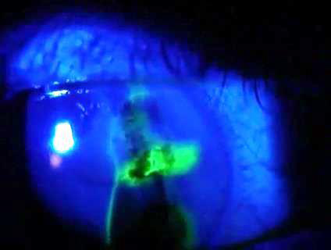
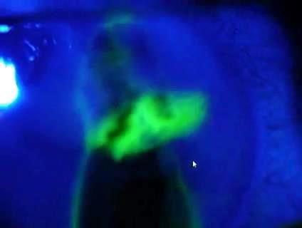
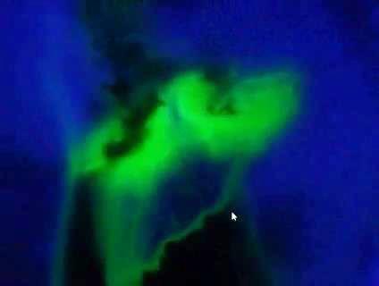

Slide 37
Intraocular FB

Slide 38
Intraocular FB:
The seriousness of the injury depends upon the retention of the intraocular foreign body , Common foreign bodies may be chips of iron or steel, particles of glass, stone , lead pellets ,wood chips ,plastic.
The symptoms of a foreign body may range from irritation to intense, excruciating pain , This is dependent on the location, material, and type of injury.

Slide 39
Siderosis bulbi
Deposition of ionized iron in the intraocular tissues resulting in toxicity.
Epithelial tissues :
Iris sphincter.
Dilator muscle.
Non pigmented ciliary epithelium.
Lens epithelium.
Retinal photoreceptors & RPE cells.

Slide 40
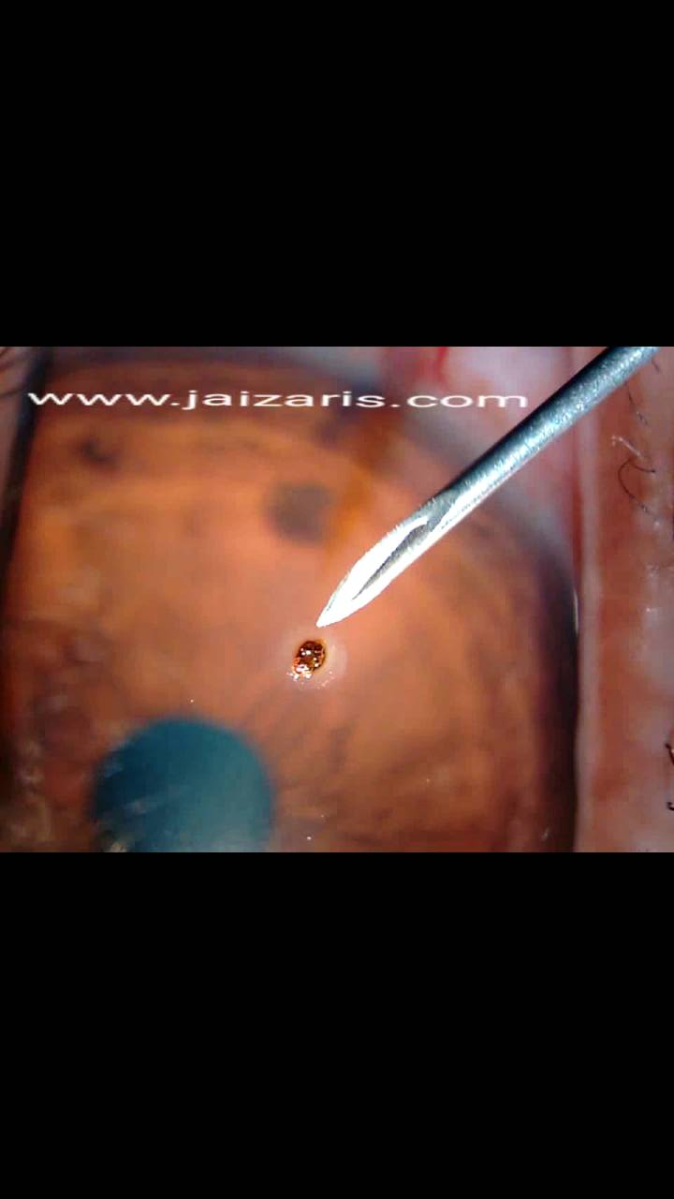
Corneal foreign body
Grinding most common cause.
Usually do not need surgery.
Treatment
  Removal of foreign body with needle and/or burr.
  Children may require GA.
Corneal FB

Slide 41
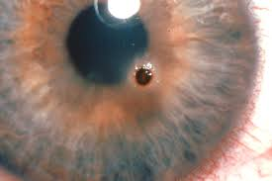

Slide 42
Chemical injury

Slide 43
Chemical eye injury:
2/3 of accidental burns occurs at work and the remainder at home
Alkali are twice as common as acid burns since alkali are more widely used at home and in industry
There are NO ANTIDOTES to these chemicals.

Slide 44
Alkali Burns:
* Strong alkalis raise the PH of tissues and cause saponification of fatty acids in cell membranes and cellular disruption.
* Once the epithelium is damaged , alkali solutions readily penetrate the corneal stroma and they rapidly destroy the collagen fibers.
* Strong alkaline may also penetrate into the anterior chamber and produce tissue damage and intense inflammation.

Slide 45
The limbus contains the corneal epithelial stem cells , when these are damaged, the surface of the cornea is often resurfaced by neighboring conjunctival epithelium and causes conjunctivalization of the cornea and vascularization, persistent and recurrent epithelial defeats.
Intraocular chemical penetration usually causes cataract and glaucoma.
In the most severe cases, phthisis of the globe may occur.

Slide 46
Acid Burns :
Acids denature and precipitate proteins in tissues they contact.
Acidic solutions tend to cause less severe tissue damage than alkaline solutions.
Because of the buffering capacity of tissues, as well as the barrier to penetration formed by precipitated protein.

Slide 47
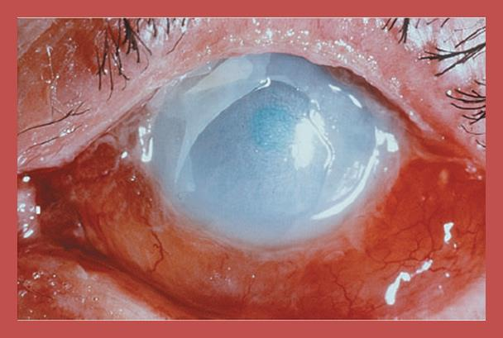

Alkali
Acid
Liquefactive necrosis
Penetration deep
More sever
(amonia- sodium hyroxide- cement – lime)
Coagulative necrosis.
Impede progress
Less severe
(buttery explosion ) hydrochloric acid.

Slide 48
Classification of severity:
Grade I: . Injuries confined to the corneal epithelium; there is no limbal ischemia, and the cornea is totally clear. These injuries carry an excellent long-term visual prognosis.
Grade II: mild corneal haze, and focal limbal ischemia. The prognosis is good, although the cornea may develop focal haze and neovascularization at the site of limbal stem cell loss.

Slide 49
Grade III : significant ischemia of most of the limbus, as well as profound corneal haze ,have a guarded prognosis.
Grade IV : carry the worst prognosis. In addition to total loss of limbal stem cells, there is destruction of the proximal conjunctival epithelium. The cornea is completely opaque,Visual recovery may not be possible.

Slide 50
Recommended Treatment
Treatment is based on the grade of injury. For most injuries, the goal of treatment is to promote epithelial healing and reduce pain while decreasing inflammation and preventing bacterial superinfection.

Slide 51
Emergency treatment:
A chemical injury is the only eye injury that requires immediate treatment without first taking a history and performing a careful examination
Copious irrigation: (15-30 min) ringer lactae or BSS
double eversion of the eye lids.
Debridement.

Slide 52


Slide 53


Slide 54
Update treatment:
Grade I:
Topical erythromicine oint.
Preservative free artificial tear
Topical steroid 1*4*1wk
Cyclogyl ED
f/u every other day until the entire ocular surface has healed

Slide 55
Grade II –IV:
Topical steroid hrly for 10 days
Atropine ED
Topical Broad spectrum antibiotic. (eg. Fluoroquinolone)
Oral tetracycline
Vit. C prevent ulceration
Control IOP
Use of amniotic membrane

Slide 56
Initial follow up –daily to assess epith. Healing and control IOP
Monitoring of corneal melting.

Slide 57




Slide 58
Radiation injury

Slide 59
Radiation injuries:
Ultraviolet radiation: welding arc , sun lamps , carbon arc.
Infrared burns : furnaces.
Ionizing radiation : cyclotron exposure , ß irradiation.

Slide 60



Welding & carbon arc
Furnace
Sun lamp

Slide 61
Ultraviolet effect on the eye
The eyes are most sensitive to UV radiation from 210 nm to 320 nm (UV-C and UV-B).
Maximum absorption by the cornea occurs around 280 nm. Absorption of UV-A in the lens may be a factor in producing cataract.
Examples of eye disorders resulting from UV exposure include "flash burn“ , "welder's flash" and "snow blindness" - depending on the source of the UV light causing the injury.

Slide 62
Ocular finding
1- Photokeratitis and photoconjunctivitis:
Def: Photokeratitis is an inflammation of the cornea, while photoconjunctivitis refers to an inflammation of the conjunctiva .
These inflammatory reactions may be compared to a sunburn of the very sensitive skin-like tissues of the eyeball and eyelids and usually appear within a few hours of exposure.

Slide 63
Photokeratitis and photoconjunctivitis can be very painful, however, they are reversible and do not seem to result in any long-term damage to the eye or vision.
An extreme form of photokeratitis is snow blindness. It sometimes occurs in skiers and climbers who experience extreme UV levels due to high altitude conditions and very strong ground reflection – fresh snow can reflect up to 80 per cent of incident UV radiation.

Slide 64
Pterygium
Is probably linked to prolonged UV exposure. Pterygium may extend over the centre of the cornea and thereby reduce vision. It also has a tendency to become inflamed.
Cataracts
Cataracts are the leading cause of blindness in the world , they appear to be enhanced by exposure to UV. Cataracts can be surgically removed.
WHO estimates suggest that up to 20 per cent of cataracts may be caused by overexposure to UV radiation and are therefore avoidable.

Slide 65
Cancer of the eye:
Current scientific evidence suggests that different forms of eye cancer may be associated with life-long exposure to the sun. Melanoma is the most frequent malignant cancer of the eyeball and sometimes requires surgical removal. A common location for basal cell carcinoma is on the eyelids.
Retinal diseases : Macular degeneration & edema.

Slide 66
Infrared burns
Acute exposure : produces temporary lid oedema & erythema.
No damage to the globe.
Chronic exposure : seen in glass blowers & metal furnace stocker.
Develop cataract.
No other anterior & posterior segment changes are found.

Slide 67


Laser pointers ocular hazards
Laser pointers are comprised of a diode emitting laser light, with an energy output between 1 and 5 mW.

Slide 68
Strong laser pointers can flash blind a pilot at a distance of more than 10 km, and at shorter distances cause permanent visual dysfunction or even blindness.
Retinal damage from very close distance even less than 1 m for red, green and infrared laser pointers occur.
Red lasers with ≤5 mW output power can cause a temporary and relative loss of the central vision.

Slide 69
Ocular symptoms:
Corneal involvement : pain, redness, irritation.
Retinal involvement : Scotoma, photophobia, metamorphopsia, chromatopsia or decreased visual acuity can occur hours after exposure.

Slide 70
Choroidal infarction , choroidal neovascularization can occur with associated risk of vision loss.
Damage to the retinal pigment epithelium.
Retinal edema and hemorrhage, if viewed for more than one second.
Focal retinal detachment & sub-hyaloid hemorrhage.

Slide 71


LE Macular hole
Choroidal infarction

Slide 72

Subhyaloid hage

Slide 73


