Slide 1

Good morning

Slide 2
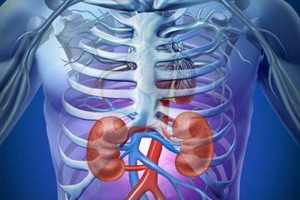
Radiology of Urinary System. Presented by : Dr. Aliya Shemisa.

Slide 3
URINARY TRACT SYSTEM
Radiological procedure

Slide 4
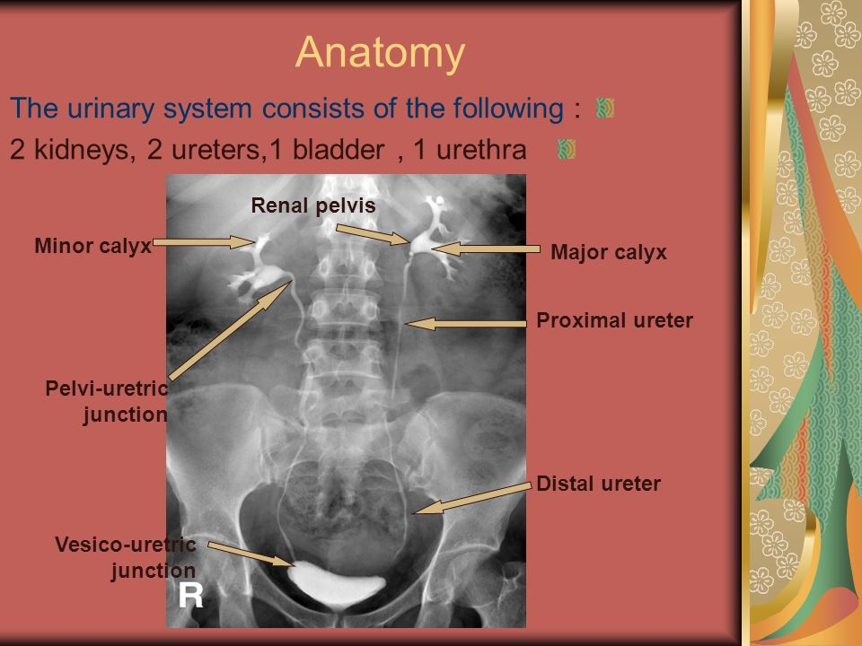

Slide 5
1. IntraVenous Urogram (IVU)
- Is a radiographic study of the renal parenchyma, pelvicayceal system, ureters & U. bladder.
Indication :
Check for normal function of kidneys, Renal colic, UTI.
Check for course of ureters
Detect & localize the ureteric obstruction & urolithiasis
Check for Congenital renal anomalies.
Pt. preparation:
-bowel preparation with laxative in young pt. ( avoided in children & elderly) -
- Take H/O the pt. for any known drug allergy or previous contrast reaction.
-pt. must be fasting at day of examination.
- Check serum creatinine level.

Slide 6
Technique :
-Plain (KUB)/ scout film: for pt. preparation, radio-opaque renal calculi, bone abnormality , soft tissue masses & any calcifications
- Water soluble non ionic Iodine contrast media.
-Pt. venous canula.
- then, dose will vary up to 1.5ml/kg body wt. & I.V contrast is injected as bolus rate.
- Antero-posterior views “AP” Films are taken to show kidneys collecting system, ureter & U.bladder.
( Nephrogram,5 mints ,15 mints, 30 mints : to visualize the PCS & ureters) ,( lastly take full bladder & post-void film), other additional times & views like oblique or prone are needed if there is some indication as in Hydronephrosis with delayed excretory function.

Slide 7
Contra-indication of contrast media
- pt. with significant decrease renal function because contrast can be nephrotoxic & worse renal function.
-Previous contrast reaction.
-H/O allergy to food or drug.
-Asthma.
Minor reaction:
-Nausea, vomiting, cough, sneezing ,skin rash, mild urticaria.
Major reaction:
-Bronchospasm, pulmonary edema, laryngeal edema.
-cardiovascular collapse.

Slide 8
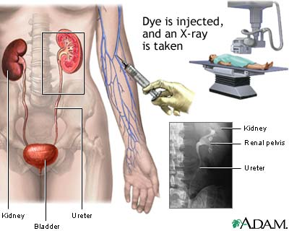

Slide 9
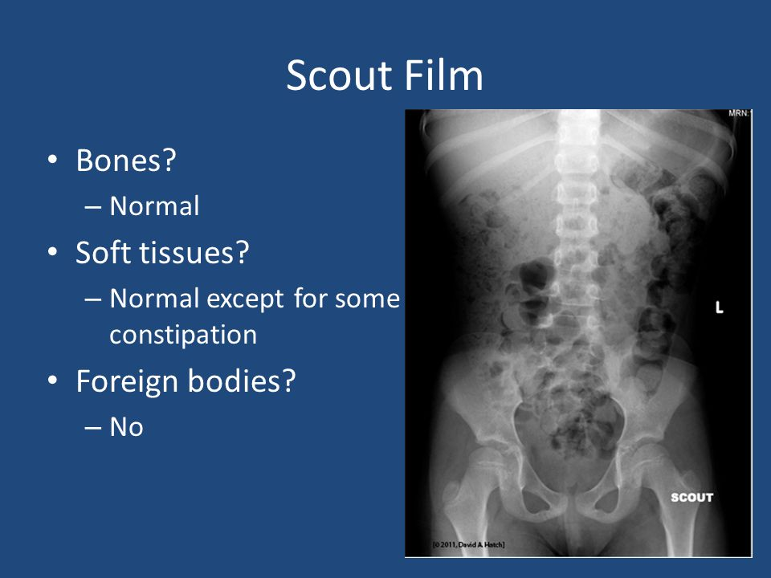

Slide 10
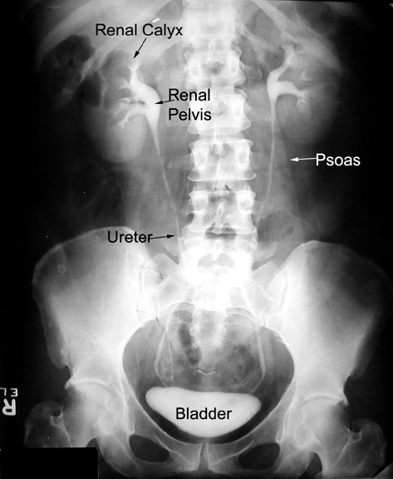

Slide 11
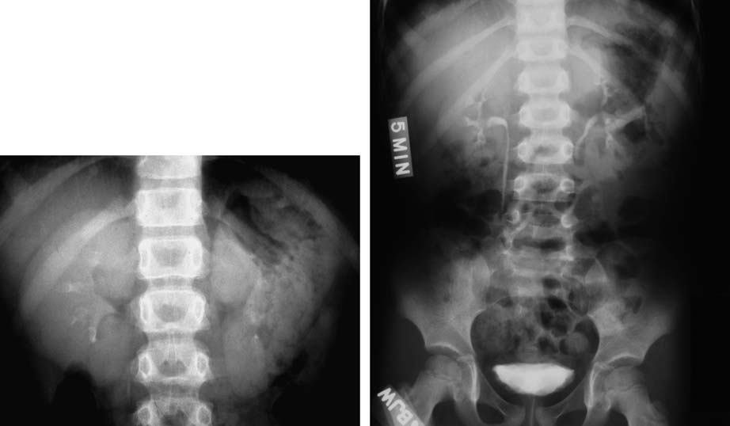
IVU normal anatomy nephrogram 5 mints

Slide 12
2. Cystogram & Voiding cystourethrogram (VCUG)
- Cystogram is a fluoroscopic study that images the U.B , while VCUG images the post. urethera
Indication:
-Recurrent UTI in children to diagnose V.U Reflux.
-Posterior urethral valve in male children.
-Posterior urethral problem in male adults.
-Post-operative evaluation of ureteric abnormality .
-Stress incontinence in female, suspected vesico-vaginal or vesico-colic fistula.
-Pelvic trauma specially in # hip bone.

Slide 13
Preparation:
-Antibiotic coverage prior to examination to avoid ascending bacterial Infection.
Technique :
- AP control film
-Foley-Catheter inserted under aseptic condition into U.B via urethra, filled the U.bladder with diluted water soluble contrast, for children:
Expected bladder capacity (ml) = (age + 2) × 30
For adults : till pt. tolerate capacity.( in trauma setting, up to 400 ml instill) inadequate U.B distension gives false-ve results.
- AP early filling image (if injury or postoperative evaluation)
-Remove catheter & take the four phases images: early filling, before ,during & post-voiding to assess the degree of empty of residual contrast.
-AP & (Rt. Or Lt. anterior oblique views are important in voiding phase for male pt.).
Contra-indication:
- In acute UTI.

Slide 14
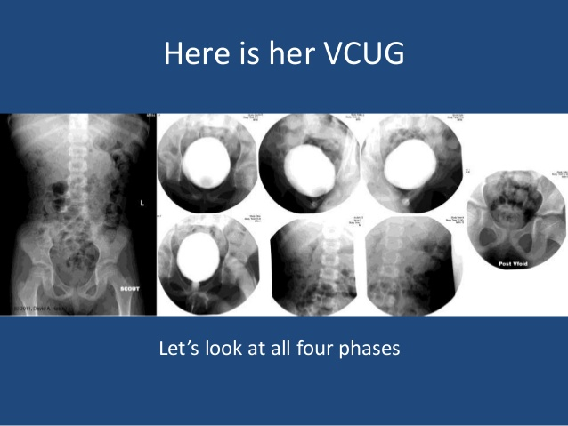

Slide 15
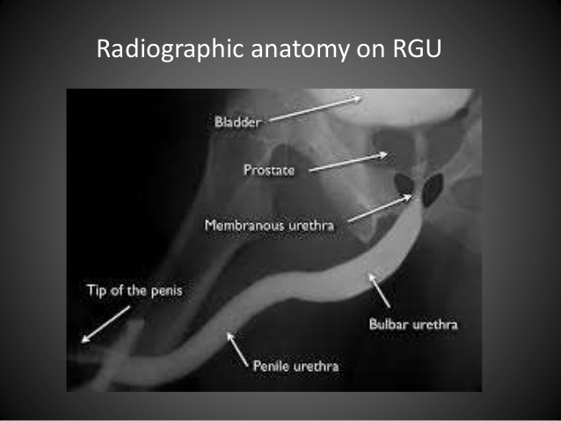
Cystogram & VCUG in male urethra Oblique view

Slide 16
3. Ascending urothrogram
Indication:
-# anterior pelvic / dislocation.
-pre & post. Operative assessment of urethral stricture.
-outline urethral anomalies as hypospedia “ Congenital
condition in males in which the opening of the urethra is on the
underside of the penis. “
Method:
-catheter is inserted at distal part of urethra .
-inject the contrast slowly , films obtained in oblique position.
Contra-indication:
-acute UTI, recent urethral instrumentation.

Slide 17
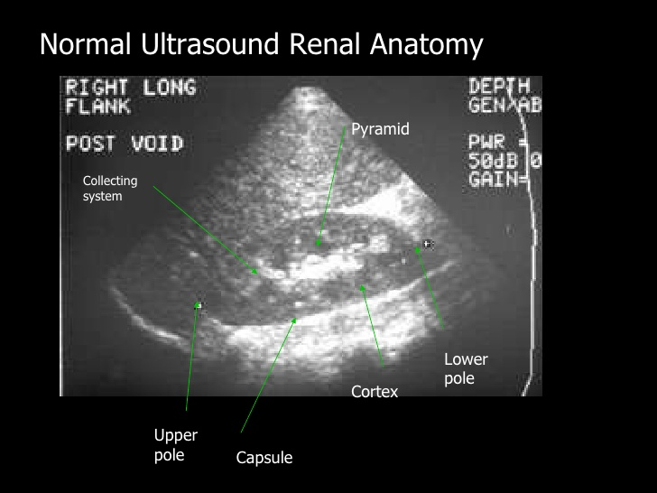

Slide 18
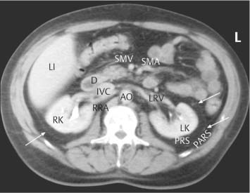
Normal renal anatomy in Cross section CT scan Renal excretory phase

Slide 19
Urinary tract obstruction & renal stones.

Slide 20
Renal colic & acute flank pain
- It is a Pain in posterio-latral abdomen from the lower thorax to pelvis.
-common renal causes :
.ureteric &renal calculus.
.PUJ obstruction or Ureteric stricture .
-non renal cause:
. Appendicitis.
. Torsion or hemorrhagic ovarian cyst.
. Diverticulitis.

Slide 21
Renal calculi (renal stone)
- commonly found in male 30-50 yrs old.
- when found with obstruction effect , IVU is indicated.
- the stone develop within the collecting system, may be slipped down into : PUJ , Ureter , UVJ ,Urinary bladder
& Urethra

Slide 22
- 80 % of the renal stones are made of calcium & radio-opaque in x-ray, uric acid stones are radio-lucent in x-ray.
- stones vary in size from small to big enough to cause renal function impairment as Staghorn stone.
- sign & symptoms:
*flank pain, obstructive hydronephrosis
*infection
*painful hematuria ( blood in urine)
Radiological modalities used for diagnosis are : USS, IVU, CTU = stone protocol (non contrast CT scan of urinary system) ,all stones are seen on CT & USS.
- Treatment: pain killer, lithotripsy or surgery.

Slide 23
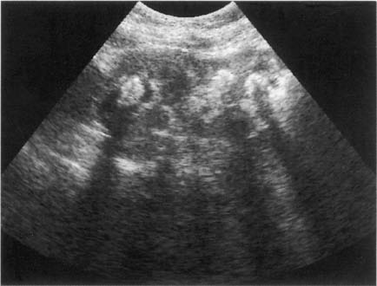
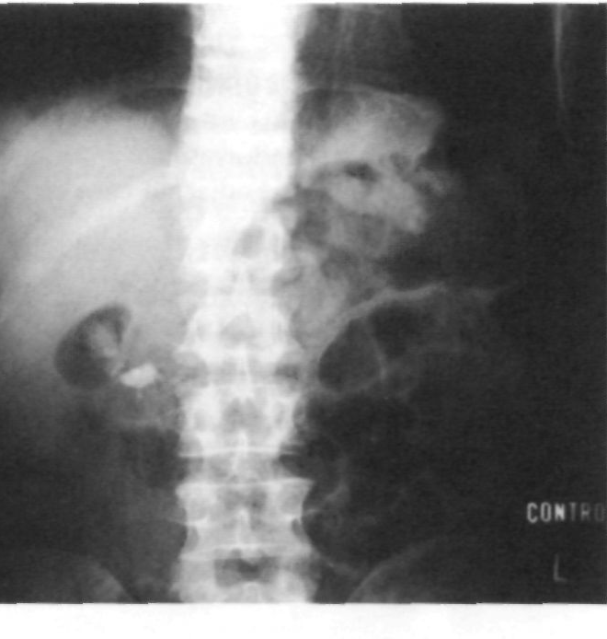
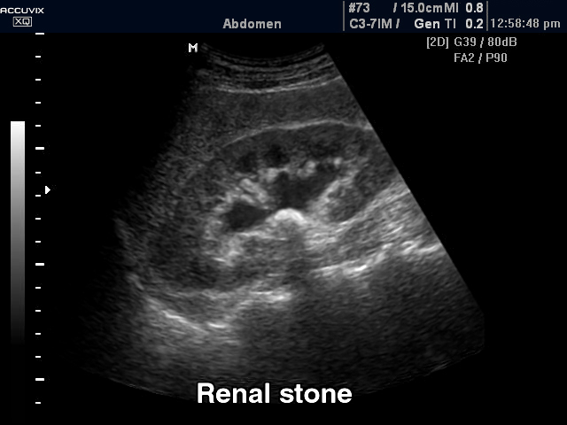
Renal calculus (stone) USS KUB

Slide 24
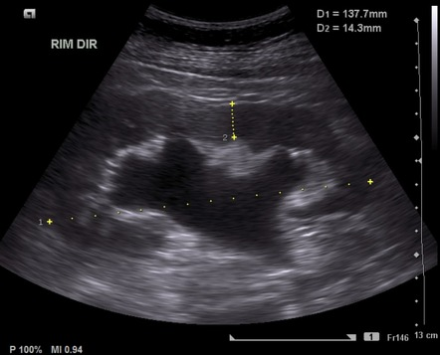

Slide 25
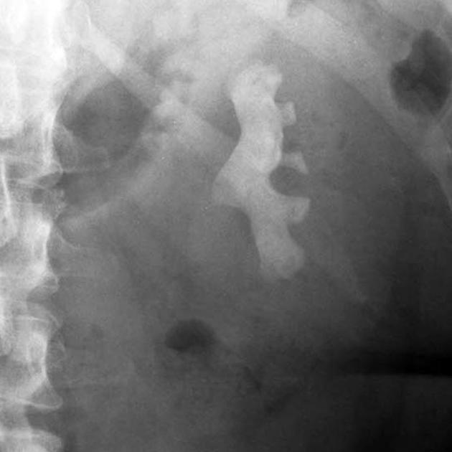
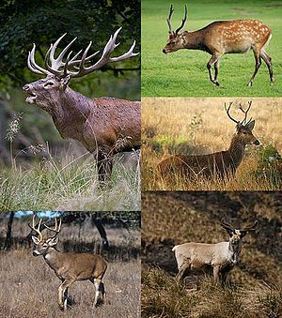
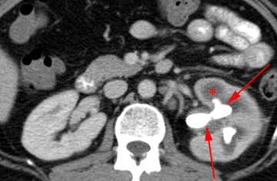
Staghorn renal stone

Slide 26
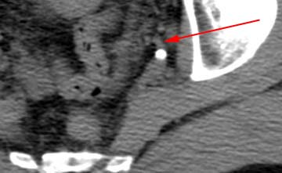
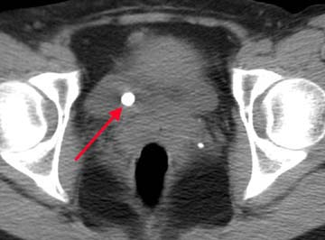
Stone at uretrovesicle junction (VUJ) CTU

Slide 27
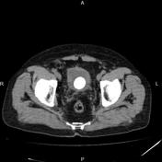
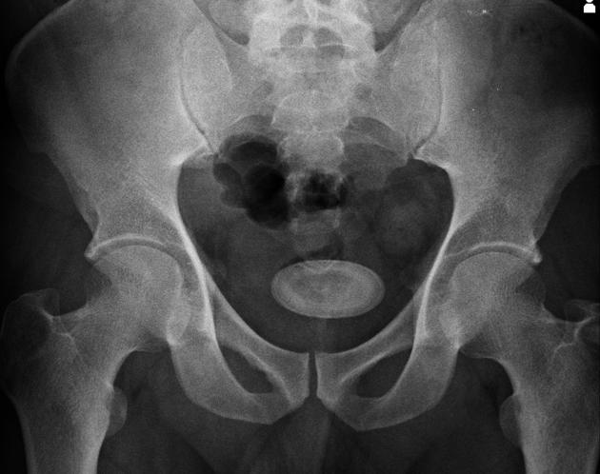
Urinary bladder stone (UB stone) KUB non contrast CT axial view

Slide 28
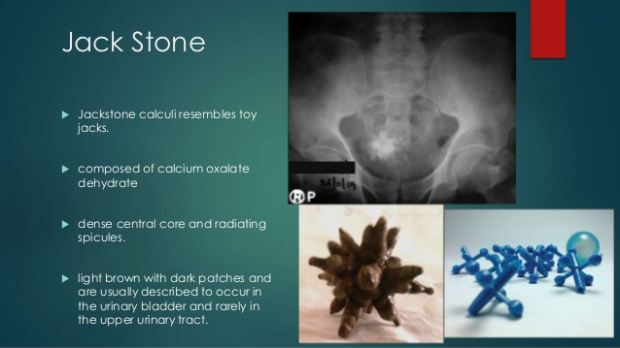
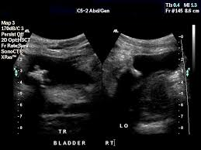
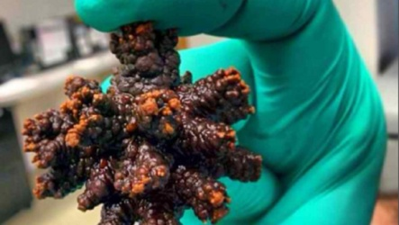
Jack stone of U.B

Slide 29
Genitourinary disease and anomaly in pediatrics 1. Renal agenesis. 2. Renal hypoplesia. 3.Renal ectopia 4. Horse shoe kidney. 5. Duplicate collecting system.

Slide 30
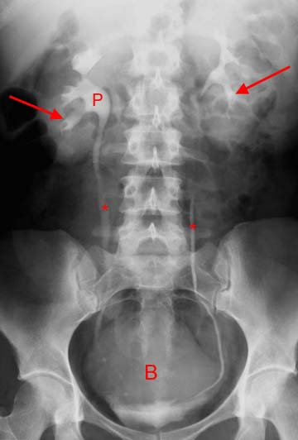
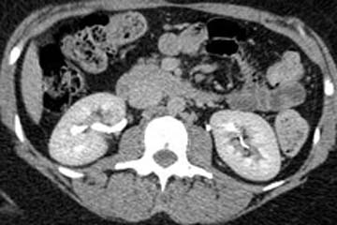
Normal kidney appearance in: IVU CT scan excretory phase

Slide 32
Normal renal anatomy in Cross section CT scan Renal excretory phase

Slide 33
1. Renal agenesis or atresia
- agenesis= atresia= congenital defect where an organ is not formed.
- it is a congenital absence of kidney with contra-lateral compensatory renal hypertrophy.
- usually unilateral & pt. has normal life expectancy ; (if bilateral : it is incompatible with life).
- no sign or symptoms unless there is UTI; usually accidentally discovered.
- USS, IVU, CT scan & MRI followed by Radionuclide scan are the modality of choice for diagnosis.

Slide 34
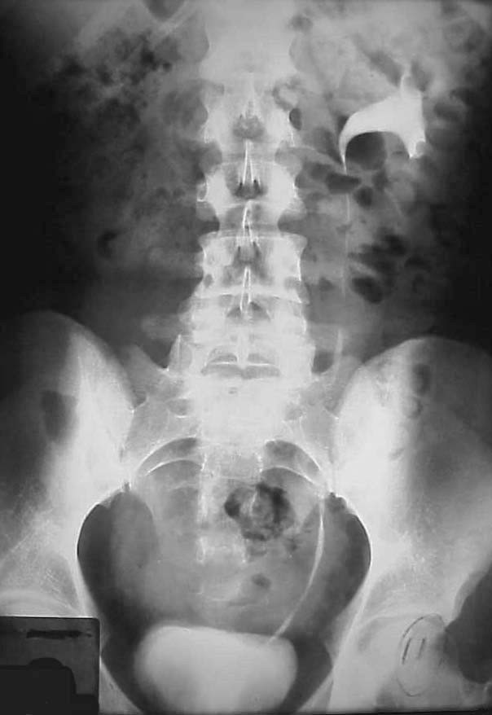
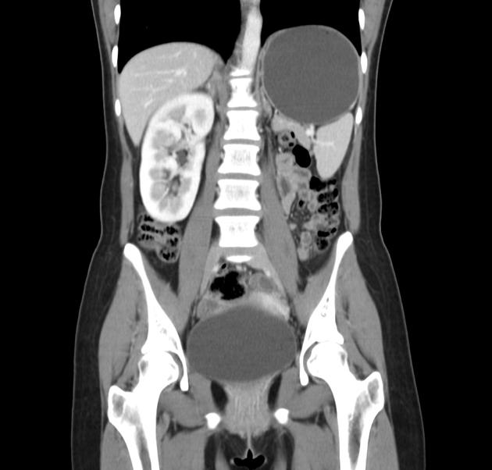
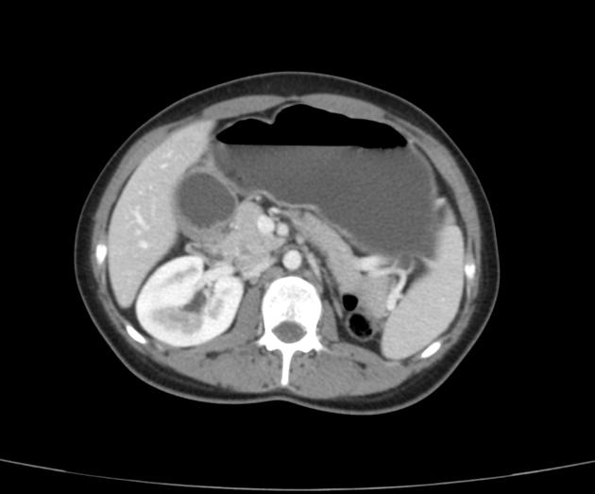
Renal agenesis IVU contrast CT coronal contrast CT. axial

Slide 35
2. Renal hypoplasia.
- hypoplasia= decrease in growth= small in size
- may be of congenital defect or chronic infection.
- no sign or symptoms unless there is UTI, discovered accidentally .
- USS, IVU, CT scan , MRI & radionuclide scan are the choice of modality.
- no treatment, just treat the UTI.

Slide 36
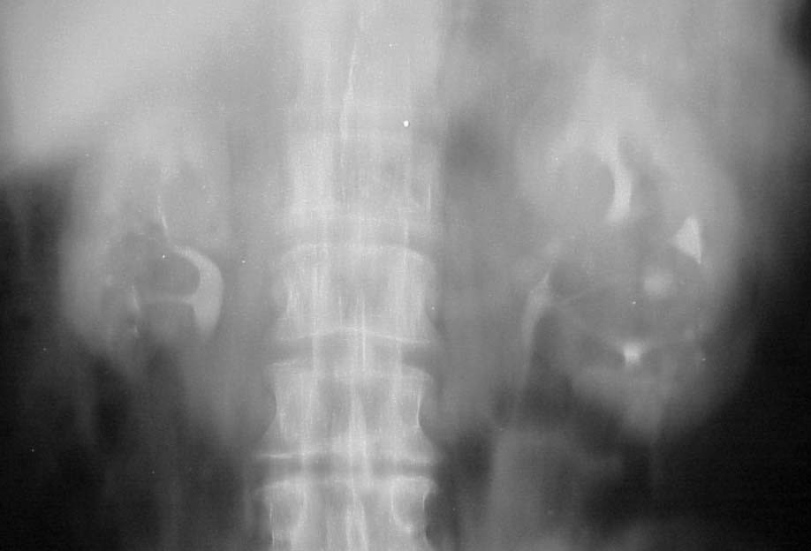
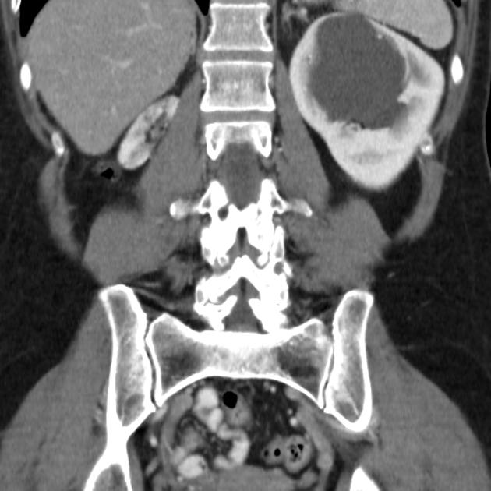
Renal hypoplasia IVU contrast CT scan

Slide 37
3. Renal ectopia
- ectopia= abnormal location of the organ
it is a congenital defect that the kidney arrest at pelvic boundary = pelvic kidney, or immigrate to the contra-lateral side (opposite side) = cross ectopia which is fused or non fused, or over immigration to thorax.
- its ureter inserted in the normal trigon.
- mal-rotation, UTI, stone formation & hydronephrosis is common.
- no symptoms or signs unless there is UTI or stone formation.
- no treatment except treatment of the infection or stone.

Slide 38
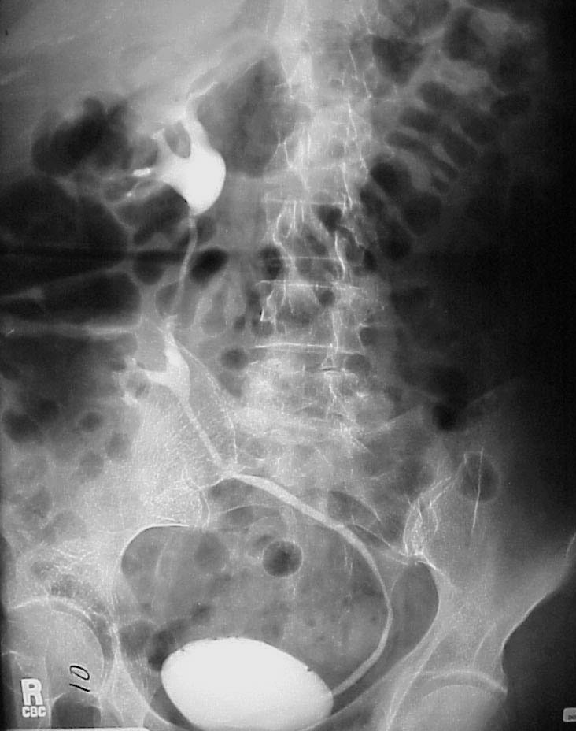
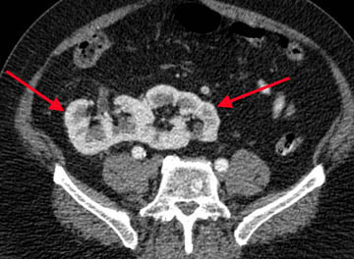
Cross Renal ectopia with mal-rotation IVU Cross fused ectopia contrast CT scan
Curved
Crossing
Midline
ureter

Slide 39
4. Horseshoe kidney
- Is an accidentally detected congenital disease where the lower poles of both kidneys fuse together ( by fibrous or parenchymal tissue) causing angle of renal collecting system.
- has risk factor for : UTI, PUJ obstruction , hydronephrosis ,stone formation, transitional cell ca. or renal cell ca. & Wilm’s tumor in children
asymptomatic unless there is hydronephrosis, stone or renal mass.
- IVU, CT scan & radioisotope scan are diagnostic.

Slide 40
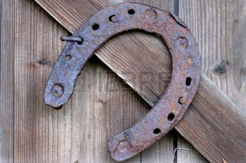
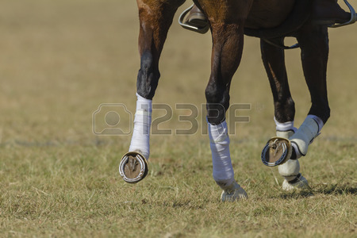
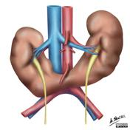
Horse shoe kidney

Slide 41
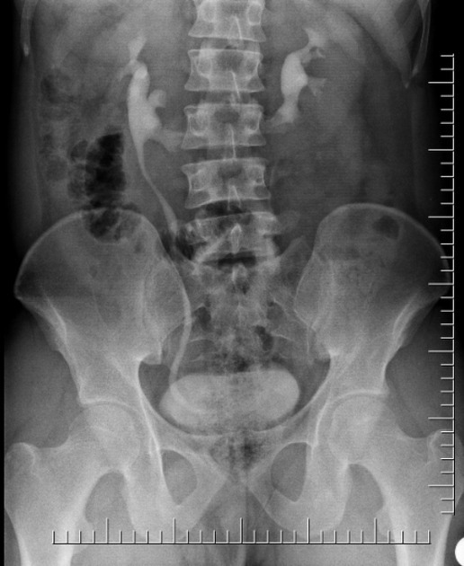
Horseshoe kidney normal IVU Horseshoe kidney IVU
Horse
Shoe kidney

Slide 42
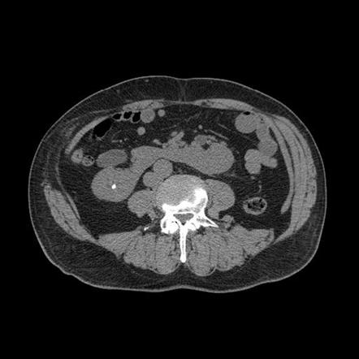
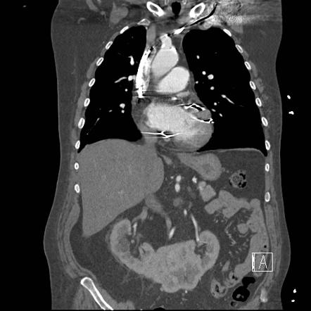
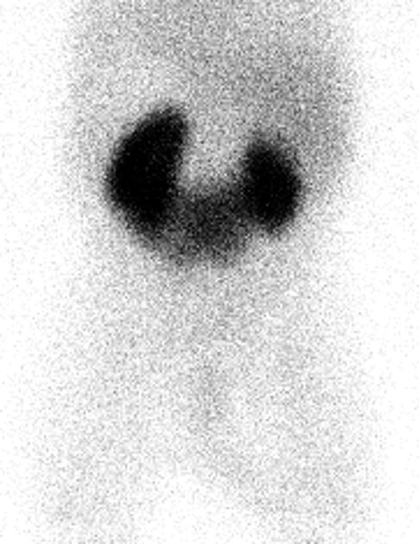
Horseshoe kidney non contrast axial contrast CT scan coronal DMS isotopescan

Slide 43
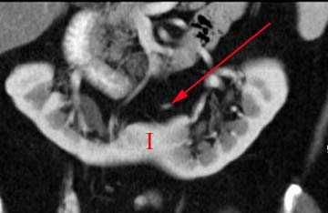
Normal shape kidneys horseshoe kidney in CT scan

Slide 44
5. Duplicate collecting system Double moiety
-most common congenital anomaly
- can be unilateral or bilateral.
- it is a defect in a kidney characterize by incomplete fusion of upper & lower pole moiety forming two renal pelvis drain into one ureter ,OR two renal pelvis & two ureters.
-the ureters may of Y shape, or enter the bladder separately with deferent orifices =complete duplication.
- complications: infection, reflux & obstruction .

Slide 45
- can be associated with other renal anomalies as ureterocele of upper moiety ureter & VUR in lower moiety..
-the upper moiety ureter can be of ectopic insertion ( into prostatic urethra in male & into vagina in female).
- Excretory CT scan , IVU with dropping Lily sign of the lower moiety in case of non functioning obstructed upper moiety..
- does not require treatment, just treat the infection & obstruction.

Slide 46
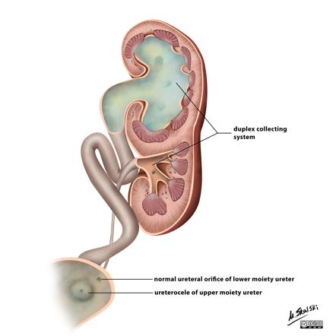

Slide 47
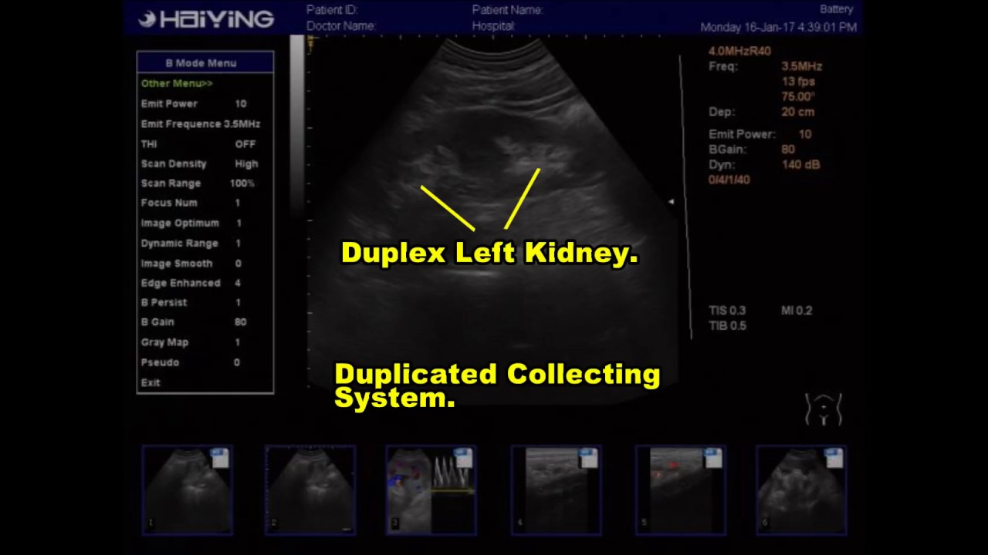
USS of non complicated Duplicated collecting system

Slide 48
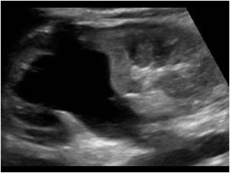
USS of duplicated collecting system with upper moiety hydronephrosis” complicated “

Slide 49
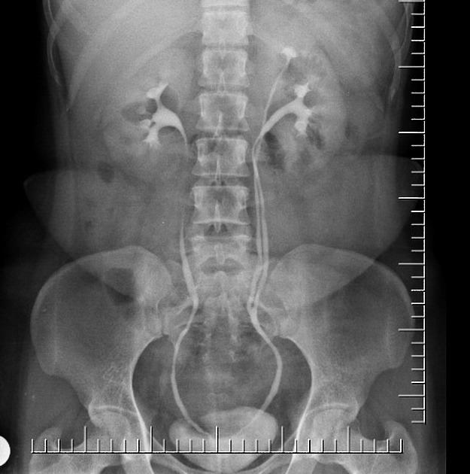
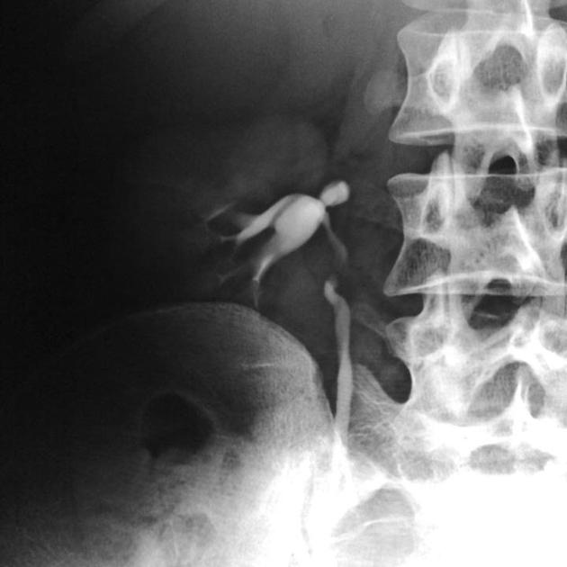

Duplicate collecting system IVU ( uncompleted duplicated Y shape ureter) dropping Lily sign

Slide 50
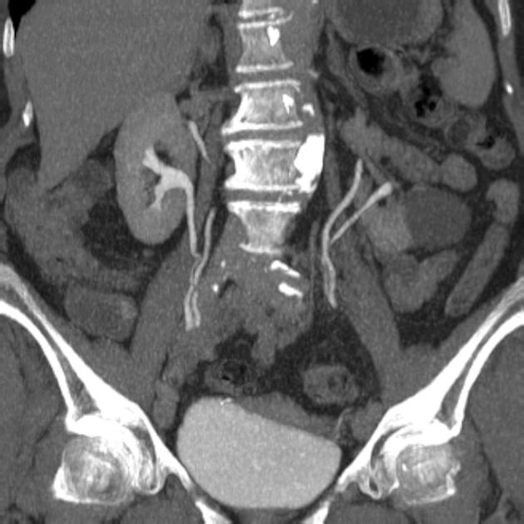
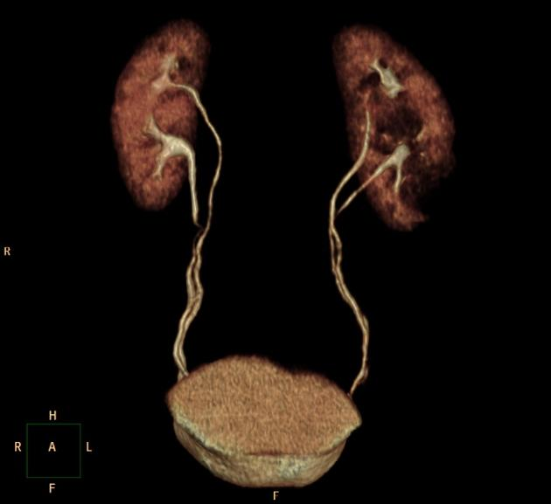
Duplicate collecting system coronal CT scan 3D CT

Slide 51
Vesico-ureteric Reflux (VUR) and post. Urethral valve ( PUV)
- VUR : is an abnormal flow of the urine from the U.B back to the ureter & to the pelvicalyceal system.
can be congenital or due to bladder infection, bladder dysfunction “neurogenic bladder” or outflow obstruction.
-most common cause of UTI in children & male children with posterior urethral valve
- sign & symptoms of UTI (including pyuria & hematuria), hydroureter & hydronephrosis.

Slide 52
- VCUG ( voiding cyto-urethrogram) or named as MCUG ( micturating cysto-urethrogram) modality of choice for diagnosis & staging : I,II, III, IV, V.
Hydroureter & hydronephrosis are seen in grade III, IV, V .
- PUV : is an obstructing membrane in the posterior male urethra as a result of abnormal in utero development. It is the most common cause of bladder outlet obstruction in male newborns.
- nuclear medicine is useful for follow up because of its low radiation effect on the pt.& to detect scaring effect of ascending renal infection.
- treatment: antibiotics for UTI , severe grades cases must be treated by surgery.

Slide 53
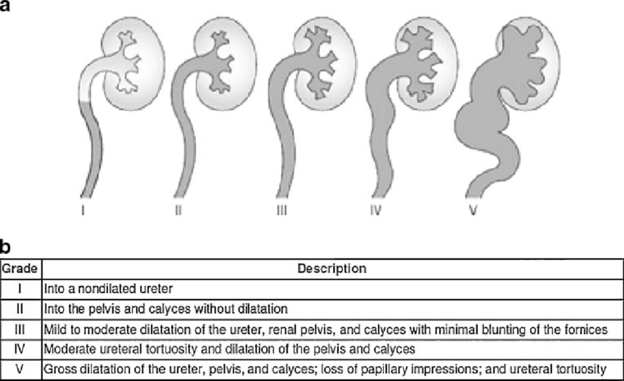
illustrated diagram of grades of VUR

Slide 54
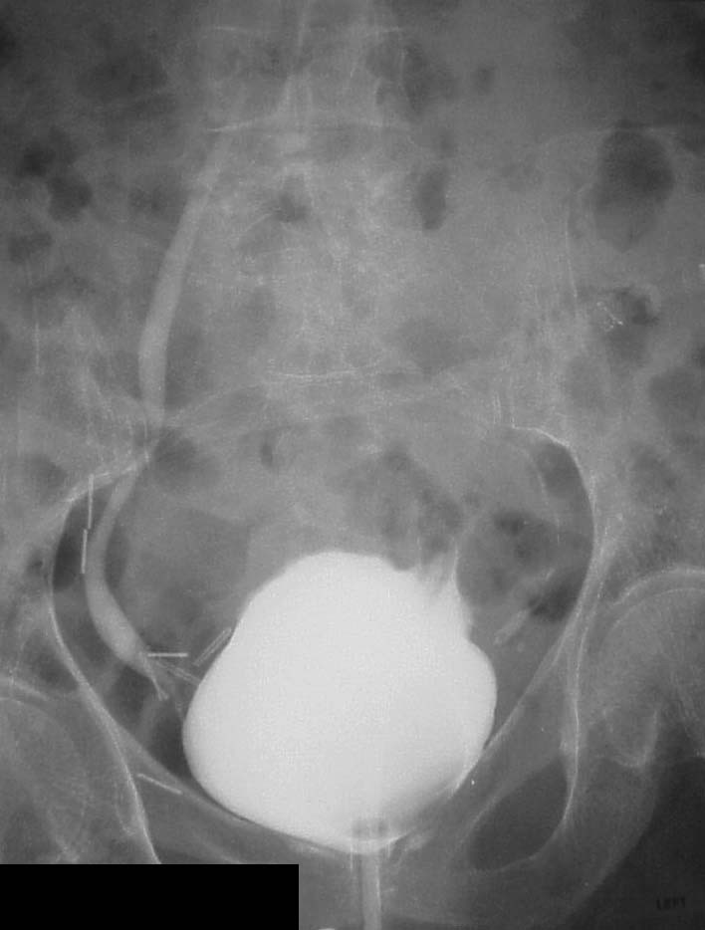

Vesicoureteric reflux VUR VCUG reflux grade I VCUG reflux grade V

Slide 55

Posterior urethral valve PUV

Slide 56


Slide 57
Renal lesions and urothelial tumors

Slide 58
Renal cysts.
- Cyst= well margineted fluid filled non vascular sac that can form at anywhere of the body.
- it is most common renal lesion found in more than 50% of the general population over 50 yrs.
- has two types : Simple & complex ( abscess or cystic renal cell ca.)
- USS is the initial choice of modality , simple cysts : appear as anechoic, thin smooth wall, increase thru transmission.
- CT scan & MRI are helpful to assess the complex cysts.( simple cyst CT scan density: 0-20 HU)

Slide 59



Slide 60


USS images of simple renal cyst

Slide 61

Complicated renal cyst

Slide 62


Renal cysts. CT scan MRI T2

Slide 63
Polycystic kidney disease (PCKD )
- is hereditary disease that characterized by enlarged kidneys with presence of multiple small cortico-medullary cysts.
- has two types: pediatric PCKD “autosomal recessive” ” adult PCKD “ autosomal dominant at age of 30 yrs
- Bilateral flank pain, HTN, renal impairment , End by renal failure.
-can be associated with cysts in the liver ,spleen,
- Cysts may be complicated by hemorrhage, infection, calcification & cystic type of Renal cell ca. (RCC)

Slide 64
- (IVU & CT scan: in normal renal function) ,USS & MRI are used for the diagnosis.
- USS, CT scan & MRI adult pt. radiological finding: bilateral renal enlargement with multiple variable in size cortico-medulalry non complicated cysts of water density, other associated cysts are seen.
- in child pt : normal kidneys at birth & the small high echo. Cysts develop.
- complicated cysts will be recognized easily in CT & MRI
- dialysis is used for treatment of renal failure.

Slide 65


USS ADPKD adults USS ARPKD children

Slide 66

Polycystic kidney disease (PCKD ) IN CHILDREN CT scan coronal view IVU

Slide 67



Adult Polycystic kidney disease (PCKD ) contrast CT coronal & axial MRI T2 coronal

Slide 68
PANILESS HAEMATURIA
-Most common causes:
. Tumors: - Renal cell ca. RCC
-Transitional cell ca. TCC
. Prostatomegaly BPH
.Acute pylonephritis.
. Coagulopathy/ Anticoagulant therapy

Slide 69
Renal cell carcinoma (RCC)
-90% of primary malignant renal tumors are adenocarcinoma arising from renal tubular epithelium.
- occurs in 50-70 years old with high mortality rate.
-moderate male predilection 2:1
-Typical presentation: painless haematuria, palpable flank mass.
- able to invade the renal vein & IVC, can be metastasize to lung, brain, liver & bones.

Slide 70
Radiological features :
USS: heterogeneous mass with area of high echo. represents calcification & hypoechoic areas represents cystic necrosis.
Contrast CT. Scan:
Large vascular renal mass of mixed density
“heterogeneous” with distorted renal parenchyma, local vessels invasion.
- Smaller masses are hypoechoic & may mimic benign renal lesions.
-modality of choice for staging & follow up & accurate for distant lung metastasis”85%” & liver metastasis .
Angiography:- prior to surgery (tumor embolization).
- surgical road map.
.

Slide 71
MRI:
-Most accurate modality in assessing the IVC involvement ; the tumor appears of heterogeneous intensity in T1&T2.
Nuclear medicine:
-bone scan in case of late bony metastasis.
-PET/CT to distinguish between scar tissue from residual recurrent active tumor.
Treatment: nephrectomy & chemotherapy.

Slide 72



RCC contrast CT. USS USS

Slide 73


Renal cell ca. (RCC) contrast CT scan axial contrast CT scan coronal

Slide 74
ADRENAL GLAND IMAGES
Indications:
- Endocrine disease: Pheochromocystoma, Cushing syndrome
- Benign masses: adenoma is most common benign tumors. <3cm , well define smooth contour, low dense in non contrast CT scan & rapidly washout the contrast .
- MRI is helpful modality in diagnosis.
- Neoplasm: primary ca. is rare ( >5cm, high density with central low density necrosis in primary neoplasm) , metastasis is common from ca. lung, breast & melanoma
- Others: neonatal adrenal hemorrhage, palpable mass.
First modality is USS abdomen for kidneys and both adrenal glands

Slide 75


CT scan of adrenal gland

Slide 76

CT scan adrenal gland Rt. Adenoma low dense Lt. metastasis heterogeneous +central

Slide 77


Slide 78
Lower Urinary Tract pathology

Slide 79
Urinary bladder diverticulum
- diverticulum= out-pouching of the wall of the organ that occurs due to weakening in the lining of its wall.
- congenital or acquired
- can be rupture or cause bladder infection, stone formation due to stasis or growth of malignant TCC
-Antibiotics are used for infection.
- Cystogram & USS is the modality of choice.

Slide 80


UB diverticulum cystogram

Slide 81
Transitional cell carcinoma (TCC)
- 90% of all malignancy in urinary system.
- common in male over 50 yrs.
TCC is related to chemical ,rubber & plastic factory and smokers.
- it is common in urinary bladder more than renal pelvis & ureter.
- pt. symptoms: painless hematuria ,hydronephrosis
if it cause PUJ or VUJ obstruction.
- able to metastasize up to ureter & renal collecting system & seeds to liver, lung, brain & bones.
- CT scan & MRI are the modality of choice.

Slide 82
Radiological features:
USS : hypoechoic soft tissue mass seen at the renal pelvis or calyceal system OR occupying the wall of U.B.
IVU : seen as filling defect, distortion to calyceal system with hydrocalycosis, filling defect at UB wall.
CT scan: help for staging , the lesion appears as soft tissue mass as filling defect, no renal parenchymal distortion, Soft tissue mass attaching to the bladder wall & may invade the surrounded structure.
MRI : modality of choice for local staging.
Cystoscopy & biopsy is important for diagnosis.

Slide 83


Renal TCC IVU USS

Slide 84


U. Bladder TCC contrast CT scan pelvis axial MRI T2 axial

Slide 85
PROSTATE
Benign Prostate Hypertrophy
Prostate cancer

Slide 86
- Prostate gland is part of male reproductive system.
- Anatomical location: the gland is inverted pyramid that surrounds the proximal urethra
- Typical weighs is 20-40 gm “young adult” with 70% glandular tissue & 30% fibromascular tissue ” stroma”
- composed of 3 zones :
1. peripheral zone 70% of total prostate volume & surround the distal urethra
2. central zone 25% contain ejaculatory ducts
3. transition zone 5% closed to proximal urethra
- Radiological assessment:
USS: transabdominal/transrectal: uniform low echo.
CT scan: poor in anatomy & pathology location, but used in metastatic staging of ca. prostate
MRI: modality of choice

Slide 87
Benign Prostate Hypertrophy BPH
- common in elderly male & major cause of UB outflow obstruction.
- is benign increase in the glandular & stromal cells “hyperplasia “ of transition & central zones
- elderly pt. c/o poor stream urine, frequency & uncompleted U.B emptying, UTI, urine retention, VUR
- USS : increase in volume >40gm, enlarged central gland, hypoechoic or mixed echo., calcification & residual urine in post-micturating phase
- IVU: UB diverticulosis due to outflow obst.
- MRI : enlarged central zone

Slide 88



Normal MRI anatomy of Prostate gland T2 coronal T2 sagittal

Slide 89

BPH USS

Slide 90



BPH MRI T2 coronal sagittal axial

Slide 91
Prostate cancer
- disease of elderly age men.
-2nd most common fatal men malignancy
- prostatic adenocarcinoma is the commonest type.
- clinical presentation: urinary symptoms, raised prostate specific antigen PSA.
- metastasis to bone 90% (osteoblastic & lytic ), lung & liver.
- USS : trans-rectal uss is the initial modality for diagnosis & biopsy guide
- appears as: peripheral zone is hypoechoic or high echo.,
- CT scan : staging for distant metastasis in bone, lungs & liver.
- MRI : modality of choice for localization & local tumor staging & local lymphadenopathy . “ tumor appears as mixed signal at peripheral zone”

Slide 92

Prostate ca. MRI

