Slide 1


Libyan International Medical University
Faculty of Business Administration
Verbal and Nonverbal Communication
Name : Khariya _ Mamash
SN:4406
Emali:khayriyh_4406@limu.edu.ly

Slide 2
Table of contents
02
01
03
04
Introduction
Objective
Verbal and nonverbal communication
05
06
Verbal communication
Ways to Improve Verbal Communication
Example
07
09
08
Reference
Conclusion
Reflection
2

Slide 3
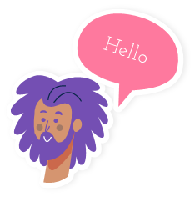
Objective
After this presentation you will be able to:
Define nonverbal communication
Diffrenentiate between verbal and nonverbal communication
Improve your speaking skills
Use your words effectively
3

Slide 4
Introduction
Verbal Communication
Communication is the process of exchanging information
, ideas, thoughts, and feelings between individuals or
groups through various mediums such as verbal,
nonverbal, written, or visual means
4

Slide 5

Verbal communication
Verbal communication it is the way you speak and the way
you write. The primary goal of verbal communication is to
use language to convey information clearly and concisely
. Verbal communication skills are most often employed
during three situations: interpersonal communication
, group conversations and public speaking
5

Slide 6
Verbal and nonverbal communication
Verbal communication is about language, both written and spoken.
verbal communication refers to our use of words while nonverbal
communication refers to communication that occurs through
means other than words, such as body language, gestures, and
silence. Both verbal and nonverbal communication can be spoken
and written.
6

Slide 7
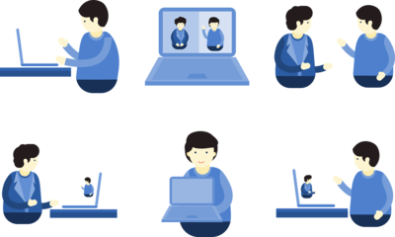
Practical Ways to Improve Verbal Communication
1. Listen and be interested : Listening more and talking less means you will understand and bring your listener into the conversation
2. Understand : understand what your friend talking about quietly and correctly
7

Slide 8


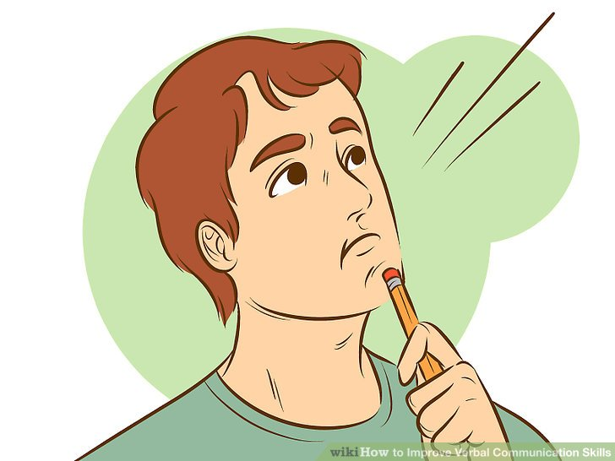

3. Prepare (if you can)– You would spend time planning what you would say if you were writing.
4. Be aware of non-verbal communication traps : the impact of the words you say is only a small element of the communication you are giving.
5. respond : think before you talk.
8

Slide 9
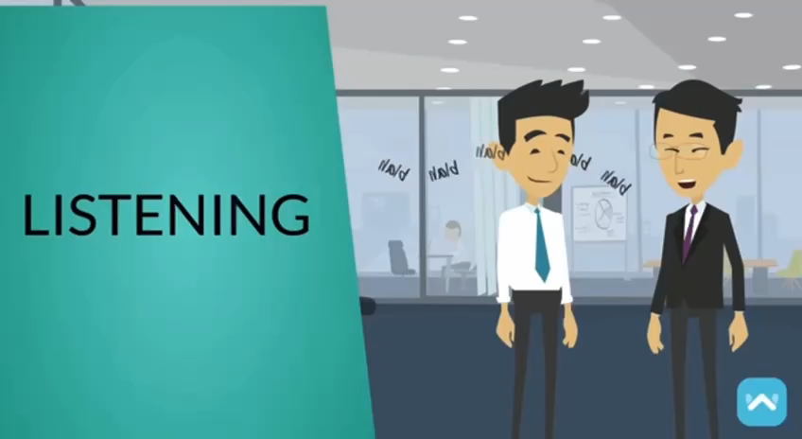

Slide 10
Conclusion
Communication is a natural part of the human experience, it’s
important to consider how you will communicate in a positive
and effective manner that aligns with your responsibilities and
reputation as a business professional.
10

Slide 11
Reflection
To improve your speaking skills and to get better at it , you have to
lesson more than talking , think before you say any thing , be
aware of body language, be careful of the words you’re saying ,
be honest and kind and the most important one is to be confident,
and this way your words will be effective and strong .
11

Slide 12



Reference
Timmer, S. J. et al. “how to improve your speakingskills." Peer J 7 (2019): e7329. Forbes, 8 Apr. 2019,
Fleischman, Bonnie. “nonverbal and verbal communication." Harvard Business Review, vol. 98, no. 3, 2020, pp. 4-5
Loeffler, K. (2020, October 27). How to be Effective.
Forbes. Retrieved from
12

Slide 13
THANK YOU!
DO YOU HAVE ANY QUESTIONS??

