Slide 1



Effect of Congenital HIV on Neurodevolpment
Second year medical student
2022/03/13
Presenter : Rahaf suliman
Student nm : 3083
1

Slide 2
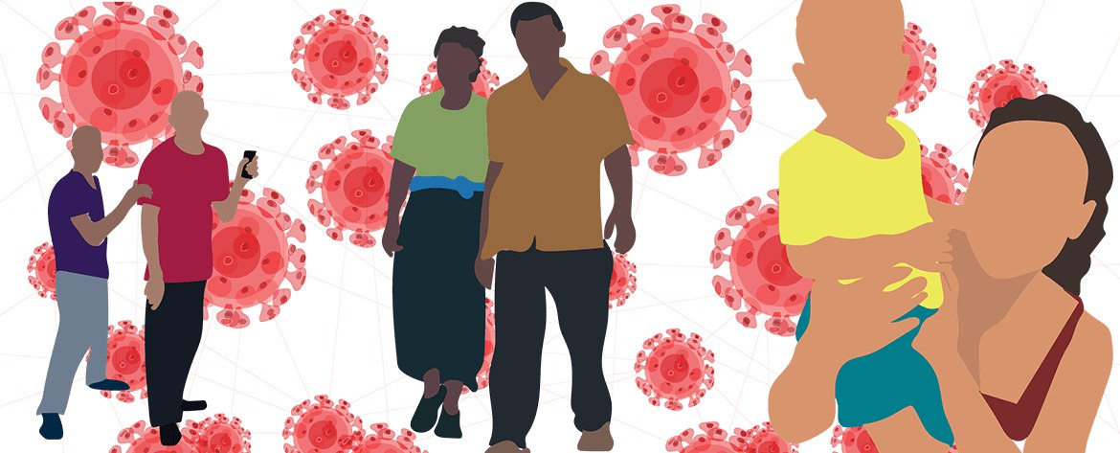
2

Slide 3

Objectives
04
Define congenital HIV infection
Discuss the mode of transmission of HIV from mother to child
Discuss the effect of congenital HIV on neurodevelopment
3

Slide 4

Define congenital HIV infection
4

Slide 5

Congenital HIV
Is an infection of ( Human
immunodeficiency virus )
that is present from the birth .
5

Slide 6


Discuss the mode of transmission
of congenital HIV
6

Slide 7




Transmission
Intrauterine
Breastfeeding
During delivery
7

Slide 8
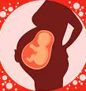
Intrauterine
At any stage of pregnancy, HIV can infect the placenta , HIV infection in the placenta can be passed on to the fetus during pregnancy
Transmission can happen through placental rupture when infected blood transfusions into the circulation of fetus .
The HIV can infect layers of placenta until it reaches the fetoplacental circulation .
8

Slide 9
Intrapartum
Direct contact of the fetus with infectious mother blood and genital secretions during the birth canal passage could result in transmission
Via absorption in the fetal-neonatal GIT and ascending infection from the vagina or cervix to the amniotic fluid
9

Slide 10
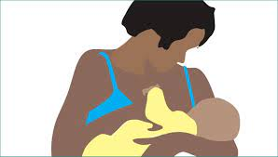
Breastfeeding
HIV may enter the mucosal lining of the GIT of newborn children by tainting cells
Or by direct passage into the circulatory system of newborn via mucosal breaches
10

Slide 11
study according to the breastfeeding transmission
In a study that was recorded in South Africa, Brazil and Europe
On breastfeeding HIV transmission
22% of infants was +HIV
78% was -HIV
11

Slide 12


Discuss the effect of congenital HIV on neurodevelopment
12

Slide 13

What is the effect of congenital HIV on neurodevelopment ?
A previous large study showed various clinical signs of HIV-related neuropathological mechanisms in children born with HIV .
The present authors described acquired microcephaly , seizure and bilateral pyramidal tract signs .
Neurological disease related to HIV is often associated with various other systemic signs of immune dysfunction .
13

Slide 14
Effect of congenital HIV on neurodevelopment
50 children
1
Effected mothers
Spastic quadriplegia
Hemiplegia
Hypotonia
Progressive Encephalopathy
Prolonged seizure
Syphilis
Major neurological findings
3
2
2
32 M
18 F
1
2
28 POSITIVE
5
14

Slide 15
Conclusion
Congenital HIV is an infection of HIV that is present from the birth .
There is many ways to transmission of the HIV from mother to child .
HIV can cause many different neuropathlogical effects .
15

Slide 16
References
Meyers A. Natural History of Congenital HIV Infection. Journal of School Health. 1994;64(1):9-10. doi:10.1111/j.1746-1561.1994.tb01269.x
Newell M. Mechanisms and timing of mother-to-child transmission of HIV-1. AIDS. 1998;12(8):831-837. doi:10.1097/00002030-199808000-00004
Diamond G, Gurdin P, Wiznia A, Belman A, Rubinstein A, Cohen H. EFFECTS OF CONGENITAL HIV INFECTION ON NEURODEVELOPMENTAL STATUS OF BABIES IN FOSTER CARE. Developmental Medicine & Child Neurology. 1990;32(11):999-1004. doi:10.1111/j.1469-8749.1990.tb08123.x
16

Slide 17

THANKS
17

