Slide 1



Diabetes in children
Type l
Name of student : Hawa idris alobeidi
Student ID:3239
Group: PTS 1
Year 1 (2020-2021)

Slide 2

Introducing diabestes type I .
type Risk factors for diabetes type I and ll diabetes.
Signs and Symptoms of diabetes type I .
How to manage and control diabetes type I.
Different between type l & ll.
Objectives

Slide 3


Type 1 diabetes is to be caused by an autoimmune reaction (the body attacks itself by mistake) that stops your body from making insulin.
Is the inability of the pancreas to produce insulin in regular blances amounts.
Introducing diabestes type I

Slide 4
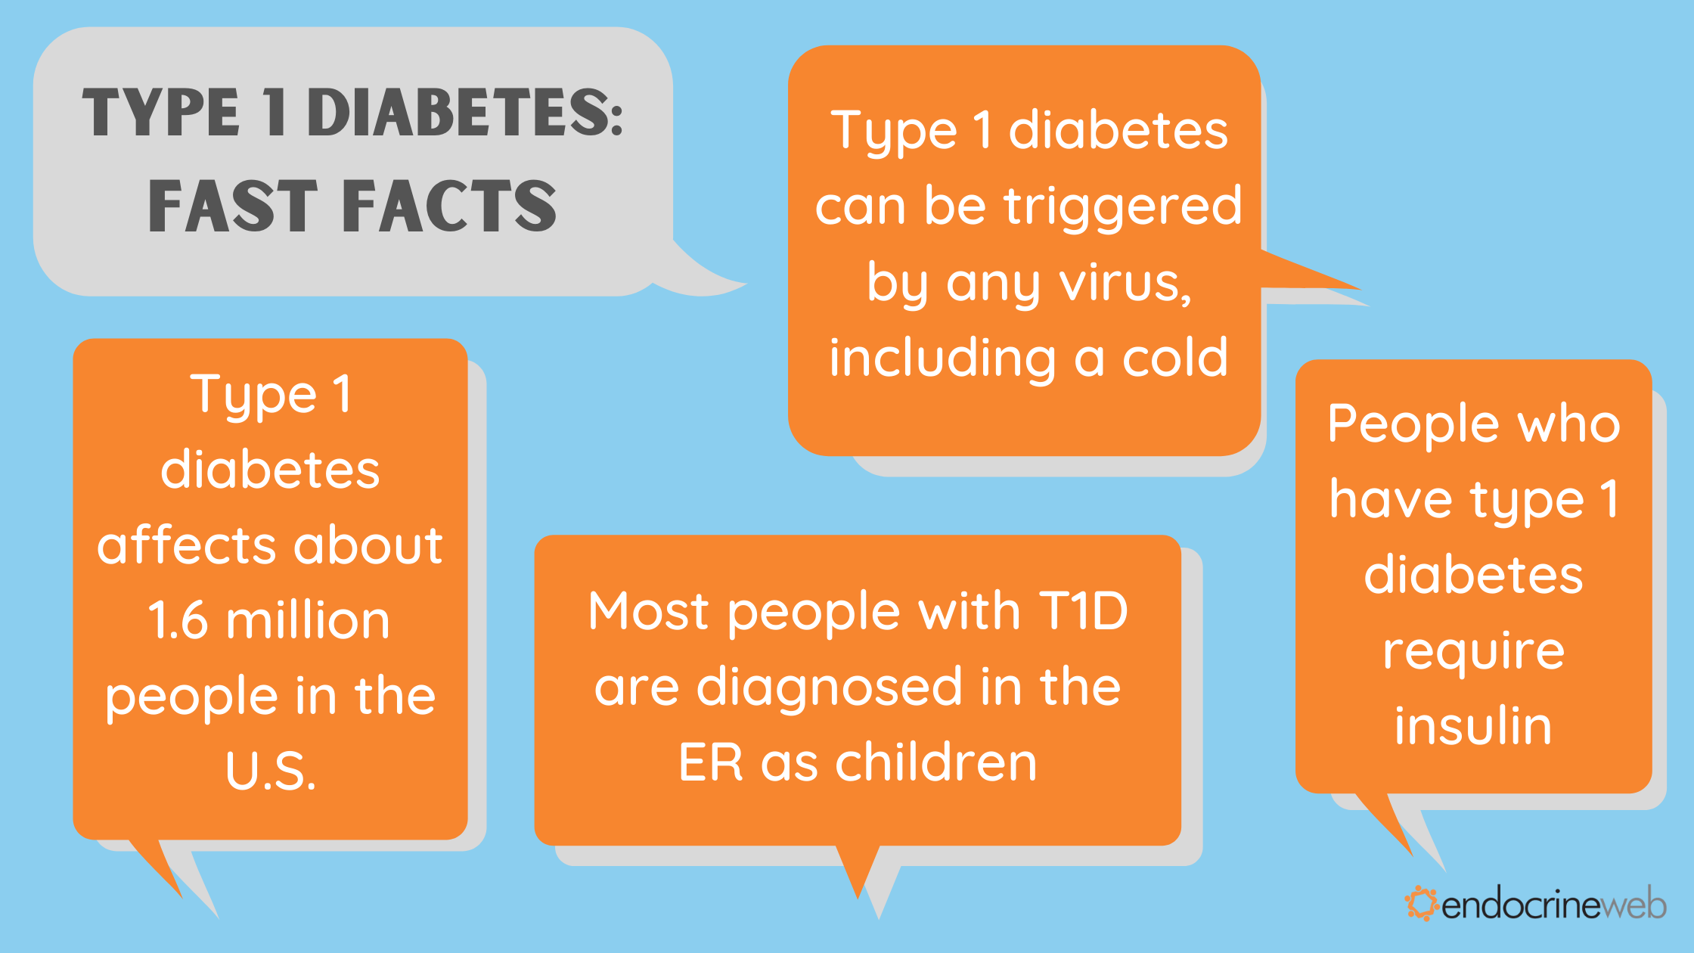

Slide 5
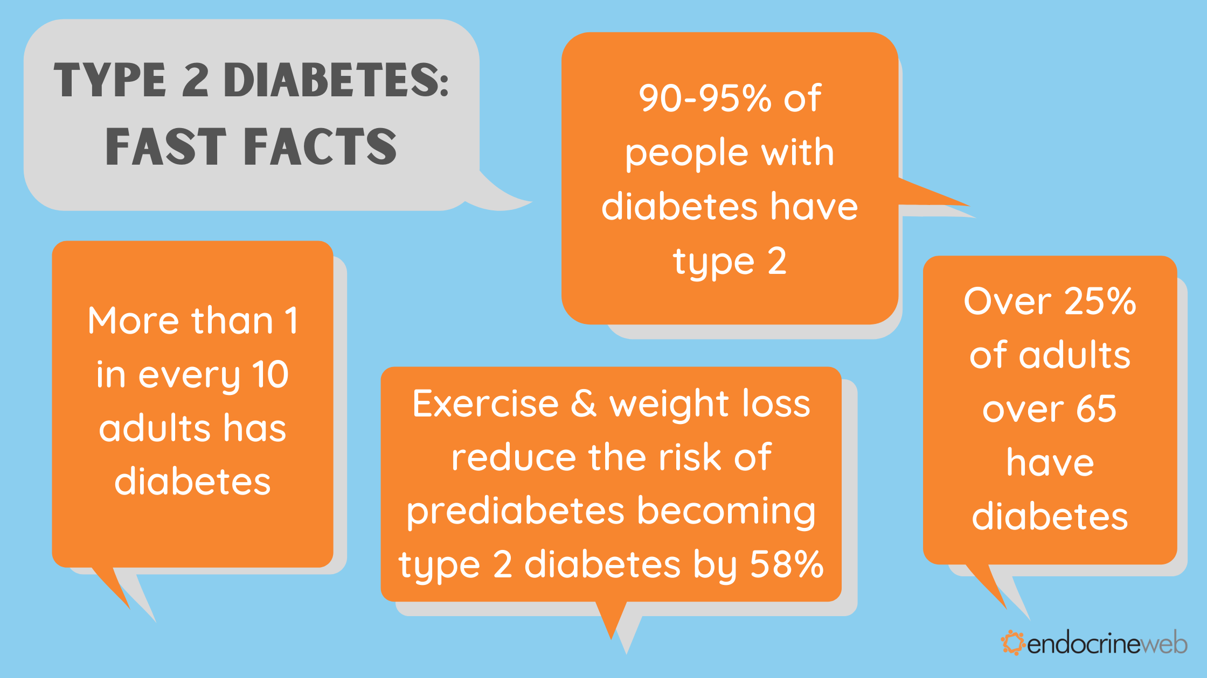

Slide 6
  Family history .
  Age.
  Have prediabetes.
  Are overweight.
  Are 45 years or older.
  Have a parent, brother, or sister with type 2 diabetes.
  Are physically active less than 3 times a week.
  Have ever had gestational diabetes .
Risk factors for prediabetes
Risk factors for type ll

Slide 7
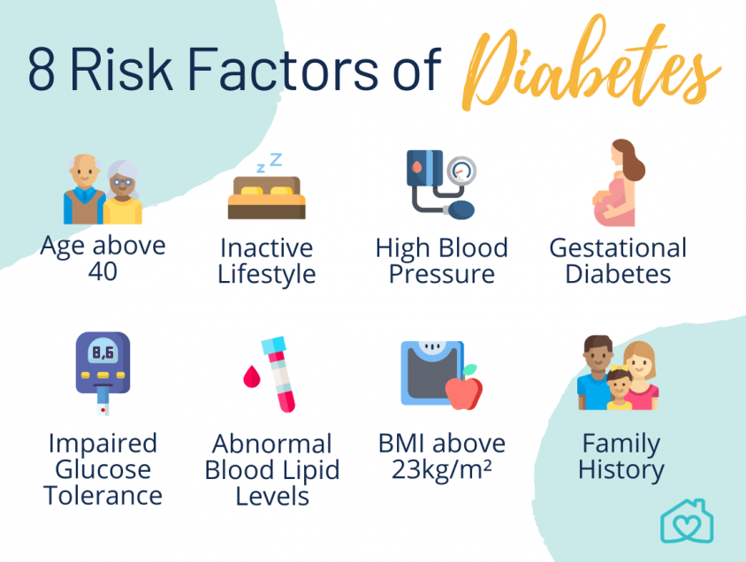

Slide 8
  increased thirst and urination
  increased hunger
  Fatigue
  blurred vision
  numbness or tingling in the feet or hands
  sores that do not heal
  unexplained weight loss
Signs and Symptoms of diabetes type I disease.

Slide 9
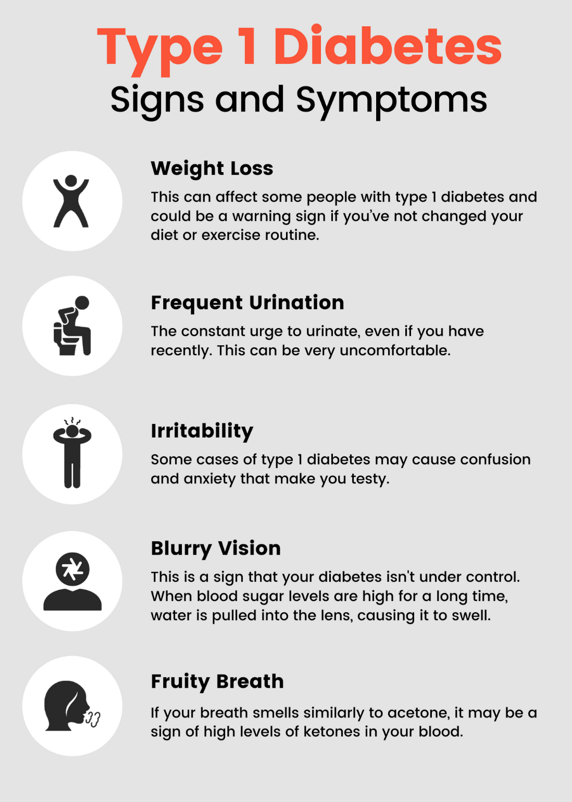

Slide 10
How to manage and control diabetes type I .
The aim diabetes management is to keep blood glucose levels as close to the target range as possible, between 4 to 6 mmol/L (fasting) .
Type 1 diabetes is controlled with:
Insulin replacement through lifelong insulin injections (up to 6 every day) or use of an insulin pump
Monitoring of blood glucose levels regularly (up to 6 times every day or as directed by a doctor or Credential Diabetes Educator)
Following a healthy diet and eating plan
Taking regular exercise

Slide 11
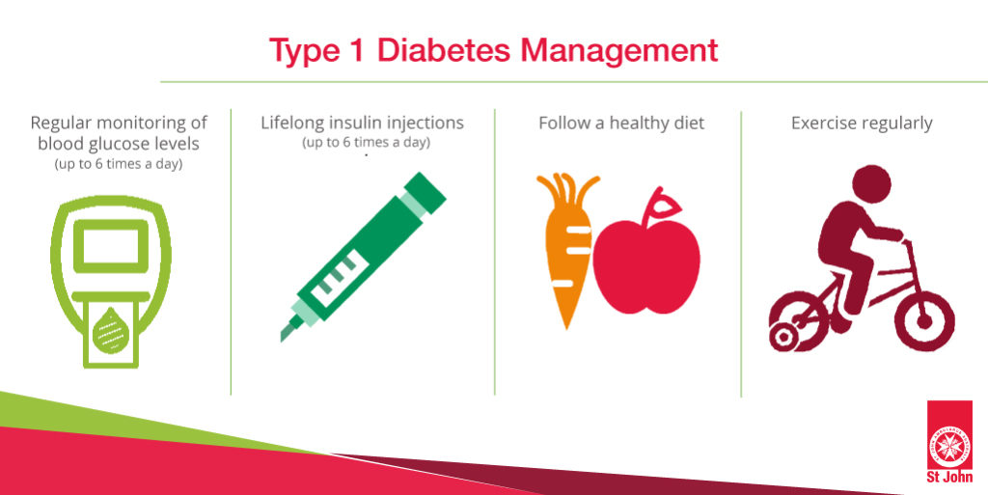

Slide 12
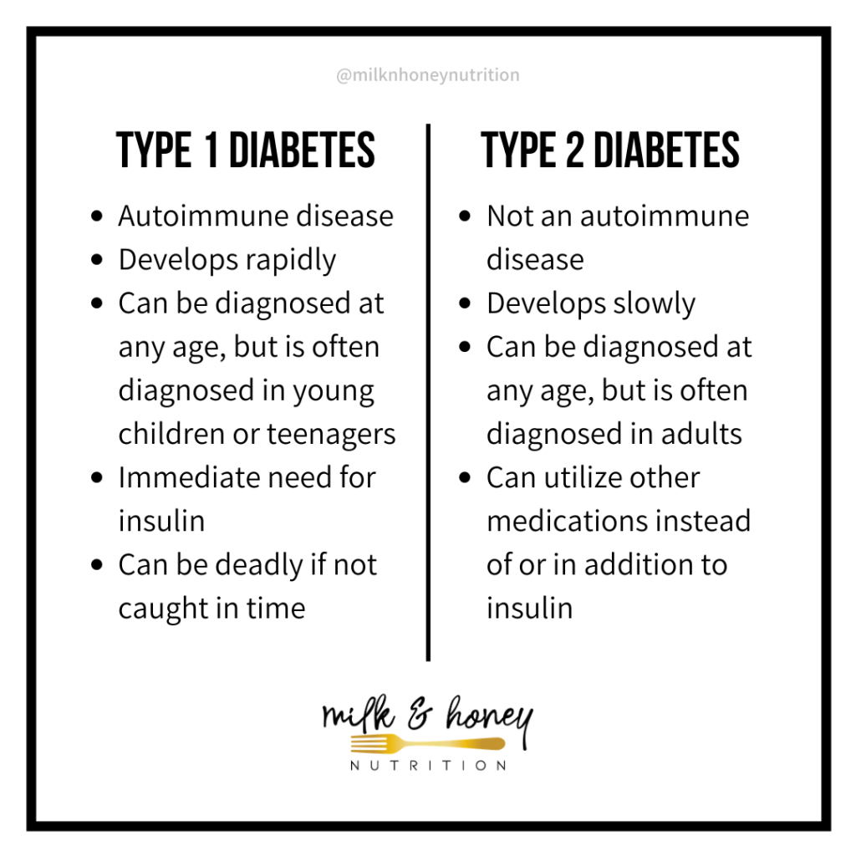
Different between type l & ll .

Slide 13
Summary
Diabetes is a disease that occurs when your blood glucose, also called blood sugar, is too high.
Blood glucose is your main source of energy and comes from the food you eat.
Insulin, a hormone made by the pancreas, helps glucose from food get into your cells to be used for energy
In healty pencreac reles a regular supply of insulin in to yor bloodstream .
Went you taking insulis as prescribed by your docter and maintaining healty diet you can keep your blood glucose levels with in healty range.

Slide 14
References
1. [Internet]. : Centers for Disease Control and Prevention. 2022 [cited 16 December 2021]. Available from: https://www.cdc.gov/diabetes/basics/diabetes.html
5. [Internet]. Centers for Disease Control and Prevention. 2022 [cited 5 April 2022]. Available from: https://www.cdc.gov/diabetes/basics/risk-factors.html
6. Diabetes S, Health N. Symptoms & Causes of Diabetes | NIDDK [Internet]. National Institute of Diabetes and Digestive and Kidney Diseases. 2022 [cited 23 May 2022]. Available from: https://www.niddk.nih.gov/health-information/diabetes/overview/symptoms-causes
7. StackPath [Internet]. Diabetesaustralia.com.au. 2022 [cited 23 May 2022]. Available from: https://www.diabetesaustralia.com.au/living-with-diabetes/managing-your-diabetes/managing-type-1
And the pictures are from a Google search.

Slide 15

* Thank you *

