Slide 1


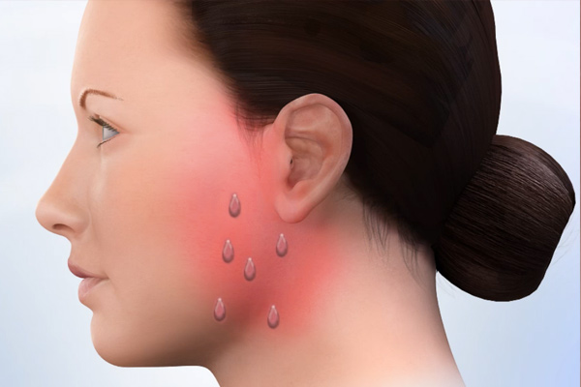
Frey's syndrome Mohamed B Moaiter 2nd Year Dentistry Faculty Of Basic Medical Sciense Libyan International Medical University
Introduction
Causes
Affected populations
Frey's syndrome (also known as auriculotemporal syndrome) .
is a rare neurological disorder resulting from damage to or near the parotid glands responsible for making saliva, and from damage to the auriculotemporal nerve often from surgery .
The disorder was first reported in the medical literature by Baillarger in 1853. A neurologist from Poland, Dr. Lucja Frey, provided a detailed assessment of the disorder and coined the term “auriculotemporal syndrome” in 1923.(1) .
Frey's syndrome commonly results as a side effect of surgeries of or near the parotid gland or due to injury to the auriculotemporal nerve, which passes through the parotid gland, Rarely, Frey's syndrome can result from causes other than surgery, including accidental trauma, local infections, sympathetic dysfunction and pathologic lesions within the parotid gland. An example of such, rare trauma or localized infection; can be seen in situations where a hair follicle has become ingrown and is causing trauma or localized infection near or over one of the branches of the auriculotemporal nerve. (1-2) .
The exact incidence of Frey's syndrome is unknown.
The disorder most often occurs as a complication of the surgical removal of a parotid gland (parotidectomy).
The percentage of individuals who develop Frey's syndrome after a parotidectomy is controversial and reported estimates range from 30-50 percent. In follow-up examinations, approximately 15 percent of affected individuals rated their symptoms as severe. Frey's syndrome affects males and females in equal numbers.(4) .
Signs and symptoms
Diagnosis
Conclusion
Signs and symptoms include erythema (redness/flushing) and sweating in the cutaneous distribution of the auriculotemporal nerve,usually in response to gustatory stimuli,They can appear when the affected person eats, sees, dreams, thinks about or talks about certain kinds of food which produce strong salivation,other symptoms have been associated with the syndrome, they are probably unrelated. Pain is sometimes described, but it is probably more related to the surgery than actually to Frey syndrome.(Fig.1) (1-2) .
Diagnosis is made based on clinical signs and symptoms and a starch iodine test, called the Minor Iodine-Starch test. The affected area of the face is painted with iodine which is allowed to dry, then dry corn starch is applied to the face. The starch turns blue on exposure to iodine in the presence of sweat.(fig.2) (3) .
1) Frey's syndrome is a rare disorder that most often occurs
ascomplication of surgery in the area near the parotid glands.
2) The main symptoms of Frey's syndrome are undesirable sweating and flushing occurring on the cheek (temporal region), after thinks about or talks about certain kinds of food that produse strong salivation.
3) The commonest cause of Frey's syndrome is due to surgeries complication of partidectomy and rarely caused by trauma or localized infection over or near auriculotemporal nerve..
4) Frey's syndrome is diagnosed by iodine-starch test.
References
von Lindern JJ. Frey Syndrome. NORD Guide to Rare Disorders. Lippincott Williams & Wilkins. Philadelphia, PA. 2003:533.
Gorlin RJ, Cohen MMJr, Hennekam RCM. Eds. Syndromes of the Head and Neck. 4th ed. Oxford University Press, New York, NY; 2001:756.
Auriculotemporal Syndrome (Frey Syndrome) Kevin M. Motz, MD and Young J. Kim, MD* Otolaryngol Clin North Am. 2016 April ; 49(2): 501–509. doi:10.1016/j.otc.2015.10.010.
Rustemeyer J, Eufinger H, Bremerich A. The incidence of Frey’s syndrome. J Craniomaxillofac Surg. 2008;36:34-37.
Figure.1(Frey's syndrome erythema and sweating)
Figure.2(iodine-starch test)

