Slide 1


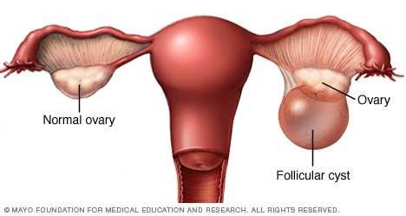
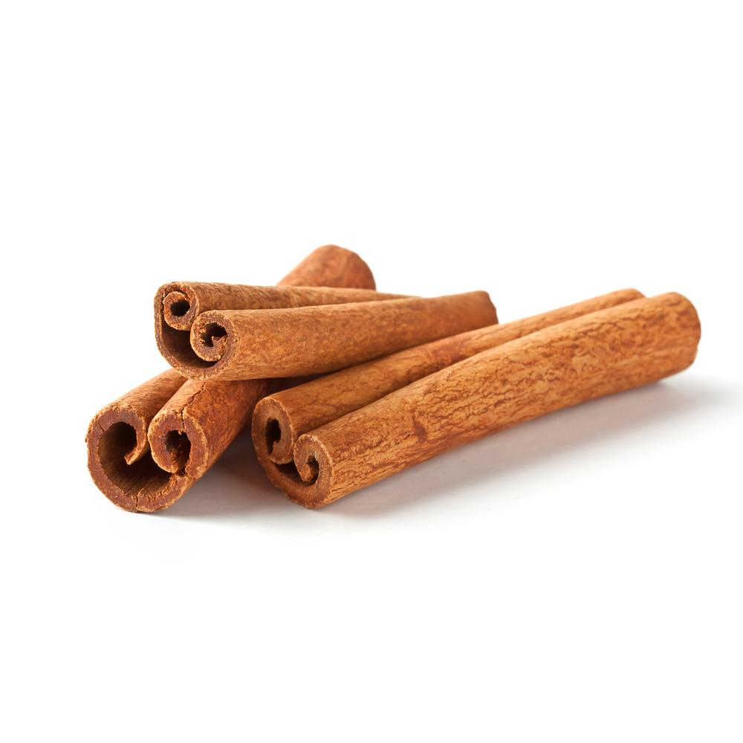
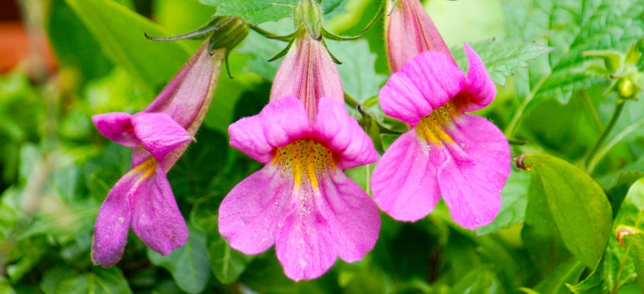
Libyan International Medical University
Treating Ovarian Cyst With Chinese Herbs
Aya R. Roaeid :1211
5th Year Medicine
Introduction:
Ovaries are the primary female reproductive organs. These glands have three important functions: they secrete hormones, they produce the ovas , and they release ovas for possible fertilization. Women have two ovaries — each about the size and shape of an almond — on each side of the uterus¹.
Ovarian cysts are fluid-filled sacs in the ovary. They are common and usually form during ovulation².
Discussion:
In China, simple ovarian cysts are most often treated with herbal combinations. The herbal treatments are reported to be very effective with a relatively short period of administration³.
The base formula used was added to hot liquid, in which it would dissolve :
Rehmannia: 20gm.
Cinnamon bark: 6gm.
Ma-huang: 6gm.
Sinapis: 12gm.
Persica: 10gm.
Laminaria: 10gm.
Zedoaria: 6gm³.
A case of a female patient suffering from continuous lower abdominal distending pain from an ovarian cyst for 1 year. The sonography taken on February 12, 2008 and showed a cystic mass on the right ovary. Treated by a formula of Chinese herbs (orally) for 90 days. Another sonography was taken on May 27, 2008 and showed that the cyst and all symptoms disappeared without any side effects⁴.
Conclusion:
Ovarian cysts are common and usually are benign and can be treated with Chinese herbs but more studies should be done.
References:
http://www.itmonline.org/arts/ovcyst.htm
https://www.womenshealth.gov/a-z-topics/ovarian-cysts
https://www.mayoclinic.org/diseases-conditions/ovarian-cysts/symptoms-causes/syc-20353405
Qu, Fan, et al. "Treating ovarian cysts with Chinese herbs: a case report." Complementary Medicine Research 16.5 (2009): 340-342.‏

