Slide 1


Libyan International University Faculty Of Business Administration
Globalization and Sustainability
Name : Ayub El Mesmary
Student Number : 2298
PBL Group 6 : Week 1
E-Mail : ayoub_2298@limu.edu.ly
Thursday, January 7, 2021

Slide 2
Content
Introduction
What is economic globalization and sustainable development ?
The concept of Sustainability development
How does globalization affect sustainability ?
Difference between globalization and sustainable
Conclusion
References

Slide 3
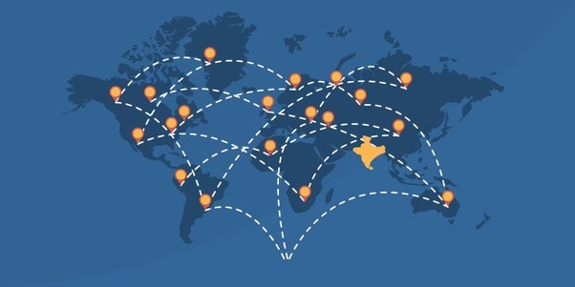
Introduction
Globalization and sustainability explores the interconnectedness of human-made systems and communities, the relationship between local and global processes; how local experiences mediate the global; the opportunities and tensions provided by world-interconnectedness, the impact of decision making on humankind and the environment .

Slide 4
What is economic globalization and sustainable development ?
Globalization describes the advancement of the global integration of the economy, culture and political structures. In political discussions on trade, globalization refers to market liberalization, shifting profits up the value chain and the interconnectivity of global markets. The Sustainable Development Goals (SDGs) are a set of policy goals that attempt to implement the principle of sustainability on the economic, social and ecological level in every country of the world. The United Nations General Assembly decided to achieve these objectives by the year 2030.

Slide 5
The concept of sustainability development
There are four dimensions to sustainable development – society, environment, culture and economy. Which are intertwined, not separate. Sustainability is a paradigm for thinking about the future in which environmental, societal and economic considerations are balanced in the pursuit of an improved quality of life. For example, a prosperous society relies on a healthy environment to provide food and resources, safe drinking water and clean air for its citizens.

Slide 6
How does globalization affect sustainability ?
The last decades of the twentieth century are characterized by increasing globalization, manifested in the rapid growth of world trade, foreign direct investment, and cross-border financial flows (Lee, 1996). The tools that facilitated this growth were international transportation, technology, and telecommunications that became cheaper, quicker, and of higher quality (Wood, 1995) and now the Internet. However, the movement among nation-states to liberalize their trade policies--removing trade barriers and focusing on exports--also contributed to globalization, a prime example of how government matters in the business sector. Globalization was also influenced by international organizations like the World Bank, the IMF, and the WTO, devoted to increasing trade and development. The result is multinational enterprises (MNEs) with budgets larger than the economies of many countries.

Slide 7
Difference between globalization and sustainability
No other issue is as important as sustainability from the point of globalization. The issue of sustainability has drawn to the attention to the people of the world that, despite their differences in terms of politics, economics, and ideologies, we do share the planet. The field of public administration has traditionally emphasized the values of efficiency, performance, social equity, diversity, and ethics. With the increased global concern about protecting the environment, the chapter emphasizes sustainability as the core values of public administration.

Slide 8
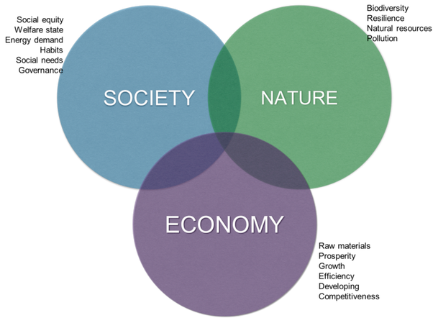

Slide 9
Conclusion
We have measured the impact of the recent process of globalization on the sustainability of world development in the light of various sustainability indices. Observing the results, globalization can be characterized as both more complicated and more surprising than was anticipated. One clear lesson can be learned from the many global assessments that have been produced over the past decades: dogmatic predictions regarding the earth‘s future are unreliable, ill-founded and misleading, and can be politically counterproductive.

Slide 10
References
Caro, J.M.B.; Golpe, A.A.; Iglesias, J.; Vides, J.C. A new way of measuring the WTI–Brent spread. Globalization, shock persistence and common trends. Energy Econ. 2020, 85, 104546. [CrossRef]
Jovanovic ́, M.N. Is globalisation taking us for a ride? J. Econ. Integr. 2010, 25, 501–549. [CrossRef]
O’Rourke, K.H. Economic history and contemporary challenges to globalization. J. Econ. Hist. 2019, 79,
356–382. [CrossRef]
Van der Meulen Rodgers, Y.; Bebbington, A.; Boone, C.; Dell’Angelo, J.; Platteau, J.P.; Agrawal, A. Experimental
approaches in development and poverty alleviation. World Dev. 2020, 127, 104807. [CrossRef]

Slide 11


