Slide 1


Peptic Ulcer & Oral Health
Name: Sarah Houssein Asnaidel
Student Number: 2910
Date: 2022/1/2
Y2D
Block: PTS

Slide 2
objectives
1-define & list causes of peptic ulcer disease.
2-list effects of peptic ulcer disease on oral health.
3-discuss h. Pylori & periodontitis.
4-tips on taking care of oral health.

Slide 3
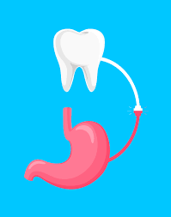
Introduction
As we may all know most diseases show signs & symptoms and many of them appear in our mouth so today we are going to discuss how can our oral cavity can get effected by peptic ulcers.

Slide 4
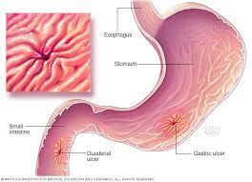
What’s peptic ulcer disease?
PUD is an open sore that develop on the inside lining of the stomach & duodenum and it can also include lower part of esophagus. It has multiple symptoms & causes that we’re going to mention later on.

Slide 5
Symptoms & causes of PUD
Many symptoms may appear but the most common are : abdominal pain, nausea, vomiting & bleeding.
The main causes are:
1- Helicobactor Pylori
2- NSAIDs
3- Tobacco

Slide 6
H. Pylori
Infection with helicobacter pylori (H. Pylori) is A major pathogenic factor for gastroduodenal ulcer disease and gastric carcinoma, as well as for other types of gastric and extragastric disease.
The oral cavity has been considered as A potential reservoir for the gastric infection and reinfection.

Slide 7
Effects Of PUD On Oral Health
Since that the main cause for peptic ulcer disease is H. Pylori and one of the routes of transmission of it is by the oral cavity it can accumulate in the gum line causing the following:
Gingivitis (bleeding gums)
Periodontitis
Halitosis (bad breath)
Apthous ulcers

Slide 8
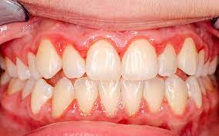
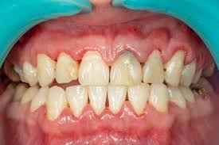
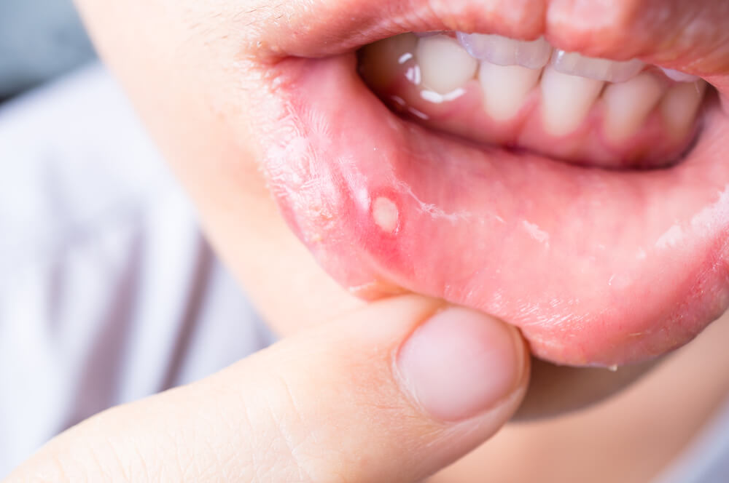
Some Of The Effects:

Slide 9
PUD & Periodontitis
Periodontitis is A severe gum infection that can lead to tooth loss and other serious health complications.
It damages the soft tissue and can destroy the bone that supports the teeth if left untreated. Which leads to teeth loss in some cases.
Having PUD increases the risk of developing periodontitis caused by the gram –ve bacteria H. Pylori.

Slide 10
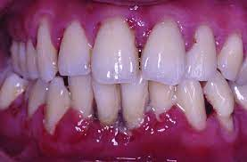
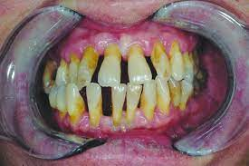
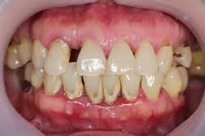
Severe cases of periodontitis:

Slide 11
Influence of H. pylori infection on periodontitis
A study was done to show the prevalence between H. Pylori & periodontitis.
Study subjects were 686 individuals (504 males, 182 females) the mean age is 53.8.
They underwent A screening test for periodontitis between april 2015 & march 2018.
The results were as the following:

Slide 12
H.Pylori & periodontitis
The results were subclassified to:
1- subjects who tested positive for PD & negative for H.pylori infection 25.2%
2- subjects who tested positive for PD & H.pylori infection 36.6%
3- subjects who tested positive for PD & post eradicated H.pylori infection 32.9%

Slide 13
H. Pylori & Periodontitis
The previous study showed that PUD caused by H. Pylori infection has A significant role in the developing of periodontitis.
The risk of periodontitis increases with having PUD.
H. Pylori increases the incident of periodontitis especially in old age.

Slide 14
Tips on taking care of your oral health
Brushing teeth daily at least twice A day.
Flossing daily.
Use mouth wash after brushing & flossing.
Healthy diet, limit sugary foods & drinks.
Replace tooth brush every 3 to 4 months.
Regular dental check-ups & cleanings.
Avoid tobacco usage.
Also, contact your dentist as soon as an oral health problem appears.

Slide 15
conclusion
Peptic ulcer disease increases the risk of periodontitis.
H. Pylori infection plays A major role in both diseases.
Taking care of your oral health is an investment in your overall health.
Regular checkups & listening to your dentist go a long way.

Slide 16
Refrences
Yeo SH, Yang CH. Korean J Gastroenterol. 2016;67(6):289-299. doi:10.4166/kjg.2016.67.6.289
Malik TF, Gnanapandithan K, Singh K. Peptic Ulcer Disease. In: StatPearls. Treasure Island (FL): StatPearls Publishing; July 29, 2021.
Narayanan M, Reddy KM, Marsicano E. Peptic Ulcer Disease and Helicobacter pylori infection. Mo Med. 2018;115(3):219-224.
Fischbach W, Malfertheiner P. Helicobacter Pylori Infection. Dtsch Arztebl Int. 2018;115(25):429-436. doi:10.3238/arztebl.2018.0429
Czesnikiewicz-Guzik M, Bielanski W, Guzik TJ, Loster B, Konturek SJ. Helicobacter pylori in the oral cavity and its implications for gastric infection, periodontal health, immunology and dyspepsia. J Physiol Pharmacol. 2005;56 Suppl 6:77-89

Slide 17
Refrences continuation:
How are stomach ulcers related to dental disease?. ALIGNERCO. https://www.alignerco.com/how-are-stomach-ulcers-related-to-dental-disease/. Published 2022
Periodontitis - Symptoms and causes. Mayo Clinic. https://www.mayoclinic.org/diseases-conditions/periodontitis/symptoms-causes/syc-20354473. Published 2022.
Adachi K, Notsu T, Mishiro T, Yoshikawa H, Kinoshita Y. Influence of Helicobacter pylori infection on periodontitis. J Gastroenterol Hepatol. 2019;34

Slide 18


