Slide 1


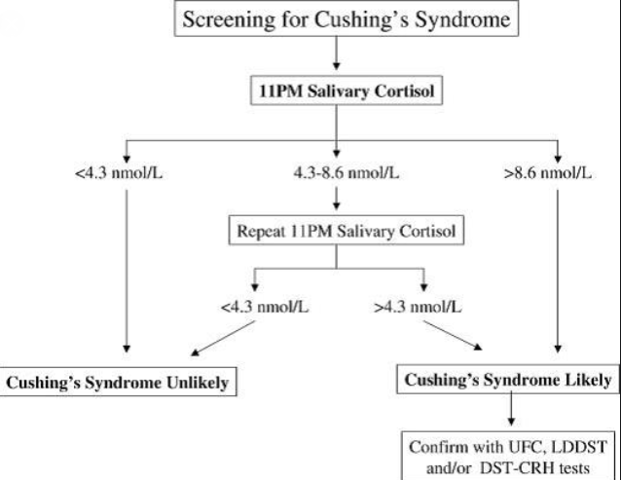
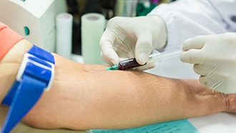


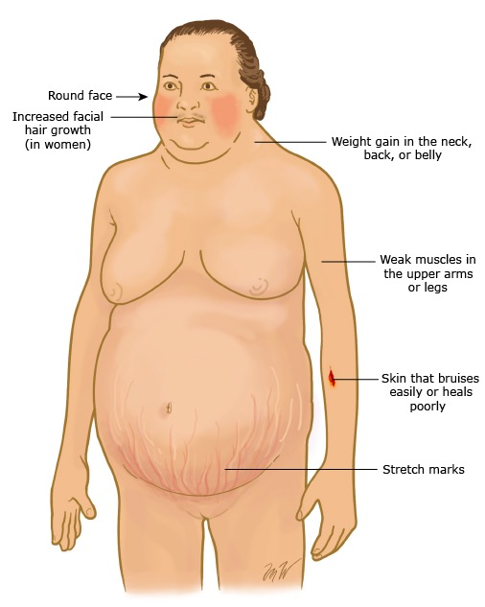


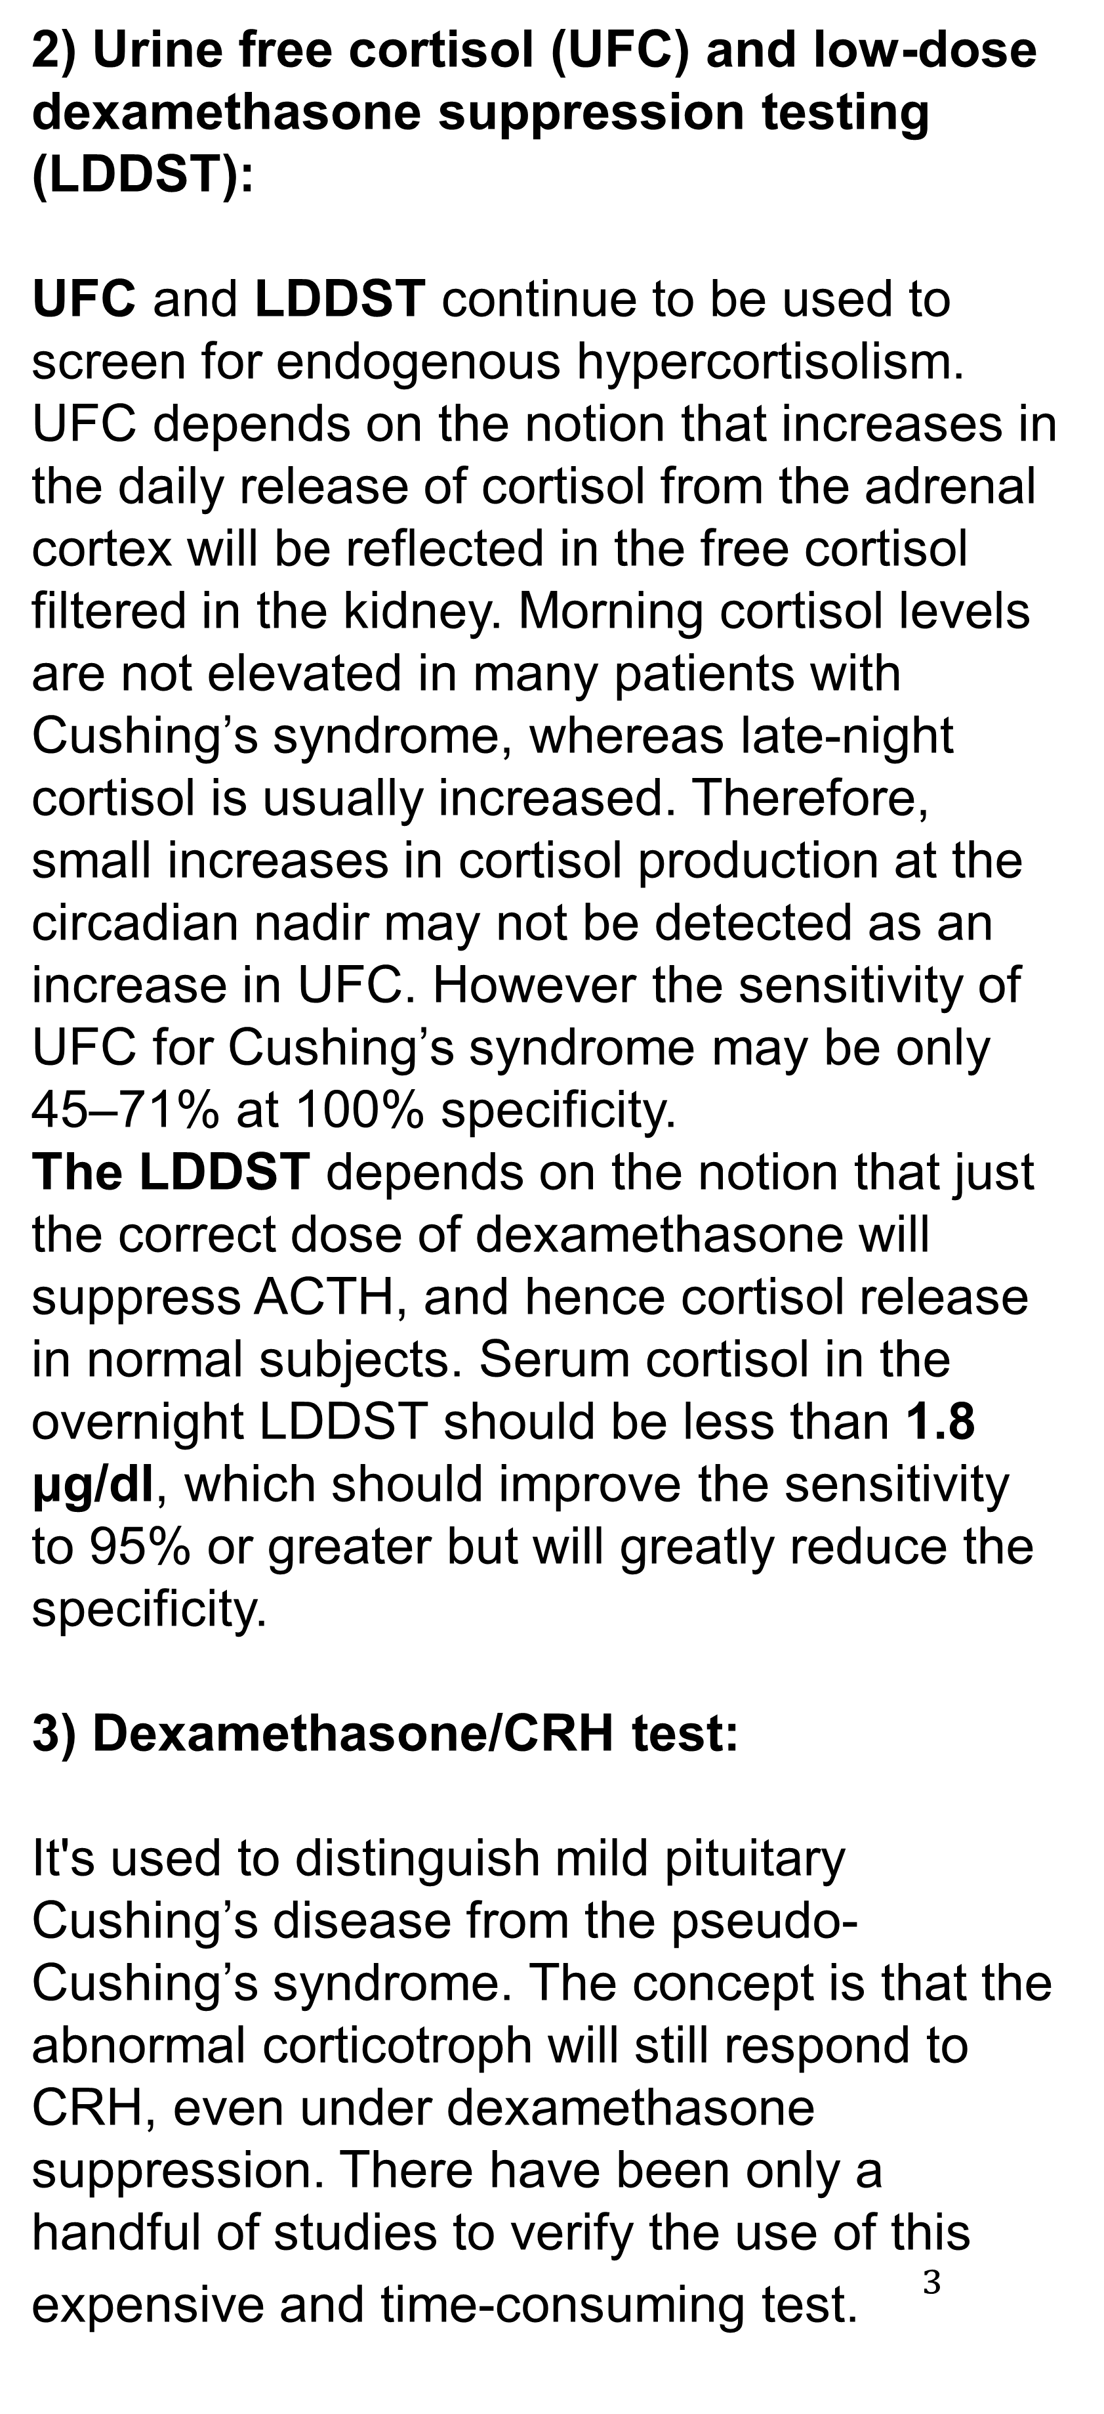

Who Should Be Screened for Cushing’s Syndrome, and What’s The Best Approach?
Liza Buhalfaya 2nd Year Medical Student
Faculty Of Basic Medical Science
Libyan International Medical University
Introduction
How patient should be screened
b
Late-night/midnight serum or salivary cortisol :
One of the earliest biochemical abnormalities in Cushing’s syndrome of any cause is the failure to fully suppress plasma cortisol at or near its late-night circadian nadir .an elevated late-night or bedtime salivary cortisol sampling is an excellent surrogate for increased midnight serum cortisol in the diagnosis of Cushing’s syndrome Late-night salivary cortisol has also been shown to be useful to identify patients with pseudo-Cushing’s syndrome. It's the best approach: it is simple, can be performed on patients with a very wide age range, has a sensitivity and specificity of greater than 90–95%.
.
Endogenous Cushing’s syndrome (hypercortisolism) is a rare condition that resembles many of the phenotypic features of the modern life: obesity, hypertension, and depression, which makes it difficult to be diagnosed. Once the diagnosis is made, the accurate differentiation of Cushing’s syndrome (CS) into its types is essential, for the appropriate treatment option to be selected. ${}^{1}$
Three diagnostic studies are currently recommended:
Late-night/midnight serum or salivary cortisol.
Urine free cortisol (UFC) and low- dose dexamethasone suppression testing (LDDST).
Dexamethasone/CRH test.
2) Urine free cortisol (UFC) and low-dose dexamethasone suppression testing (LDDST):
UFC and LDDST continue to be used to screen for endogenous hypercortisolism. UFC depends on the notion that increases in the daily release of cortisol from the adrenal cortex will be reflected in the free cortisol filtered in the kidney. Morning cortisol levels are not elevated in many patients with Cushing’s syndrome, whereas late-night cortisol is usually increased. Therefore, small increases in cortisol production at the circadian nadir may not be detected as an increase in UFC. However the sensitivity of UFC for Cushing’s syndrome may be only 45–71% at 100% specificity.
The LDDST depends on the notion that just the correct dose of dexamethasone will suppress ACTH, and hence cortisol release in normal subjects. Serum cortisol in the overnight LDDST should be less than 1.8 μg/dl, which should improve the sensitivity to 95% or greater but will greatly reduce the specificity.
3) Dexamethasone/CRH test:
It's used to distinguish mild pituitary Cushing’s disease from the pseudo-Cushing’s syndrome. The concept is that the abnormal corticotroph will still respond to CRH, even under dexamethasone suppression. There have been only a handful of studies to verify the use of this expensive and time-consuming test. ${}^{3}$
A simplified paradigm for screening patients for Cushing’s syndrome using late-night salivary cortisol.
Who should be screened ?
Conclusion
Signs and symptoms that warrant a screening test for CS include:${}^{2}$
Moon facies.
Buffalo hump.
Muscle weakness.
Thinning skin.
Abdominal striae.
Immune suppression.
Depression.
Confirmatory tests
The diagnosis of Cushing’s syndrome is the most challenging problem in endocrinology, and may be difficult for even experienced endocrinologists. Measurement of late-night or bedtime salivary cortisol is a useful and simple approach to screen for Cushing’s syndrome.
References
Tran HA, petrovsky N 2014 difficulties in excluding cushing syndrome in obese subject. Endocrinologist 15-19.
Klatt, E., Kumar, V. and Robbins, S. (2010). Robbins and Cotran review of pathology. 8th ed. Philadelphia: Saunders/Elsevier.
Findling JW, Raff H 2005 Screening and diagnosis of Cushing’s syndrome. Endocrinol Metab Clin North Am 34:385–402.
This diagram shows the common clinical features of individuals with Cushing's syndrome.

