Slide 1


Libyan international medical university faculty of business administration
Definition of Ethics, Law and Morality Sense
Alaa said Rashwan
ID:3313

Slide 2
content:
Introduction
Definition of Ethics
Definition of law
Definition of morality sense
The Differences between Ethics, Law and morality sense
Conclusion
Reference

Slide 3
Objective:
What is definition of ethics,law and morality sense.

Slide 4
Introduction:
Business ethics deals with the application of moral standards in the business environment. Morals are judgments and rules of good conduct in the society, while law is rule of conduct developed by government or society.

Slide 5
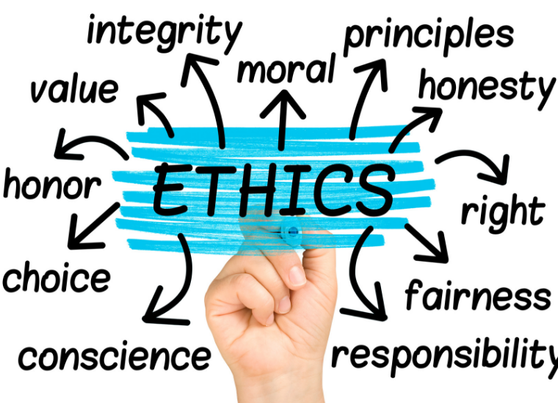
Definition of Ethics:
Ethics is based on well-founded standards of right and wrong that prescribe what humans ought to do, usually in terms of rights, obligations, benefits to society, fairness, or specific virtues.
Ethics also called moral philosophy.

Slide 6
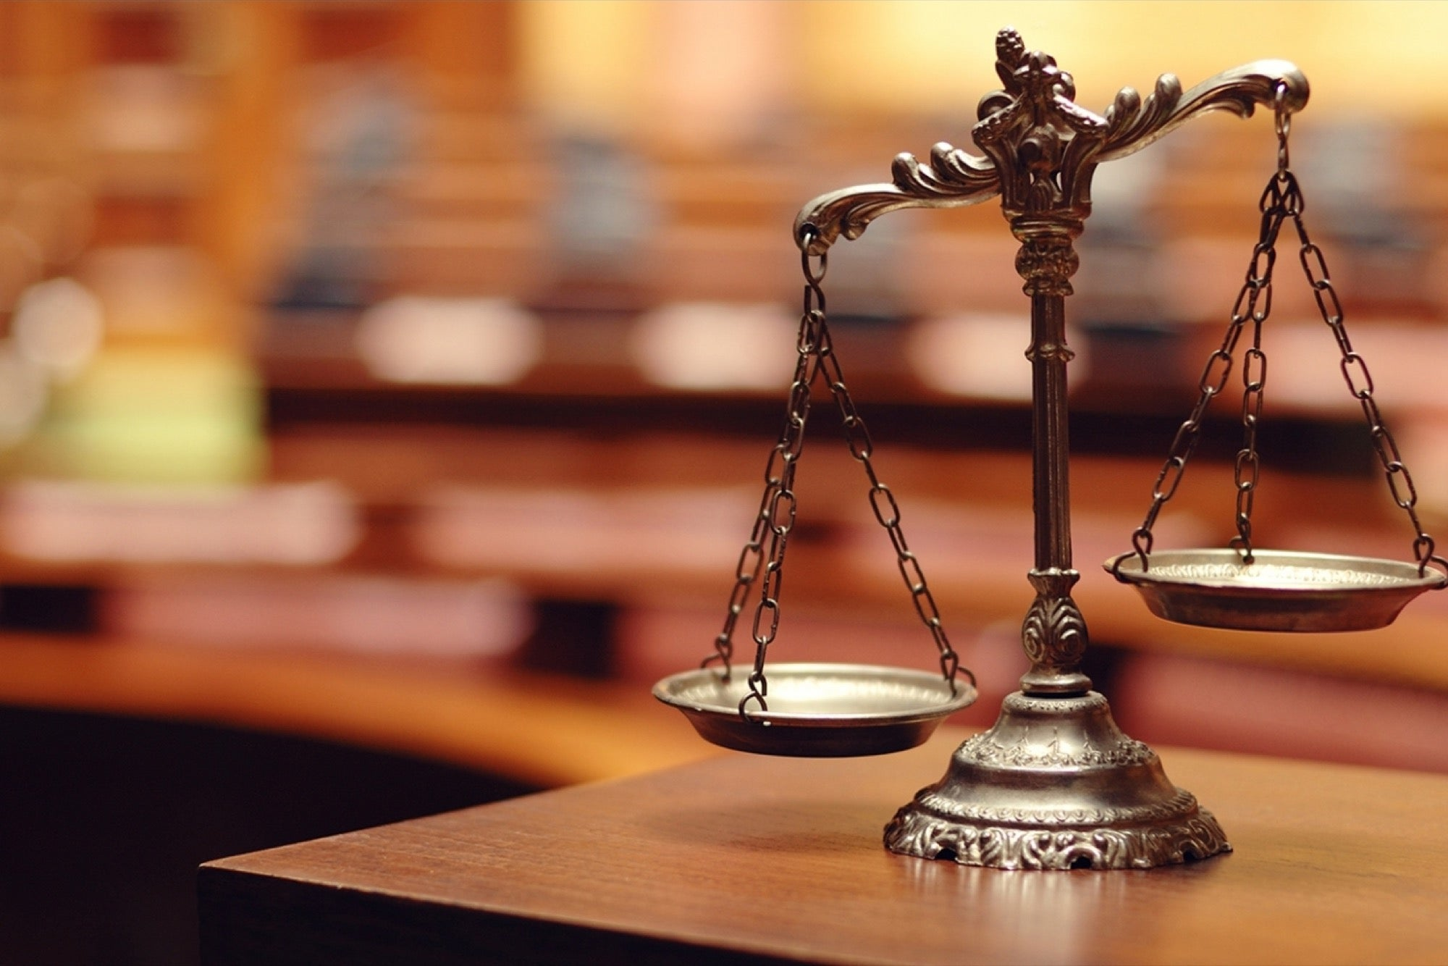
Definition of Law
The law is a system of rules that a society or government develops in order to deal with crime, business agreements, and social relationships. You can also use the law to refer to the people who work in this system.

Slide 7
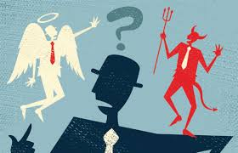
Definition of Morality Sense:
concern with the distinction between good and evil or right and wrong; right or good conduct.
For example:Your sense of morality prevents you from cheating on your school exams, on your taxes, or on your spouse.

Slide 8
The Differences Between Ethics,Law and Morality sense:
Ethics is the moral principles that govern a person's behavior or the conducting of an activity. Morals are concerned with the principles of right and wrong behavior and the goodness or badness of human character. Law is the system of rules that a particular country or community recognizes as regulating the actions of its members and may enforce by the imposition of penalties.

Slide 9
Conclusion:
Morality governs private, personal interactions. Ethics governs professional interactions. Law governs society as a whole, often dealing with interactions between total strangers.

Slide 10
Reference:
Mujtaba, B. B. (2015, November 19). Understanding ethics and morality in business.
Introduction to law - TOPPR-guides. (n.d.).
University, S. C. (n.d.). What is ethics? Markkula Center for Applied Ethics.
HarperCollins Publishers Ltd. (n.d.). Law definition and meaning: Collins english dictionary. Law definition and meaning.
Perez, D. A. (2021, February 9). Ethics vs morals vs law. LinkedIn.

