Slide 1


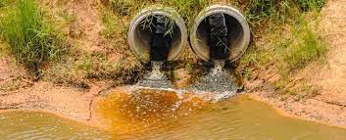
Lead pollution
St. Name:Marwan Dougman
St. Nom:3068
Block:PTS
Y2 med student
24th–May-2022
1

Slide 2
Objectives:
  Discussion about lead
1
  Discussion about Lead pollution.
2
3
Discussion about lead poisoning
  Discussion about the Prevention
4
2

Slide 3

Introduction:
3

Slide 4
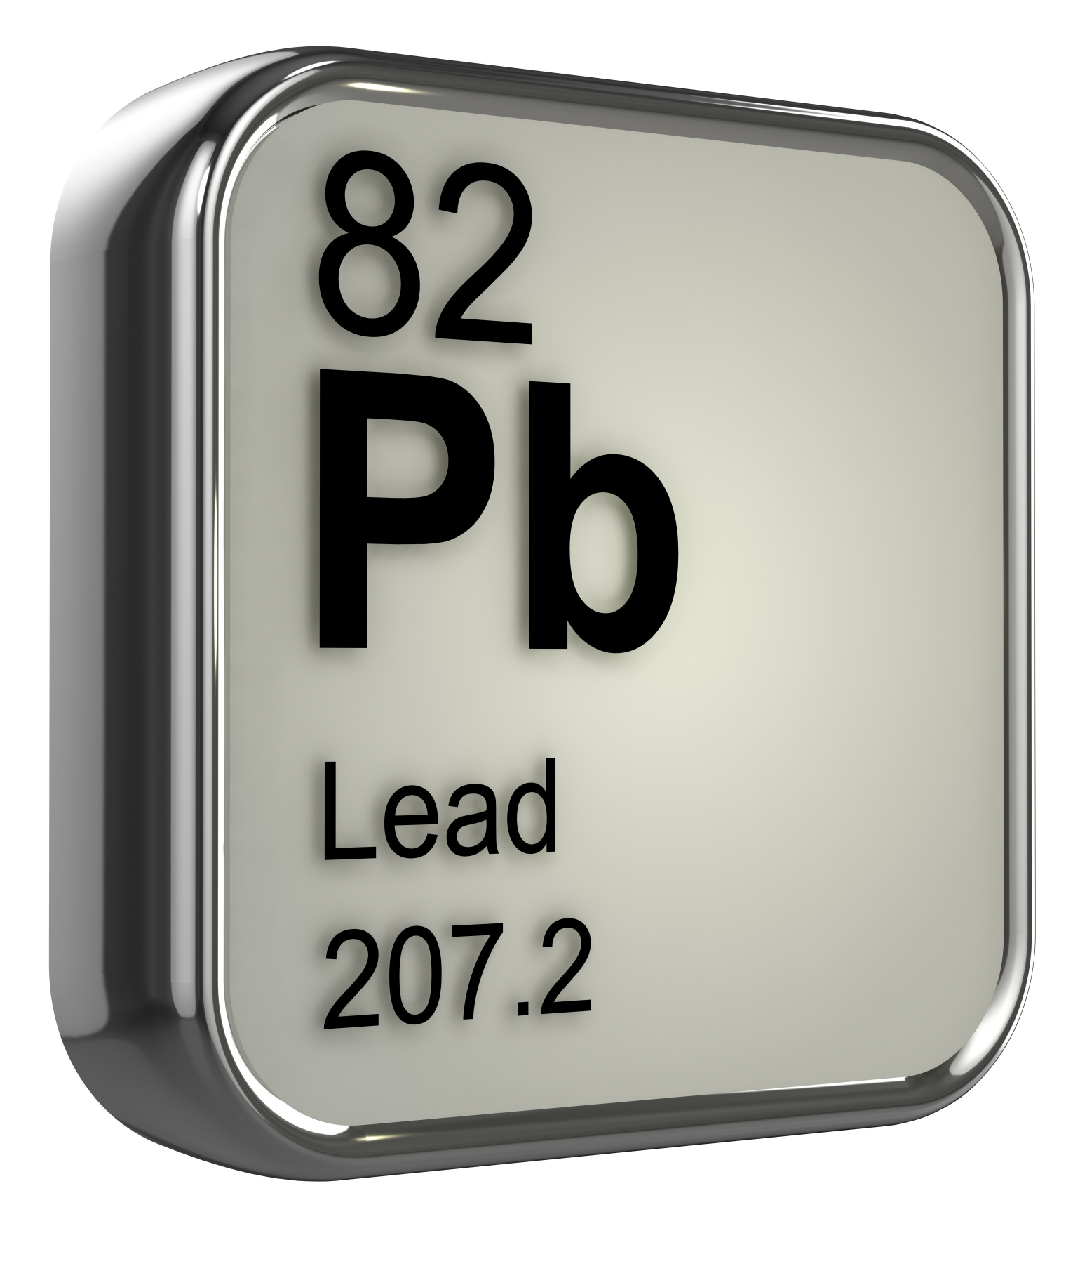
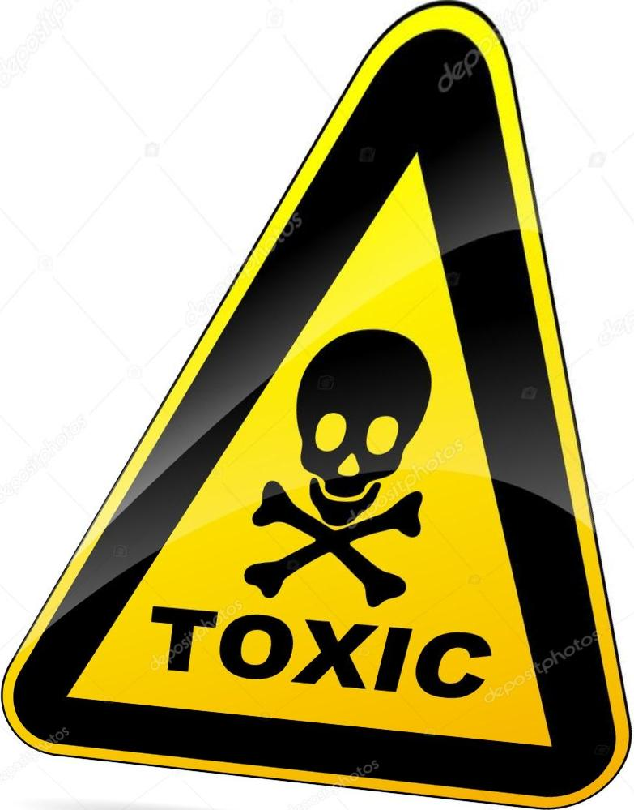



Lead {Pb}
1854
1921
500 BC-300 AD
1970s
1985
6500BC
4

Slide 5
Lead features
Very soft, highly malleable
Blueish-white shiny color
Poor conductor of electricity
Sweety in taste
5

Slide 6
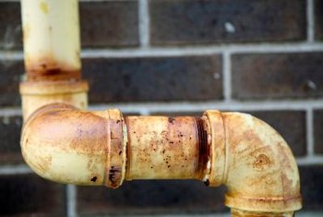
Where can find the lead
Gasoline
Pipes
Old painting
Non-European
Makeup
1978
Batteries
Certain sweets from Mexico
6

Slide 7
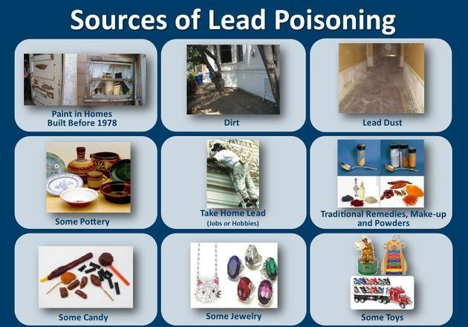
7

Slide 8
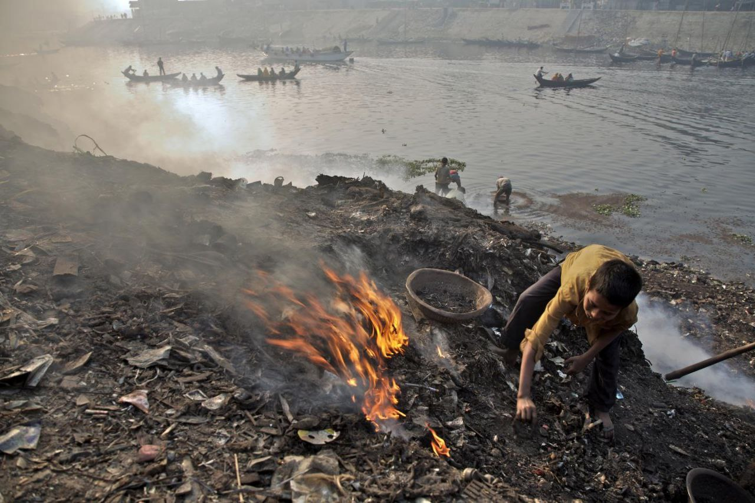
8

Slide 9
Lead pollution
Cities roads
Burning wastes
War wastes
Mnufactories waste productes
Old houses
9

Slide 10
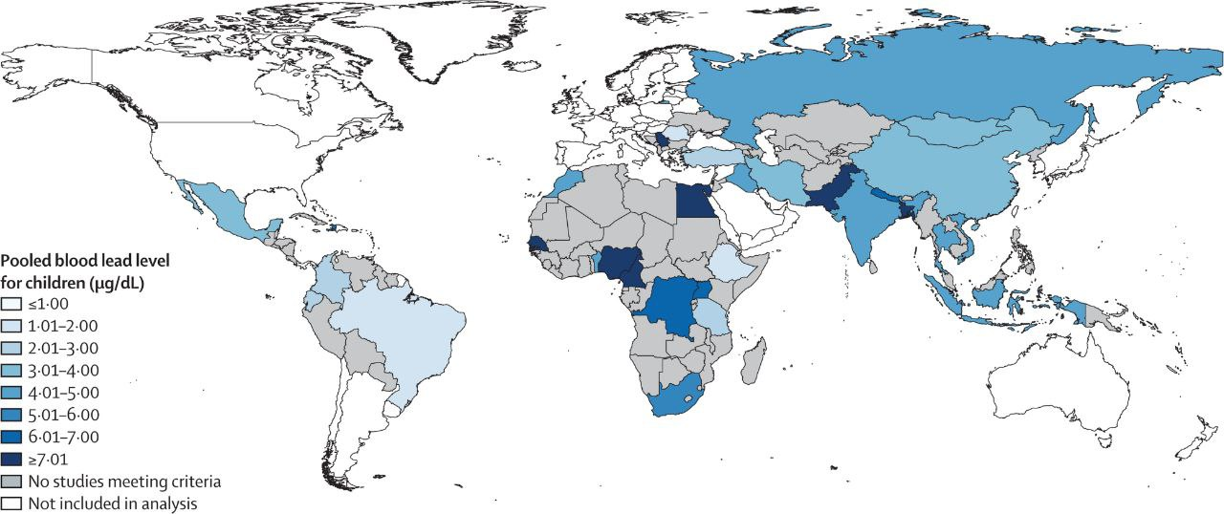
10

Slide 11
Libyan study found the concentration of lead on soil in Janzor in 2013
0.137 ,0.222 & 4.490 p.p.m
Lead occurs naturally in soils, typically at concentrations that range from 10 to 50 p.p.m
Because of the widespread use of leaded paint before the mid-1970s and leaded gasoline before the mid-1980s
11

Slide 12
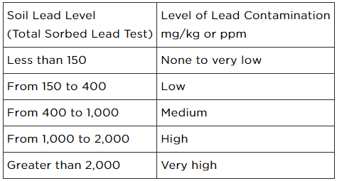
12

Slide 13
Lead poisoning
-Its serious and fatal .
-Causing marked brain damage.
-lead can be absorbed via skin.
-The blood levels should be near ZERO.
-Lead accumulates in our bones, liver, and kidneys and can get into our blood.
Half-life Of Lead - 25 DAYS: BLOOD.
40 DAYS:SOFT TISSUE.
20 YEARS:BONE
13

Slide 14
Acute exposure
Chronic exposure
Anemia
Abdominal pain
Constipation
Vomiting
Decreased appetite
Death
Severe damage to the brain and kidneys
Reproductive system damage
Increased blood pressure
Anemia
14

Slide 15



Preventi n
Remove the old paint
Avoid inhale the waste products
Pb
Enforce a clean hands
Keep the agriculture crops away from the roads
15

Slide 16
Conclusion
The lead is one of the most dangerous element
  Due to it’s fatal effect & because it is hide in our life & we are not aware
It don’t has a certain treatment ,but we can take preventing procedures.
Check the product before buy it .e.g.by put the name of product on [EWGs skin deep]
16

Slide 17
References:
Mayo Clinic. 2022. Lead poisoning - Symptoms and causes. [online] Available at: <https://www.mayoclinic.org/diseases-conditions/lead-poisoning/symptoms-causes/syc-20354717> [Accessed 24 May 2022].
Basic Information about Lead Air Pollution | US EPA [Internet]. US EPA. 2022 [cited 24 May 2022]. Available from: https://www.epa.gov/lead-air-pollution/basic-information-about-lead-air-pollution
Lead [Internet]. Lung.org. 2022 [cited 24 May 2022]. Available from: https://www.lung.org/clean-air/at-home/indoor-air-pollutants/lead
Why Are Lead Pipes Not Used in Plumbing Anymore? [Internet]. Home Guides | SF Gate. 2022 [cited 24 May 2022]. Available from: https://homeguides.sfgate.com/lead-pipes-not-used-plumbing-anymore-87354.html
Why Are Lead Pipes Not Used in Plumbing Anymore? [Internet]. Home Guides | SF Gate. 2022 [cited 24 May 2022]. Available from: https://homeguides.sfgate.com/lead-pipes-not-used-plumbing-anymore-87354.html
بحث [Internet]. Search.mandumah.com. 2022 [cited 24 May 2022]. Available from: https://search.mandumah.com/Record/769889
Lead (Pb) - Chemical properties, Health and Environmental effects [Internet]. Lenntech.com. 2022 [cited 24 May 2022]. Available from: https://www.lenntech.com/periodic/elements/pb.htm#:~:text=Lead%20is%20a%20bluish%2Dwhite,tarnishes%20upon%20exposure%20to%20air.
11. Lead in Residential Soils: Sources, Testing, and Reducing Exposure [Internet]. Penn State Extension. 2022 [cited 24 May 2022]. Available from: https://extension.psu.edu/lead-in-residential-soils-sources-testing-and-reducing-exposure#:~:text=Lead%20occurs%20naturally%20in%20soils,of%20soil%2C%20or%20ppm).
16

Slide 18


