Slide 1

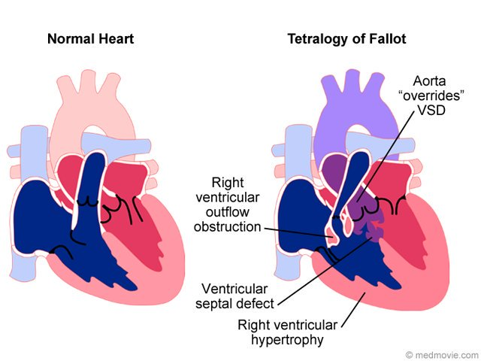
My Baby Looks Blue! Is This Sign Of Serious Health Issues?
Retaj Ramadan Alfaitory 2nd Year Medical Student
Faculty Of Basic Medical Science
Libyan International Medical University
Introduction
Conclusion
Add your information, graphs and images to this section.
Add your information, graphs and images to this section.
Add your information, graphs and images to this section.
Add your information, graphs and images to this section.
Blue baby syndrome, is termed used to describe infants with cyanosis, or blue-tinted skin. The condition develops when the organs, cells and tissue do not receive adequate oxygen, and the tissue begins to turn blue in color instead of pink, and this indicated poor oxygen level, the infants presented with skin discoloration, breathing difficulty and Failure to thrive (2).
Many reasons cause blue baby syndrome, which is a condition of decrease level of oxygen in infants characteristic in change of tissue from pink to blue
References
1. . Reference G. Methemoglobinemia, beta-globin type. Genetics Home Reference.https://ghr.nlm.nih.gov/condition/methemoglobinemia-beta-globin type#definition …. Published 2019. Accessed March 8, 2019 .
2. . Blue Baby Syndrome. http://Bhia.org . http://www.bhia.org/articles/childrens-health/bluebabysyndrome.html …. Published 2019. Accessed March 8, 2019
Add your information, graphs and images to this section.
Pathogenesis of methemoglobinemia
Causes
Methemoglobinemia, beta-globin, it alters a molecule called hemoglobin within n red blood cells hemoglobin, within red blood cells attaches to oxygen molecule in the lungs , which it carries through the bloodstream then releases in tissues throughout the body . in Methemoglobinemia beta-globin type , the abnormal hemoglobin gives the blood brown color .
1.Tetralogy of fallot .
2.Methemoglobinemia .
3. Other congenital heart defect
Add your information, graphs and images to this section.

