Slide 1
GLAUCOMA by DR. HALA A BUZAKOUK

Slide 2
CONTENTS
1.Anatomy and physiology of aqueous production , outflow
and IOP
2.Clinical evaluation and instruments
3.Primery glaucoma
4.Secondary glaucoma
5.Primery congenital glaucoma
6.Glaucoma medication

Slide 3
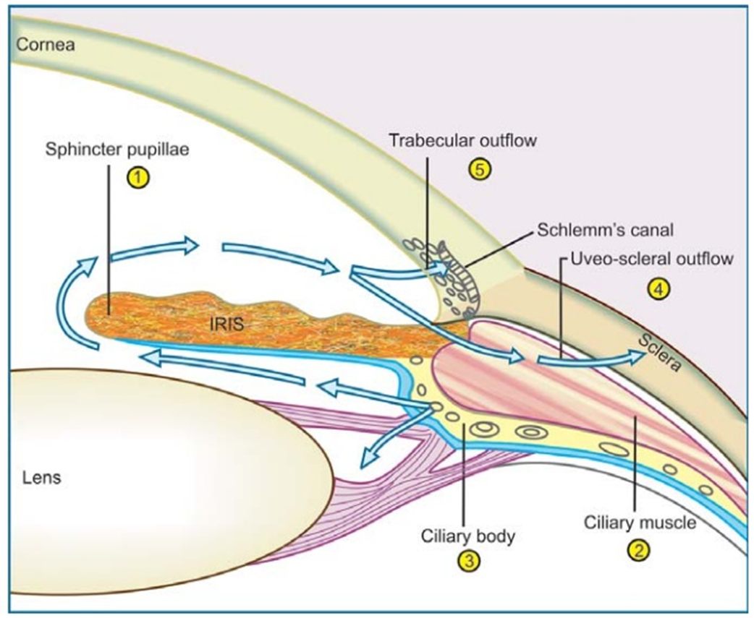
Anatomy and physiology

Slide 4
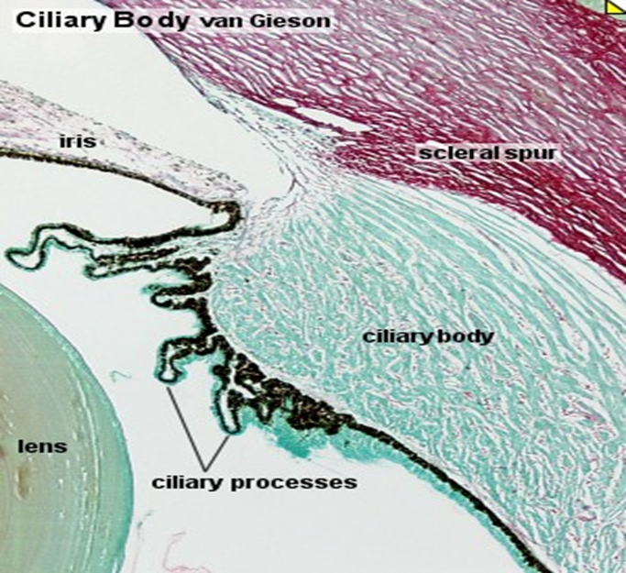
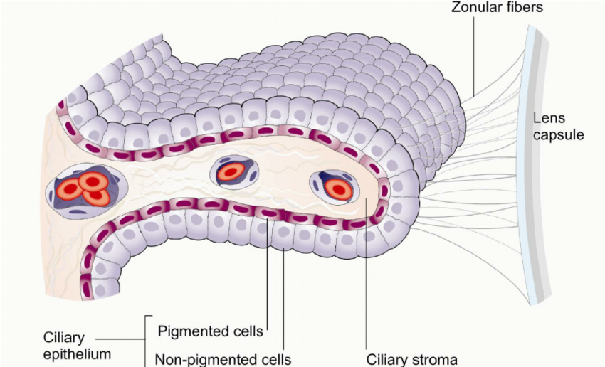
Aqueous secretion
Ciliary body - Pars-plicata
70 radially oriented ciliary processes

Slide 5
Aqueous secretion
by 2 mechanisms:
1. Active secretion
By non-pigmented ciliary epithelium
Na⁺ / K⁺ ATPase pump
Independent of IOP level
2. Passive secretion
Ultrafiltration and diffusion
Depends on level of IOP
Conditions causing hyposecresion
Drugs :
betablockers,sympathomim-etics, CI inhibitors
Ciliary body shutdown
CB detachment
Iridocyclitis
Retinal detachment
Cyclodesructive procedures
cyclocryotherapy

Slide 6
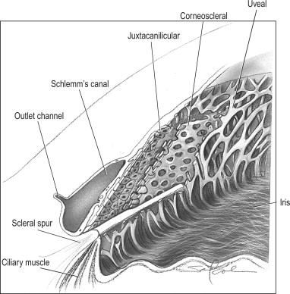
Aqueous outflow
1.Trabecular meshwork 90%
uveal
corneoscleral
juxtacanalicular
2.Schlemm canal

Slide 7

Aqueous outflow
Trabecular( conventional) Uveoscleral( unconventional)
90% 10%
Schlemm canal suprachoroidal space
Drained by Drained by venous
Episcleral veins circulation In CB,choroid, sclera

Slide 8
INTRAOCULAR PRESSURE IOP
Normal range of IOP 11-21 mmHg
< 21 mmHg with glaucomatous damage
NORMAL TENSION GLAUCOMA
> 21mmHg without detectable glaucomatous damage
OCULAR HYPERTENSION / GLAUCOMA SUSPECT
IOP is determined by the rate of aqueous secretion and rate of outflow.
IOP varies with the time of day , heartbeat, blood pressure, respiration.
Diurnal variation:
higher in the morning lower in the afternoon & evening
a mean diurnal pressure variation of 5 mmHg ( higher fluctuation in
glaucoma & ocular hypertension and same in normal tension G)
In clinic , morning hours may be sufficient

Slide 9
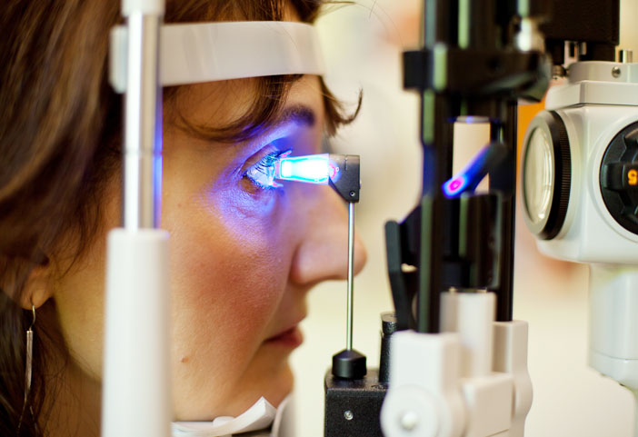
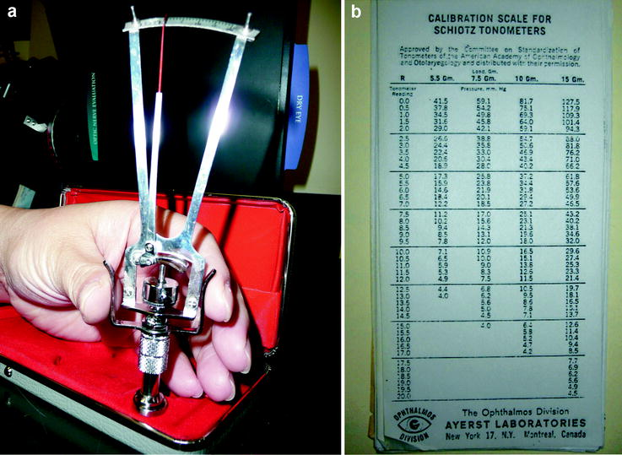
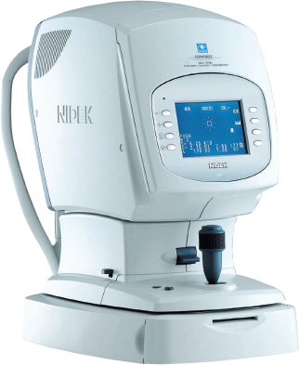
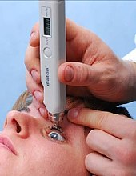
TONOMETRY
measures the IOP
Applanation tonometer
Goldmann
Schoitz tonometer
indentation
Handheld tonometer
Tonopen
Automated tonometer
Non-contact

Slide 10
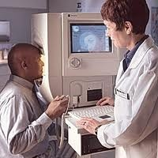
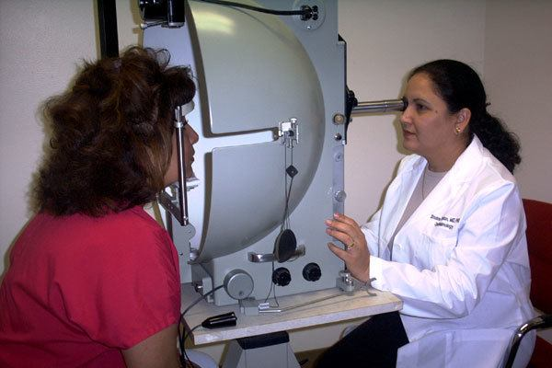
PERIMETRY
detects visual field defects
Automated perimetry
Manual perimetry

Slide 11
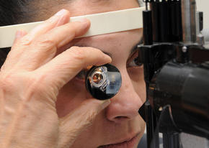
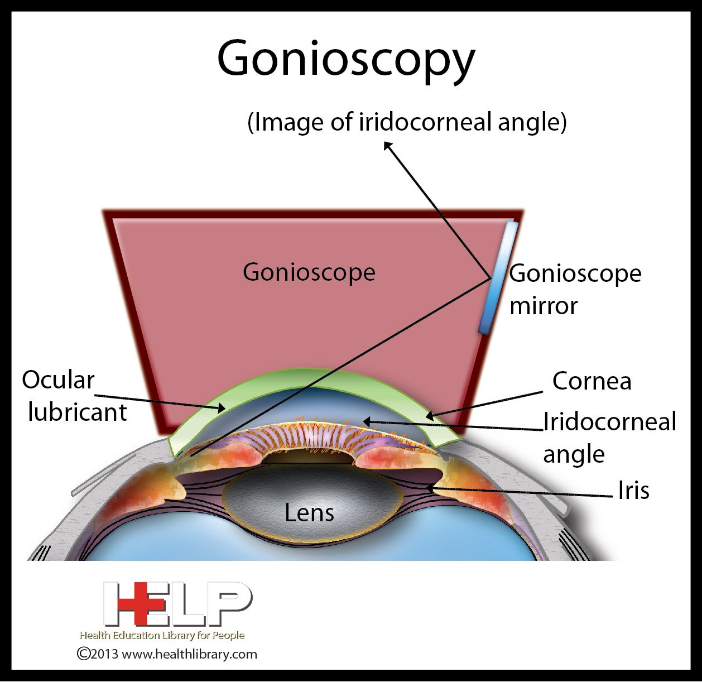
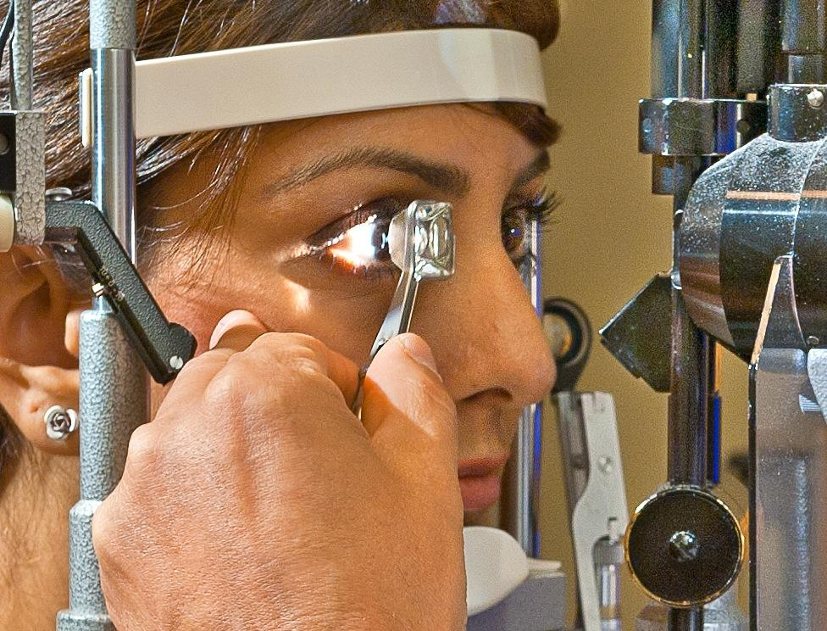
Gonioscopy
Examine structures of AC and grading
by Goniolens

Slide 12
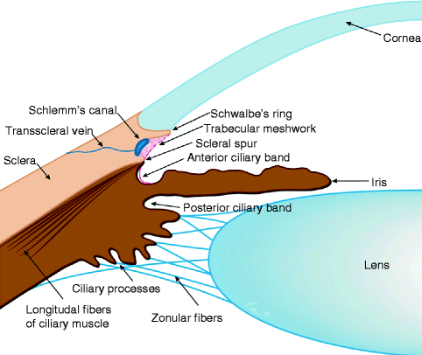
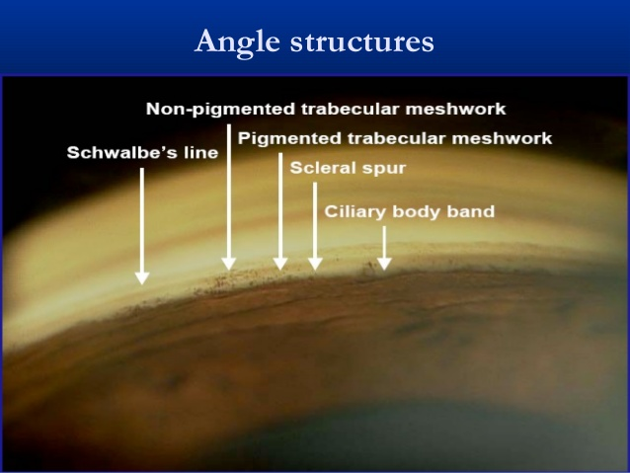
Sructures of angle of AC as seen by Goniolens

Slide 13
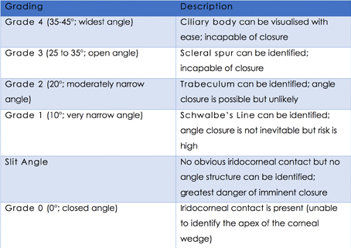
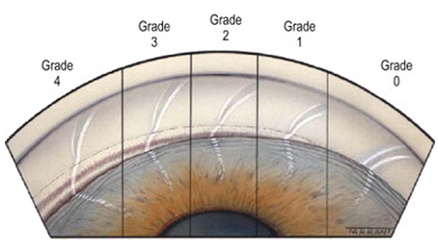
SHAFFER SYSTEM
grading of AC angle

Slide 14
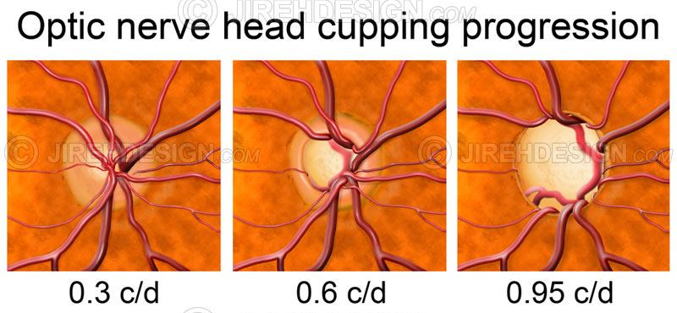
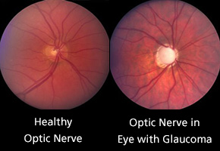
Funduscopy

Slide 15
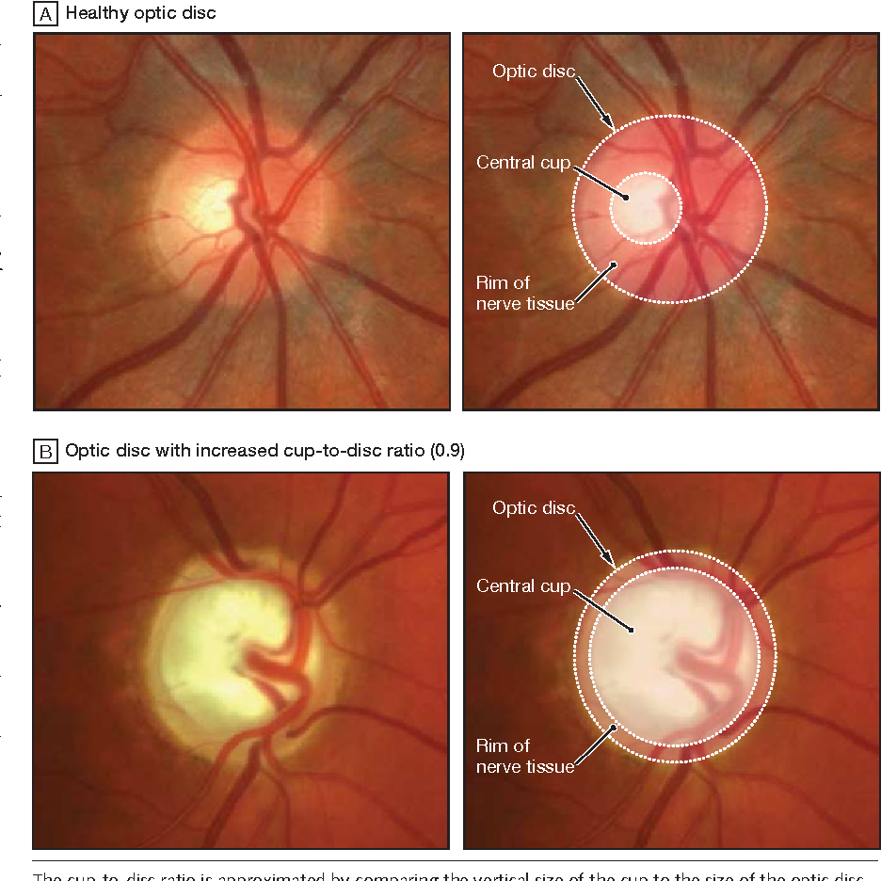

Slide 16
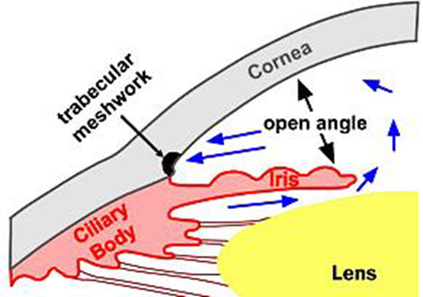
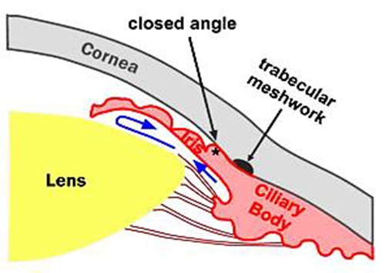
Primery glaucoma
Definition
Is a disease which exhibits a characteristic optic neuropathy which may result in progressive visual field loss.
Open angle glaucoma
Closed angle glaucoma

Slide 17


Primery open angle glaucoma
Is a neurodegenerative disease of optic nerve, characterized by
accelerated ganglion cell death
subsequent axonal loss
optic nerve damage
eventual visual field loss
Criteria
Adult
IOP > 21mmHg
Glaucomatous optic n head damage
Open angle normal
Visual field loss

Slide 18
Risk factors
Age > 65yrs.
Race: black
Family history: POAG is inherited and has genetic basis
Diabetes mellitus
Reduction of perfusion pressure
Myopia
Retinal diseases : central retinal vein occlusion, rhegmatogenous RD 5%, retinitis pigmentosa 3%
Steroid responsiveness mainly with use of topical
?Genetic
Systemic steroids ?

Slide 19
Diagnosis and evaluation
1. V/A and refraction
2.Slit-lamp biomicroscopy
3.Applanation tonometry for Raised IOP
Diurnal fluctuations in IOP 5 mmHg in 30% of normal
Fluctuation is exaggerated in 90% of POAG
Asymmetry of IOP between two eyes > 5mmHg is significant
4.Fundus examination for Optic nerve damage
5.Perimetry for Visual field changes
6.Gonioscopy normal open angle

Slide 20
Pathogenesis of glaucomatous damage
Ischemic theory Direct mechanical theory
Compromise of the microvasculature Raised IOP directly damages
with resultant ischemia of optic head the retinal nerve fiber

Slide 21
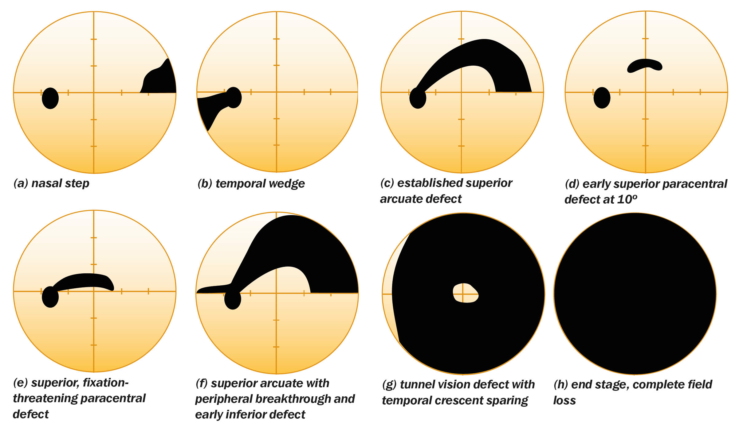
Visual field defects in POAG

Slide 22
Treatment
Target pressure
An IOP level is identified below which further damage is considered unlikely
Monitoring of optic nerve and visual field stable
Drugs Beta blockers or prostaglandin analogue
4 wks follow up
Failure inappropriate target pressure
non-compliance with therapy
wide fluctuation in IOP

Slide 23
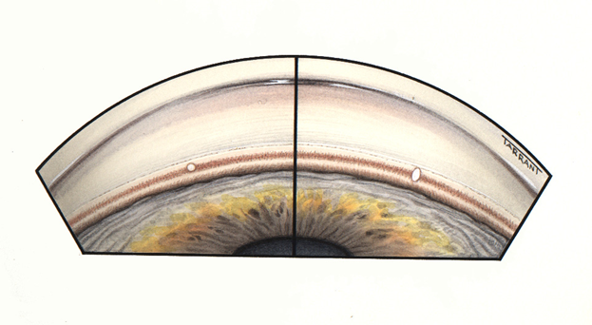
LASER TRABECULOPLASTY
Discrete argon or diode laser burns are applied to the trabeculum to enhance aqueous outflow and lower IOP
Transient effect
IOP reduction seldom > 30%
Indications:
Avoidance of polypharmacy
Avoidance of surgery
in elderly pts
in black pts ( filteration surgery poor prognosis)
Primery therapy in non-compliance pts with medical therapy
IOP
> 28 mmHg ?? L T

Slide 24
TRABECULECTOMY
Indications
1.Failed medical therapy and / ALT
2.Unsuitability for laser therapy
uncooperative pts / poor visualization of trabeculum
3. Advanced disease requiring low target pressure

Slide 25
NORMAL TENSION GLAUCOMA
Is a variant of POAG
Characterized by
A mean IOP ≤ 21mmHg on diurnal variation
Glaucomatous optic nerve damage and visual field loss
Normal open angle on gonioscopy
Absence of secondary causes for optic n damage
Risk factors:
Age: older
Gender: F> M 2:1
Race: more in japan
Family history : genetic
Diagnosis
IOP ↓
Optic n head damge
Visual field defects

Slide 26
Associated with:
Peripheral vascular spasm and cooling Raynaud phenomenon
Migrain
Nocturnal systemic hypotension
Reduced blood flow velocity in the ophthalmic and posterior ciliary arteries ( colour Doppler imaging)
Paraprotienemia and presence of auto-antibodies
Monitering with perimetry 4-6 months before starting treatment
Why? In some pts the visual field loss is non-progressive
So treatment not required

Slide 27
TREATMENT
Beta-blocker /prostaglandin analogues
Trabeculolectomy in progressive field loss
Monitoring of systemic blood pressure

Slide 28
OCULAR HYPERTENSION GLAUCOMA SUSPECT
IOP consistently > 21 mmHg with no optic nerve damage or visual field changes.
Risk factors
1. IOP > 28 mmHg
2. Diurnal variation significant > 8 mmHg
3. Central corneal thickness < 555micro
4. Cupping difference between BEs > 0.2
5.Associated with: Splinter hemorrahge
Peripapillary atrophy
Retinal nerve fiber defect

Slide 29
6.Associated with
High myopia , diabetes , pigmentary changes in AC
7. Strong family history of glaucoma
Treatment
With high risk factors : start treatment ( aim to reduce IOP by 20%)
With no high risk factors
Annually follow up
IOP record
optic disc any glaucomatous damage start
perimetry treatment

Slide 30
PRIMERY ANGLE CLOSURE GLAUCOMA
Anatomical predisposing factors
1.Lens size ↑ : with shallow AC 1.8mm in PACG
2.Corneal diameter ↓ : in PACG 0.25 mm smaller than normal
3.Axial length ↓: in short eye (hypermetropia)
PACG
In anatomically predisposing eyes, an elevation of IOP as
a consequence of obstruction of aqueous outflow by occlusion of
trabecular meshwork by peripheral iris.
Normal AC depth ?

Slide 31
Risk factors
1.Age: 60yrs
2. Gender : F>M 4:1
3.Race : coucasians /south-east Asian but rare in blacks
4.Family history :in 1st degree relatives

Slide 32
Classification of PACG
5 overlapping stages:
1. Angle closure suspect
2. Intermittent(subacute)angle closure
3.Acute angle closure
4.Chronic angle closure:
is caused by gradual and progressive synechial angle closure
5.Absolute angle closure :
is an end-stage of acute congestive/ blind eye

Slide 33
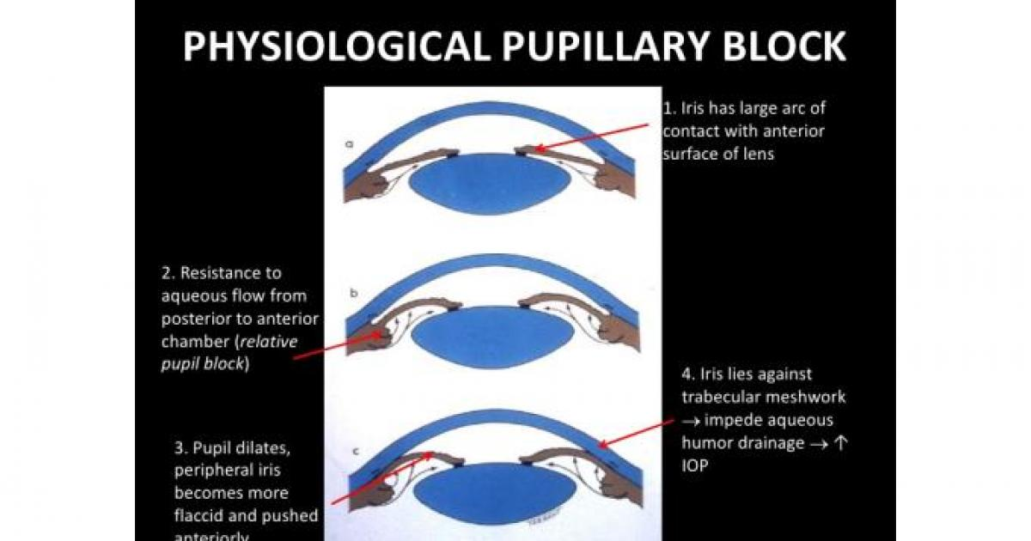
Angle closure suspect
Iris lens diaphragm is convex
Relative pupillary block physiological
AC depth is less than normal
Close proximity of iris to the cornea
Iris bomb’
Iridocorneal contact
Usually asymptomatic
Gonioscopy
Shaffer grade I or 0 occludable angle
Treatment
Prophylactic peripheral laser iridotomy
may be considered.
If an attack of ACG occurs , other eye should undergo the prophylactic

Slide 34
Intermittent subacute angle closure
Occurs in a predisposed eye with an occludable angle with intermittent pupillary block
Sudden rise in IOP then relief of pupillary block and the angle opens then IOP returns to normal
↙ ↘
physiological mydriasis in dark shallowing of AC in prone position
watching TV in reading
Symptoms
Transient blurring of vision with haloes around lights
Frontal headache / discomfort
Treatment prophylactic laser PI should be

Slide 35
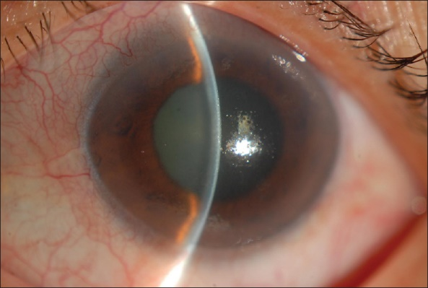
Acute congestive glaucoma
Sight threatening emergency
Sudden periocular pain with congestion and loss of vision
+/- nausea and vomting
Signs
Ciliary congestion circumcorneal
Corneal oedema
Shallow AC + aqueous cells & flare
Oval semi-dilated unreactive pupil
IOP ≥ 50 mmHg
Angle complete iridocorneal conact
(Shaffer grade 0)
Optic disc hypermic

Slide 36
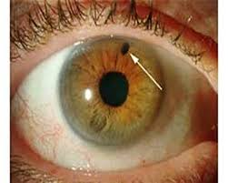
Treatment
1.Admission the patient
2.Supine positioning
3.analgesic / antiemetic
4.Intravenous I/V Diamox 500mg and orally
5.Intravenous mannitol 20% 1-2g/kg over 45 min
or oral glycerol 50% stat as a hyperosmotic
6.Topical drops:
timolol 0.5% b.d
prednislone q.i.d
pilocarpine 2% q.i.d after 1hr / 1% q.i.d to the fellow eye
7.Laser peripheral iridotomy ( Nd:YAG)
and prophylactic laser PI to fellow eye
Keeping check of IOP during treatment

Slide 37
Secondary glaucoma
Most common:
1.pseudoexfoliation glaucoma
2.pigmentary glaucoma
3.neovascular glaucoma
4.inflammatory glaucoma
5.Lens induced glaucoma
6.traumatic

Slide 38
PSEUDOEXFOLIATION GLAUCOMA
Elevated IOP due to secondary trabecular blockage by pseudoexfoliative deposits and/ or pigmentation
Chronic open angle glaucoma (in 7th decade)
Clinical features: seen in slides
a. PEX on pupillary margin
b. Sphincter iris atrophy (trans illumination defect)
c. Central disc with peripheral band of PEX on anterior lens surface
d. Gonioscopy shows patchy trabecular hyperpigmentation and deposits of PEX

Slide 39
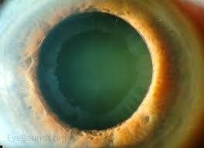
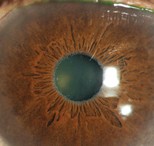
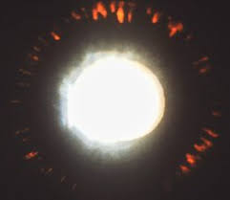
c
a
b

Slide 40
PIGMENTARY DISPERSION GLAUCOMA
Elevation of IOP caused by pigmentary obstruction of inter-trabecular spaces and damage to trabeculum
Chronic open angle glaucoma ( in 3rd to 4th decade)
Pigment dispersion syndrome:
a. Corneal endothelial pigment deposition in a vertical spindle-shape
distribution (Krukenberg spindle)
b. Deep AC due to posterior bowing of peripheral iris
c. Mid-periphery iris atrophy
radial slit-like transillumination defects
d. Gonioscopy shows wide open angle with trabecular hyperpigmentation

Slide 41
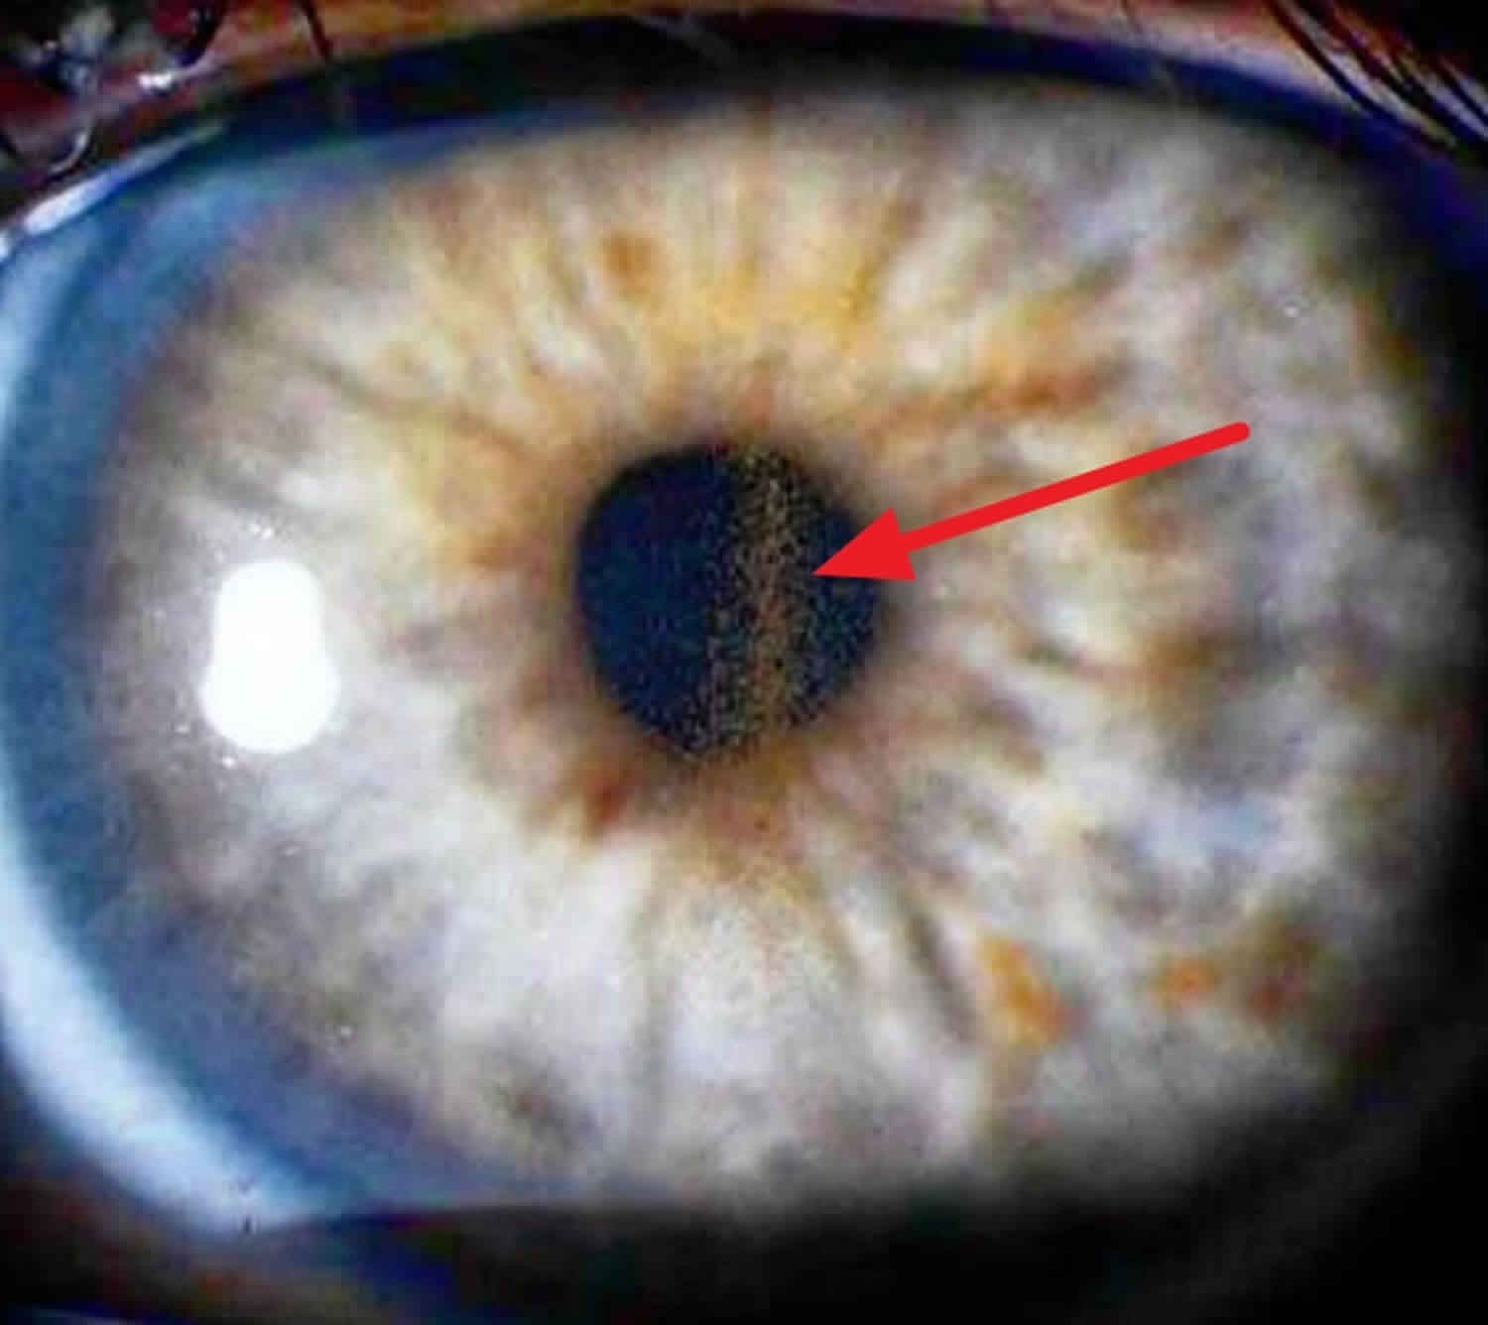
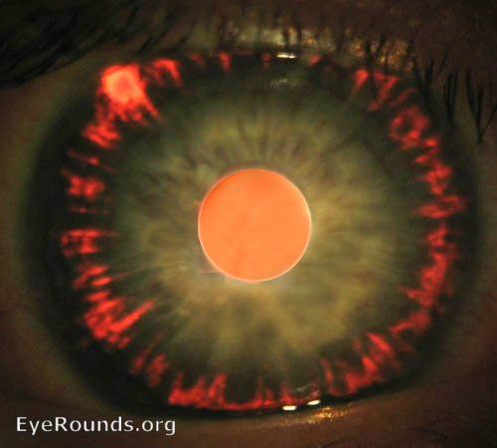
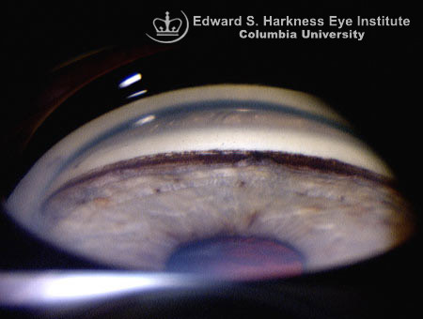
c
a
d

Slide 42
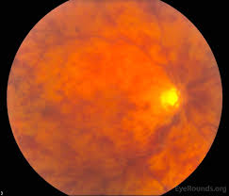
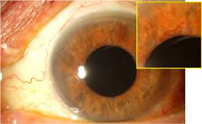
Prevented by laser photocoagulation of NV
Neovascular glaucoma
severe chronic retinal ischemia(hypoxia)
↓
produces vascular endothelial growth factor VEGF
↓
revascularize hypoxic areas by neovascularization
proliferative retinopathy, rubiosis iridis and neovascularization of AC
↙ ↘
early OAG later CAG
(impair aqueous out flow )

Slide 43
Causes of NVG
1. ischemic central retinal vein occlusion 36%
2. diabetes mellitus 32%
3. other causes : Central retinal artery occlusion
Carotid obstructive disease
Long-standing RD
Chronic intraocular inflammation
Intraocular tumours

Slide 44
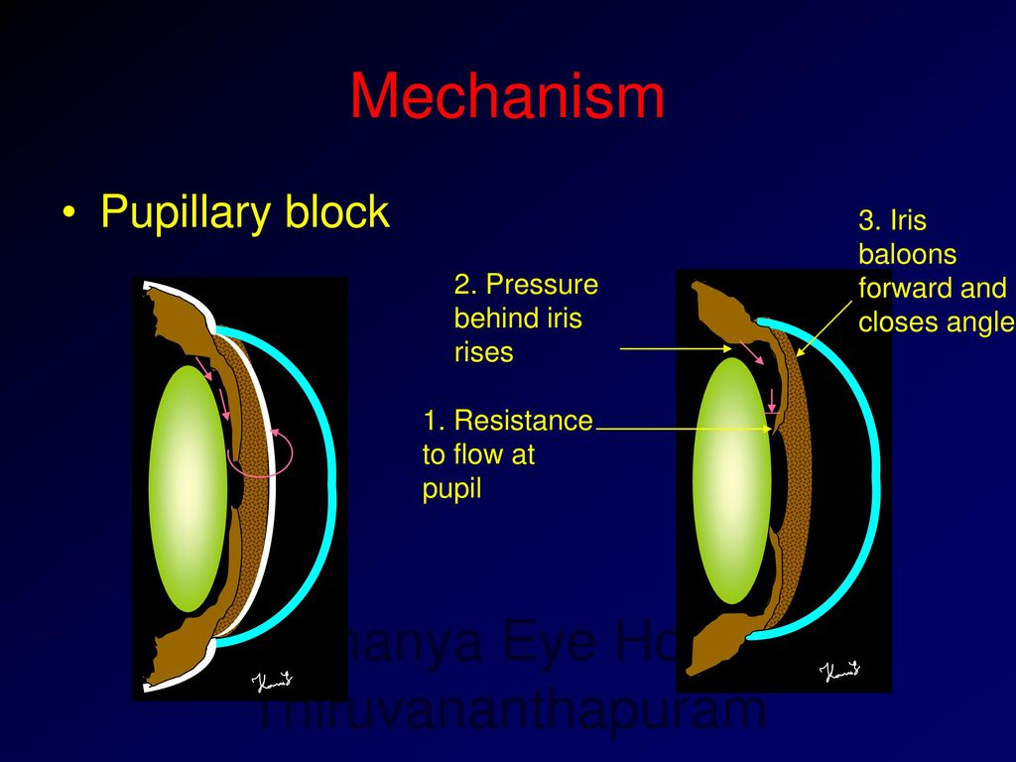
INFLAMMATORY GLAUCOMA
Elevation of IOP secondary to intraocular inflammation
Classification
1. angle-closure with pupil block
Seclusio pupillae → iris bomb’ → shallow AC → peripheral iridocorneal conact

Slide 45
2. angle- closure without pupil block
Secondary to deposition of inflammatory cells and depris the angle with subsequent organization and contraction and synechial angle closure PAS
AC angle is deep
3. Open angle glaucoma
Elevated IOP in:
acute anterior uveitis secondary to
trabecular obstruction by inflam cells and plasmoid aqueous or
acute trabeculitis
Chronic anterior uveitis secondary to trabecular sclerosis

Slide 46
4.Posner-Schlossman syndrome
Glaucomatocyclitic crisis
Recurrent attacks of unilateral, acute raise of IOP few hours to several days associated with mild anterior uveitis
Secondary open angle Glaucoma
Young adult / more in males
Signs
Corneal epithelial oedema / IOP 40-80 mmHg / few aqueous cells/ KPS

Slide 47
LENS INDUCED GLAUCOMA
1.Phacolytic glaucoma
In hypermature cataract, secondary OAG due to trabecular blockage by lens proteins containing macrophages that leaks through intact lens capsule
Phacoanaphylactic uveitis
Autoimmune granulomatous reaction to lens proteins with ruptured capsule in hypermature cat /post surgery / trauma

Slide 48
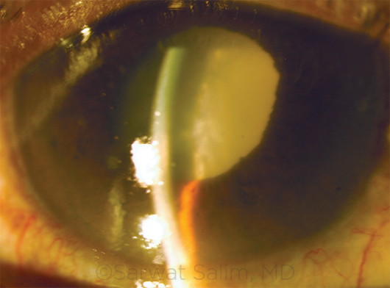
2.Phacomorphic glaucoma
Acute secondary angle closure glaucoma precipitated by an intumescent cataractous lens

Slide 49
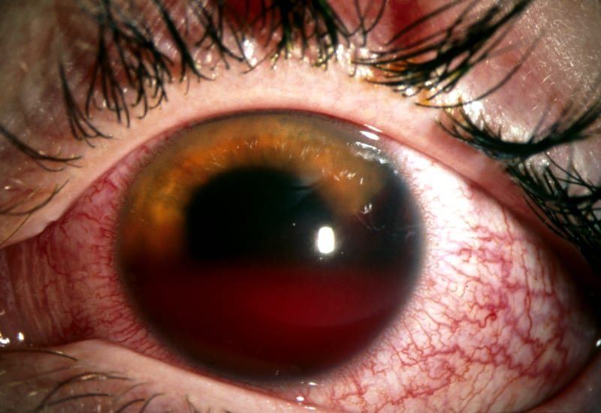
TRAUMATIC GLAUCOMA
1.Red cell glaucoma
A traumatic hyphema associated with elevation of IOP due to a trabecular blockage by red blood cells
2.Angle recession glaucoma
Unilateral chronic glaucoma secondary to rupture face of ciliary body
Between iris root and scleral spur gonioscopy
Associated signs of previous blunt trauma as sphincter rupture

Slide 50
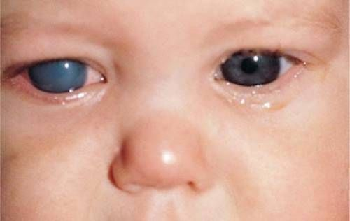
Primery congenital glaucoma
Sporadic / 10% inheritance is AR
1:10.000 births 65% are boys
Pathogenesis
Mal-development of the angle of AC unassocited with other major ocular anomalies isolated trabeculodysgenesis
Classification
True in which IOP becomes elevated during intrauterine life
Infantile which manifests prior to the third birthday
Juvenile which develops after third birthday but before 16yrs

Slide 51
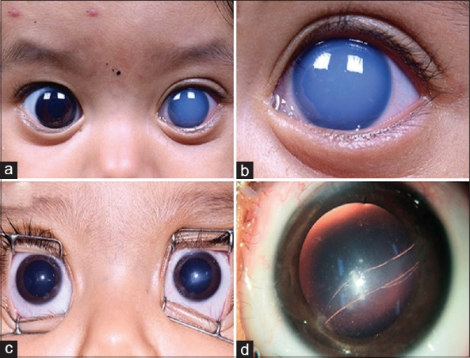
Signs
1.Corneal haze due to ↑ IOP (lacrimation/ photophobia/bleparospasm)
2.Buphthalmus
Large eye secondary to stretching due to elevated IOP causing thinning of sclera and a blue appearance of underlying uvea
3.Breaks in Descement membrane
Secondary to corneal stretching
Haab striae
horizontal curvilinear lines
represent healed breaks
4. Optic disc cupping
May regress once the IOP is normalized

Slide 52
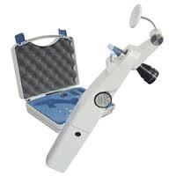
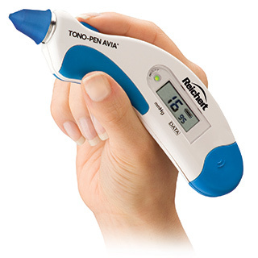
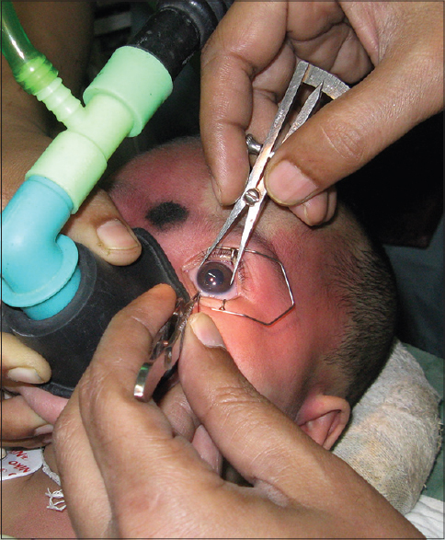
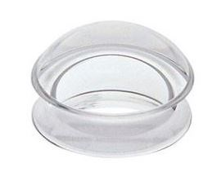
Manegment
Evaluation
Under general anesthesia
IOP Perkins tonometer / Tonopin
Corneal dimeter
measure vertical and horizontal meridians with calipers
>11mm prior to age of 1yr
>13mm at any age
Funduscopy
Gonioscopy
Direct goniolens
Koeppe lens →

Slide 53
Surgery
1. Goniotomty
At time of examination and diagnosis is confirmed
If cornea is clear and good visualization of the angle
2. Trabeculotomy
If cornea is cloudy
In failed goniotomy
3.Trabeculectomy
combined with antimetabolite

Slide 54
Differential diagnosis
1.Cloudy cornea at birth
Birth trauma
Intrauterine rubella
Metabolic disorders as mucopolysaccharidosis and mucolipidosis
Congenital heriditory endothelial dystrophy
2.Lacrimation due to delay canalization of nasolacrimal duct
3.Megalocornea or large cornea in high myopia

Slide 55
Secondary infantile glaucoma
causes
1.Tumors as retinoblastoma
2.Intraocular inflammation
3.Retinopathy of prematurity
4.Persistent anterior fetal vasculature
5.Trauma
6.Ectopia lentis

Slide 56
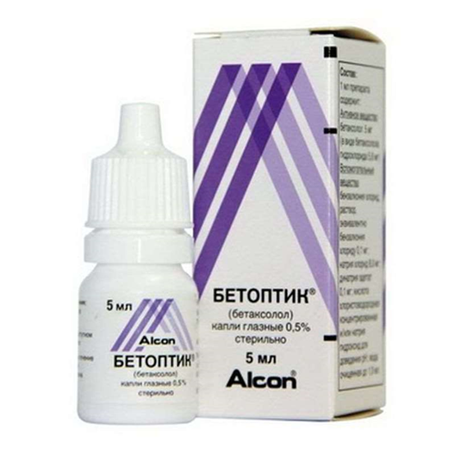
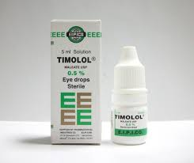
Medical treatment in glaucoma
1.Beta blockers :
reduce IOP by decreasing aqueous production
Side effects : bradycardia , hypotension, bronchospasm
Contraindicated in bronchial asthma , congestive cardiac failure, pulmonary obstructive disease
Non-selective
Timolol
Beta-1 selective
Betoptic

Slide 57
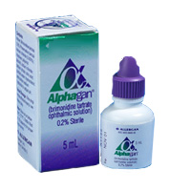
2.Alpha – 2 agonist :
decreases aqueous secretion via an effect on the ciliary epithelium, and increases uveoscleral outflow.

Slide 58
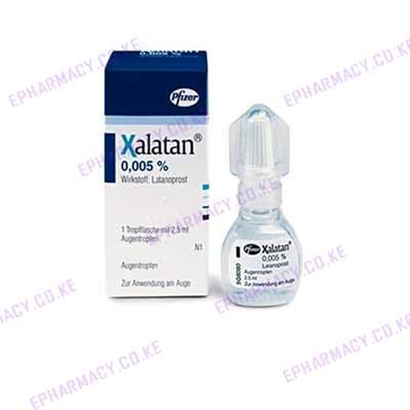
3.Prostaglandin analogues :
The major mode of prostaglandin (PG)action is the enhancement of
uveo-scleral aqueous outflow, although increased
trabecular outflow facility

Slide 59
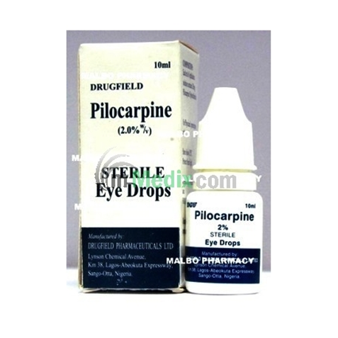
4.Miotics :
In POAG reduce IOP by contraction of the ciliary muscle, which increases the facility of aqueous outflow through the trabecular meshwork
In PCAG reduce IOP by contraction of sphincter pupillae and pulls peripheral iris away from trabeculum

Slide 60
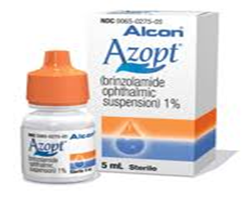
5.Carbonic anhydrase inhibitors :
They lower IOP by inhibiting aqueous secretion
Drops: single or in combination
Systemic : tablets oral / powder intravenous

Slide 61

Trabeculectomy
1.The pupil should be miosed
2.Conjunctinval flap
3.Superficial scleral flap
4.Deep Scleral block 1*2 mm
5.Peripheral iridectomy
6.Suture of scleral flap
7.Balanced salt solution is injected into AC to test patency of fistula or any leak through the flap
8.Suture of conjunctival flap

Slide 62
Thank you

