Slide 1



Covid_19 and Human Immunity
First year Applied Medical Science Student
Name Salma Abdullah Muhammed
ID: 3574
Block PTS
Date 2nd JUN 2022
Supervised by Dr Haneen Alshwaihdi

Slide 2
Objectives
1
Define Coronavirus disease (COVID-19)
Outline The Herd Immunity
Discuss The Immunity of Covid-19
Discuss The Emerging Treatment Strategies For Covid_19 Infection
2
3
4

Slide 3
Introduction
Coronavirus disease (COVID-19) is an infectious disease caused by the SARS-CoV-2 virus, Most people infected with the virus will experience mild to moderate respiratory illness and recover without requiring special treatment. However, some will become seriously ill and require medical attention.

Slide 4
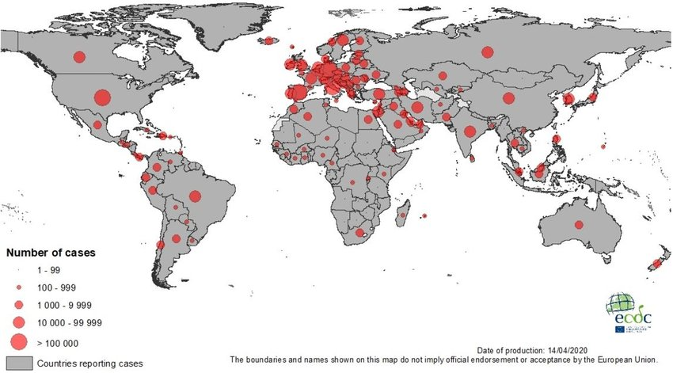
Geographical distribution Of Covid_19

Slide 5
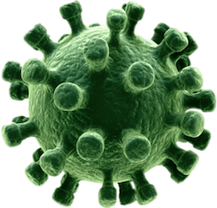
Define Coronavirus disease (COVID-19)
1

Slide 6
Coronavirus Disease (COVID-19) is an infectious disease caused by the SARS-CoV-2 virus COVID-19 is an RNA virus belongs to the family coronaviridea with a outer surface proteins resembles the crown it has a concave surface with a ridges .

Slide 7

Discuss The Herd Immunity
2

Slide 8
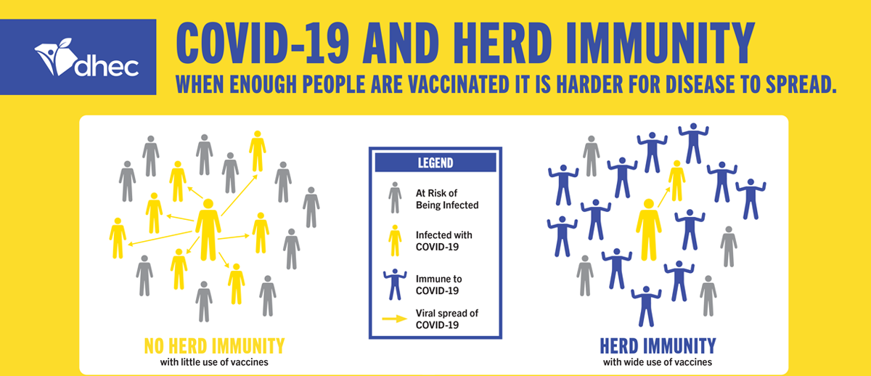
What is herd immunity?
Herd immunity is the indirect protection from a contagious infectious disease that happens when a population is immune either through vaccination or immunity developed through previous infection.

Slide 9

Discuss The Immunity of Covid-19
3

Slide 10
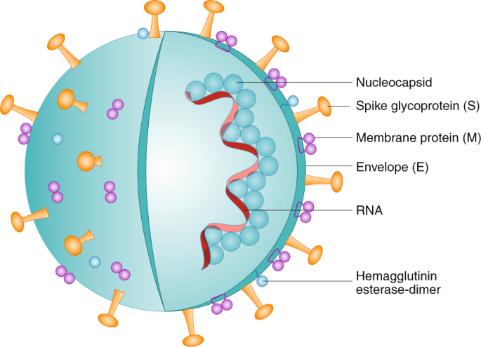
Structure of COVID-19
COVID-19 is an RNA virus with a crown-like appearance. Its diameter is approximately 60–140 nm. On one side, it has a concave surface with a ridge. It makes a larger binding interface, as well as more contacts with ACE2.
it is transmitted through respiratory droplets from coughing and sneezing and enters the nasal system by inhaling and starts replicating.

Slide 11
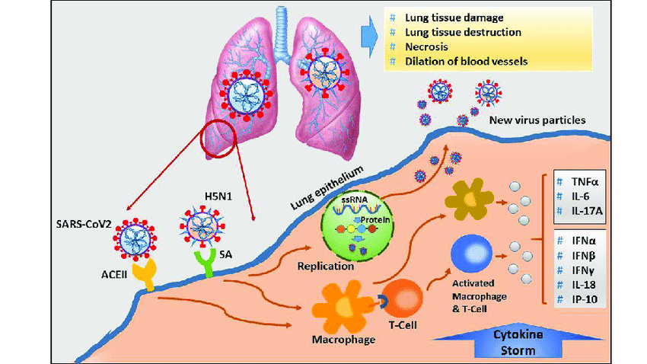
Pathogenesis of virus and its Impact on human body
The virus binds to ACE 2 as the host target cell receptor in synergy with the host’s transmembrane serine protease 2 (cell surface protein), which is expressed in the airway epithelial cells. This leads to membrane fusion and releases the viral genome into the host cytoplasm. figure (3) show the remaining steps of viral replication, leading to viral assembly, maturation, and virus release

Slide 12

Discuss The Emerging Treatment Strategies For Covid_19 Infection
4

Slide 13

Emerging Treatment and Management
There is an urgent need for effective and specific antiviral treatment. Currently, supportive care measures such as
Ventilation oxygenation
Fluid management remain the standard of care.

Slide 14
MANAGEMENT OF COVID -19
MILD
MODERATE
SEVERE
Antipyretic
Home isolation
Antivirals
Anticoagulant
Supportive care
Antivirals
Anticoagulant
Supportive care :
Oxygen support
Azithromycin
Antibiotics
Manage ARDS

Slide 15
Conclusion
Respiratory symptoms ranging from mild to moderate appear on most of those infected with the virus and recover without the need for special therapeutic intervention.
The best way to prevent and slow the transmission of COVID-19 infection is to be familiar with the characteristics of the disease and the way the virus is spread.

Slide 16
References
Brouwer, P. J., Caniels, T. G., van der Straten, K., Snitselaar, J. L., Aldon, Y., Bangaru, S., ... & van Gils, M. J. (2020). Potent neutralizing antibodies from COVID-19 patients define multiple targets of vulnerability. Science, 369(6504), 643-650.
Randolph, H. E., & Barreiro, L. B. (2020). Herd immunity: understanding COVID-19. Immunity, 52(5), 737-741.
Jamshaid, H., Zahid, F., Zeb, A., Choi, H. G., & Khan, G. M. (2020). Diagnostic and treatment strategies for COVID-19. AAPS PharmSciTech, 21(6), 1-14.

Slide 17
THANKS

