Slide 1
Obesity
Dr Mousa Tuwati Alfakhri

Slide 2
Definition
It is defined as a state of excess adipose tissue.
WHO definition
BMI ≥25 is overweight
BMI ≥30 is obesity

Slide 3
Epidemiology of obesity
Overweight and obesity rapidly increasing globally
One billion adults are overweight , and 475 million are obese.
highest rates of obesity (>30%) USA, Mexico, and Middle East.
200 million school-aged children are either overweight or obese

Slide 4
Aetiology of obesity
Genetic factors
Prader Willi Syndrome, Albright Hereditary Osteodystrophy
Environmental factors
increased energy (food) intake or decreased energy expenditure due to physical inactivity, as the major determinants of obesity in genetically susceptible individuals

Slide 5
Secondary causes
Hypothyroidism
Cushing’s disease/syndrome
Insulinoma
• Polycystic ovary syndrome (PCOS)
• Iatrogenic:
drugs: antipsychotic medication, hypoglycaemics ( insulin and SU) , glucocorticoids, anti-epileptic drugs
Alcohol ,smoking cessation

Slide 6
Medical complication of obesity
Insulin resistance and type 2DM
Dyslipidaemia
Hypertension
Cardiovascular disease
Reproductive disorders
Hypoventilation syndrome
GIT complications
CNS complication
Bones ,and joints complication
Skin diseases
Malignancies

Slide 7
Obesity and insulin resistance and type 2DM
Mainly associated with Intra abdominal fat
muscle and adipose are insulin resistant
Circulating peptides –TNFα, IL6, Adiponectin, and Resistin have altered expression & modify the insulin action
80 % of Type 2 DM are obese

Slide 8
Obesity and dyslipidaemia
10% wt gain → 12 mg/dl increase in cholesterol.
Increase LDL, TG,and Decrease HDL
Due to decrease activity of Lipoprotein Lipase.
treatment of obesity → improvement in dyslipidemias

Slide 9
Obesity and hypertension
Increased blood volume
Increase cardiac output
Increase sympathetic tone
Increase Salt sensitivity
Salt retention by insulin
Increase angiotensinogen

Slide 10
Obesity and cardiovascular disease
Hypertension
Dyslipidaemias
Endothelial damage
Diabetes
W/H ratio may be the best predictor
BMI > 29 →3 fold rise in MI
Obesity is responsible for 17% of all CVD
Angina increases by 1.8 times
MI increases by 3.2 and 1.5 fold in woman and men respectively

Slide 11
Obesity and reproductive disorders
Men
Plasma Testosterone and SHBG are reduced
Increase Estrogen
Gynaecomastia
Women
Increased Androgen
Decrease SHBG
PCOS(anovulation, obesity, hirsutism)
Uterine cancer (lower body obesity )
infertility ,and low chances of IVF success

Slide 12
OSAS – Obstructive sleep apnoea syndrome
Obesity hypoventilation syndrome
Old name – PICKWICKIAN SYNDROME
Chronic alveolar hypoventilation in Obese with BMI> 30 (PaO2 <70 PaCO2 >45 )
Cause
Dysfunction of respiratory centre
Repeated nocturnal sleep apnoea

Slide 13
OSAS – Obstructive sleep apnoea syndrome
Complications
1. Pulmonary hypertension
2. right sided heart falure
3. Polycythemia
4. Stroke
5. Arrythmias
7. Car accidents

Slide 14
GIT
Gall stones
Pancreatitis
Abdominal hernia
non-alcoholic fatty liver disease (NAFLD)
GERD

Slide 15
CNS
Stroke
↑ Blood pressure
Type 2 DM
Elevated cholesterol levels
Depression and Sleep disturbances

Slide 16
Bones ,joints ,skin
Osteoarthritis –Trauma & joint malalignment Gout

Slide 17
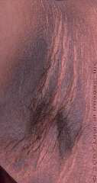
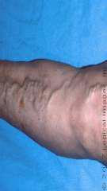
Obesity and skin diseases
Acanthosis Nigricans:
Thickening of skin folds of neck, elbows,
Dorsal interphalyngeal spaces Reflects severity of
insulin resistance
Friability of skin and varicosities.
Aggravation of other conditions
caused by DM
1. Necrobiosis lipoidica
2. Ulcers
3. Infections

Slide 18
Cancer
Both sexes affected equally with high mortality rate
Males: Ca. esophagus, colon, rectum, pancreas, liver& prostate
Females: Ca. gall bladder, bile duct, breast, endometrium, cervix, ovaries

Slide 19
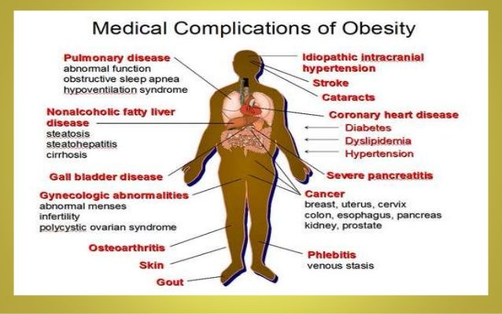
Summary of Medical complication of obesity

Slide 20
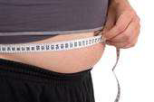
Measurement of obesity
BMI
Waist ∕ hip ratio
Skin fold thickness
DEXA (Dual Energy Xray Absorptiometry)
CT / MRI
Bioelectrical impedance analysis
Total body electrical conductivity
Hydrometry

Slide 21
Body mass index (BMI)
Calculated as Weight(kg)/Height(m^2)
there is Correlation between rise in BMI and Complications.
BMI may be misleading in certain cases
BMI may be high in a vey muscular person
For similar BMIs women have greater fat mass than their male counterparts

Slide 22
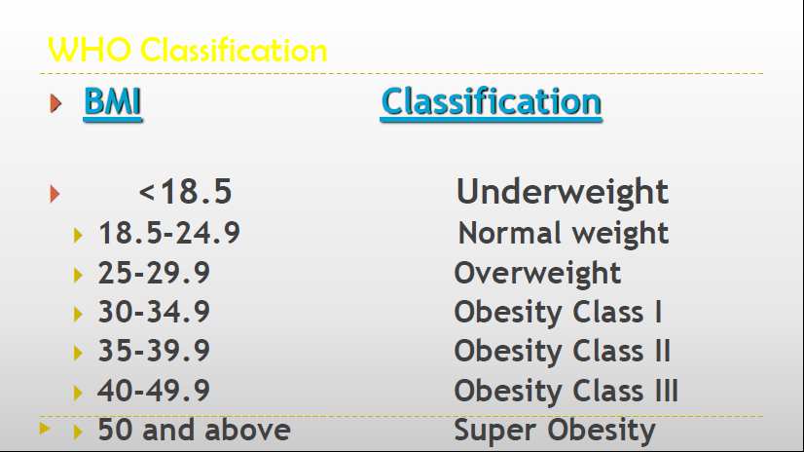

Slide 23
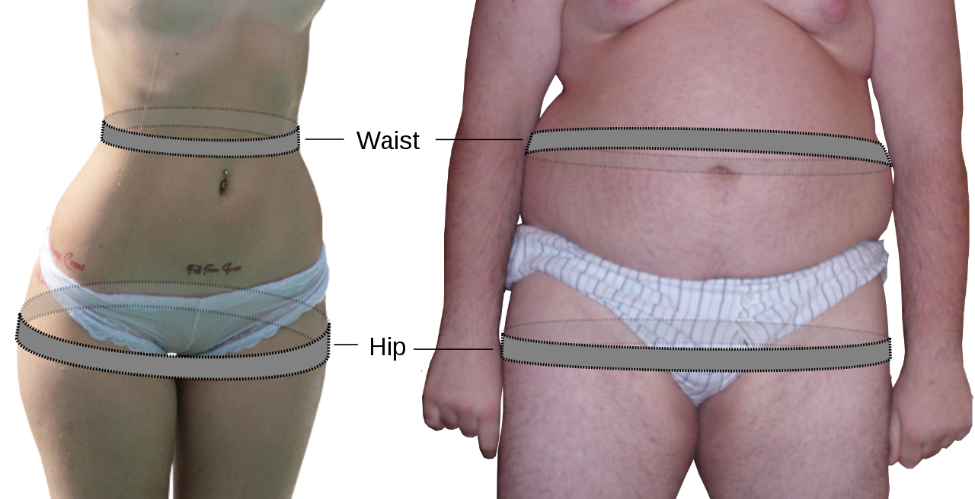
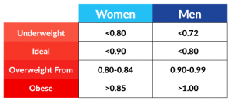
Waist to hip ratio
Central or abdominal obesity is associated with more co-morbid conditions.
So measuring central obesity is of greater significance
W/H ratio is taken
by a simple measure
tape

Slide 24

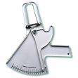
Skin fold thickness
Harpenders callipers
It is measured at biceps/triceps/ and interscapular
Normal: < 40 mm in males, < 50 mm in females

Slide 25
Management of an obese patient
History
Current eating habits and triggers for eating/activity levels.
• Family history of obesity and obesity-related disease.
• Symptoms or previous diagnosis of obesity-related diseases, including CVD, diabetes, psychological issues (eating disorder, depression, low self-esteem), OA, obstructive sleep apnoea, PCOS.
• Other risks, such as smoking and alcohol intake.
• Drugs that exacerbate weight gain.

Slide 26
Examination
• Height, weight, fat distribution.
• Skin: acanthosis nigricans and skin tags (insulin resistance), intertrigo, fat distribution .
• Cardiovascular: hypertension, heart failure
• Respiratory: airway, obstructive sleep apnoea (somnolence), pulmonary hypertension.
• GI: hepatomegaly, herniae
• Musculoskeletal: mobility.
• Consider other diagnoses: hypothyroidism, Cushing’s syndrome

Slide 27
Investigations
• CBC (iron deficiency anaemia from reflux or GI bleeding; polycythaemia from hypoventilation).
• Renal function.
• Liver function (non-alcoholic steatohepatitis).
• Glucose, HbA1c (prediabetes, diabetes).
• Fasting lipid profile (raised triglycerides, total and LDL cholesterol, lowered HDL cholesterol).
• Vitamin D (often deficient in the obese).
• Thyroid function (hypothyroidism).
• ECG (atrial fibrillation, left ventricular hypertrophy)

Slide 28
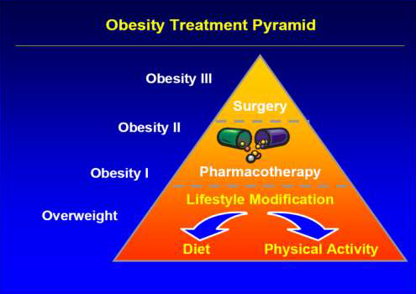
Management of obesity

Slide 29
Goal is to reduce or prevent comorbidities.
Diet Therapy
Physical Activity Therapy
Behavioral Therapy
Pharmacotherapy
Surgery

Slide 30
Diet
Low calorie diet
Low in saturated fats
Normal protein intake
Increased fibers in diet
1000 K cal deficit produces 1 kg wt loss per week

Slide 31
Pharmacotherapy
Indications
1. BMI > 30
2. BMI > 27 with risk factors like HT, DM, CHD, Sleep Apnoea, Dyslipidemia
Orlistat
Saxenda

Slide 32
Orlistat : is a gastrointestinal and pancreatic lipase inhibitor that induces weight loss by inhibiting dietary fat absorption
Liraglutide(saxenda) is a glucagonlike peptide-1 (GLP-1) analog ,acts by decreasing the appetite and calorie intake.

Slide 33
Bariatric surgical techniques
Indications
1. BMI greater than 40, or 100 pounds overweight
2. BMI 35-39.9 and a life-threatening condition, such as heart disease or diabetes.
3. BMI 35-39.9 and severe physical limitations that affect employment, mobility, and family life

Slide 34
Bariatric surgical techniques
Divided into two groups
1. Malabsorptive procedures - Induce decreased
absorption of nutrients by shortening functional
length of small intestine
2. Restrictive procedures - Reduce storage
capacity of stomach and as result early
satiety arises, leading to decreased caloric intak

Slide 35
Malabsorptive procedures
Jejunoileal bypass
Biliopancreatic diversion
Biliopancreatic diversion with duodenal switch
Restrictive procedures
Vertical banded gastroplasty
Laparoscopic adjustable gastric band

Slide 36
THANKS

