Slide 1



Perception
Libyan International Medical University Faculty Of Business Administration
And its 5 stages
By: Aisha Elshaare
E-mail: aisha_2869@limu.edu
ID: 2869
Dec 16th, 2020

Slide 2
Content
What is Perception?
The stages of Perception.
Perceptual Process.
Conclusion.
References.

Slide 3
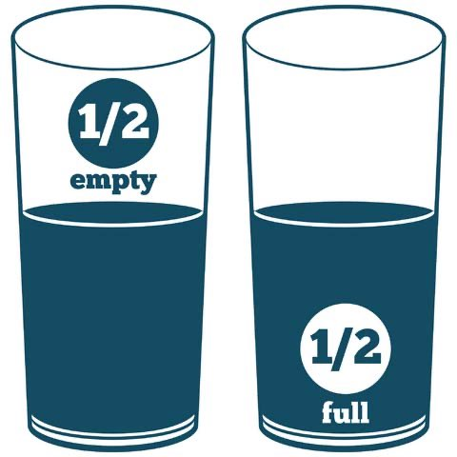

Do you think this glass is half full? Or half empty?
& why?

Slide 4
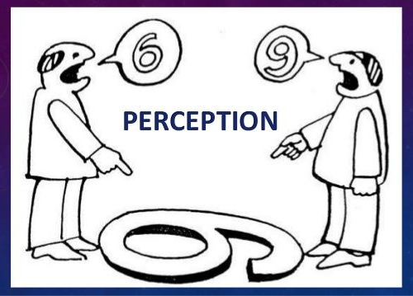
Perception:
Is the interpretation of how we see the world around us, and it differs from one person to another.
Perception includes the 5 senses: touch, sight, sound, smell, and taste.

Slide 5



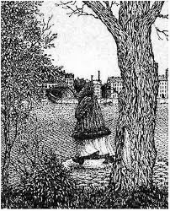
The 5 stages:
Of perception
Stimulation.
Organization.
Interpretation - Evaluation.
Memory.
Recall.

Slide 6

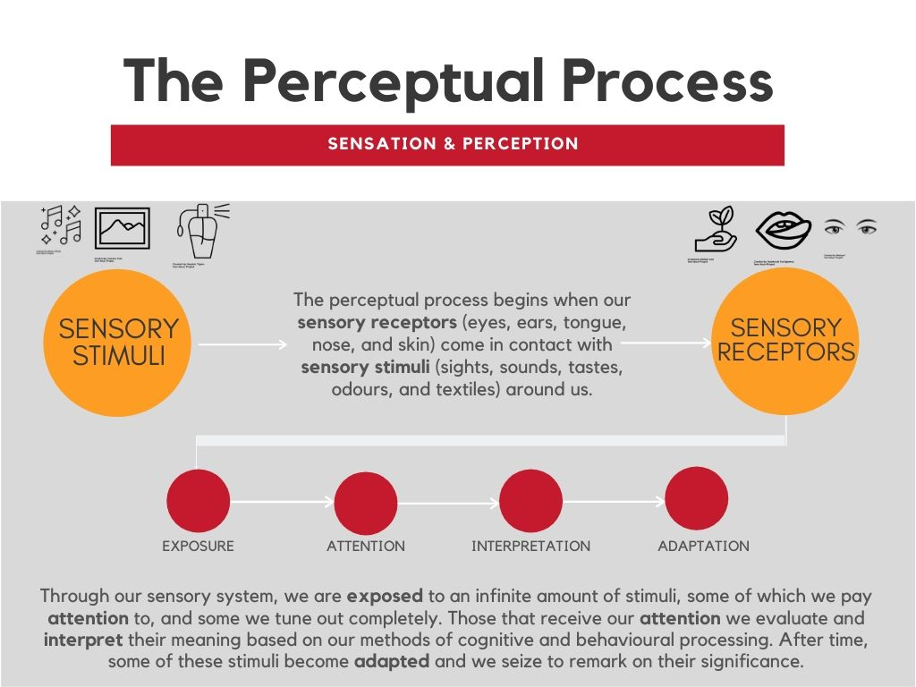
Perceptual process:
is the process of selecting, organizing, and interpreting information

Slide 7


Conclusion
Next time you make an opinion about a person, remember this is not who they really are, it is only your perception of them.

Slide 8
“There are things known and there are things unknown, and in between there are doors of perception”
Aldous Huxley

Slide 9
References
UKEssays. (November 2018). The Five Stages of Perception. Retrieved from https://www.ukessays.com/essays/psychology/definition-and-the-five-stages-of-perception-psychology-essay.php?vref=1
Cherry, K. (2020, July 09). How Does Perception Work? Retrieved December 15, 2020, from https://www.verywellmind.com/perception-and-the-perceptual-process-2795839
Niosi, A. (n.d.). The Perceptual Process. Retrieved December 15, 2020, from https://kpu.pressbooks.pub/introconsumerbehaviour/chapter/the-perceptual-process/

Slide 10

Thank you :p

