Slide 1


Libyan International Medical University
Faculty of Business Administration
The Stages of Emotion
Name: Hossen Mohammed Aldarrat
ID: 3783
Email: husayn_3783@limu.edu.com

Slide 2
Table of Content
Objective
Introduction
Emotions Occur in Stages
Emotions Involve Both Body and Mind
Conclusion
Reflection
Reference

Slide 3

Objective
By the end of this presentation, you’ll be able to understand:
Emotions Occur in Stages
Emotions Involve Both Body and Mind

Slide 4

Introduction
there are conflicting theories about emotions, all agree that emotions occur in stages. also Emotion involves both the body and the mind.

Slide 5
Emotions Occur in Stages
Think about how you might explain what happens when you feel emotionally aroused. Most people would recognize the following stages:
A thing happens.
You feel an emotion, such as shock, happiness, or rage.
Your body reacts by quickening your heartbeat, flushing your face, and so forth.

Slide 6
Emotions Involve Both Body and Mind
Emotion is something you feel physically as well as mentally. Physical responses—like blushing when you're embarrassed—and mental assessments and interpretations—like calculating the chances of getting a yes when you propose—interact.

Slide 7
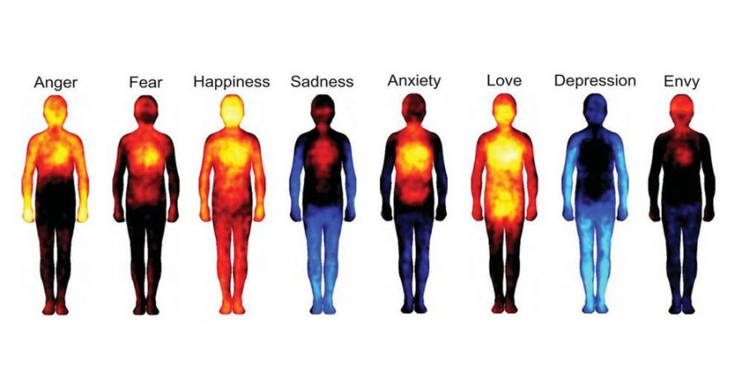
The Body
Bodily reactions are the most obvious aspect of our emotional experience because we can observe them easily.

Slide 8
The Mind
The mental or cognitive part of emotional experience involves the evaluations and interpretations you make on the basis of what you experience.
we look at our brain and emotions and what different reactions occur in our heads when we feel :
Anger.
Fear.
Love.

Slide 9
Conclusion
Despite competing theories regarding emotions, they all agree that emotions go through different stages. also When you feel emotion, your body and mind are both involved.

Slide 10
Reflection
In my point of view, emotion can give a bigger message than words and they are two parts physical and mental

Slide 11
Reference
DEVITO, J.O.S.E.P.H.A. (2022) Interpersonal Communication Book, Global edition. S.l.: PEARSON EDUCATION LIMITED.
Miles, L. (2020) Brain and emotions: How anger, fear or love work in your brain, Learning Mind. Available at: https://www.learning-mind.com/brain-and-emotions/ (Accessed: December 7, 2022).

Slide 12
THANK YOU

