Slide 1



Libyan International Medical University
Faculty of Business Administration
The Micro and Macro Environment
in Marketing
By :fatima alzhraa almkhal
ID: 3190
Email: fatimaalzhra_3190@limu.edu.ly

Slide 2


Table of Content
Introduction
Microenvironment
Macroenvironment
Conclusion
References
02

Slide 3
Introduction
The people and institutions that make up a company’s marketing environment are the key factors that determine the success of its influencer marketing program.
03

Slide 4

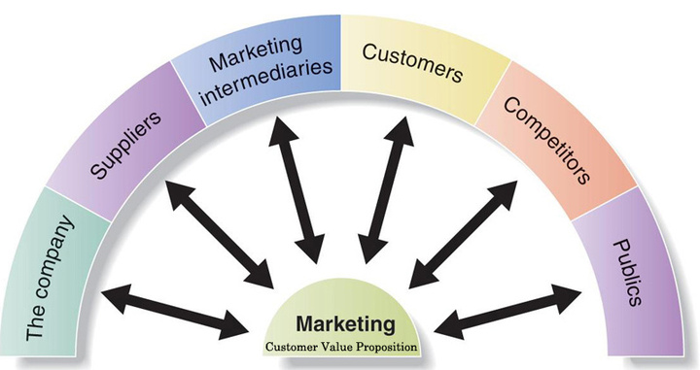
Microenvironment
The actors that influence a company's ability to serve its customers are its suppliers, competitors, and publics.
04

Slide 5
The Company:
When it comes to developing marketing plans, the management team takes into account the various departments within a company, such as finance, R&D, and human resources.
05

Slide 6

Suppliers:
Suppliers: Suppliers can control the success of the business when they hold power . the supplier’s product is a core part of the buyer’s finished product .
06

Slide 7

Marketing Intermediates
Marketing intermediates help company in advertising, selling, and distributing their products to end users.
07

Slide 8
The competition
Those who sell the same or similar products and services as your organisation is your market competition,
08

Slide 9
Public
Your organisation has a duty to satisfy the public.
09

Slide 10

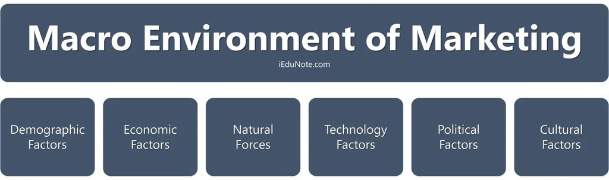
Macroenvironment
External forces make up macro environmental factors. These external forces influence the company's marketing strategy.
10

Slide 11
Demography
is the study of human populations in terms of size, density, location, age, and other statistics.
11

Slide 12
Economic Environment
Consists of economic factors that affect consumer buy power and spending
12

Slide 13
Conclusion
Micro and macro environments have a significant impact on the success of marketing activities, and therefore such environmental factors must be considered in-depth during the process of creating a strategic marketing plan.
13

Slide 14

References
Marketing environment: Macro and Micro Marketing Environment. (2020, March 12). Retrieved April 6, 2022, from https://www.iedunote.com/marketing-environment
The impact of micro and macro environment factors on marketing. (2021, November 08). Retrieved April 6, 2022, from https://blog.oxfordcollegeofmarketing.com/2014/11/04/the-impact-of-micro-and-macro-environment-factors-on-marketing/

Slide 15
Thank
you!
Do You Have Any Questions?

