Slide 1
Pancreatitis
Dr. nadia ezzawi
Gastroenterology department
BMC

Slide 2
objectives
Anatomical and physiological back ground.
Difinition and types of pancreatitis.
Clinical features and complications of disease and their management.

Slide 3
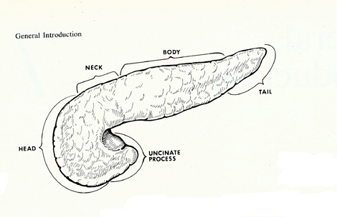
Pancreas: Anatomy and Physiology
Retroperitoneal organ . It is almost completely covered by the stomach and duodenum .
15-20cm in length
Head, neck, body and tail
curves behind the superior mesenteric vessels

Slide 4
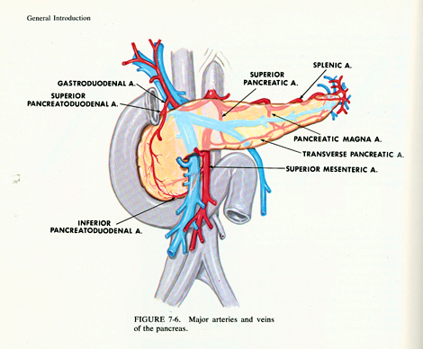
Pancreas: blood supply
HEAD：
Superior pancreatoduodenal A. (from gastroduodenal A.)
Inferior pancreatoduodenal A. (from SMA)
BODY AND TAIL：
superior pancreatic A.
pancreatic magna A.
transverse pancreatic A.
VEIN：
to splenic vein ,SMV and portal vein

Slide 5
Physiology
Exocrine：
the acinar cells produce digestive juices, which are secreted into the intestine and are essential in the breakdown and metabolism of proteins, fats, and carbohydrates.
Endocrine：
A cell：glucagon
B cell：insulin
D cell ：somatostatin
G cell ：gastrin

Slide 6
Pancreatitis
Difinition :-
It is an inflammatory process of the pancrease with associated escape of pancreatic enzymes into surrounding tissues.
Classified into:-
Acute Pancreatitis.
Chronic Pancreatitis

Slide 7
Acute pancreatitis
It is an acute inflammatory process of the pancreas, accompanied by abdominal pain and elevations of serum pancreatic enzymes.
It has Variable severity and duration.
Abrupt onset and unpredictable course.

Slide 8
Classification
based on physiological findings, laboratory values, and radiological imaging
Mild Acute pancreatitis (MAP).
Mild disease is not associated with complications or organ dysfunction and recovery is uneventful.
Severe Acute pancreatitis (SAP).
severe pancreatitis is characterized by pancreatic dysfunction, local and systemic complications, and a complicated recovery.

Slide 9
Other classification:
-- acute interstitial pancreatitis.
the gland architecture is preserved but is edematous. Inflammatory cells and interstitial edema are prominent within the parenchyma
-- acute hemorrhagic pancreatitis.
characterized by marked necrosis, hemorrhage of the tissue, and fat necrosis. There is marked pancreatic necrosis along with vascular inflammation and thrombosis.

Slide 10
Etiology of acute pancreatitis.
Biliary tract disease .
Abuse of ethanol.
Trauma and operation.
Ischemia of pancreas.
Drugs … (azathioprine).
Idiopathic pancreatitis.
Hypercalcemia .
Hyperlipidemia .
Infections and Parasites .
Procedure….(Endoscopic retrograde cholangiopancreatography )

Slide 11
Pathogenesis
“Self digestion”, oedema and necrosis .
Reflux of bile or duodenal juice
Trypsinogen was activated
Release of the enzymes------ fat necrosis in both pancreatic and peritoneal cavity .
Collection of pancreatic enzymes form pancreatic pseudocyst.

Slide 12
Clinical manifestations
Abdominal pain
Nausea, vomiting
abdominal Distension
abdominal Tenderness, rebound tenderness, muscular regard
Fever，jaundice，
Gray-Turner sign: flank ecchymoses
Cullen sign: periumbilical ecchymoses
MODS(multiple organ dysfunction syndrome )

Slide 13
laboratory test
High Amylase level in serum and in urine( increased renal clearance).
High Lipase level ( more specific).
Blood :impaired RFT, liver function, high BS, low PaCO2 ,
Raised serum calcium,
DIC manifestations.
Imaging studies
USS: especially if the cause is stones, abcess, hge.
CT : Important finding include pancreatic swelling, peripancreatic fluid collection, an area of non enhancement because of necrosis.
ERCP.
MRCP.
Abdomen plain film.

Slide 14
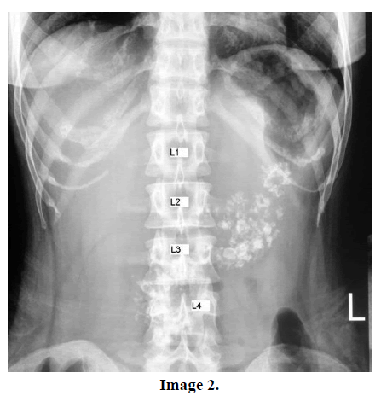
X ray

Slide 15
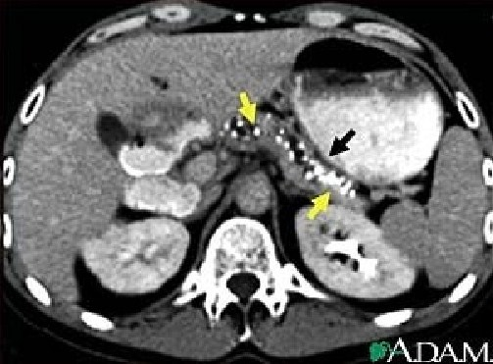
CT scan abdomin

Slide 16
Diagnosis Ransons criteria
Within 48hrs | On admission
Hematocrit decrease by > 10% | Age > 55 years
Urea nitrogen increase > 5mg/ dl | WBC >16,000mm
Serum calcium < 8 mg/dl | LDH > 350IU/l
Arterial Po2 <60 mmhg | Glucose > 200mg/dl
Base deficit > 4 mEq/L | AST > 250 IU /L
Estimated fluid sequestration > 6L

Slide 17
Glasgow criteria
Urea > 45 mg/dl | Glucose > 180 mg/dl | Age >55
Arterial Po2 < 60mmhg | Albumin < 3.2 g/dl | WBC > 1500 mm
 | Calcium < 8mg/dl | LDH > 600

Slide 18
Complications of acute pancreatitis
Pancreatic necrosis( relaese of pancrearic lipase)
Pancreatic abscess
Pancreatic pseudocyst
Acute pancreatic pseudocyst:-
Collection surrounded by fibrous tissue or granular tissue. Peripancreatic fluid Those persisting beyond the phase of acute inflammation become pancreatic pseudocysts.

Slide 19
Treatment of acute pancreatitis
Non Operative trearment:
ICU ：to prevent MODS
fasting the patient, nasogastric suction
Minimizing pancreatic secretion
antacids
Fluid replacement and Nutritional support
maintenance of adequate hydration
TPN，glucose ,lipid, amino acid, protein
Analgesia
Antibiotics
Abdominal lavage

Slide 20
operative
Indication of Operation:
Biliary obstruction
Secondary pancreatic infection
Undetermined diagnosis, needs laparotomy.
Surgery usually is drainage of fluids, abscess.
Methods
Percutaneous drainage
Operative drainage
Cystgastrostomy, cystjejunostomy
Resection of pancreatic body and tail

Slide 21
Chronic pancreatitis
It is benign inflammatory process and fibrosing disorder characterized by
- irreversible morphologic changes,
- progressive and
- permanent loss of exocrine and endocrine function .

Slide 22
Clinically the disease is characterized by recurrent episodes of sever and uncontrollable upper abdominal pain and by a loss of exocrine function (diarrhea , steatorrhea) and endocrine function ( DM).

Slide 23
Clinical manifestations
abdominal pain:
may be continuous, intermittent or absent
Pattern is often atypical
RUQ or LUQ of the back
Diffuse throughout upper abdomen
May be referred to the anterior chest or flank
Typical form:
Persistent , deep-seated,
Unresponsive to antacids
Worsened by alcohol intake or a heavy meal (especially fatty foods)
Often need narcotics

Slide 24
Pancreatic insufficiency
Weight loss
Fat malabsorption:
Steatorrhea: 15% of patients present with steatorrhea and no pain.
Pancreatic diabetes:
Like DM1 needs insulin , but risk of hypoglycemia is more than DM (because alfa cells is also affected).
Fat-soluble vitamin deficiency →rare

Slide 25
Etiology
- toxic metabolic
Idiopathic
Genetic / hereditory
Autoimmune / immunologic
Recurrent acute acute pancreatitis
Obstructive /mechanical

Slide 26
Lab data
Amylase and lipase : usually normal
CBC ,electrolytes, and liver function tests are typically normal
Bilirubin and ALP may be increased
Impaired glucose intolerance and elevated fasting blood glucose
Sudan staining of feces or quantitative test for steatorrhea
fecal elastase (Among pancreatic function tests, fecal elastase measurement is the most sensitive and specific, especially in the early phases of pancreatic insufficiency)

Slide 27
Classic triad “ pancreatic calcification , steatorrhea , and diabetes mellitus “usually establishes chronic pancreatitis
Classic triad : found in fewer than one-third
It is often necessary to perform secretin stimulation test (abnormal when 60% or more of pancreatic exocrine function has been lost)
A decreased serum trypsinogen (<20ng/ml) or a fecal elastase level of <100ug/mg of stool strongly suggests severe pancreatic insufficiency

Slide 28
Imaging study
CT, MRI, US
calcifications
ductal dilatation
enlargement of the pancreas
fluid collections (eg, pseudocysts

Slide 29
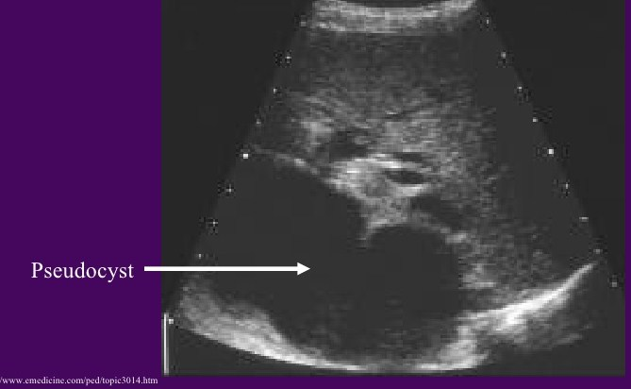
USS of pancreatic pseudocyst

Slide 30
ERCP
May provide useful information on the status of the pancreatic ductal system
Abnormalities include :
1)luminal narowing
2)irregularities in the ductal system with stenosis, dilation,saculation,and ectasia
3)blockage of the duct by calcium deposits
Endoscopic ultrasonography
The most predictive endosonographic feature is the presence of stone

Slide 31
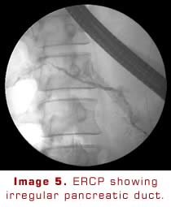
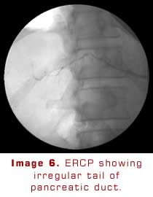

Slide 32
Complications of chronic pancreatitis
pseudocyst formation
bile duct or duodenal obstruction
pancreatic ascites or pleural effusion
splenic vein thrombosis
Pseudoaneurysms
pancreatic cancer
acute attacks of pancreatitis( particularly alcoholics who continue drinking)

Slide 33
Treatment
Establish a secure diagnosis.
Cessation of alcohol intake.
Small meals.
Pancreatic enzyme supplements.
Patients should also be treated with acid suppression (either with an H2 receptor blocker or a proton pump inhibitor) to reduce inactivation of the enzymes from gastric acid.
Analgesics

Slide 34
pancreatitis can be suspected clinically, but requires, biochemical, radiologic, and sometimes histologic evidence to confirm the diagnosis.
measurement of amylase and lipase are useful for diagnosis of pancreatitis.
Imaging studies helps in diagnosis and comlication detection .

Slide 35
Thank you

