Slide 1



The Factors Affecting Consumer Behavior
Libyan International Medical University
Faculty of Business Administration
by :Fatima Alzhraa Almkhal 3190
fatimaalzhra_3190@limu.edu.ly

Slide 2
Table of contents
Introduction
Conclusion
03
01
Important Factors That Influence Consumer Behavior
References
02
04
02

Slide 3
01
Introduction
03

Slide 4
Introduction
Many different factors influence consumer behavior. A marketer should try to understand the influences on consumer behavior.
04

Slide 5
02
Important Factors That Influence Consumer Behavior
05

Slide 6
Important Factors That Influence Consumer Behavior
Here are 4 major influences on customer behavior:
Social Factors
Cultural Factors
Personal Factors
Psychological Factors
06

Slide 7
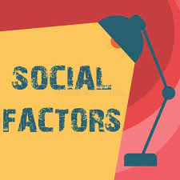
Social Factors
Social factors have an impact on consumer behavior:
FOTO
Family
Social roles and status
07

Slide 8
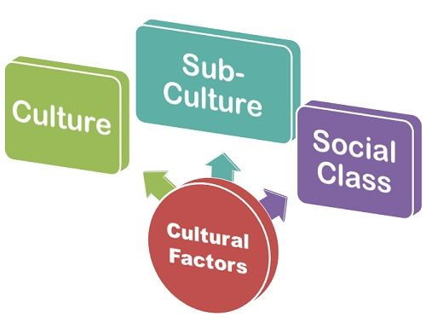
Cultural Factors
Marketers must know the value of the buyer's role:
Culture
Subculture
Social Class
08

Slide 9
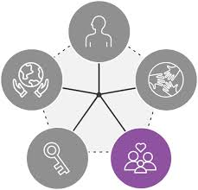
Personal Factors
Personal qualities can also impact a buyer's decision:
Occupation
Age and stage
Economic situation
Lifestyle
Personality and self-concept.
09

Slide 10
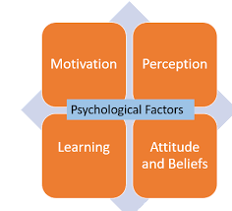
Psychological Factors
Four important psychological elements influence a person's buying decision:
Motivation
Perception
Learning
Beliefs and attitudes.
10

Slide 11

Conclusion
03
When you understand your consumer buying behavior, you can adopt more directed marketing efforts towards increased sales.
11

Slide 12
References
What are the 5 factors influencing consumer behavior? (n.d.). Retrieved April 13, 2022, from https://www.clootrack.com/knowledge_base/major-factors-influencing-consumer-behavior
Bose, S. (2021, February 17). 4 factors influencing consumer buying behaviour: Consumer awareness. Retrieved April 13, 2022, from https://www.techjockey.com/blog/4-common-factors-influencing-consumer-buying-behaviour
Consumer behaviour: 4 factors that influence consumer behaviour. (2021, July 10). Retrieved April 13, 2022, from https://www.educba.com/4-factors-influencing-consumer-behaviour/

Slide 13
Thank you for your attention
Do you have any questions?

