Slide 1


Libyan International Medical University Faculty of Business Administration
The Principles of Conversation
prepared By: Mohammed Wannees
Email:mohammed_3781@Limu.Edu.ly
ID:3781

Slide 2

TABLE OF CONTENTS
03
01
02
Examples
Introduction
Principles of Conversation
05
Reflection
04
06
Conclusion
References

Slide 3
Introduction
Conversation is a process for improvement. Quantity Principle: Only provide information that is necessary to convey your idea.

Slide 4
Principles of Conversation
01
Recognize the other person's presence and importance.
02
Avoid negative feedback and condemnation.
03
Respect the other person by well of.
04
The opposite is a speech.
05
Keep the channels open.

Slide 5
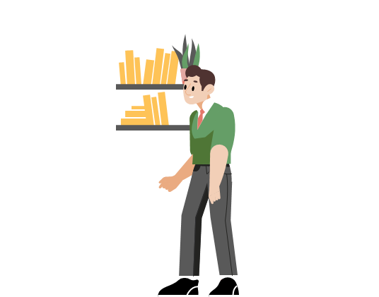
conversation elements
Intro.
Social Acknowledgements.
Content-specific Responses.
Turn-indicator Responses.
Related Resources.

Slide 6
Examples
How your day going?
Having a busy day?
How everything?
hi, how are you?

Slide 7
Conclusion
Conversation is a collective activity that includes sequentially organized, locally controlled, and improvised participation activities (verbal and nonverbal) between at least two people.

Slide 8
Reflection
It is very important and from them we learn the principles of conversation with people, the principles of every conversation

Slide 9

References
Libretexts. (2022, June 25). 9.1: Principles of conversation. Social Sci LibreTexts. Retrieved December 14, 2022, from https://socialsci.libretexts.org/Bookshelves/Communication/Introduction_to_Communication/Communicating_to_Connect_-_Interpersonal_Communication_for_Today_(Usera)/09%3A_Conversation_Skills/9.01%3A_Principles_of_Conversation
Google. (n.d.). Google search. Retrieved December 14, 2022, from https://www.google.com/search?q=Examples%2B%2Bprinciples%2Bof%2Bconversation&amp;rlz=1C1GCEA_enLY1030LY1030&amp;hl=en&amp;source=lnms&amp;sa=X&amp;ved=2ahUKEwiR6-O56fb7AhUFvaQKHUDvDEUQ_AUoAHoECAoQAg&amp;biw=1536&amp;bih=722&amp;dpr=1.25

Slide 10


