Slide 1


STRATEGIES of interest groups
By: Muhaned Gumati
ID: 2510

Slide 2

Content
Introduction
Body
Conclusion
References

Slide 3

Introduction
An interest group is a group of people that seeks to influence public policy on the basis of a particular common interest or concern.

Slide 4

Strategies of interest groups
Direct and indirect strategies are general classifications of the techniques used by interest groups.

Slide 5
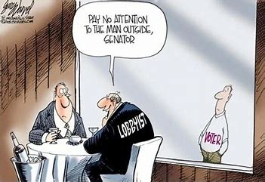


Direct strategies that interest groups use include:
Lobbying techniques
Rating government officials
Building alliances

Slide 6



Indirect strategies that interest groups use include:
Generating public pressure
Using constituents as lobbyists
Public protest demonstrations

Slide 7

Conclusion
In conclusion, interest group strategies are divided into direct and indirect strategies.

Slide 8
References
Interest Groups: The Politics of Influence. (2013). American Government, 185-218. doi:10.4324/9780203109397-9

Slide 9


