Slide 1


Snapchat Business Model
Libyan International University
Faculty of Business Administration
By: Jassem Mohammed 1801
Email: jasem_1801@limu.edu.ly
Instructor: Mr. Mohammed Alzwawi

Slide 2
Table of contents
1
3
5
2
4
Target market of snapchat
Snapchat SWOT Analysis
Introduction
The Risks that the snapchat faces
Analysis the Business Model of snapchat

Slide 3
01
Introduction
Snapchat is a photo, video, and chat-based social networking app that allows users to engage with one another. The main principle of the app is snapping. Every picture, video, or message you send is only visible to the recipient for a short period of time before disappearing.
The brief existence was designed to encourage immediate and engaging contact. Both iOS and Android smartphones are supported by this App.

Slide 4
Target market of snapchat
Snapchat isn't right for every business. Snapchat is primarily utilized by people under the age of 35 and is recognized for being a playful platform. However, if it sounds like a good fit for your company, make sure you have a solid social media plan in place before you start.

Slide 5
The Risks that snapchat faces
The failure to retain users, the fact that the majority of its users are between the ages of 18 and 34 means it relies on a set of people who aren't recognized for their loyalty.
On other hand the corporation admitted that the majority of its processing, storage, bandwidth, and other services are provided by Google Cloud. Any disruption in such service – or a price increase – would be disastrous for the company.
Moreover, Apple, Facebook, and Google, for example, could use their strong or dominant positions in one or more markets to gain a competitive advantage over Snapchat. Collaboration to integrate their products, impeding Snapchat's accessibility, or simply consolidating.

Slide 6
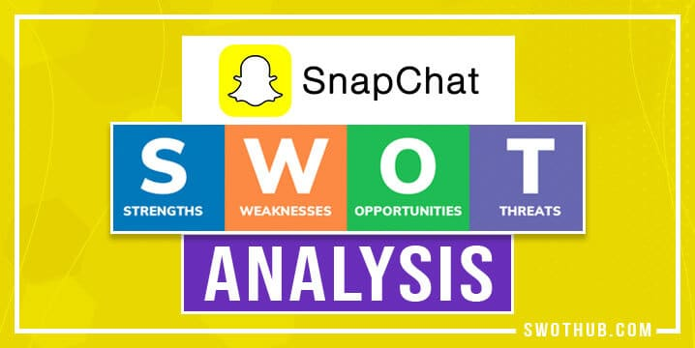

Slide 7
Strengths | Weaknesses
The company's user base now stands at 166 million, with a 36 percent yearly growth rate. In the following three years, this number is likely to double. The app allows deleting communications within a specified time frame, which sets it apart from other messaging apps. For its intended demographic, this is a competitive advantage. Many people like this feature. | Many users began to compare Snapchat's offerings to those of other instant messaging apps. In terms of features, WhatsApp, for example, has more to offer. This is why this application did not make it to the top of the list of chat services.
Threats | Opportunities
Twitter, Facebook, WhatsApp, and Instagram are among the new and experienced competitors that Snapchat is up against. Customers' pleasure with instant messaging is dependent on the speed of the network in their area, which can cause service problems in some areas | Working remotely is encouraged in the modern era of information technology firms. Their reliance on instant messaging platforms for communication is high in demand. In a time when concerns such as data theft are on the rise, as a result, in instant messaging services, privacy has become a must. This software has a number of features that provide enhanced security protection.

Slide 8
Business Model of snapchat

Slide 9
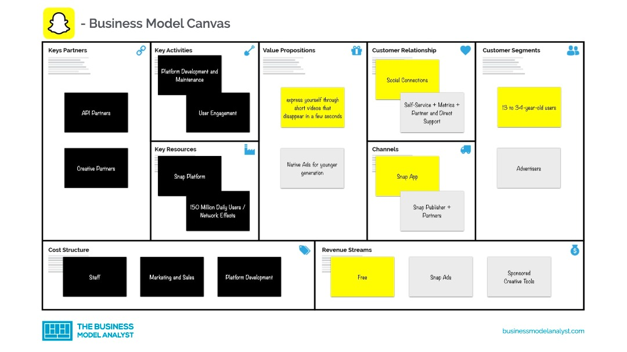

Slide 10

Analysis the Business Model

Slide 11
1. Snapchat Customer Segments:
The Snapchat business model, like any multisided platform, includes multiple consumer segments. There are two in this case:
Users: 218 million active users, about 70% of whom are between the ages of 13 and 17, with the fastest-growing markets being the United States, India, Brazil, and France. For advertising purposes, this audience will be micro-segmented.
Advertisers: Companies that place ads on the Snapchat app. They're separated by size, intended audience, area, type, and more.
2. Snapchat Value Propositions:
For each consumer segment, there are different value propositions:
Users: Snapchat is a quick way to communicate that allows users to express themselves through photos and videos (with the help of its filters/editions), as well as life at the moment, without worrying about their appearance or anything else, because the posts will be deleted soon. While having fun, they can also learn about other individuals from around the world.
Advertisers: Among 13-24-year-olds, Snapchat is arguably one of the most widely used platforms. Users will interact with commercials and companies without seeing them and will feel less "invaded" by them if they are reached using creative techniques. Businesses can also use Snapchat's self-serving capabilities to build their own adverts. In addition, e-commerce tools and APIs for integration are available.

Slide 12
3. Snapchat Channels:
The app/website is the primary distribution mechanism for the Snapchat business strategy. However, there are alternative options: App stores are places where you can get apps. Use of social media Word-of-mouth marketing Snap partners and publishers.
4. Snapchat Customer Relationships:
Customer relationships must be divided into customer categories:
Users: Snapchat must demonstrate to its users that the site prioritizes their interests over advertising by providing a pleasant user experience;
Advertisers: In addition to analytics (which businesses use to determine value), advertisers value self-serving ad development, partner and direct assistance models (for those who prefer to have a team put up advertising), and the ability to communicate directly with people.
5. Snapchat Revenue Streams:
Snapchat earns money from advertising by providing marketers with ad spaces on its app. In fact, advertising provided 99 percent of Snapchat's entire income in 2020, according to the company. AR Ads and Snap Ads are used to do this.

Slide 13
6. Snapchat Key Resources:
The app/platform and its network effects are the most important essential resources of a social network. Other critical assets for this to continue to work include content, consumers, relationships with advertising, employees, brand, technology infrastructure, and intellectual property.
7. Snapchat Key Activities:
The core operations of the Snapchat business model revolve upon user engagement. As a result, the platform focuses on expanding its user base (including all important partners), innovating and improving the user experience, growing content, maintaining and developing the app and website, refining algorithms, and marketing.
8. Snapchat Key Partners:
Users: Users contribute the majority of the material (which generates engagement).
Influencers, media outlets, publications, websites, and a slew of others who create material specifically for this platform are known as content creators.
Advertisers: Companies that pay for advertising and sponsorship to support the Snapchat business model.
Ad technology and agency partners: Partners who use Snap APIs to create ads, target audiences, and track their progress.
Third-party apps that interface with Snapchat is called developers.

Slide 14
9. Snapchat Cost Structure:
The cost structure of Snapchat's business strategy hinges around any multisided platform expense:
App/website and algorithm research and development.
Upkeep of technology infrastructure.
Staffing costs for sales and marketing, as well as general and administrative costs.

Slide 15
Conclusion
The business's founders' refusal of a $3 billion acquisition by Mark Zuckerberg's Facebook Inc. in 2013 proved to be a well-played move, as Snap Inc., the parent company of Snapchat, is now worth over $37 billion.
Despite the fact that the Snapchat app is responsible for the majority of its worth, Snap Inc. has grown significantly in the technology sector with the debut of the Spectacles device and the acquisitions of Bitmoji and Zenly.

Slide 16
References
Snapchat business model and SWOT analysis - how does Snapchat Make Money? WikiSME. (2021, November 17).
Pereira, D. (2022, May 20). Snapchat Business Model. Business Model Analyst.
Haslett, E. (2017, February 3). 11 risks that keep Snapchat bosses awake at night. CityAM.
.

