Slide 1



Libya International Medical University Breast cancer
Aya Jamal Salmah
3297
PTS
1ST YAER
4/6/2022
-2022

Slide 2
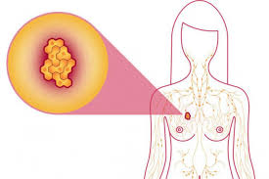
objective
Describe signs and symptoms breast cancer
Describe cancer TNM Staging system
List of prevention of breast cancer
List of treatment of breast cancer

Slide 3
Introducion
Breast cancer is cancer that forms in the cells of the breasts.
After skin cancer, breast cancer is the most common cancer diagnosed in women .Breast cancer can occur in both men and women, but it's far more common in women.

Slide 4
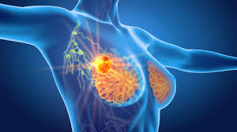
Symptoms
Signs and symptoms of breast cancer may include:
Nipple changes
A breast lump or thickening that feels different from the surrounding tissue

Slide 5
Redness or pitting of the skin over your breast, like the skin of an orange

Slide 6
Change in the size, shape or appearance of a breast
Changes to the skin over the breast, such as dimpling
A newly inverted nipple

Slide 7
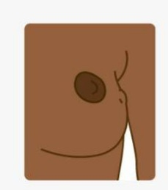
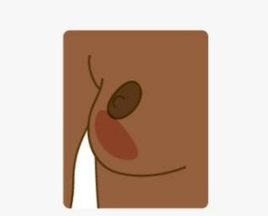
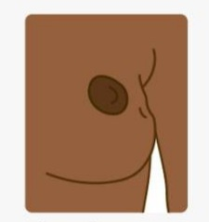
A persistent lump / A change in skin color of A change
Fullness/hard breast/nipple in size /shape
Knot/dimpling/ ( reddening or darkening ) of mature breast
Swelling in breast or in armpit area
or around collarbone area

Slide 8
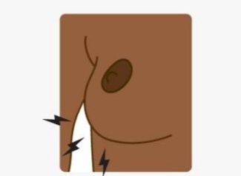

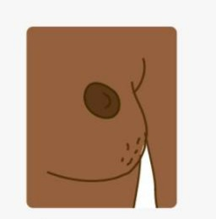
A change in nipple Discharge ( liquid ) or blood itch, Constant
(Retracted\inverted-pulled from one or both nipples Warmth or rash on-
In nipple ) or its position. That occurs suddenly without breast area/nipple /
Squeezing. Armpit.

Slide 9
Breast cancer TNM staging system
TUMOR STAGE. Stage is a measure of the extent of the tumor at the time of diagnosis and is important for all biological cancers.
1.Tumor size(T)
2.Lymph Node status (N)
3.Distant metastases(M)

Slide 10
Bones are the most affected, and in Small proportions of Metastases
Appear in the lung , liver , Central Nervous system , Skin and adrenal glands.

Slide 11

Prevention
Ask your doctor about breast cancer screening. Discuss with your doctor when to begin breast cancer screening exams and tests, such as clinical breast exams and mammograms.

Slide 12
Become familiar with your breasts through breast self-exam for breast awareness.

Slide 13
Breast awareness can't prevent breast cancer, but it may help you to better understand the normal changes that your breasts undergo and identify any unusual signs and symptoms

Slide 14
Drink alcohol in moderation, if at all. Limit the amount of alcohol you drink to no more than one drink a day, if you choose to drink.
Exercise most days of the week. Aim for at least 30 minutes of exercise on most days of the week.

Slide 15
Some women experience bothersome signs and symptoms during menopause and, for these women, the increased risk of breast cancer

Slide 16
To reduce the risk of breast cancer, use the lowest dose of hormone therapy possible for the shortest amount of time.
Maintain a healthy weight.

Slide 17
Treatment
There are many options for breast cancer
Breast cancer surgery
Radiation therapy
Chemotherapy
Immunotherapy
Hormone therapy.

Slide 18
Conclusion
Breast cancer is a health issue that needs attention and awareness.
Screening should begin at age 40.
Survival rate increases the earlier the cancer in detected.

Slide 19
References:
https://www.mayoclinic.org/diseases-conditions/breast-cancer/symptoms-causes/syc-20352470
https://www.mayoclinic.org/diseases-conditions/breast-cancer/diagnosis-treatment/drc-20352475

Slide 20
Thanks

