Slide 1


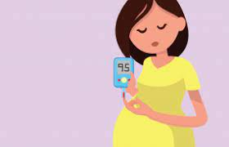
Libyan International Medical University Faculty of Basic medical science Gestational Diabetes
Name Salwa Alhasi
Roll NO 3482
Supervised by Dr. Asma Alshiky

Slide 2
Objectives
Define gestational Diabetes
Explain pathophysiology and Risk Factors of Gestational Diabetes
Outline Diagnosis of Gestational Diabetes
Clarify Symptoms of Diabetes during Pregnancy
Outline Prevention of Gestational Diabetes
2

Slide 3
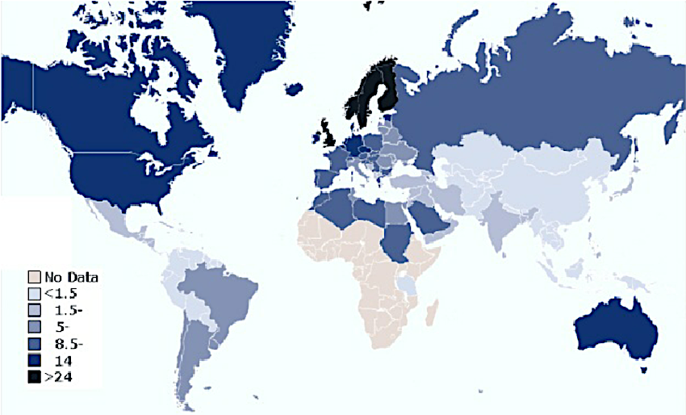
Introduction
Diabetes mellitus, commonly known as diabetes, is a metabolic disorder that causes high blood sugar. About 422 million people worldwide have diabetes, the majority living in low-and middle-income countries, and 1.5 million deaths are directly attributed to diabetes each year.

Slide 4
Gestational Diabetes

Slide 5
Gestational Diabetes
Gestational diabetes is high blood sugar (glucose) that develops during pregnancy and usually disappears after giving birth.
It can happen at any stage of pregnancy, but is more common in the second or third trimester.
5

Slide 6
Diabetes in pregnancy
Pre-existing diabetes
IDDM
(Type1)
NIDDM
(Type2)
Gestational diabetes
Pre-existing diabetes
True GDM
6

Slide 7
Pathophysiology of Gestational Diabetes

Slide 8
Pathophysiology of Gestational Diabetes
Fetoplacental Hormones
Increased blood glucose level
Growth hormone
Cortisol
Prolactin
Insulin resistance & Decreased sensitivity
Increased Insulin Resistance
Hormones produced by placenta
Counteract
compensatory increase in insulin secretions
Pancreas
insulin
Normal Pregnancy

Slide 9
Risk factors of Gestational Diabetes

Slide 10
Risk for Gestational diabetes Increases if you:
Overweight
Over age 25
had gestational diabetes during a past pregnancy
have given birth to a baby weighing more than 9 pounds
have a family history of type 2 diabetes
have polycystic ovary syndrome (PCOS)
10

Slide 11
Diagnosis
11

Slide 12
Diagnosis
Glucosuria is common in pregnancy (Renal glycosuria) SO its not diagnostic
Oral glucose challenge a 50-g oral glucose challenge
Sensitivity is improved if the test is performed in the
fasting state .
plasma value above 130-140 mg/dl one hour after is
commonly used as a threshold for performing a 3-hour oral glucose tolerance test (OGTT).
12

Slide 13
Symptoms
13

Slide 14
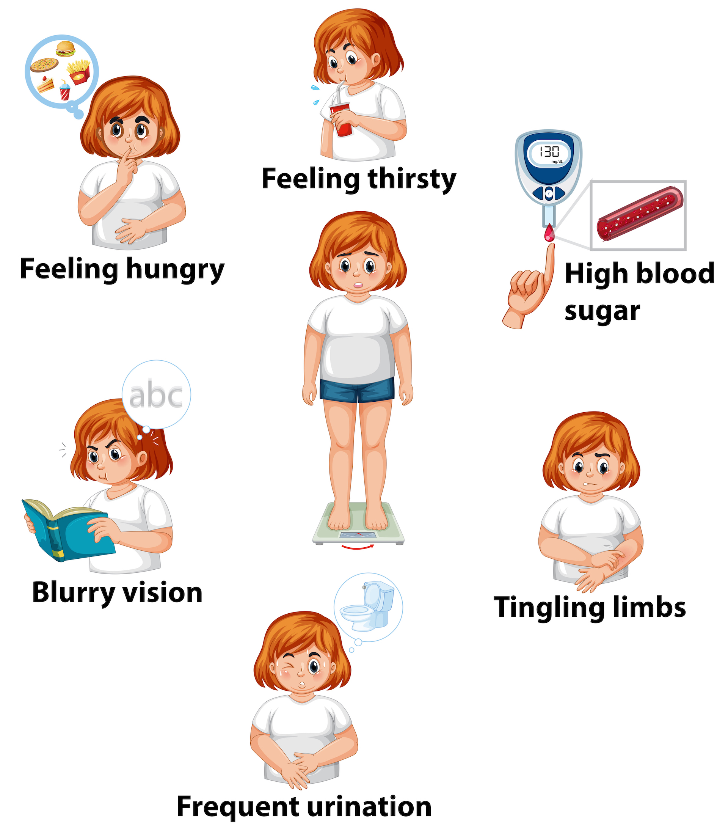
Symptoms of Gestational Diabetes
Increased, frequent urination.
Increased thirst.
Fatigue.
Nausea and vomiting.
Weight loss even with increased appetite.
Blurred vision.
Yeast infections.
14

Slide 15
Prevention
Eat healthy foods.
Exercising before and during pregnancy
Start pregnancy at a healthy weight.
Don't gain more weight than recommended.
15

Slide 16
CONCLUSION
Gestational diabetes is a type of high blood sugar (glucose) that develops during pregnancy and usually goes away after the baby is born.
Women with gestational diabetes are at increased risk of developing diabetes in the future.
16

Slide 17
References
Diabetes [Internet]. World Health Organization. World Health Organization; [cited 2022May02]. Available from: https://www.who.int/health-topics/diabetes#tab=tab_1
NHS choices. NHS; [cited 2022May02]. Available from: https://www.nhs.uk/conditions/gestational-diabetes/
Plows JF, Stanley JL, Baker PN, Reynolds CM, Vickers MH. The pathophysiology of gestational diabetes mellitus [Internet]. International journal of molecular sciences. MDPI; 2018 [cited 2022May02]. Available from: https://www.ncbi.nlm.nih.gov/pmc/articles/PMC6274679/
17

Slide 18
Thank you !

