Slide 1


Libyan International Medical University
Faculty of Business Administration
The Various Democracy Presuppositions
Name :nahawand elhammali
Id :2752
Email : nahawand_2752@limu.edu.ly

Slide 2
Table of Content :
01.
Introduction
02.
Definition Of Democracy
03.
Types Of Democracy
04.
Functions Of Democracy
05.
The Characteristics Of Democracy
06.
Conclusion
07.
References

Slide 3
1.
Introduction

Slide 4

Democracy means rule by the people. The name is used for different forms of government, where the people can take part in the decisions that affect the way their community is run. The people select their leaders. These leaders take this decision about laws.

Slide 5

Definition of Democracy
The form of government in which political control is exercised by all the people, either directly or through their elected representatives. The word democracy itself means rule by the people.

Slide 6
03.
Types of Democracy

Slide 7

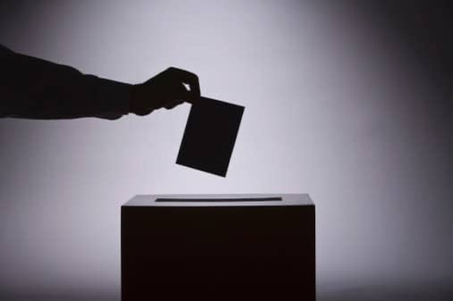
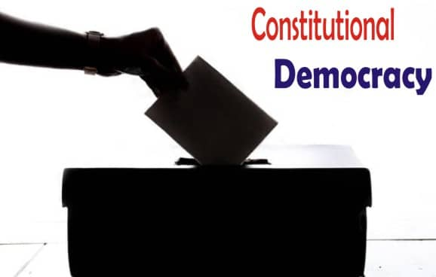
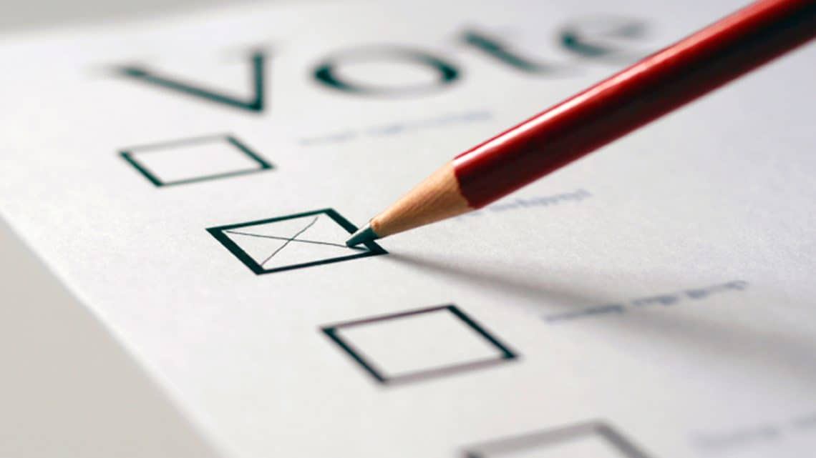
1. Direct Democracy
2. Representative Democracy
3. Constitutional Democracy
4. Monitory Democracy

Slide 8
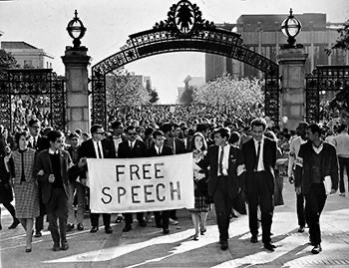
Democracies understand that one of their prime functions is to protect basic human rights such as freedom of speech and religion; the right to equal protection under law and the opportunity to organize and participate fully in the political, economic, and cultural life of society
The Main Functions of Democracy

Slide 9
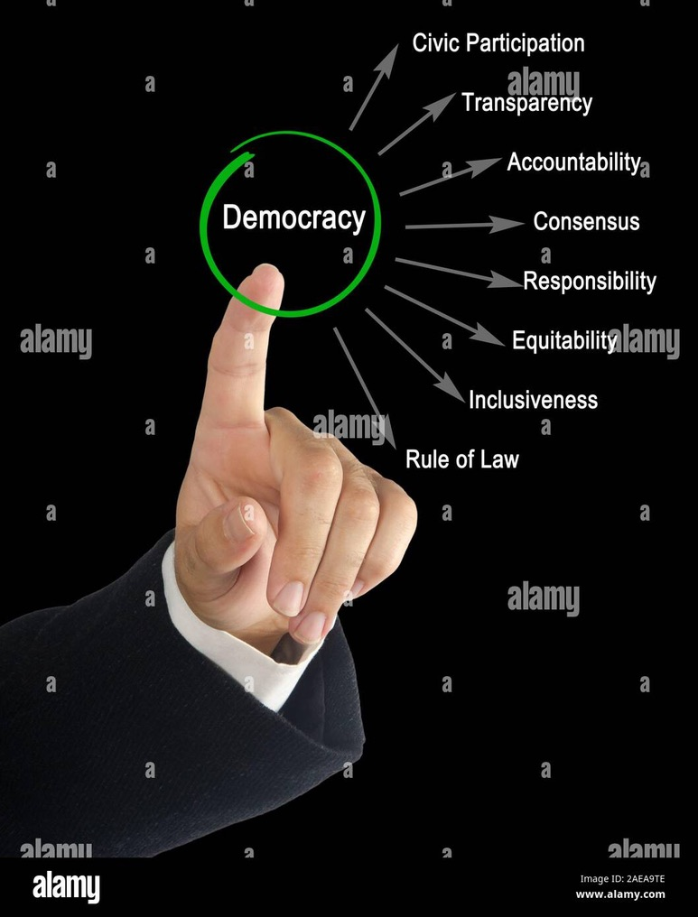




The Characteristics of Democracy

Slide 10
Conclusion
The word Democracy is the system of government in which all citizens, either directly or through their elected representatives, exert political control. The literally means is people's rule.

Slide 11
References
kirola, N. (2021, October 9). What is democracy?: Types of democracy: Principals of democracy. Dunia Ka Gyan. Retrieved November 29, 2021, from https://duniakagyan.com/what-is-democracy/.
Vaeenma. (2018, June 11). Characteristics of democracy stock illustration - illustration of election, transparency: 112562233. Dreamstime. Retrieved November 29, 2021, from https://www.dreamstime.com/characteristics-democracy-eight-characteristics-western-democracy-image112562233.
/75. Seenthis. (n.d.). Retrieved November 29, 2021, from https://seenthis.net/sites/1647496.

Slide 12
THANK YOU

