Slide 1


The Five Main Elements in a Control System
Define" Corrective Actions" in Management Control System
Libyan International Medical University
Faculty of Business Administration
By :Fatima Alzhraa Almkahl
ID: 3190
Email: fatimaalzhra_3190@limu.edu.ly

Slide 2
Objectives:
Understand 5 main elements in a control system:
Planning
Establishment of standards
Monitor and evaluate actual performance
Compare actual results with the expected results
. Rectify differences and take corrective actions
Understand " corrective actions" in management control system

Slide 3
Table of contents
01
02
03
Introduction
Elements Of Management Control System
Define" Corrective Actions" in Management Control System
04
05
Conclusion
References

Slide 4

01
Introduction

Slide 5
Introduction
Management control systems (MCS) are structures that a company's management uses to compare its goals and strategy to its actual performance. There are both official and informal management control methods.

Slide 6
02
Elements Of Management Control System

Slide 7
Elements Of Management Control System:
Five elements that are related to the management control system can be identified:
Planning
Establishment of standards
Monitor and evaluate actual performance
Compare actual results with the expected results
Rectify differences and take corrective actions

Slide 8
Planning
we already know what is planning
Business organizations should clearly identify their purpose of existence. Based on this purpose, the vision, mission, goals, and objectives should be defined by the organization. these goals and objectives should be achievable with the available resources and should align with the external factors of the business.

Slide 9
Establishment of standards
Managers should set standards to measure the success and performance of business activities when implementing business strategy and defining company's operations. These standards and measurements help the company in aligning its business activities with the company's goals and objectives.

Slide 10
Monitor and evaluate actual performance:
Once the performance standards are set in place, the organization should put necessary measures in place to monitor and evaluate the performance at multiple levels of the production process. It helps to identify the performance at each level of the production process and helps the management in strategic decision-making.

Slide 11
Compare actual results with the expected results
Once the performance details are obtained, those details should be compared with the expected results. This helps the business to identify the success level of their goal attainment. The comparison of actual and expected performance levels helps the business to focus more on the areas that need improvement.

Slide 12
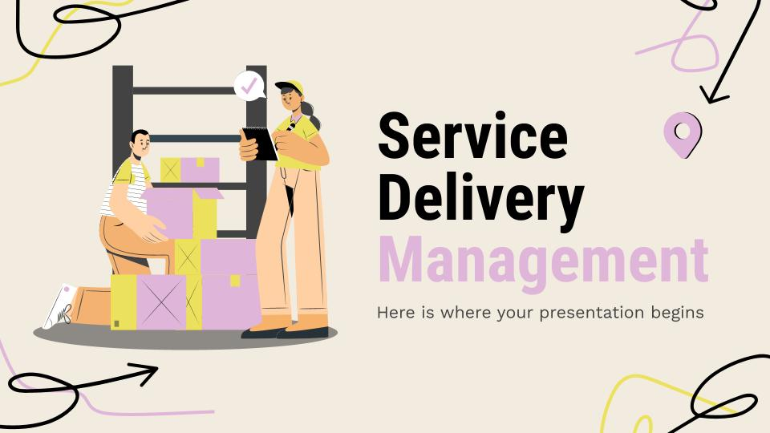
Rectify differences and take corrective actions
If there is a difference between the expected result and the actual result of the performance, the business should take immediate measures to rectify the cause for the difference. The reason for the difference should be identified and the corrective actions should be implemented accordingly.

Slide 13

03
Define" Corrective Actions" in Management Control System

Slide 14
What is " Corrective Actions" in Management Control System?
Rectify differences and take corrective actions
Corrective action is an aspect of quality management that aims to rectify a task, process, product, or even a person’s behavior when any of these factors produce errors or have deviated from an intended plan. Corrective actions can be thought of as improvements to an organization to eliminate undesirable effects

Slide 15
04
Conclusion

Slide 16
Conclusion
This is a repetitive process throughout the life span of the business as it is highly important for the business to keep its activities aligned with the expectations from the business. since the business environments are changing often, it can create an impact on the business process. To avoid any negative impact on the business, it is mandatory for the business to make constant changes and improvements to survive in the business as well as to achieve.

Slide 17
05
References

Slide 18
1 | An introduction to corrective actions. (n.d.). Retrieved May 11, 2022, from https://www.smartsheet.com/corrective-action#:~:text=Corrective%20action%20is%20an%20aspect%20of%20quality%20management,improvements%20to%20an%20organization%20to%20eliminate%20undesirable%20effects.
2 | Admin. (2021, October 20). Management control systems: Meaning and 05 main elements. Retrieved May 11, 2022, from https://www.econposts.com/business-management/management-control-systems/

Slide 19
Thanks For your attention
Do you have any questions?

