Slide 1


Libyan International Medical University
Faculty of Business Administration
The Exchange Process
Presented By: Alaa Rashwan
ID:3313
E-mail:alaa_3313@limu.edu.ly

Slide 2
Table of Content
01
Introduction
02
The meaning of exchange process
03
The conditions for exchange in marketing
04
Why is exchange important in marketing
05
06
Conclusion
References
2

Slide 3
Introduction
At the beginning of any marketing course or programme it is important to appreciate how exchange process work. Exchange marketing describes the basic process of a company offering a good or service of value customer willing to buy it.
3

Slide 4

The Meaning of Exchange Process
A marketing exchange is what happens any time two or more people trade goods or services (Chron,2020). Such as suppliers and customers.
Marketing theorists consider exchange to be the central concept without which there would be no such thing as marketing .
For an exchange to happen, both parties have to have something of value for each other.
4

Slide 5

The Conditions for Exchange in Marketing
Two or more individuals, groups, or organizations must participate.
The exchange should provide a benefit or satisfaction to both parties involved in the transaction.
Each party must have confidence in the promise of the "something of value" held by the other.
To build trust, the parties to the exchange must meet expectations.
5

Slide 6
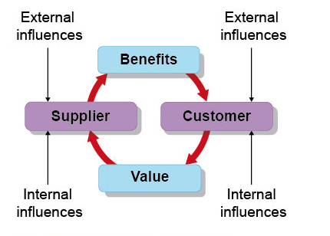
Why is Exchange Important in Marketing
The concept of exchange value in marketing is a useful tool to position product and service offerings. Consumers use value to evaluate the worth of the offerings as compared to competitive offerings. From the seller’s perspective, buyer oriented pricing involves understanding consumers’ benefit needs and setting a price consistent with this value. This paper suggests that the exchange value concept is a medium for achieving a more balanced relationship between buyer and seller in the market place.
6

Slide 7
Conclusion:
To sum up , without the exchange process, there would be no marketing. It is all about trading goods and services between two or more people, To create balanced relationship between buyer and seller in the market place.
7

Slide 8
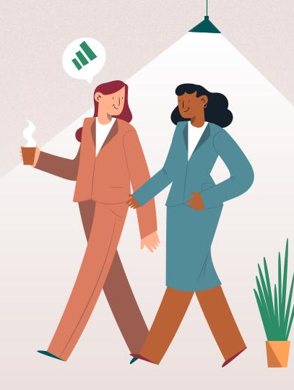
Reference:
Redirection to equivalent @ cengage. (n.d.). Retrieved March 21, 2022.
Dodds, W. B. (2015, December 1). The exchange value concept in marketing. ResearchGate. Retrieved March 21, 2022.
Friesner, A. T. (2016, April 28). Marketing exchange process. Marketing Teacher. Retrieved March 21, 2022.
Kokemuller, N. (2017, November 21). How should an exchange relationship marketing strategy work? Your Business. Retrieved March 21, 2022.
Contributor, C. (2020, September 8). What is a marketing exchange? Small Business - Chron.com. Retrieved March 21, 2022.
8

Slide 9
Thanks
Alaa Rashwan
9

