Slide 1
Hypopituitarism
Dr Mousa Tuwati Alfakhri

Slide 2
Anatomy
Pituitary gland is enclosed in sella turcica and bridged over by fold of dura mater called diaphragma sellae, with sphenoidal air sinuses below and optic chiasm above.
The cavernous sinuses are lateral to pituitary fossa and contain 3rd, 4th and 6th cranial nerves and internal carotid arteries.
The gland is composed of two lobes, anterior and posterior, and is connected to hypothalamus by infundibular stalk, which has portal vessels carrying blood from hypothalamus to anterior lobe and nerve fibres to posterior lobe

Slide 3
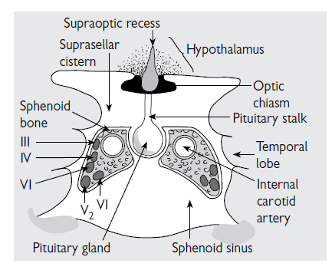

Slide 4
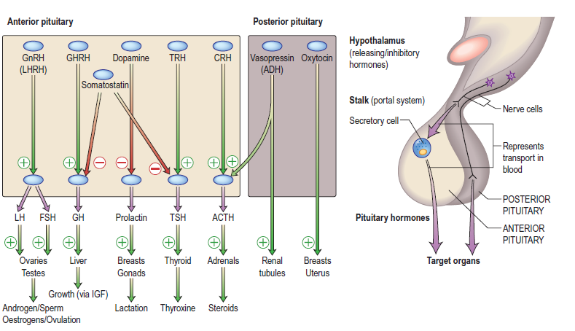
Notes:
Thyroid-stimulating hormone-releasing hormone (thyrotropin-releasing hormone [TRH]) stimulates the release of TSH.
Corticotropin-releasing hormone (CRH) stimulates the release of adrenocorticotropin.
Somatotropin-releasing hormone (SRH) stimulates the release of somatotropin (growth hormone).
Luteinizing hormone-releasing hormone (LHRH) stimulates the release of luteinizing hormone (LH) and FSH.
Prolactin-releasing hormone (PRH) stimulates the release of prolactin.
Prolactin inhibitory factor (PIF) inhibits prolactin secretion.

Slide 5
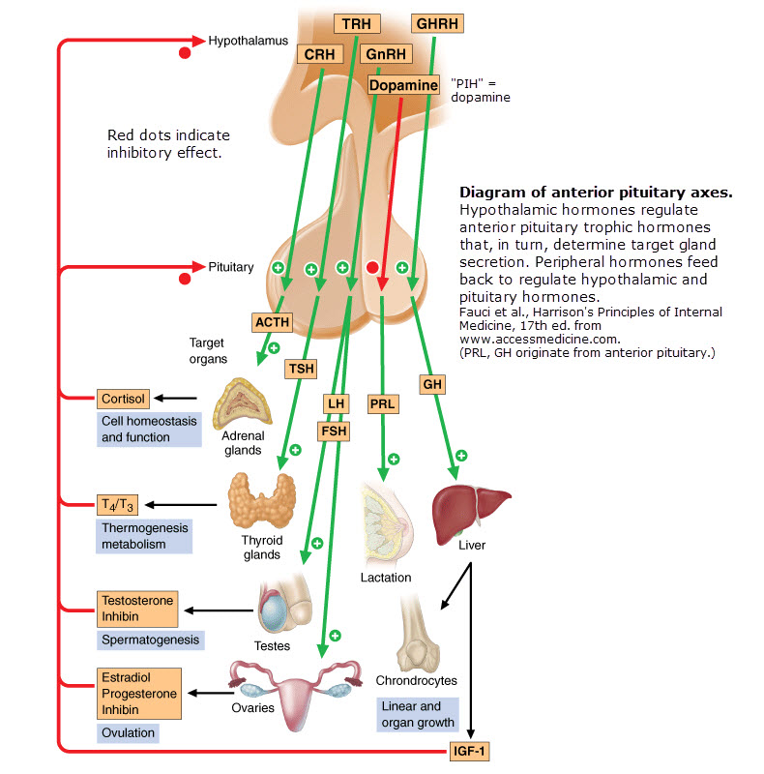

Slide 6
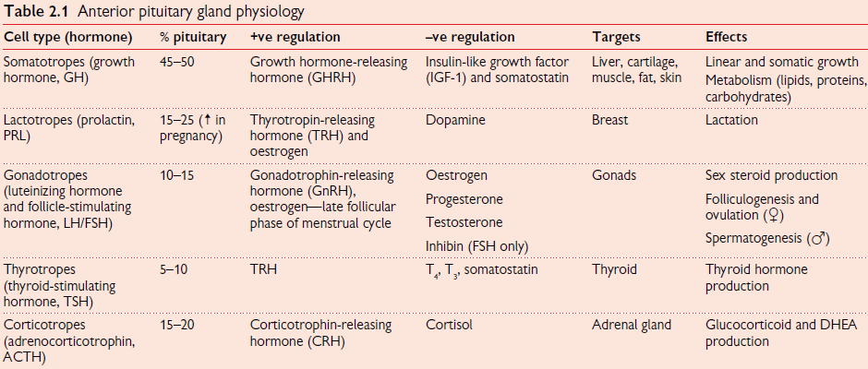

Slide 7
Hypopituitarism
Definition
Causes
Clinical features
Investigations and diagnosis
treatment

Slide 8
Definition
Deficiency of one or more hormones of pituitary gland ,Due to pituitary disease or to hypothalamic pathology which interferes with the hypothalamic control of pituitary
Deficiency of one or multiple hormones of the anterior pituitary -hypopituitarism
Deficiency of the posterior lobe -central diabetes insipidus
Deficiency of all pituitary hormones panhypopituitarism

Slide 9
Causes
Pituitary tumours(macroadenomas).
Parapituitary tumours—craniopharyngiomas, meningiomas, secondary deposits (e.g. breast, lung), gliomas.
Radiotherapy—pituitary, cranial, nasopharyngeal.
Pituitary infarction (apoplexy), Sheehan’s syndrome.
Infiltration of the pituitary gland—sarcoidosis, lymphocytic hypophysitis, haemochromatosis,
Empty sella.

Slide 10
Causes... Contd.
Infection—tuberculosis, pituitary abscess.
Trauma (including traumatic brain injury).
Subarachnoid haemorrhage.
Isolated hypothalamic-releasing hormone deficiency, e.g. Kallmann’s syndrome due to GnRH deficiency.
Genetic causes.

Slide 11
Clinical Features
clinical features depend on type and degree of hormonal deficits.
In majority of cases, development of hypopituitarism follows characteristic order, with secretion of GH,then gonadotrophins being affected first, followed by TSH and ACTH secretion at later stage. PRL deficiency is rare, except in Sheehan’ssyndrome associated with failure of lactation.
ADH deficiency is virtually unheard of with pituitary adenomas but may be seen rarely with infiltrative disorders and trauma

Slide 12
Specific Hormone Deficiencies

Slide 13
Gonadotropin Deficiency
Women
Oligomenorrhea or amenorrhea
Loss of libido
Vaginal dryness or dyspareunia
Loss of secondary sex characteristics (estrogen deficiency)
Men
Loss of libido
Erectile dysfunction
Infertility
Loss of secondary sex characteristics
Atrophy of testes
Gynecomastia (testosterone deficiency)

Slide 14
ACTH Deficiency
Results in hypocortisolism
  Malaise
  Anorexia
  Weight-loss
  Gastrointestinal disturbances
  Hyponatremia
Pale complexion
  Unable to tan or maintain a tan
No features of mineralocorticoid deficiency
  Aldosterone secretion unaffected

Slide 15
TSH Deficiency
Secondary Hypothyroidism
apathy and cold intolerance. In contrast to primary hypothyroidism, frank myxoedema is rare, presumably because the thyroid retains some autonomous function

Slide 16
Prolactin Deficiency
Inability to lactate postpartum
Often 1st manifestation of Sheehan syndrome

Slide 17
Growth Hormone Deficiency
Adults
  Often asymptomatic
  May complain of
    Fatigue
    Degrees exercise tolerance
    Abdominal obesity
    Loss of muscle mass
Children
  GH Deficiency
  Constitutional growth delay

Slide 18
Diagnosis
Biochemical diagnosis of pituitary insufficiency
  Demonstrating low levels of trophic hormones in the setting of low target hormone levels
Provocative tests may be required to assess pituitary reserve

Slide 19
Diagnosis of Hypocortisolism
Basal ACTH secretion
  Cortisol < 3 μg/dL, cortisol deficiency
  Cortisol > 18μg/dL, sufficient ACTH
  Cortisol > 3 μd/dL but < 18 μg/dL - test ACTH reserve
ACTH reserve
Short ACTH stimulation test( synacthin test)
    ACTH (0.25mg IM or IV)→0,30,60 min serum cortisol
    (Cortisol > 18 μg/dL, normal)
Insulin tolerance test only if there is uncertainty in interpretation of short ACTH stimulation test
    regular insulin (0.05-0.15U/Kg I.V.)→-30,0,30,60,90 min for glucose and cortisol
    Normal respose -Glucose<40mg/dl. Cortisol>18ug/dl

Slide 20
Diagnosis of Hypothyroidism
Measure random serum T4
Note that TSH is often detectable in secondary hypothyroidism

Slide 21
Diagnosis of Hypogonadism
In the male, measure random serum testosterone, LH andFSH
In the pre-menopausal female, ask if the menses are regular
In the post-menopausal female, measure random serum LH and FSH (FSH normally > 30 IU/L and LH > 20 IU/L)

Slide 22
Diagnosis of GH Deficiency
Insulin tolerance test:
Regular insulin(0.05-0.15U/kg I.V.)
0,30,60,120 min for glucose & GH
Normal respose
Glu˂40mg/dl
GH˃3μg/L-Normal
Contraindications
• Ischaemic heart disease
• Epilepsy
• Severe hypopituitarism (08:00 hrs plasma cortisol <(6.6 μg/dL)

Slide 23
Establish the anatomy and diagnosis
Consider visual field testing
Image the pituitary and hypothalamus by MRI or CT

Slide 24
Treatment
Hormone replacement therapy
  usually free of complications
Treatment regimens that mimic physiologic hormone production
  allow for maintenance of satisfactory clinical homeostasis

Slide 25
Hormone Replacement
Hormone Deficit | Hormone Replacement
ACTH | Hydrocortisone (10-20 mg A.M.; 10 mg P.M.) Prednisone (5 mg A.M.; 2.5 mg P.M.)
TSH | L-Thyroxine (0.075-0.15 mg daily)
FSH/LH | Males Testosterone enanthate (200 mg IM every 2 wks) Testosterone skin patch (5 mg/d) Females Conjugated estrogen (0.65-1.25 mg qd for 25days) Progesterone (5-10 mg qd) on days 16-25 Estradiol skin patch (0.5 mg, every other day) For fertility: Menopausal gonadotropins, human chorionic gonadotropins
GH | Adults: Somatotropin (0.3-1.0 mg SC qd) Children: Somatotropin [0.02-0.05 (mg/kg per day)]
Vasopressin | Intranasal desmopressin (5-20 ug twice daily) Oral 300-600 ug qd

