Slide 1
Laryngeal tumors
Dr. Salem Alzwai

Slide 2
Bengin tumors
Laryngeal papilloma: Most common, caused by Human papilloma virus (type 6, 11). Possible in utero transmission. Presents as hoarseness or airway difficulty. Clinical course highly variable. Plethora of treatments, including surgery, laser, interferon, mumps vaccines, phototherapy and radiation.

Slide 3
Benign tumors
Chondroma: Cricoid cartilage most commonly affected. Present commonly with hoarseness. Differentiation with malignant lesion is difficult. Excision is curative.
Haemangiomas:Juvenile and adult forms, Juvenile form generally associated with cutaneous lesion. Large tumours may require a tracheostomy until their natural resolution
Paraganglioma, Neurofibroma, leiomyoma, rhabdomyoma, salivary gland tumors

Slide 4
Malignant tumors
Epidemiology
Larynx is the most common site for squamous cell carcinoma in the head and neck.
Worldwide, laryngeal tumors account for 156 000 per year and 83 000 deaths.
The incidence is more in men.
The tumors are most common after the age of 60 years and less common under 40.
The incidence of laryngeal cancer has decreased by 20% between 1990 and 2002.

Slide 5
Etiology
Smoking
Alcohol intake
The combination of smoking and alcohol is synergistic rather than additive.
Exposure to toxic agents such as asbestos, wood dust and cement dust.
Low socioeconomic status.
Some syndromes such as Fanconi anemia and congenital dyskeratosis.
HPV infection.

Slide 6
Pathology
Squamous cell carcinomas accounts for over 95% of primary laryngeal cancers.
Other less common malignancies include verrucous carcinoma, adenocarcinoma, spindle cell carcinoma, fibrosarcoma and chondrosarcoma.

Slide 7
Anatomy of the larynx
the larynx is divided into three regions, supraglottis, glottis, subglottis.
The supraglottis includes laryngeal surface of the epiglottis, aryepiglottic folds, arytenoids, false vocal cords.
The glottis contains the true vocal cords, the anterior commissure , the interarytenoid region, and the floor of the ventricle. It extends inferiorly to 1 cm below the apex of the ventricles.

Slide 8
Anatomy of the larynx
The conus elasticus arises from the inner surface of the cricoid arch and extends superiorly to attach anteriorly to the inner surface of the thyroid cartilage and posteriorly to the tip of the vocal process of the arytenoid.
The quadrangular membrane extends between the arytenoids and the epiglottis. Its upper border forms the aryepiglottic fold, while the free lower border constitutes the false vocal cord.

Slide 9
Anatomy of the larynx
The preepiglottic space: lies anterior to infrahyoid epiglottis. It is bounded superiorly by hyoepiglottic ligament, inferiorly by the attachment of epiglottis to the thyroid cartilage and anteriorly by the thyrohyoid membrane and upper part of the thyroid cartilage. Laterally, it merges with the paraglottic space.

Slide 10
Anatomy of the larynx
The paraglottic space surrounds the laryngeal ventricle.
It is bounded anterolaterally by the thyroid cartilage, posterolaterally by the pyriform sinus mucosa.
Superomedially by the quadrangular membrane and inferomedially by the conus elasticus.

Slide 11
Lymphatic drainage
The supraglottis has a rich lymphatic drainage, and drains to level II, III, IV groups of lymph nodes.
The drainage from the glottis is sparse.
The subglottis drains mainly to the paratracheal lymph nodes ( level VI )

Slide 12
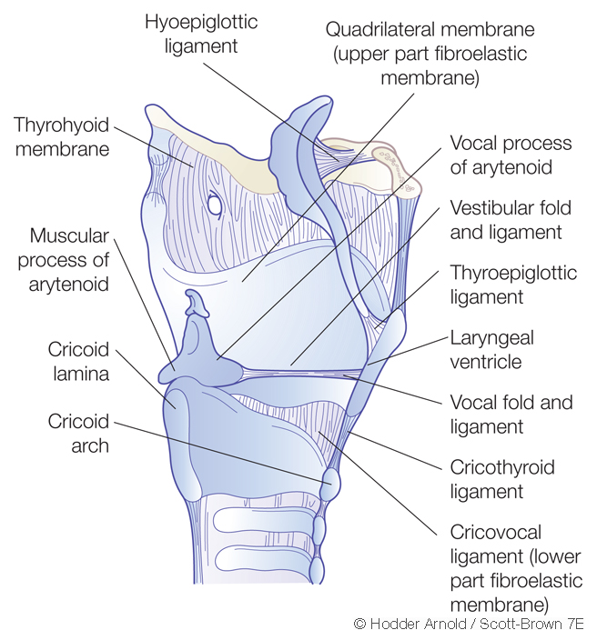

Slide 13
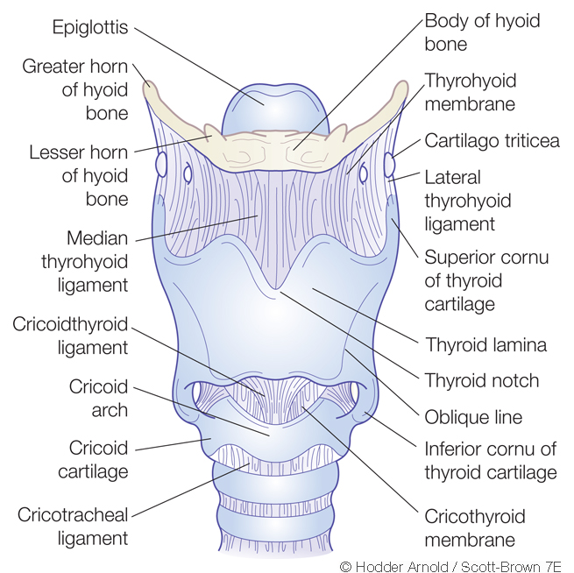

Slide 14
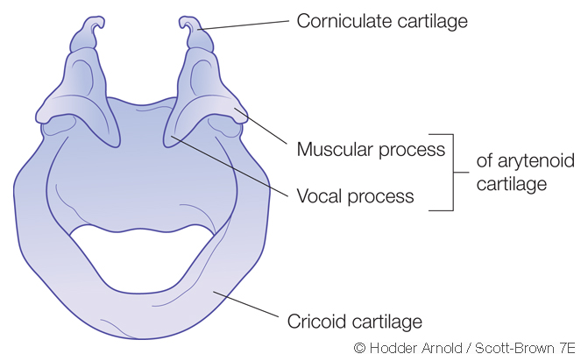

Slide 15
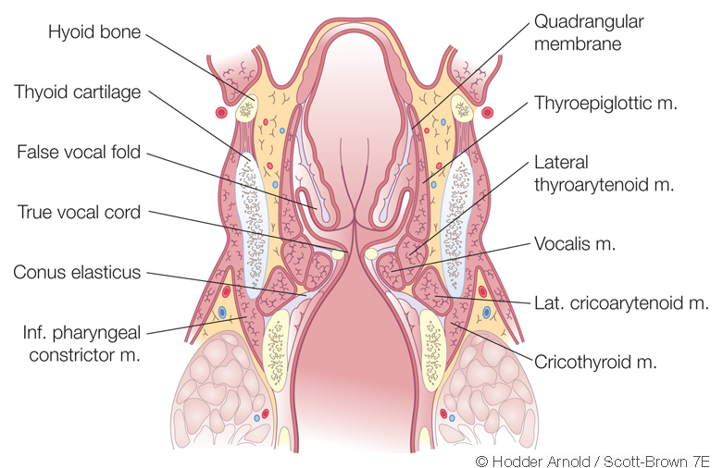

Slide 16
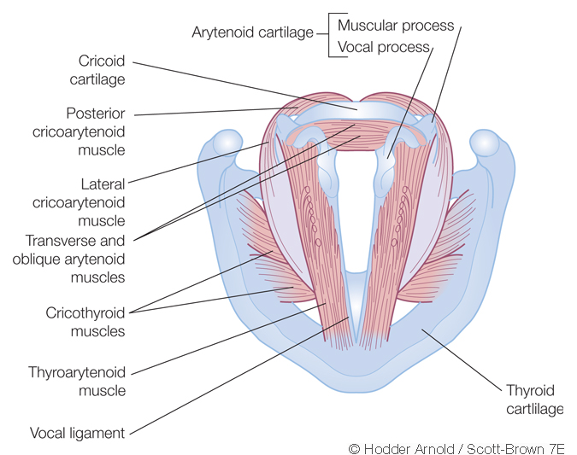

Slide 17
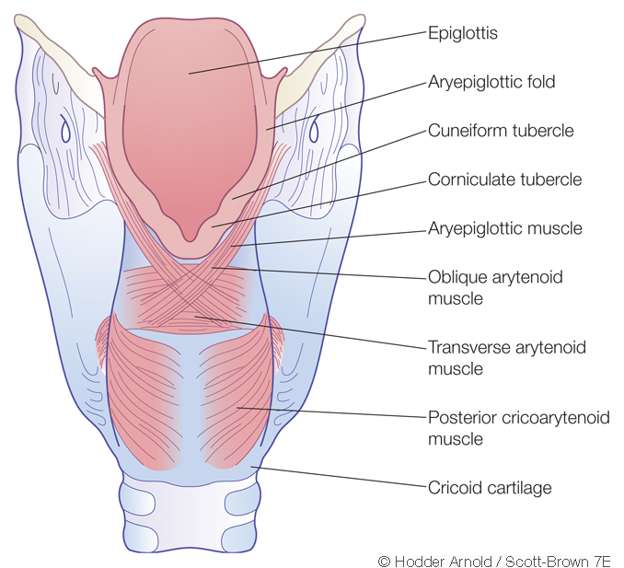

Slide 18
Clinical presentation
Glottic cancer:
Hoarseness of voice.
Breathiness
Aspiration
Dyspnea and stridor
Referred otalgia
Neck nodes

Slide 19
Clinical presentation
Supraglottic cancer:
Globus or foreign body sensation
Cervical LAP
Hemoptysis
Referred otalgia
Altered phonation

Slide 20
Clinical presentation
Subglottic cancer:
Foreign body sensatios
Hoarseness of voice
Dyspnea and stridor

Slide 21
Assessment and staging
Outpatient setting:
Detailed history and examination.
Flexible nasal laryngoscope is the preferred tool to the examine the larynx.
Imaging: ( neck and chest )
CT scan
MRI , better in detection of cartilage invastion.
Assessment of pulmonary function.

Slide 22
staging
Larynx: Glottis:
TX: Primary tumor cannot be assessed.
Tis: Carcinoma in situ
T1: Tumor limited to the vocal cord(s) (may involve anterior or posterior commissure), with normal mobility
T1a: Tumor limited to 1 vocal cord
T1b: Tumor involves both vocal cords
T2: Tumor extends to the supraglottis and/or subglottis, and/or with impaired vocal cord mobility.
T3: Tumor limited to the larynx with vocal cord fixation and/or invasion of the paraglottic space and/or inner cortex of the thyroid cartilage.
T4a: Tumor invades through the outer cortex of the thyroid cartilage and/or invades tissues beyond the larynx (eg, trachea, , soft tissues of the neck including deep extrinsic muscle of the tongue, strap muscles, thyroid, or esophagus).
T4b: Tumor invades prevertebral space, encases carotid artery, or invades mediastinal structures

Slide 23
staging
Larynx: Supraglottis:
TX: Primary tumor cannot be assessed.
Tis: Carcinoma in situ.
T1: Tumor limited to 1 subsite of the supraglottis, with normal vocal cord mobility.
T2: Tumor invades mucosa of more than 1 adjacent subsite of the supraglottis or glottis or region outside the supraglottis (eg, mucosa of base of the tongue, vallecula, medial wall of piriform sinus), without fixation of the larynx.
T3: Tumor limited to the larynx, with vocal cord fixation, and/or invades any of the following: postcricoid area, preepiglottic space, paraglottic space, and/or inner cortex of the thyroid cartilage.
T4: same as glottic cancer.

Slide 24
staging
Larynx: Subglottis:
TX: Primary tumor cannot be assessed.
Tis: Carcinoma in situ.
T1: Tumor limited to the subglottis.
T2: Tumor extends to vocal cord(s), with normal or impaired mobility.
T3: Tumor limited to the larynx with vocal cord fixation and/or invasion of paraglottic space and/or inner cortex of the thyroid cartilage.
T4: same as glottic and suprglottic cancers.

Slide 25
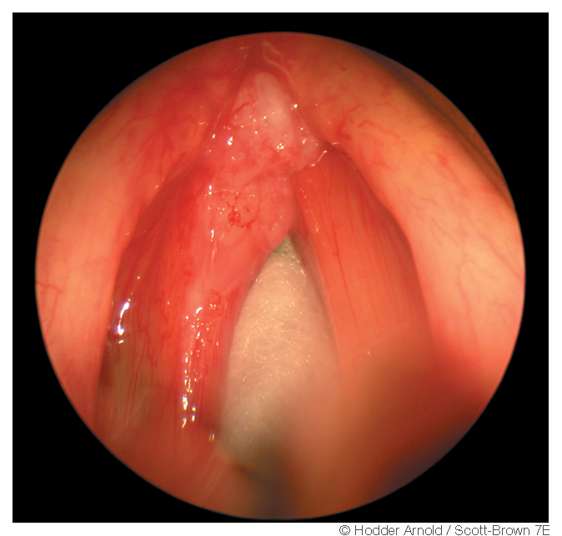

Slide 26
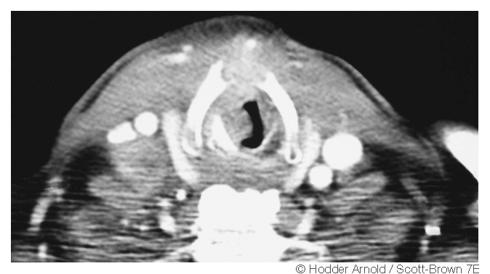

Slide 27
Management of early laryngeal cancer
Transoral partial laryngectomy.
Open partial laryngectomy
Radiation therapy

Slide 28
T3 laryngeal cancer
Chemoradiotherapy
Open partial laryngectomy
Tranoral partial laryngectomy
Total laryngectomy

Slide 29
T4 laryngeal cancer
Chemoradiotherapy
Total laryngectomy
Open partial laryngectomy or transoral partial laryngectomy in selected cases.

Slide 30
Management of the neck
Clinically or radiologically positive neck requires the patient to undergo neck dissection.
Ipsilateral positive neck requires ipsilateral neck dissection.
Contralateral or bilateral positive neck requires bilateral neck dissection.
Presence of multinodal or multilevel neck disease with extracapsular spread is an indication for radiotherapy or chemoradiotherapy.

Slide 31
Management of the neck
N0 neck:
if the risk of neck metastasis is more than 15 to 20 %, elective neck treatment is indicated.

Slide 32
Than you

