Slide 1


OZONE HOLE
Libyan International Medical University
Faculty of Business Administration
Course Instructor: Mr. Waleed Shaibani
Presentation By: Suzan Abdullah El Yakoubi
Student no: 2211
Email: Suzan_2211@limu.edu.ly

Slide 2
TABLE OF CONTENTS
INTRODUCTION
OZONE DEPLETION
AFFECTING FACTORS
CONCLUSION
REFERENCES

Slide 3
01 INTRODUCTION

Slide 4
INTRODUCTION
The ozone is the sheet or cover that is present on the earth's second major layer of its atmosphere called the stratosphere.
One of the ozone significant functions is the absorption of the sun's ultraviolet light rays and radiation., this ray if impacted straight onto the human skin, it may lead to severe skin damage.
The ozone hole due to consumption of vehicle and factory air pollution lead to eruption on the earths balance where major change occurred like climate change.

Slide 5
02 OZONE DEPLETION

Slide 6
OZONE DEPLETION
The ozone depletion means that there is as decrease in the ozone layer.
The major effect or hand on this issue is mankind, where the pollution resulted from our cars, factories, and some activities result in the diffusion of toxic gases that release a certain gas that effects the ozone.

Slide 7
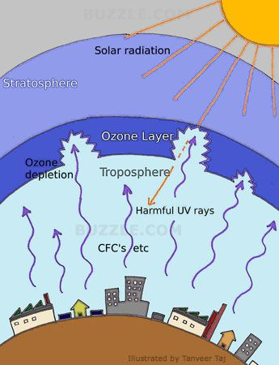
OZONE DEPLETION

Slide 8

03 AFFECTING FACTORS

Slide 9
FACTOR NO.1
HYBRID CARS
Recently, thanks to innovations in the car industry substituting normal cars to eco-friendly cars known as hybrid cars.
Having rechargeable batteries, or using solar systems to run the car instead of using fuel or diesel, where when burnt release toxic gases into the air causing air pollution.
Even though the demand on this type of cars isn’t very sufficient, several well-known car organizations have adopted this uprising idea to protect the environment.

Slide 10
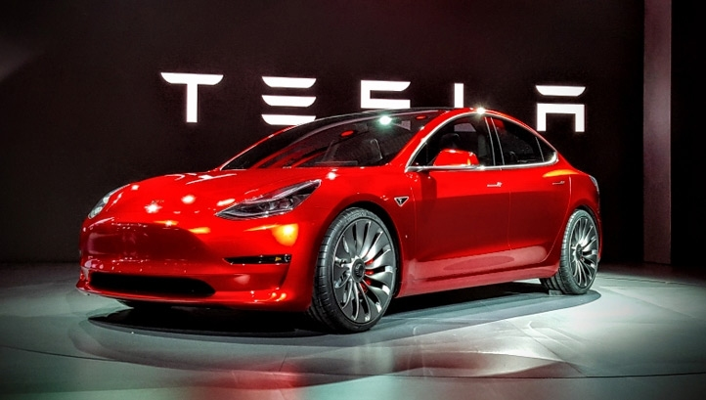
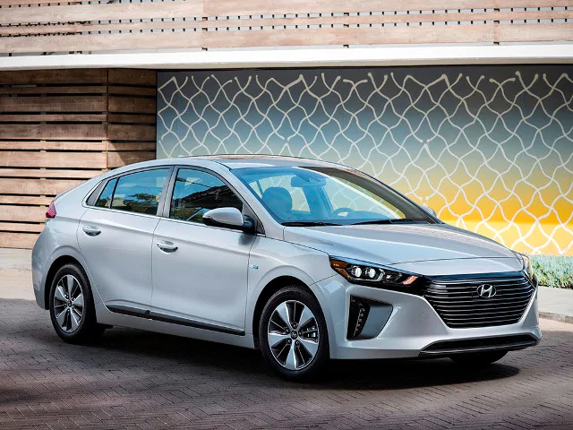
FACTOR NO.1
HYBRID CARS

Slide 11
FACTOR NO.2
CORONA VIRUS
Ever since the virus and the world has been in lockdown. This deadly virus forced all types of sectors to shut down from factories in the manufacturing sector, to stock markets, international brands and etc.
The shutdown of the of the factories and the rate or capacity of people at home not using their cars, led to no pollution in other words no toxic gases and chemicals are expelled into the atmosphere.

Slide 12
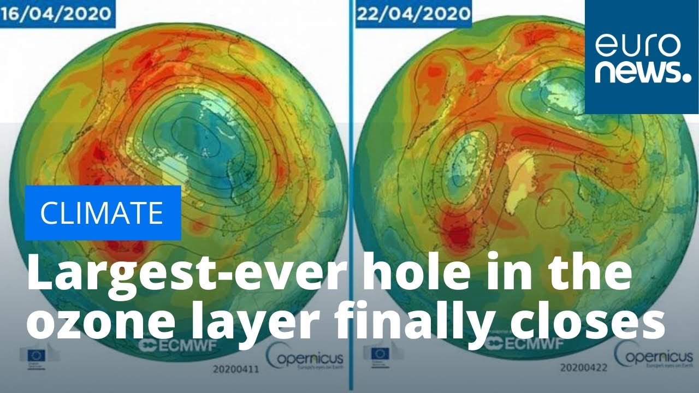
FACTOR NO.2
CORONA VIRUS

Slide 13
04 CONCLUSION

Slide 14
CONCLUSION
The ozone is the layer that is protecting us living creatures from any damage that may occur from the sun's rays and radiation.
The production of toxic gases and chemicals lead to the breach in the layer resulting a hole to occur.
The market and industry both have an influence of the ozone layer and vice versa where, like in times of this deadly virus like corona the amount of demand and supply of products and services has decreased causing a business criteria to almost most organizations.

Slide 15

05
REFERENCES

Slide 16

REFERENCES
Solomon, S. (1999). Stratospheric ozone depletion: A review of concepts and history. Reviews of Geophysics, 37(3), 275-316.
Rowen, R. J., & Robins, H. (2020). A Plausible “Penny” Costing Effective Treatment for Corona Virus Ozone Therapy. J Infect Dis Epidemiol, 6, 113.
Chua, W. Y., Lee, A., & Sadeque, S. (2010, January). Why do people buy hybrid cars?. In Proceedings of Social Marketing Forum, University of Western Australia, Perth, Western Australia (pp. 1-13). Edith Cowan University.

Slide 17
THANK YOU !

