Slide 1



The Different Types of Plans
Name : Ahmed Khalid ELthanie
ID : 2976
Email : ahmed_2976@limu.edu.ly

Slide 2
Table of contents
Definition of planning
01
02
Types of planning
03
Introduction
2

Slide 3
01
Introduction
3

Slide 4

Introduction
The major job of management is planning, and successful planning is critical for the organization's early fulfillment of its goals. Many aspects will be considered by the planner while designing any strategy for his undertaking.
4

Slide 5

Awesome words

Slide 6
02
Definition of Planning
6

Slide 7

Definition of Planning
planning in management
In management, planning entails determining what actions must be taken to achieve the objective, anticipating changes and obstacles, and determining how to best utilize human resources and opportunities to achieve the desired result.
7

Slide 8

Education
2007
2016
Jupiter is the biggest planet of them all
Saturn is composed of hydrogen and helium
2013
2020
Venus is the second planet from the Sun
Mars is actually a very cold place

Slide 9
03
Types of Planning
9

Slide 10
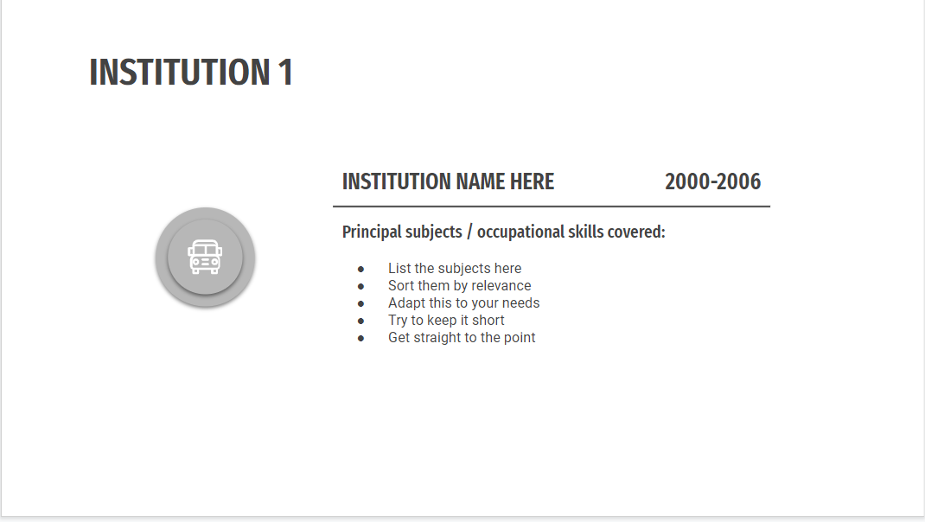
Types of planning
the four major types of plans
Operational Plans
Strategic Plans
Tactical Plans
Contingency Plans
10

Slide 11

Education
2007
2016
Saturn is composed of hydrogen and helium
2013
2020
Venus is the second planet from the Sun
Mars is actually a very cold place
Jupiter is the biggest planet of them all

Slide 12
References
(2017, December 10). Types of planning: What are the different types? - management. Bank With Us. Retrieved April 13, 2022, from https://www.bankwithus.in/types-of-planning/
Jowett, E., & Florien, S. (2021, November 1). Animation Project Management. Deride Animated Explainer Video Production Company | Animation Studio. Retrieved April 13, 2022, from https://darvideo.tv/dictionary/animation-project-management/
12

Slide 13
COCNLUSION
In management, planning entails determining what actions must be taken to achieve the objective, anticipating changes and obstacles, and determining how to best utilize human resources and opportunities to achieve the desired result.
12

Slide 14
Thank you
Any QUESTIONS

