Slide 1

Climate Change & Its Solution
PRESENTED BY: Moad Alsarah
ROLL NUM. 2988
2nd YEAR MED. STUDENT
24th May 2022
1

Slide 2


Objectives
Discuss the cause of climate change & List relevant greenhouse gases.
Describe the effect of transportation and possible solution.
Outline The primary sources of greenhouse gas emissions.
Discuss the effect of electricity production.
Outline the consequences of climate change on Libya.
2

Slide 3

INTRODUCTION
3

Slide 4
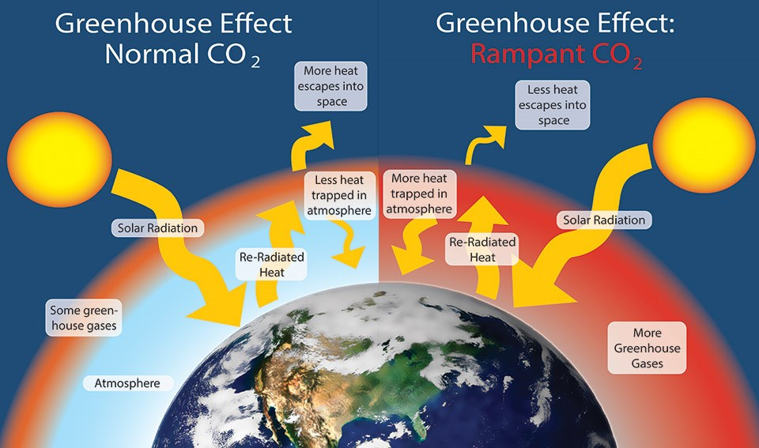

Slide 5
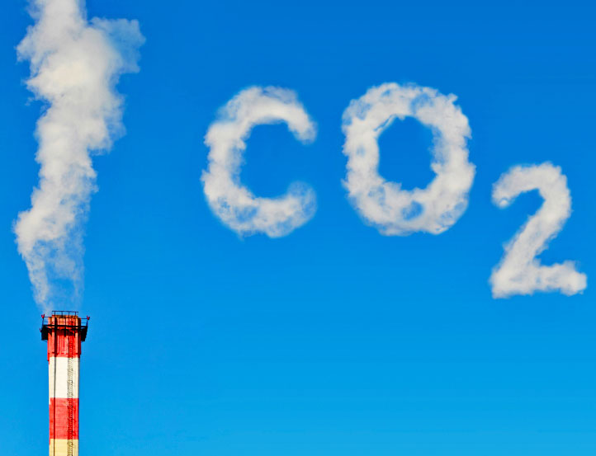
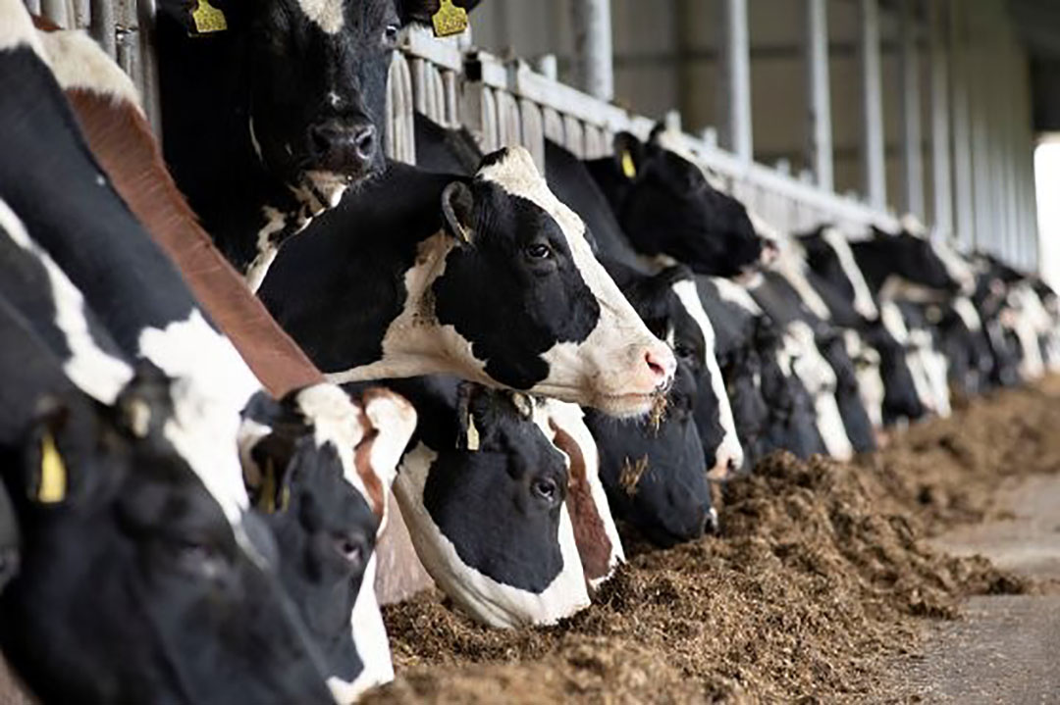
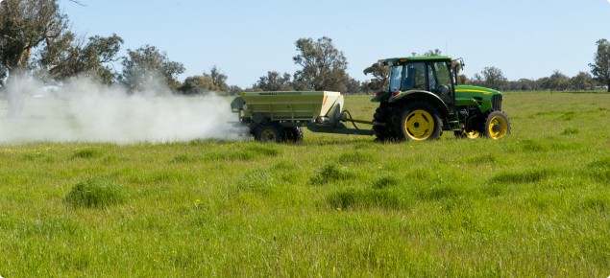
Relevant greenhouse gases
Carbon dioxide (CO2): The burning of fossil fuel use is the primary source.
Methane (CH4) : waste management, energy use, and biomass burning all contribute to CH4 emissions.
Nitrous oxide (N2O : (Agricultural activities, such as fertilizer use, are the primary source of N2O emissions.
5

Slide 6
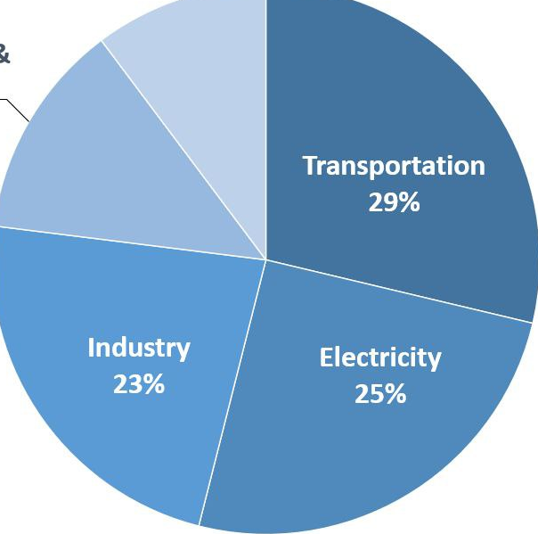
Total U.S greenhouse gas emission by economic sector in 2019 .
Agriculture
10%
Transportation
Commercial & residential
29%
13%
Industry
Electricity
23%
25%
6

Slide 7
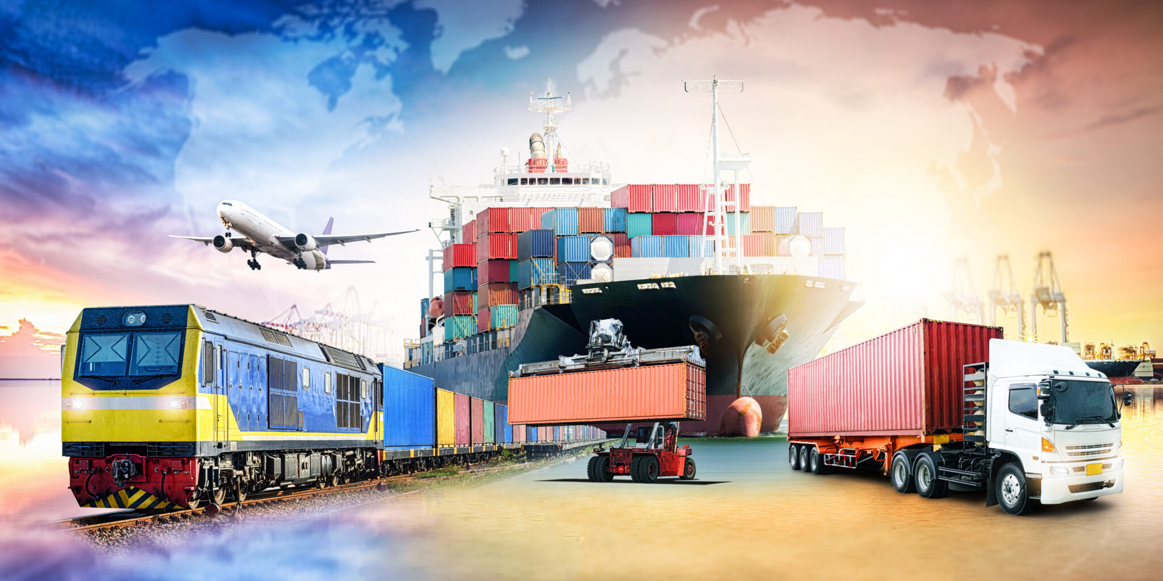
Effect of transportation
Transportation (29 % of 2019 greenhouse gas emissions)
The transportation sector generates the largest share of greenhouse gas emissions.
7

Slide 8


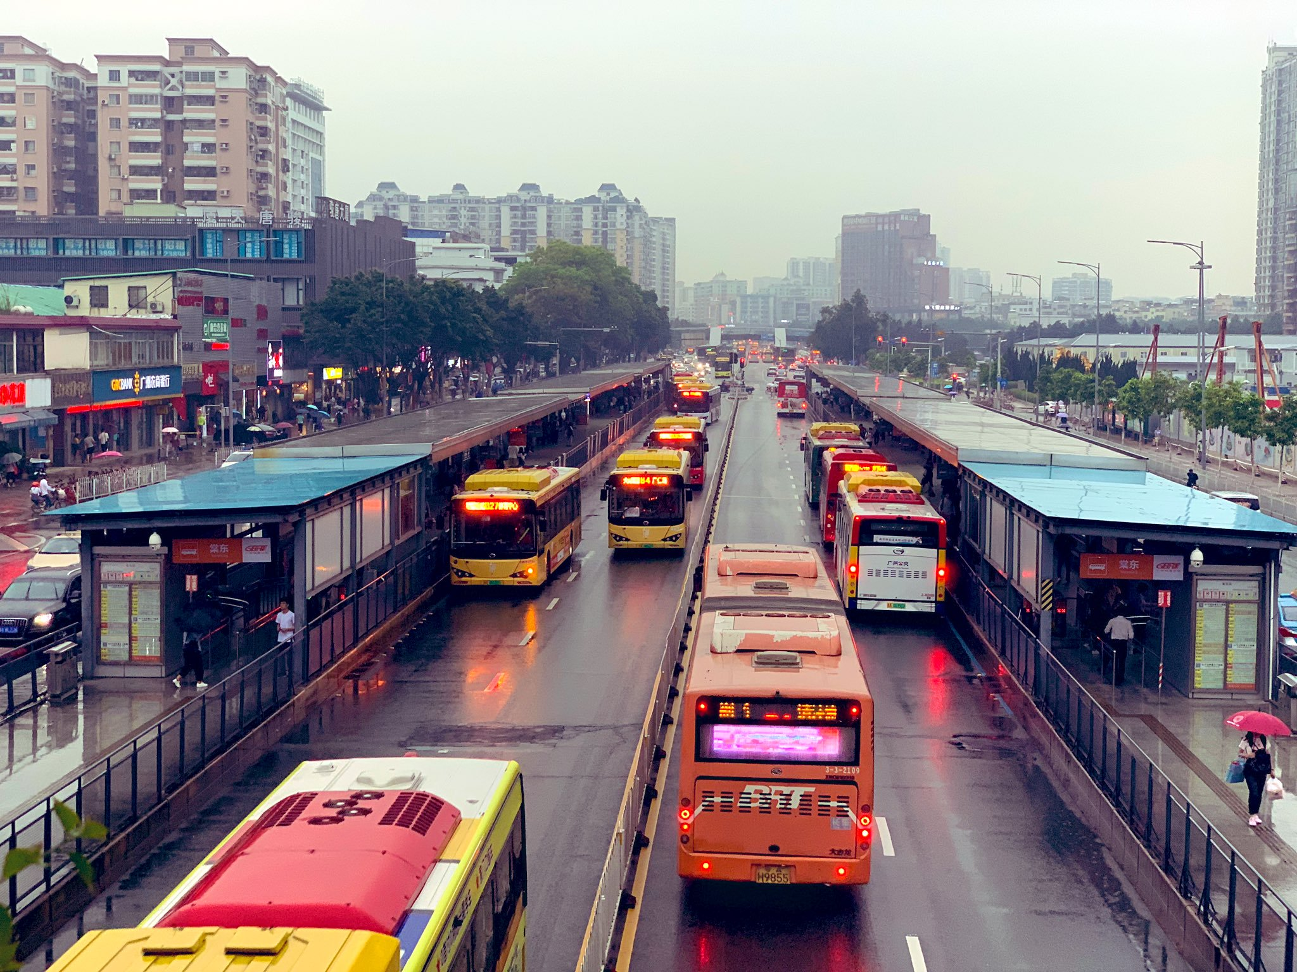
The solution for transportation
8

Slide 9
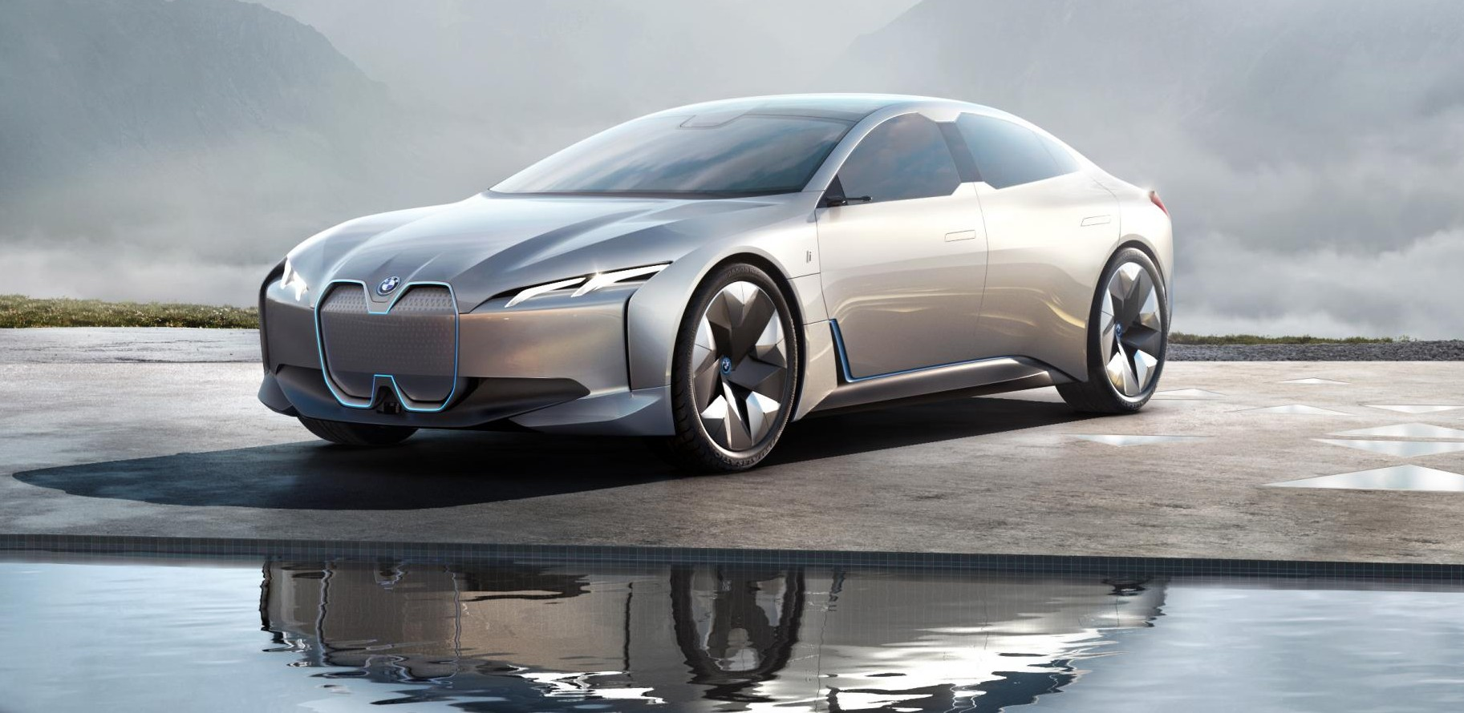
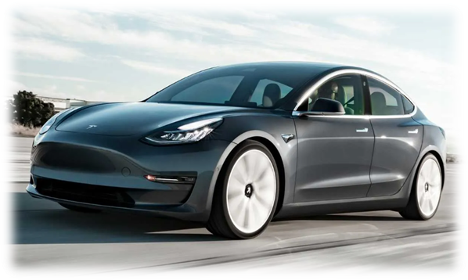
Do you think electric cars are a better alternative then traditional cars?
9

Slide 10
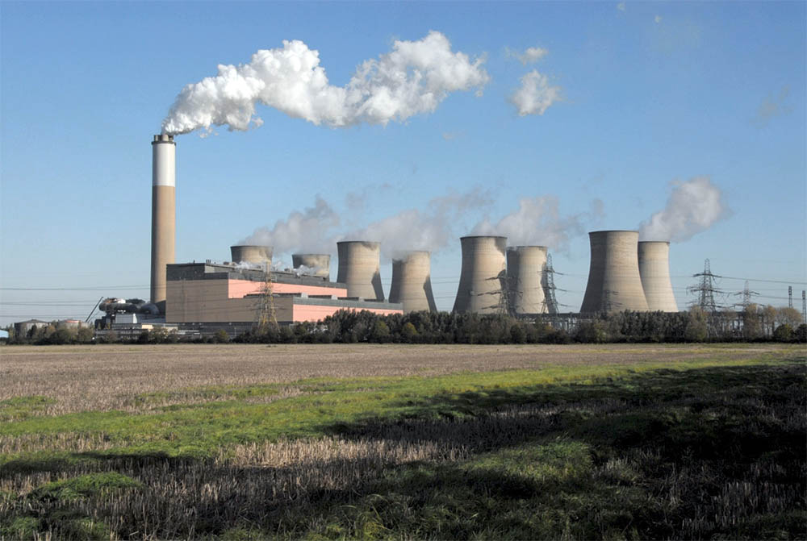
Effect of electricity production
Electricity production (25% of 2019 greenhouse gas emissions)
The electricity production generates the second largest share of greenhouse gas emissions .
10

Slide 11




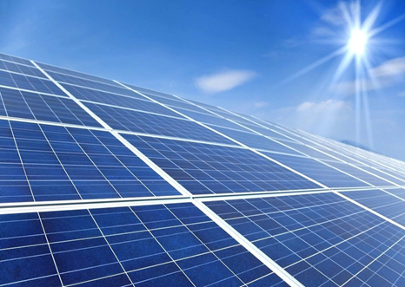
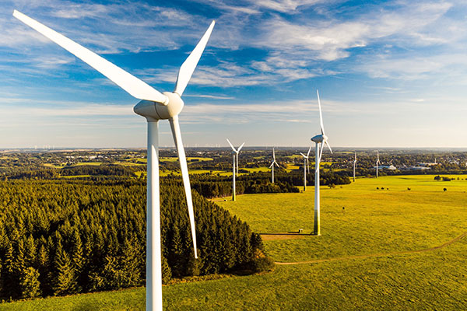
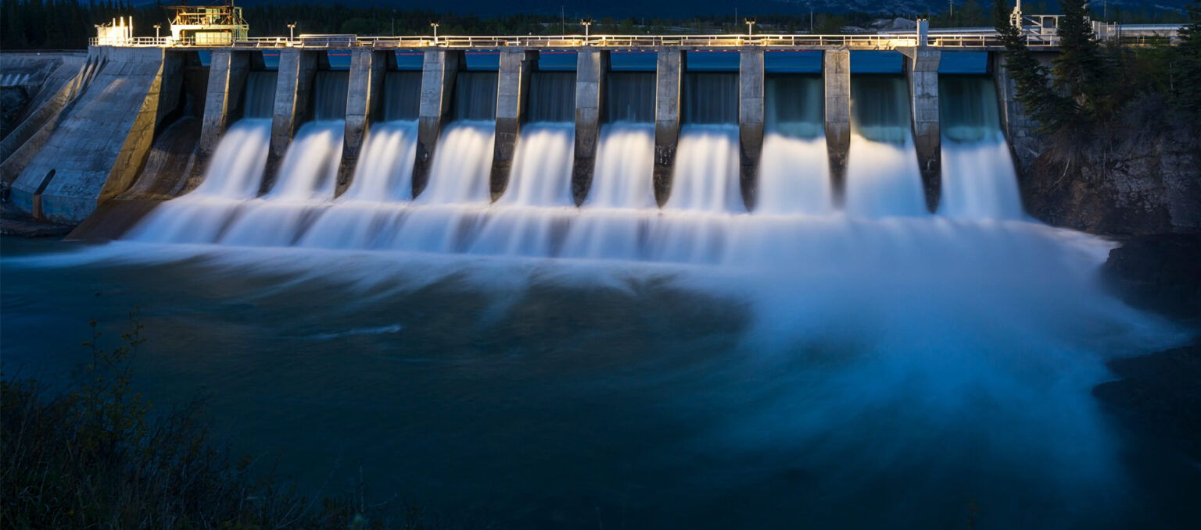
Hydro power
11

Slide 12

Do you think that the amount of CO2 that a Libyan person emits is higher or lower than a Chinese person?
12

Slide 13
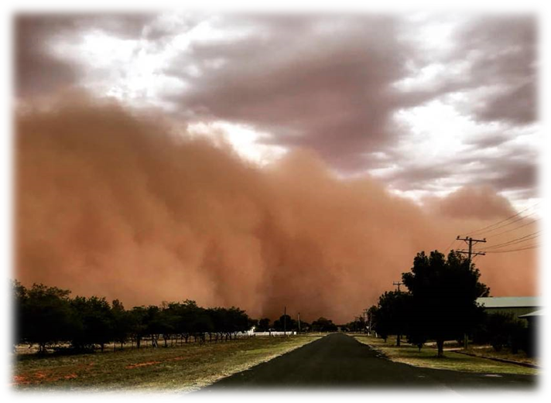
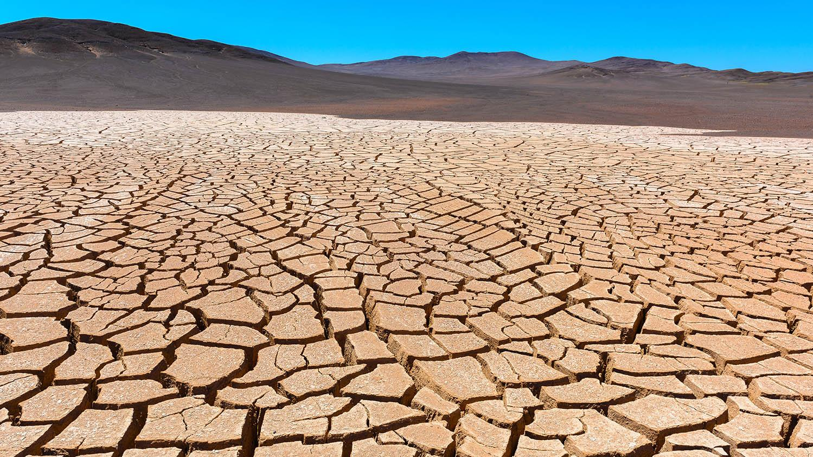
Consequences on libya
We emit 8.12 tons per person which is double the world average, and the highest in Africa.
13

Slide 14




Consequences
Air pressure is affected resulting in
dryer summers and more sandstorm.
The changed climate will cause the extinction of many species.
Mediterranean will like rise faster than any other body of water flooding cities like Benghazi.
Intense rains in the winter that will destroy infrastructure.
14

Slide 15
Conclusion
- Whether we like it or not we are in the center of climate change, And we will suffer the worst from its consequences.
- If we don't solve problems like our complete dependence on oil for our income, and energy We will be doomed.
- So when we talk about solution for climate change,We are not trying to save the planet we are saving our-selfs.
15

Slide 16
References
Sources of Greenhouse Gas Emissions | US EPA [Internet]. US EPA. 2019 [cited 22 May 2022].
Global Greenhouse Gas Emissions Data | US EPA [Internet]. US EPA. 2019 [cited 22 May 2022]
Denchak M. Greenhouse Effect 101 [Internet]. NRDC. 2019 [cited 22 May 2022].
Brubacher M. LIBYA CLIMATE-FRAGILITY RISK BRIEF [Internet]. Climate-security-expert-network.org. 2021 [cited 22 May 2022
16

Slide 17


