Slide 1



Diabetes
Nujoum ibrahim 3540
GBSM2
Year 1
18-5-2022

Slide 2
Objectives
The introduction.
Define the diabetes.
List type of diabetes.
Mention causes of children’s diabetes

Slide 3
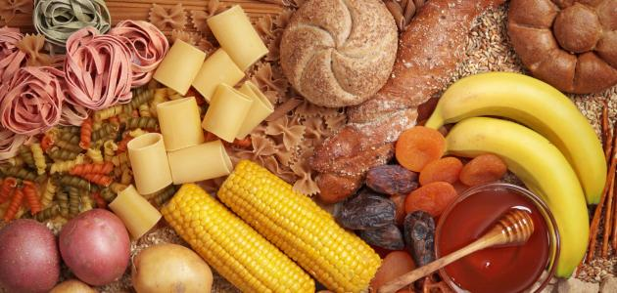
Introduction.
Most of the food you eat is broken down into sugar (also called glucose) .
When the level of glucose in the blood increases, the pancreas secretes the hormone insulin to adjust the level of sugar by entering it into the cells.
Diabetes is a disease related
to the level of glucose in
the blood and the hormone insulin.

Slide 4
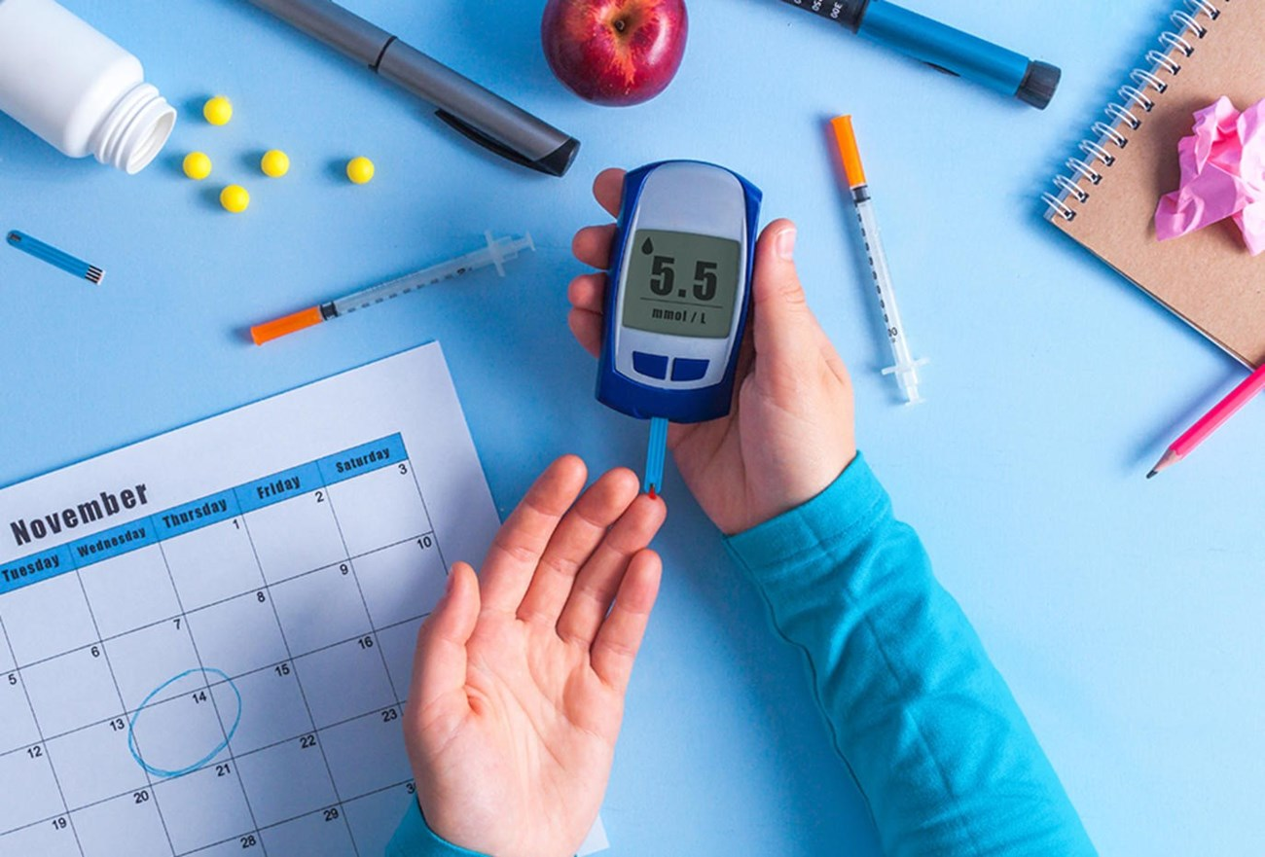
What is Diabetes ?
It is a chronic disease that affects the way the body’s cells receive glucose or the amount of insulin secreted by the pancreas, leading to an abnormally high or
low level of sugar in
the blood.

Slide 5
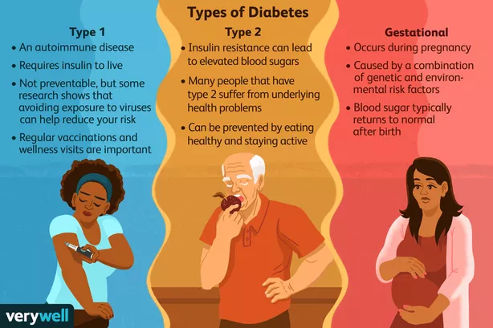
List type of diabetes

Slide 6
Diabetes in children
The exact cause of diabetes is unknown, but there are many factors to occur the diabetes in children :
Family history.
Genetics.
Certain viruses.

Slide 7
The patient’s family must give their children insulin and will need to check and record their child's blood sugar, and the children should eat healthy foods and do exercise regularly.

Slide 8
Referns
Mayo Foundation for Medical Education and Research. (2022, March 10). Type 1 diabetes in children. Mayo Clinic. Retrieved May 17, 2022,
from https://www.mayoclinic.org/diseases-conditions/type-1-diabetes-in-children/diagnosis-treatment/drc-20355312 .
Centres for Disease Control and Prevention. (2021, December 16). What is diabetes? Centres for Disease Control and Prevention. Retrieved May 17, 2022,
from https://www.cdc.gov/diabetes/basics/diabetes.html

Slide 9


