Slide 1


1
Libyan International Medical University
Faculty Of Business Administration
Business Model of Instagram
Prepared and presented by:
Shahed N Boshiha
ID Number : 2354
Instructor: Mr. Mohammed Alzwawi

Slide 2
TABLE OF CONTENTS
01
02
03
04
2
Introduction.
SWOT analysis of Instagram
Benefits of Instagram
Business model canvas
of Instagram
05
06
Instagram's targeting system
Objectives of Instagram
07
08
References.
Conclusion

Slide 3

Introduction
3
Business Model of Instagram
Instagram is an online social networking company that was first founded and created by Kevin Systrom, as they introduced the first Business Model of Instagram.
When it first began, it had no goal of becoming a giant, and now it is the go-to app for over 1 billion people for not only sharing videos and pictures, but also for marketers to promote and advertise their products and services. ( Bhasin, 2021 )

Slide 4
Introduction Cont.
4
Background Information
Instagram is a photo and video-sharing social networking app created in 2010 and later acquired by Facebook Inc. Users can post photos and videos that can be modified with filters and categorized using hashtags and location sharing. Posts can be shared with the general public or with followers who have been pre-approved. Users can explore other users' content by tag and location, see what's trending, such as photographs, and follow other users to add their content to their own personal feed.

Slide 5
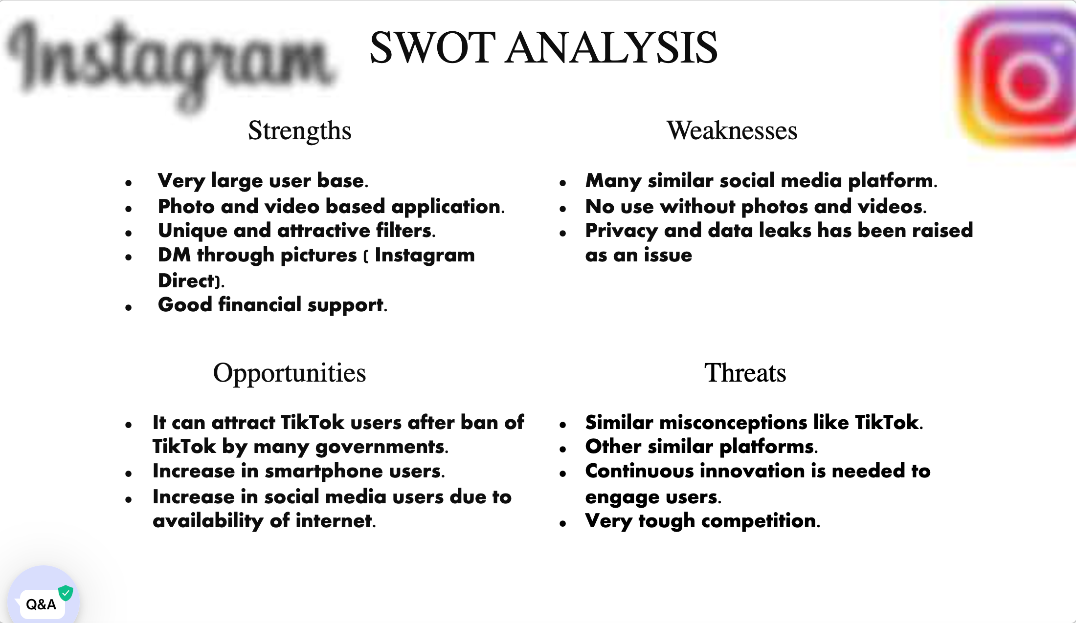
SWOT Analysis of Instagram
5
STRENGTHS
WEAKNESS
OPPORTUNITIES
THREATS

Slide 6
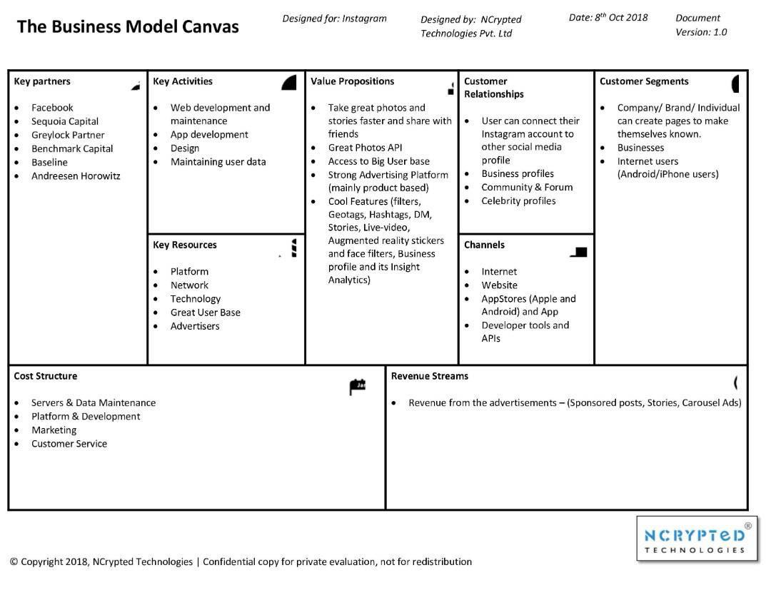
Business Model Canvas
of Instagram
6
Notes:
Download more minimal templates here: https://crmrkt.com/GK9Dwa

Slide 7
Key Partners:
Facebook, Benchmark Capital, Baseline and Sequoia Capital.
Key Resources:
Technology and network which are the main resources needed in the making and updating and completing all the procedures of the app.
Value Propositions:
take great photos and stories faster and share with friends, great photos API,
access to big user base,
strong advertising platform and mainly product or app based,
filters, hashtags, direct messages, stories, live videos, business profile and insight analytics.
7
*SOME BUILDING BLOCKS OF INSTAGRAM*

Slide 8
8
As a social networking company, it provides loads of benefits, here are some of them:
It is easy to target and retarget your audience.
More businesses and consumers are joining every day.
Use all the visual marketing features on Instagram.
Customers Engage, as it is where they spend most of their time.
Build up user-generated content.
Benefits
of Instagram
( Copadis, 2019)
Notes:
Download more minimal templates here: https://crmrkt.com/GK9Dwa

Slide 9
9
Instagram’s Targeting System
Instagram ads make use of Facebook's advertising, which provides the most effective and efficient targeting capabilities. You can specify the location, demographics, hobbies, and behaviors of your target audience, among other things. You can also target those who have purchased from you or interacted with you, as well as others who are similar to them.

Slide 10
10
Instagram targets and benefits many different areas and people like businesses, art and even regular people, its ultimate goals are to increase product sales and Increasing customer satisfaction as these relate to business sector, driving traffic to your website, attracting top talent, and identifying new artists and establishing relationships with influencers.
In addition that it increases brand awareness, and finally create a fun, enjoyable platform and entertain users to get their full satisfaction.
Objectives
of Instagram
Notes:
Download more minimal templates here: https://crmrkt.com/GK9Dwa

Slide 11
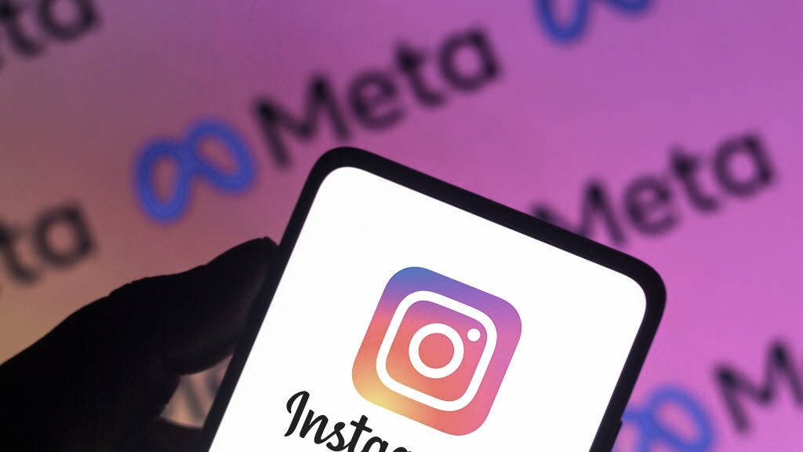
CONCLUSION
11
In brief, Instagram is the world’s leading videos photos-sharing social media platform, the ultimate purpose of Instagram's business model canvas is to create a baseline for Instagram to make things clear, also to help managers regulate and organize their companies to achieve goals and reach users satisfaction.

Slide 12
REFRENCES
12
Bhasin, Hitesh. “Business Model of Instagram - How Does Instagram Make Money?” Marketing91, 7 Nov. 2019, www.marketing91.com/business-model-of-instagram/.
Black, Stewart, et al. “Business Model Canvas.” Opentextbc.ca, OpenStax, 27Feb.2019,opentextbc.ca/organizationalbehavioropenstax/chapter/business-model-canvas.
“Business Model Canvas Explained | Enterprising Oxford.” Eship.ox.ac.uk, eship.ox.ac.uk/business-model-canvas-explained/#:~:text=The%20Business%20Model%20Canvas%20is.
Shaw, Ahsan Ali. “SWOT Analysis of Instagram.” SWOT & PESTLE Analysis, 25 Feb. 2021, swotandpestleanalysis.com/swot-analysis-of-instagram/.
DeLane, Juntae. “Setting Goals for Your Business on Instagram.” Digital Branding Institute, 28 May 2018, digitalbrandinginstitute.com/instagram-business-goals/.
Copadis, Amy. “7 Benefits of Instagram Brands Likely Don’t Know | PowerReviews.” PowerReviews, PowerReviews, 28 Feb. 2019, www.powerreviews.com/blog/benefits-of-instagram/.

Slide 13
THANK YOU
13
Shahed N Boshiha

