Slide 1



Interpersonal
Communication
2022/nov/2
Libyan International Medical University
Faculty of Business Administration
By: Marwan Fouad Abed Eloshipi
ID: 3782
Email: marwan_3782@limu.edu.ly

Slide 2
Table of Contents
01
04
Introduction
Conclusion
02
Interpersonal Communications
05
Reflection
03
06
Elements of IC
References
2

Slide 3
Learning Objectives
1
Define Interpersonal Communication
2
List the Elements of Interpersonal Communication
3

Slide 4

01.
Introduction
4

Slide 5
Introduction
Can you tell what these have in common?
Waving to your classmate.
Having a deep conversation with your best friend.
Telling the waitress your order in a restaurant.
Sending a meme in the group chat.
— All of them are forms of interpersonal communication.
5

Slide 6
02.
Interpersonal Communication
6

Slide 7
Interpersonal Communication
Interpersonal Communication (IC) Is a process between two or more people where they exchange thoughts, ideas, feelings, opinions, and information.
Interpersonal communication often involves words, but it’s not necessary — it can be both verbal and nonverbal.
6
7

Slide 8
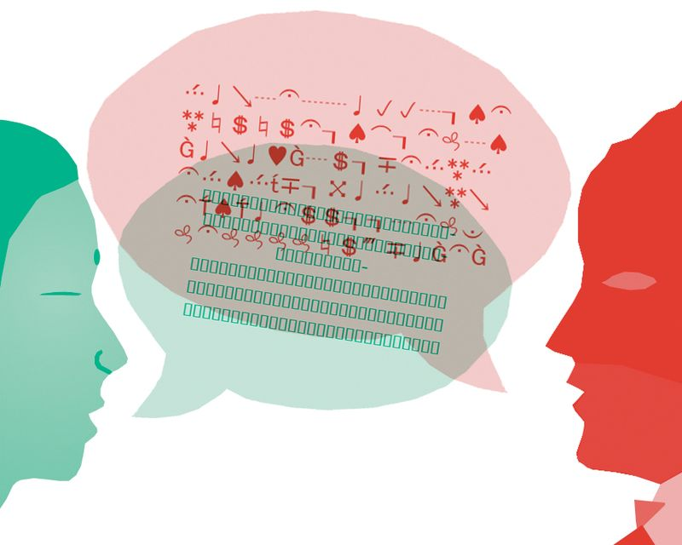
03.
Elements of IC
8

Slide 9
Elements of IC
Sender / Encoding
Receiver / decoding
The source or encoder of the message is the sender. The individual who decides to communicate and determines the purpose of the message.
The receiver(s) is the individual that decodes the message and tries to figure out the source.
The receiver is the transactional model of communication.
9

Slide 10
Elements of IC
Message
Channel
Any form of textual, verbal or non-verbal communication in which individuals give meanings to.
The way signals are sent. Technology has advanced those channels and created new ones to our traditional channels.
10

Slide 11
Elements of IC
Noise
Ethics
Noise refers to anything that interferes with the message. Noise prevent the message from being fully understood.
Morals or morality. What is right and wrong on the communication aspect.
11

Slide 12
Conclusion
In conclusion, effective interpersonal communication is essential for building and fostering relationships.
Interpersonal communication comes on a variety of forms which enables every human being to communicate on his way.
12

Slide 13
Reflection
In my opinion, Interpersonal Communication is one of the most important things for businessmen.
Good relationships at the workplace contributes to increase the productivity.
13

Slide 14
References
Author: DunjaJovanovic Dunja Jovanovic is a writer and researcher passionate about communication and psychology. (n.d.). Interpersonal communication: Definition, importance, and skills to know. Pumble Blog. Retrieved November 1, 2022, from https://pumble.com/blog/interpersonal-communication/.
Libretexts. (2022, May 18). 2.2: Elements of interpersonal communication. Social Sci LibreTexts. Retrieved November 1, 2022, from https://socialsci.libretexts.org/Bookshelves/Communication/Interpersonal_Communication/Book%3A_Interpersonal_Communication_ _A_Mindful_Approach_to_Relationships_(Wrench_et_al.)/02%3A_Overview_of_Interpersonal_Communication/2.02%3A_Elements_of_Interpersonal_Communication.
14

Slide 15
THANKS!
Do you have any questions?

