Slide 1


physical activity in osteoarthritic patient
Presented by: Yasmina Elgibani
2nd medical student
St.number:2804
Date:2022/5/16
1

Slide 2
Objectives:
Definition of osteoarthritis
List the predisposing factors of osteoarthritis
Outline the stages of osteoarthritis
Outline the types of activity in osteoarthritic patient
Discuss why the physical activity important in osteoarthritic patient
2

Slide 3
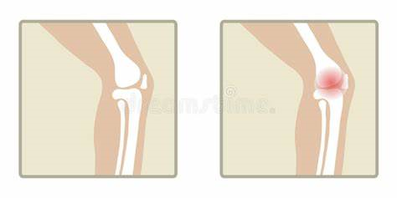

Introduction
3

Slide 4

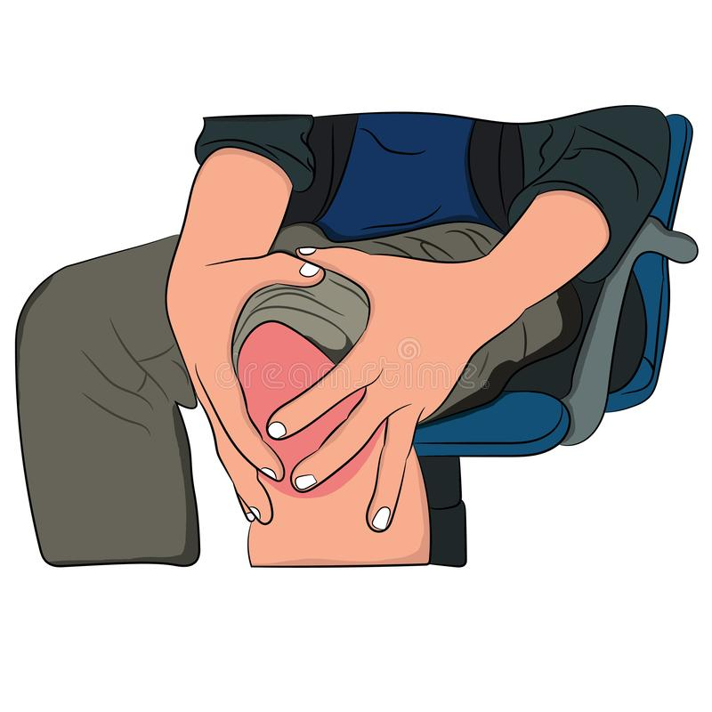
Definition of osteoarthritis :
Degenerative wear and tear processes occurs in joints, mainly occurs in joints under stress and its more in lower limb than upper limb.
4

Slide 5

Predisposing factors :
1-congental factor
2-previous fracture
3-previous injury
4-previous disease
5-malaligment of joint
6-obesity
7-age
5

Slide 6
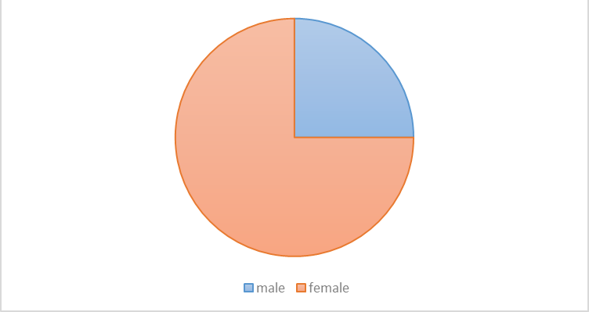
The statistic done on A total of 1267 patients who visited the Jordanian field hospital in Benghazi and diagnosed to have OA between January 2012 and November 2012 were involved in this study.
25%
75%
6

Slide 7
Stages of osteoarthritis:
Stage 0 (pre-osteoarthritis)
Stage 1 (early or doubtful)
Stage 2 (mild or minimal)
Stage 3 (moderate)
Stage 4 (sever)
7

Slide 8
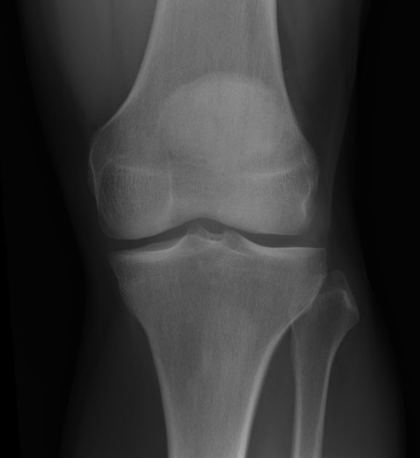
Stage 0:
In this stage the joint may be healthy before disease manifests.
May described as early stage of osteoarthritis.
Sign and symptoms: no noticeable symptoms or detectable sign.
8

Slide 9
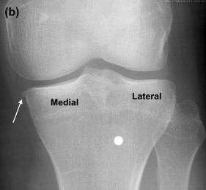
Stage 1:
Lose of some cartilage between joints.
Sign and symptoms: there is no sign and symptoms or mild.
pain in the joints.
9

Slide 10
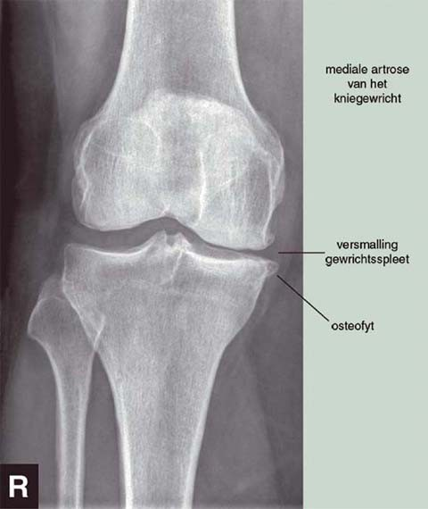
Bone spurs develops and become painful
Joint space begin to narrow
Sign and symptoms: more pain during activity or after period of increased activity and sometimes impair movement
Diagnosis: X-ray (bone spurs)
10

Slide 11
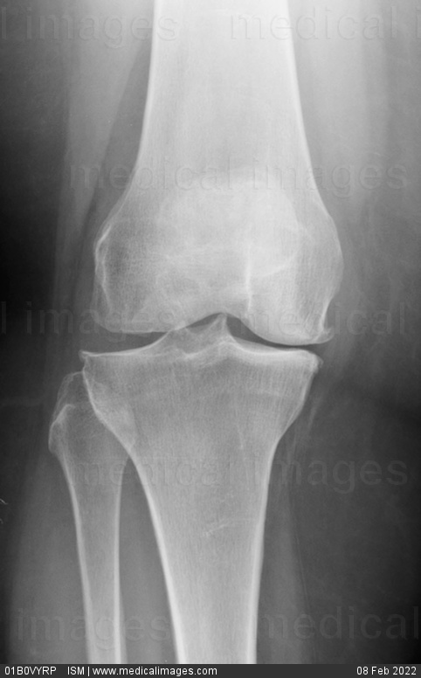
Cartilage between bones shows sign of wear
Joint space becomes narrower with more bone spurs
Sign and symptoms:1-frequent pain 2-stiffness of joints 3-swelling
Diagnosis: X-ray / M.R.I
11

Slide 12
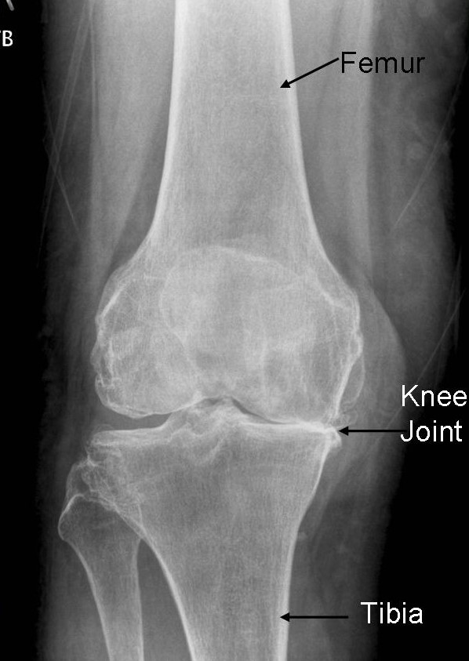
Stage 4:
Joint space is much smaller
Less synovial fluid to lubricate the joints
Bone spurs are larger
Sign and symptoms: a lot of pain, daily activity may be difficult or impossible,stiffness,sever swelling
Diagnosis: X-ray / lab test / M.R.I
12

Slide 13
Does arthritis feel worse after exercise ?
13

Slide 14

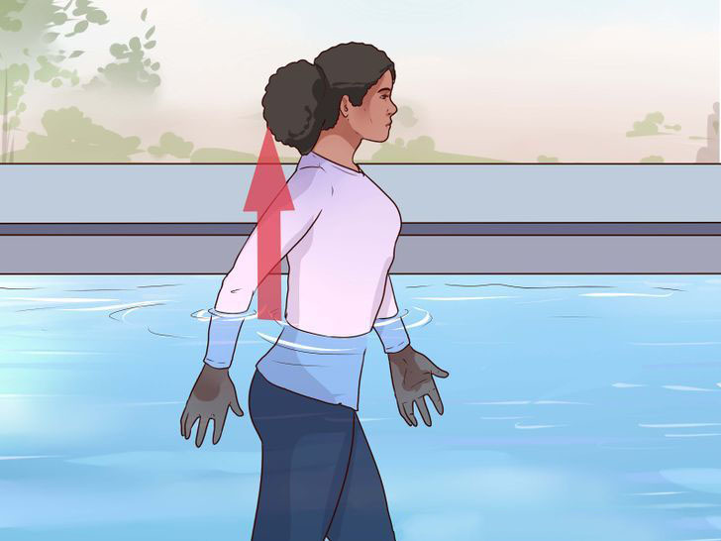


Types of physical activity in osteoarthritic patient:
1- Aerobic exercises:
A. walking:
B. swimming
C. cycling
C. Gym equipment
14

Slide 15
2- Strengthening exercises:
Strength program targeting on lower body it helps limit decline in muscle that supporting the knee.
Main muscles to be involved in this program are :
1- quadriceps muscle.
2- hamstring muscle.
15

Slide 16
3- Stretching exercise:
Helps to minimize loss of flexibility in and around knees.
Muscles involved in this type of exercise:
1- hamstring muscle
2- quadriceps muscle
3- calf muscle
4- hip flexors muscle
16

Slide 17
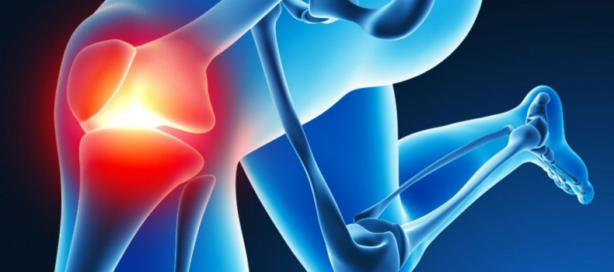
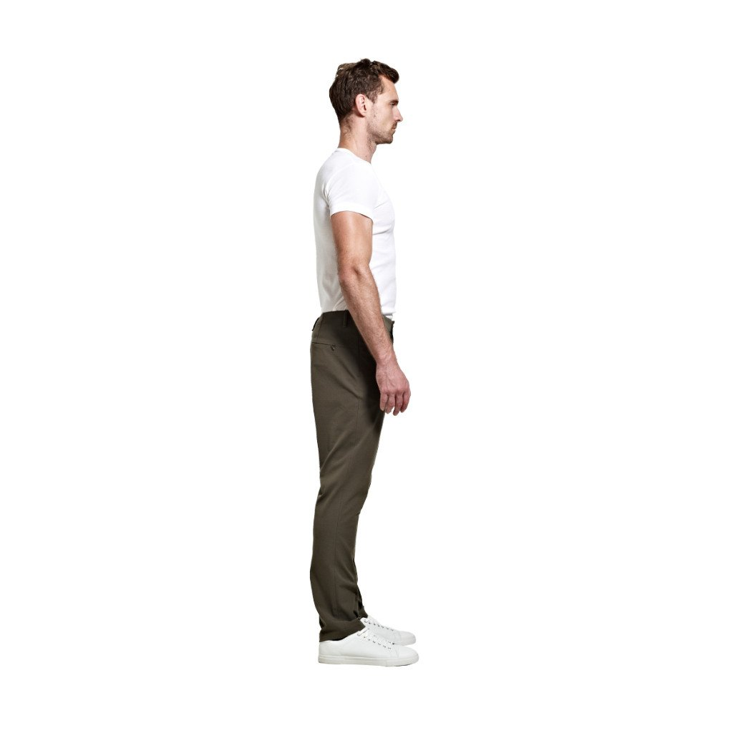


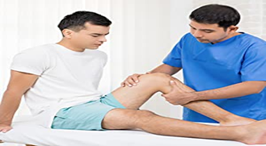
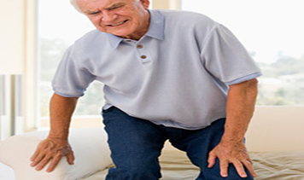
Importance 0f physical activity in osteoarthritic patient:
Researches have found that regular exercise is one of the most effective treatment for arthritis it can help to
Improve (mobility, flexibility, posture, balance)
Decrease(pain, fatigue, muscle tension, stress)
17

Slide 18
Also physical activity will improve over all health:
1- improve fitness of heart and lungs
2-increase bone strength
3-decrease body weight
4- improve sleep, energy level, mental well being
18

Slide 19
Conclusion
Nothing of limits until your body says so
Choose type of exercise that are helpful and not harmful to the stage of osteoarthritis
Stay as active as your health allows
Change your activity level depends on your symptoms
19

Slide 20
References:
What You Need to Know About Osteoarthritis (OA). Healthline. https://www.healthline.com/health/osteoarthritis#symptoms. Published 2022. Accessed May 15, 2022.
Buckwalter JA, Lane NE. Athletics and osteoarthritis. Am J Sports Med. 1997;25(6):873-881. doi:10.1177/036354659702500624
ROBINS S. Textbook Of Pathology, With Clinical Applications, Etc.
20

Slide 21
THANK YOU
21

