Slide 1



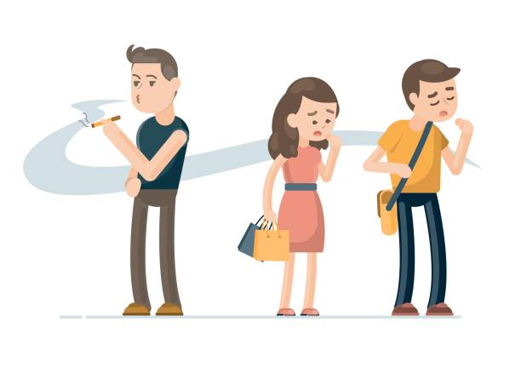
Tobacco Use Secondhand Smoking
St. Name: Laila Ehab Kuyumzakis
St. No.:3627
First year GBMS II/PTS

Slide 2
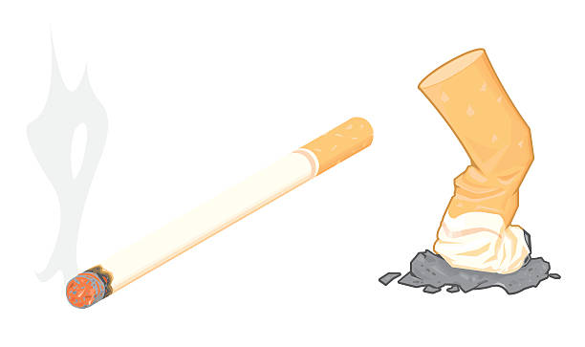
INTRODUCTION
SecondhandSmoking(SHS)
Is the combination of smoke from the burning end of the cigarette,smoke that breath out by smokers. Secondhand smoke contains more than 7,000 chemicals,of which hundreds are toxic and about 70 can cause cancer.

Slide 3
Objectives:
Neptune is the
1.How Secondhand smoke effects on pregnancy.
2.Diseases caused by secondhand smoking.
3.Harmful effects of secondhand smoke on adults.
4.How do we protect non-smokers from secondhand smoking.
Mercury is the planet to the Sun
Jupiter is the biggest in the Solar System
3
1
4

Slide 4
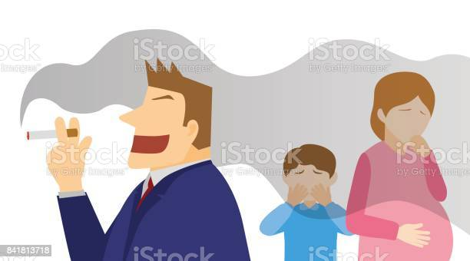
How secondhand smoke effects on pregnancy
-
Secondhand smoking can cause problems for the fetus,it can cause long-term health risks to the baby,such as lung problems and physical problems.

Slide 5
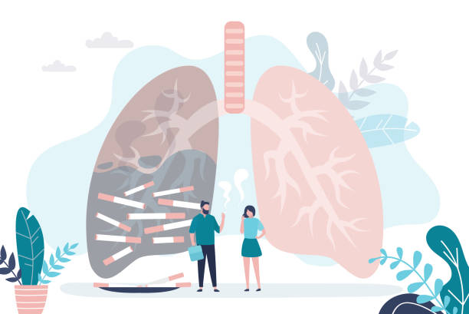
Diseases caused by secondhand smoking
Secondhandsmoking cause lung cancer in adults.
0
Non-smokers who are exposed to second hand smoking at home or at work increase their risk of developing long cancer by 20%-30%.
When you inhale cigarette smoke that is full of carcinogens,changes in lung tissue almoust immediately,At first your body may be able to repair this damage but with each repeated exposure,the normal cells that in your lungs are icreasingly damaged, over time the damage causes cells to function abnormally.

Slide 6
Harmful effects of secondhand smoke on adults
It causes sinus cancer.
1
Mercury is the smallest planet
Jupiter is the biggest planet
6
2
Exposure of non-smokers to smoke from cigarettes can increase the risk of heart attacks.
5
3
Secondhand smoking affects the arteries and doubles the incidence of storke.
Neptune is the farthest planet
.

Slide 7
How do we protect non-smokers from second hand smoking.
.You can protect yourself and your loved ones by:
Making your home and car smoke-free.
Asking people not to smoke around you and your children.
Teaching children to stay away from secondhand smoke.

Slide 8
Conclusion:
Second-hand smoke is serious health risk for both those who smoke and those who don’t.
Children are particularly at risk of serious health effects from secondhand smoke.

Slide 9
For further reading
-
https://www.cdc.gov/tobacco/data_statistics/fact_sheets/secondhand_smoke/health_effects/index.htm#:~:text=U.S.%20Department%20of%20Health%20and%20Human%20Services.%20The,Office%20on%20Smoking%20and%20Health%2C%202006%20%5Baccessed%202017%20Jan%2011%5D.
U.S. Department of Health and Human Services. A Report of the Surgeon General: How Tobacco Smoke Causes Disease: What It Means to You. Atlanta: U.S. Department of Health and Human Services, Centers for Disease Control and Prevention, National Center for Chronic Disease Prevention and Health Promotion, Office on Smoking and Health, 2010 [accessed 2017 Jan 11].

Slide 10
THANKS!
0

