Slide 1


Networks Generations
Libyan International Medical University
Faculty of Business Administration
BY
Ali Korghali 2312
Abdullah Abdalsalam 2104

Slide 2
Content
Introduction
What is the meaning “ G “
1G - First Generation
2G - Second Generation
3G - Third Generation
4G - Fourth Generation
5G - Fifth Generation
The speed of each networks generation
Conclusion
Reference
1

Slide 3
Introduction
There are five generations of phone networks, and each generation is better than the previous one. We will explain each generation
2

Slide 4
What is the meaning “ G “
Simply, the "G" stands for "GENERATION" . While you connected to internet, the speed of your internet is depends upon the signal strength that has been shown in alphabets like 2G, 3G, 4G etc.
3

Slide 5
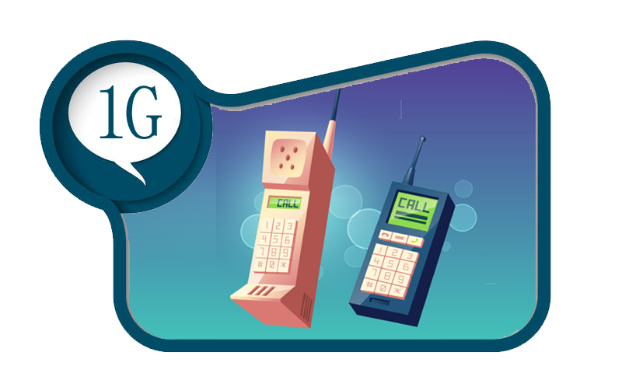
1G - First Generation
This was the first generation of cell phone technology . The very first generation of commercial cellular network was introduced in the late 70's with fully implemented standards being established throughout the 80's. It was introduced in 1987 by Telecom (known today as Telstra)
4

Slide 6
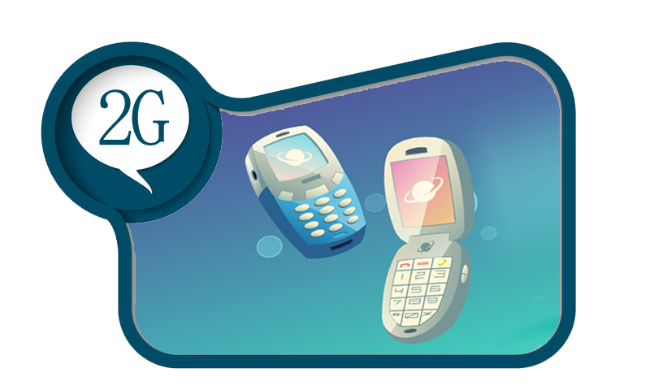
2G - Second Generation
Cell phones received their first major upgrade when they went from 1G to 2G. The main difference between the two mobile telephone systems (1G and 2G), is that the radio signals used by 1G network are analog, while 2G networks are digital
5

Slide 7
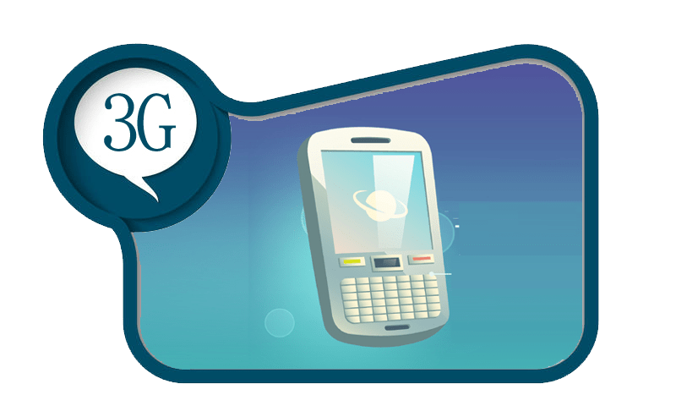
3G - Third Generation
This generation set the standards for most of the wireless technology we have come to know and love. Web browsing, email, video downloading, picture sharing and other Smartphone technology were introduced in the third generation
6

Slide 8
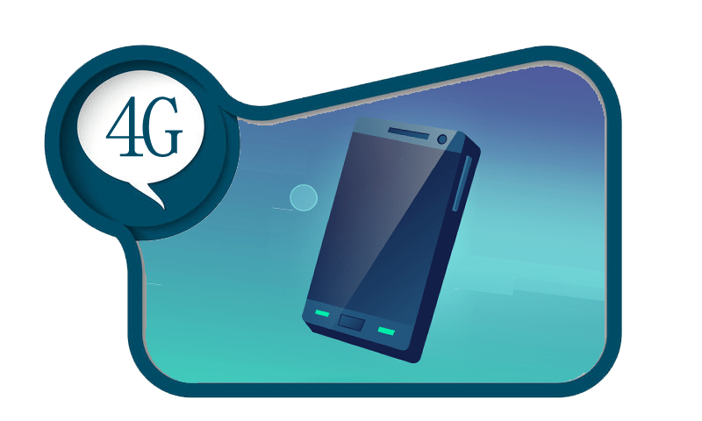
4G - Fourth Generation
4G is a very different technology as compared to 3G and was made possible practically only because of the advancements in the technology in the last 10 years. Its purpose is to provide high speed
7

Slide 9
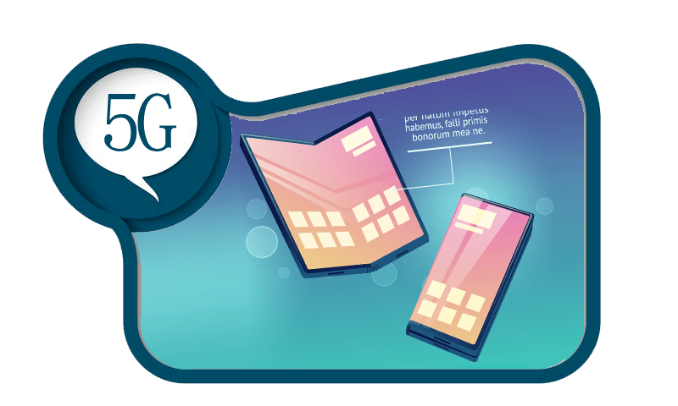
5G - Fifth Generation
5G is a generation currently under development , that's intended to improve on 4G. 5G promises significantly faster data rates, higher connection density, much lower latency, among other improvements.
$20K
8

Slide 10
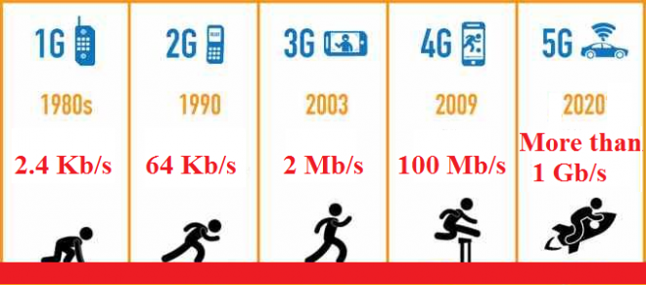
The speed of each networks generation
9

Slide 11

Conclusion
So 5G well be the best as compared with another generations, Also is going to be for many years
10

Slide 12
Reference
﻿History of 5G | ﻿History of 5 Generation Wireless Technology | InforamtionQ.com. (2021). Retrieved 8 December 2021
, from https://informationq.com/history-of-5-generation-wireless-technology
﻿What are the differences between 1G, 2G, 3G, 4G and 5G?. (2021). Retrieved 8 December 2021, from
http://net-informations.com/q/diff/generations.html
11

Slide 13


