Slide 1



The Concept of Globalization
BY : SALEM IBRAHIM OSMAN
ID : 3799
Email:salem_3799@limu.edu.ly

Slide 2


Definition.
Advantages.
Disadvantages.
Conclusion.
References.
2

Slide 3


Globalization means the speedup of movements and exchanges (of human beings, goods, and services, capital, technologies or cultural practices) all over the planet. One of the effects of globalization is that it promotes and increases interactions between different regions and populations around the globe.
3

Slide 4

Advantages
1 Proponents of globalization believe it allows developing countries to catch up to industrialized nations through increased manufacturing, diversification, economic expansion, and improvements in standards of living.
2 Outsourcing by companies brings jobs and technology to creating countries, which help them to develop their economies. Trade activities increase cross-border trading by removing supply-side and trade-related constraints.
3 Globalization has progressed social equity on an international scale as well, and advocates report that it has focused attention on human rights around the world that might have something else been ignored on a large scale.
4

Slide 5

Disadvantages
1 One clear result of globalization is that an economic downturn in one country can make a domino effect through its trade partners. For example, the 2008 financial crisis had a severe affect on Portugal, Ireland, Greece, and Spain. All these countries were members of the European Union, which had to step in to bail out debt-laden nations, which were from that point known by the acronym PIGS.
2 Globalization detractors contend that it has made a concentration of wealth and power in the hands of a small corporate elite that can gobble up smaller competitors around the globe.
5

Slide 6
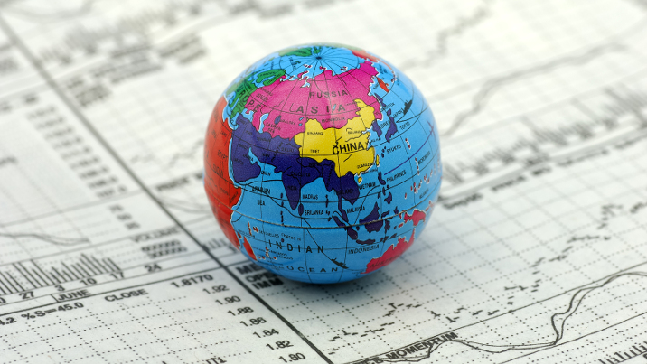
Disadvantages
3 Globalization has become a polarizing issue in the U.S. with the vanishing of entire industries to new locations abroad. It's seen as a major factor in the economic pressure on the middle class.
4 For better and worse, globalization has also expanded homogenization. Starbucks, Nike, dominate commercial space in many nations. The sheer size and reach of the U.S. have made the cultural trade among nations largely a one-sided affair.
6

Slide 7
Is Globalization Good or Bad?
Proponents of globalization will point to the dramatic decrease in poverty that has taken place all through the world over the past a few decades, which many economists attribute in part to increased trade and investment between nations. Additionally, they will argue that globalization has allowed products and services such as phones, airplanes, and information technology to be spread far more widely all through the world. On the other hand, critics of globalization will point to the negative impact it has had on specific nations’ industries, which might face increased competition from international firms. Globalization can also have negative environmental impacts due to economic development, industrialization, and international travel.
7

Slide 8
Conclusion
Globalization is important because it is one of the most powerful forces affecting the modern world, so much so that it can be difficult to make sense of the world without understanding globalization.
8

Slide 9

Fernando, Jason. “Globalization.” Investopedia, 1 Jan. 2021, www.investopedia.com/terms/g/globalization.asp.
9

Slide 10

Thank you .
Any questions!

