Slide 1


Corporations and Moral Responsibility
Libyan International Medical University
Faculty Of Business Administration
Name: Nahawand Elhammali
ID :2752
Email : nahawand_2752@limu.edu.ly

Slide 2
Table of content:
01. Introduction.
02. Moral Responsibility Means.
03. Three Elements Of Moral Responsibility.
04. Important Of Moral Responsibility.
05. 5 Ways To Step Up And Become A Moral Leader.
06. Conclusion.

Slide 3
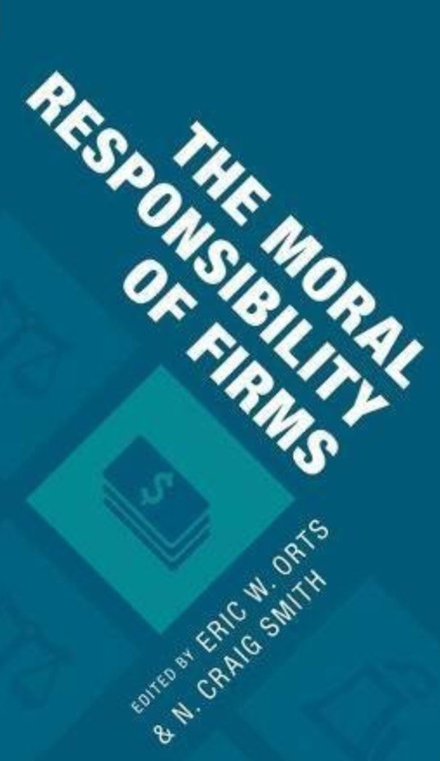
Introduction:
Introduction:
Moral responsibility is the extent to which the person or group deserves blame or punishment for what he/she has done.
In the other words, she/he should not throw his/her moral responsibility to other people after committed certain action.

Slide 4

Moral
Responsibility
Means
Moral responsibility is the status of ethically deserved praise, blame, reward, or punishment for an act or omission that is in compliance with one's moral obligations, as defined by philosophy. A major challenge of ethics is determining what constitutes as "morally obligatory.

Slide 5
3 Elements
Of Moral Responsibility:
- Causality. ( The relation between cause and effect)
- Knowledge. ( The facts, information and the skills acquired by the person through education or experience)
- Freedom. ( Freedom of speech and act without any restraints)

Slide 6

Important of
Moral Responsibility:
    Making moral judgements regarding a person's moral responsibility for her conduct, as well as holding others and ourselves accountable for our actions and the consequences of our actions, is an important and common element of our moral practices and interpersonal relationships.

Slide 7
5 Ways To Step Up And Become A Moral Leader
1. Identity a set of values
2. Manage your ego
3. Consider diverse groups of people, and include their views
4. Embrace change
5. Build consensus, and establish unity

Slide 8
Conclusion:
For an act or omission that is in accordance with one's moral obligations, moral responsibility is the status of ethically due praise, blame, reward, or punishment.

Slide 9
References:
Anon https://sevenpillarsinstitute.org/corporations-moral-status-of/, accessed 26 October 2021.
Avery Blank, C. 5 ways to step up and become a moral leader [Internet]. https://www.weforum.org/agenda/2019/08/5-ways-moral-leader, accessed 26 October 2021.
Talbert, M. (2019) Moral responsibility [Internet]. https://plato.stanford.edu/entries/moral-responsibility/, accessed 26 October 2021.

Slide 10
Thank you
Any question!

