Slide 1


Libyan International
Medical University
Faculty of
Business Administration
Business Structures
Prepared and presented by:
Heba N Bushiha
Email: hbitalla_3285@limu.edu.ly
ID Number:
3285
Notes:
Download more minimal templates here: https://crmrkt.com/GK9Dwa

Slide 2
2
Introduction
Tall Organizational Structure
Flat Organizational Structure
Contents
Centralized Management Structure
Decentralized Management Structure
Conclusion
Reflection
References
Notes:
Download more minimal templates here: https://crmrkt.com/GK9Dwa

Slide 3
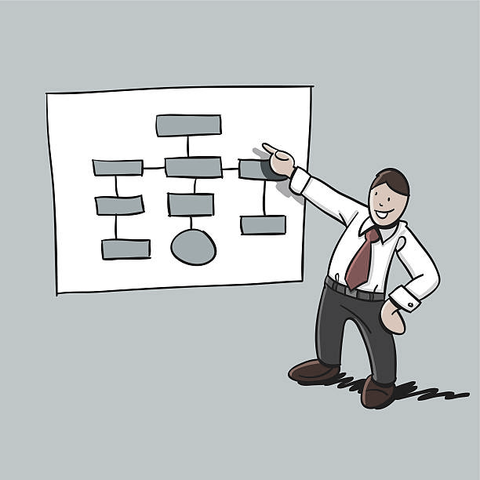
Introduction
3
An organizational structure is how a business represent its staff and divide their activities.
There are two main types of organizational structure used in businesses : hierarchical (or tall) and horizontal (or flat).
There are two different types of management in the business : centralized and decentralized.

Slide 4

Tall Organizational Structure
4
It has many leaders and layers of management and a long chain of command , a manager will also have a small span of control.

Slide 5
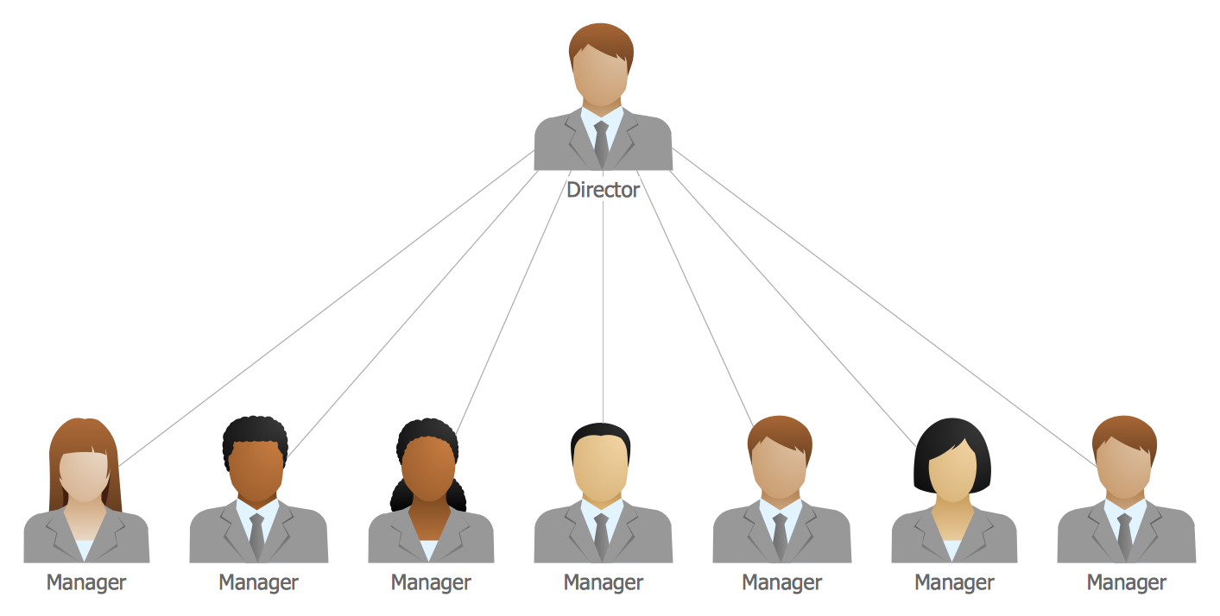
Flat Organizational Structure
5
It has few layers of management and a short chain of command, and a manager will have a wide span of control and more responsibilities.

Slide 6

Centralized Management Structure
6
In centralized structure the decision is made in the head office and then passed down to the subordinates.
These types of businesses will have a weak response to any changes in the internal or external business environment.

Slide 7

Decentralized Management Structure
7
In decentralized structure the subordinates and managers are allowed to make decisions .
These types of businesses will have a strong response to any changes in the internal or external business environment.

Slide 8

8
Conclusion
To sum up, there are two types of organizational structure, tall and flat.
Centralization and decentralization are the two main types of a business management.

Slide 9

Reflection
9
In my opinion, a flat structure is better because there will be good communication between people in the organization.
Decentralized management makes the employees feel more responsible because they are able to make decisions which make them work more effective, but in centralized management less mistakes will occur because the decision is made by the head office.

Slide 10
References
10
“Horizontal (Flat) Structures and Hierarchical (Tall) Structures - Organisational Structures - Eduqas - GCSE Business Revision - Eduqas.” BBC Bitesize.
“Centralised and Decentralised Organisational Structures - Organisational Structures - Edexcel - GCSE Business Revision - Edexcel.” BBC Bitesize.

Slide 11
THANK YOU
Heba N Bushiha
Notes:
Download more minimal templates here: https://crmrkt.com/GK9Dwa

