Slide 1


BLOOD SUGAR GAOL
الجامعة الليبية الدولية للعلوم الطبية
كلية العلوم الطبية التطبيقية
Presenter: salsabil algomati
S.N : 3306
First year 2021_2022

Slide 2

OBJECTIVES :
1.Define and causes of diabetes 2.Main types and treatment
3.Early sings and organs effect
4.How to control your life

Slide 3
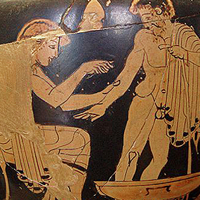
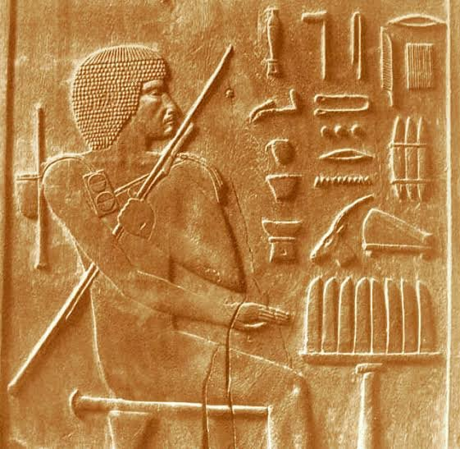
(Ancient Egyptians 3000 years ago)
(Discovered Diabetes )

Slide 4
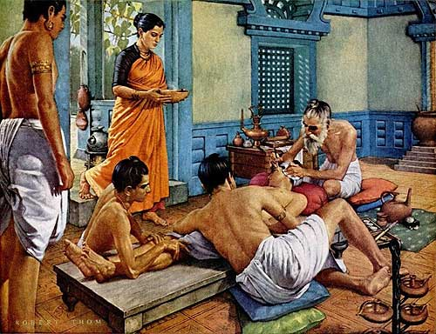
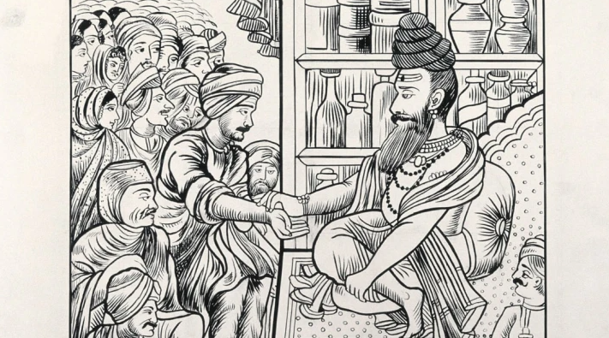
(Ancient Indian)
(sweetness of urine
&blood)

Slide 5
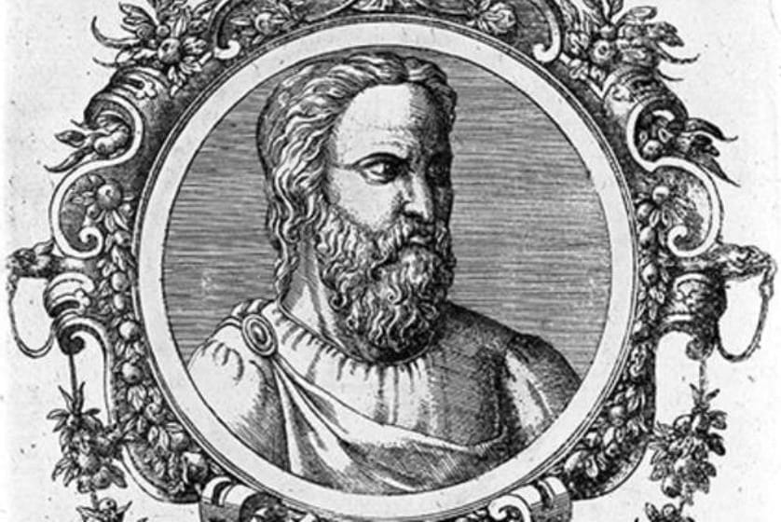
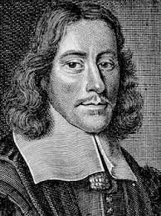
Aratus Thomas Willis
(Greek physician ) (Britain Doctor)
(Diabetes Greek word: siphon ( mellitus: sweet
18-133AD) 1675)

Slide 6
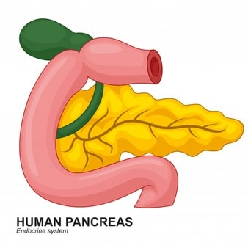
Definition:
Diabetes mellitus is the collective term for heterogeneous metabolic disorders whose main finding is chronic hyperglycemia(Genetic Disease)
Hyperglycemia: a condition in which your blood sugar ( glucose) level is higher than the standard range

Slide 7

fasting
80-110 | normal
111-124 | Max
125 | abnormal
mg/dl

Slide 8
Causes:
Disturbed insulin secretion
Disturbed insulin effect
Or usually both

Slide 9
Main Types :
Type I “β-cell of pancreas”
Type II “insulin resistance, deficiency of secretory”

Slide 10
Treatment:
Type 1:
Diabetes involves insulin injections or the use of an insulin pump.
Type 2:
Diabetes medications, insulin or both.
Insulin : Is a 51 amino acid dipeptide

Slide 11
Early sings:
Blurry vision
Increased thirst
Tiredness
Increased urination
Sores that are
slow to heal
Extreme hunger
Unintentional
weight loss

Slide 12
Organs effect:
Brain
disease
Eyes
Heart
disease
Kidneys
Nervous system
Diabetic foot

Slide 13
How to control your life:
Exercise
Take medicine
Eat healthy
Weight loss
Monitor

Slide 14
Conclusion:
β-cell of pancreas
Deficiency of secretory”
Is chronic hyperglycemia.
Insulin injections
Diabetes medications
Disturbed insulin secretion
Disturbed insulin effect
Be healthy

Slide 15
Reference:
Ahmed AM. History of diabetes mellitus. Saudi Med J. 2002 Apr;23(4):373-8. PMID: 11953758.
Peterman A, Müller-Wieland D, Müller UA, Landgraf R, Nauck M, Freckmann G, Heinemann L, Schleicher E. Definition, Classification and Diagnosis of Diabetes Mellitus. Exp Clin Endocrinol Diabetes. 2019 Dec;127(S 01):S1-S7. doi: 10.1055/a-1018-9078. Epub 2019 Dec 20. PMID: 31860923.
https://www.healthline.com/health/diabetes
Medically reviewed by Lauren Castiello, MS, AGNP-C — Written by Ann Pietrangelo — Updated on October 20, 2021
Medically reviewed by Marina Basina, M.D. — Written by Stephanie Watson — Updated on February 26, 2020

Slide 16
No matter how severe your illness is, Stay positive , Be optimistic , Be patient and strong to overcome it
Thank you for attention

