Slide 1


The Environmental Forces That Affect a Company
Libyan International Medical University
Faculty of Business Administration
Arwa Fawzi Ghaith 3275
Arwa_3275@limu.edu.ly
6th of April, 2022

Slide 2
Objectives
After this presentation hopefully you'll be able to:
Define Marketing Environment in a company
Define Microenvironment and what it consists
Define Macro Environment and what it consists
1

Slide 3
Table of Contents
01
02
Introduction
Microenvironment
What is a Company’s Marketing Environment?
03
04
Macroenvironment
Summary
05
References
2

Slide 4
Introduction
What is a Company’s Marketing Environment?
A company’s marketing environment consists of the actors and forces outside marketing that affect marketing management’s ability to develop and maintain successful relationships with its target customers.
The marketing environment consists of a microenvironment and a macroenvironment.
3

Slide 5
Microenvironment
The microenvironment consists of the forces close to the company that affect its ability to serve its customers.
It includes:
The Company
Suppliers
Marketing Channel Firms
Customer Markets
Competitors
Publics
4

Slide 6
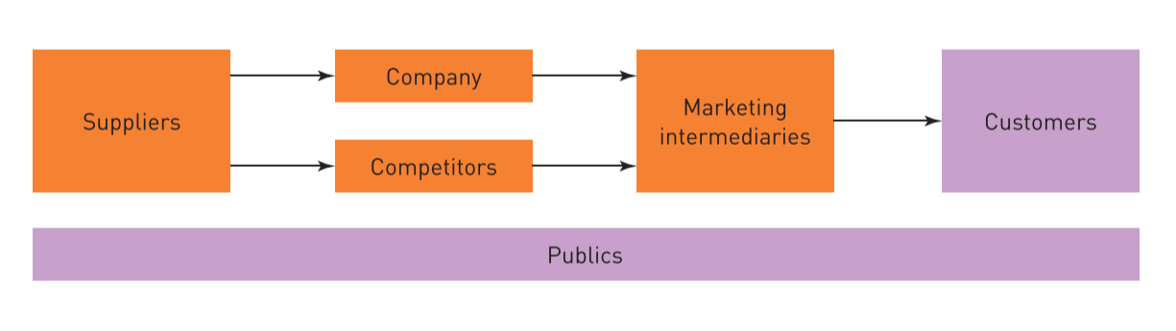
Microenvironment
5

Slide 7
Macroenvironment
The macroenvironment consists of the larger societal forces that affect the whole microenvironment
It includes:
Demographic Forces
Economic Forces
Natural Forces
Technological Forces
Political Forces
Cultural Forces
6

Slide 8
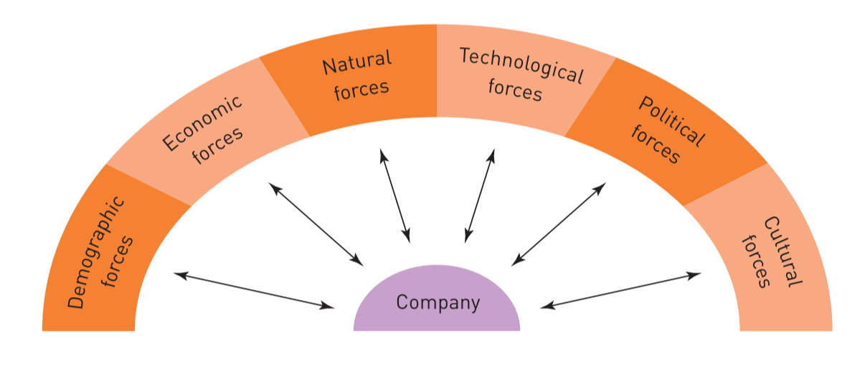
Macroenvironment
7

Slide 9
Summary
The company’s marketing environment can be divided into the microenvironment and the macroenvironment. The microenvironment consists of other actors close to the company that combine to form the company’s value delivery network, it includes the company’s internal environment. As for the company’s macroenvironment it consists of six forces that shape opportunities and pose threats to the company that affect the entire microenvironment.
8

Slide 10
References
Kotler, P., Wong, V., Saunders, J., & Armstrong, G. (2004). Principles of Marketing: European Edition (Pie) (4th ed., Vol. 3) [E-book]. Financial Times/ Prentice Hall.
9

Slide 11
Thanks!
Any Questions?
10

