Slide 1



Faculty of Applied Medical Scince
Libyan International Medical Universty
The most dangerest type of cancer!
Soft tissues sarcoma
Rokya Hesham
3593
PTS
2022-june-1
01

Slide 2

02
01
Cancer
Objectives
02
Sarcoma cancer and their types
03
Soft tissues sarcoma
we will talk about:
04
The treatment
05
Survival rate

Slide 3

03
What is the cancer?
the cancer is
A disease in which some of the body’s cells devivde uncontrollably and spread to other parts of the body.

Slide 4
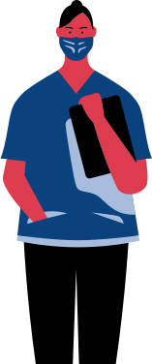
is a rare type of cancer and it is tumor that develops in connective tissue, such as bone, cartilage or muscle.
Sarcoma
04

Slide 5
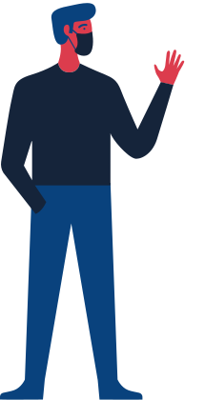
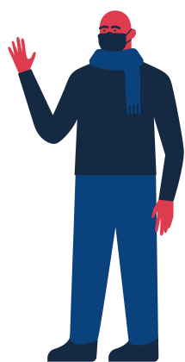
Types of sarcoma
Osteosarcoma
Soft tissues sarcoma
the most common type of cancer that starts in the bones.
Soft tissue sarcoma refers to cancer that begins in the muscle, fat, fibrous tissue, blood vessels, or other supporting tissue of the body.
05

Slide 6

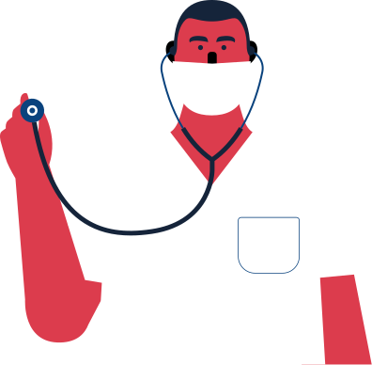
06
STAGE 1
Soft Tissues Sarcoma Development
Cycle
The cancer is low-grade and not larger than 5 centimeters (cm), or about 2 inches, across. It has not spread to the lymph nodes or other parts of the body.
STAGE 5
The cancer is high-grade and larger than 5 cm across. It has not spread to the lymph nodes or other parts of the body. OR the cancer is any size or grade, but it has spread to the lymph nodes (and not to distant parts of the body).
STAGE 2
The cancer is low-grade and is larger than 5 cm across. It has not spread to the lymph nodes or other parts of the body.
A multi-step process
STAGE 3
STAGE 4
The cancer is medium or high-grade and not larger than 5 cm across. It has not spread to the lymph nodes or other parts of the body.
The cancer is medium-grade and larger than 5 cm across. It has not spread to the lymph nodes or other parts of the body.

Slide 7

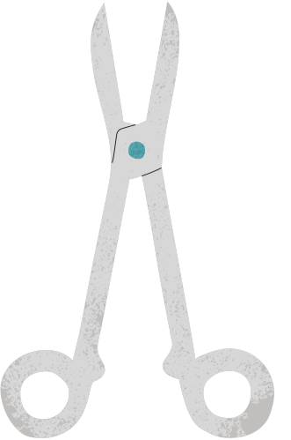

The Treatment
Chemotherapy
Surgery
Radiation
07

Slide 8
The 5 Years Survival Rates
75
50
  over all 65%
  regional 50%
  distance 18%
25
0
Distance
Regional
Over all
08

Slide 9

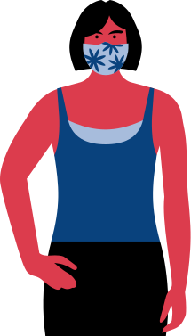

09
Conclusion
  Sarcoma cancer is a rare type of cancer , can comes in the conective tissues of our body.
  It is two types ( SOFT TISSUE SARCOMA , OSTEOSARCOMA ).
  It develope so fast anf it can back if we do NOT follow the correct pathway treatment.
  We have to start in our treatment early becouse the survival rate in the last stages is so low .

Slide 10
Refrences
  Saint Luke's Health System. 2022. Soft Tissue Sarcoma: Your Chances of Recovery (Prognosis). [online] Available at: <https://www.saintlukeskc.org/health-library/soft-tissue-sarcoma-your-chances-recovery-prognosis#:~:text=Overall%2C%20the%205%2Dyear%20survival,survival%20rate%20is%20about%2018%25.> [Accessed 1 June 2022].
  Mayoclinic.org. 2022. Soft tissue sarcoma - Diagnosis and treatment - Mayo Clinic. [online] Available at: <https://www.mayoclinic.org/diseases-conditions/soft-tissue-sarcoma/diagnosis-treatment/drc-20377730> [Accessed 1 June 2022].
10

Slide 11
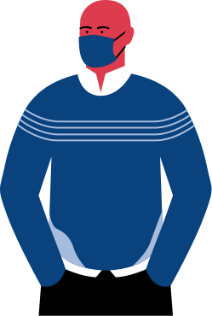
11
Questions or comments?
TUTOR
Marwa Elfaitory
Get in touch!

