Slide 1
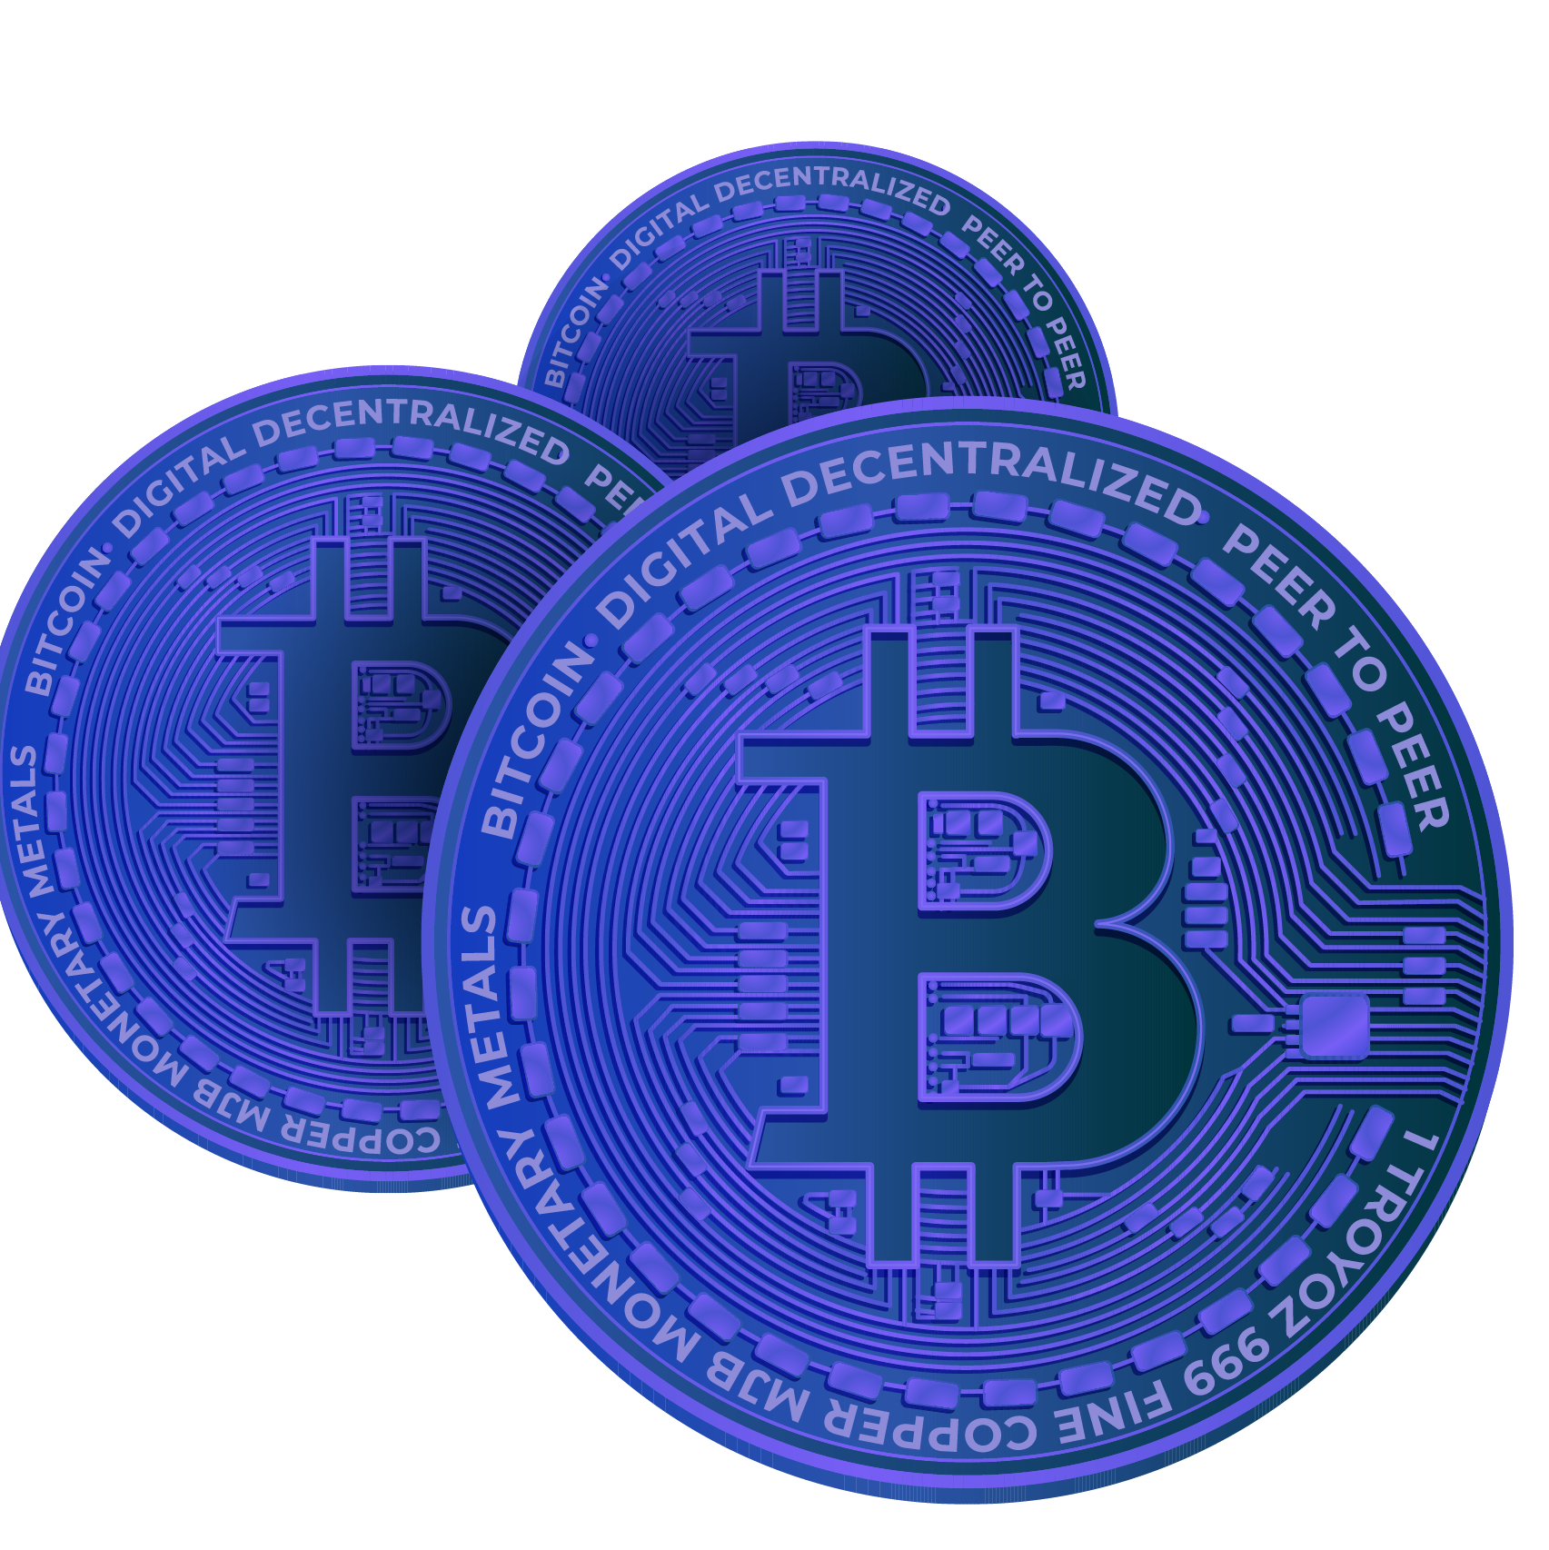

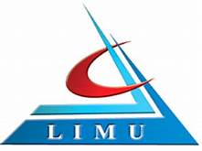
Future of money
Libyan International Medical University Faculty of Business Administration
Supply chain management
Abdallah zwawi 2826
Yousef elkikiha 2762
Instructor: Mr. Mohamed Zuwawi
Date: 30.12.2021
Notes:
1. Table of contents
2. Introduction
3. Our company
4. Our team
5. Problem
6. Them vs. us
7. Solution
8. SWOT analysis
9. Product overview
10. Our plans
11. Product demo
12. Traction
13. Case study
14. Reviews
15. Awards
16. Market size
17. Target
18. Competitors
19. Business model
20. Timing
21. Predicted growth
22. Investment

Slide 2
Table of Contents
01
02
03
04
Introduction
Evolution of money
Types of payments
Digital banking
1

Slide 3
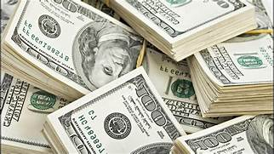
Introduction
Money performs many primary and secondary functions. These functions help us transit in goods and services with ease. Our entire economy and society depend on money to function smoothly
2

Slide 4
Evolution of money
1.
Commodity Money
3.
Paper Money
2.
Metallic Money
4.
Credit Money
5.
Plastic Money
3

Slide 5
Evolution of money cont.
Commodity Money: In the earliest period of human civilization, any commodity that was generally demanded and chosen by common consent was used as money
Metallic Money: Metals like gold, silver, copper, etc. were used as they could be easily handled and their quantity can be easily ascertained.
4

Slide 6
Evolution of money cont.
Paper Money: Paper money is regulated and controlled by Central bank of the country (central Libya bank). At present, a very large part of money consists mainly of currency notes or paper money issued by the central bank.
Credit Money: People keep a part of their cash as deposits with banks, which they can withdraw at their convenience through cheques.
5

Slide 7
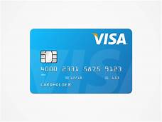
Evolution of money cont.
Plastic Money: The latest type of money is plastic money in the form of Credit cards and Debit cards. They aim at removing the need for carrying cash to make transactions.
6

Slide 8
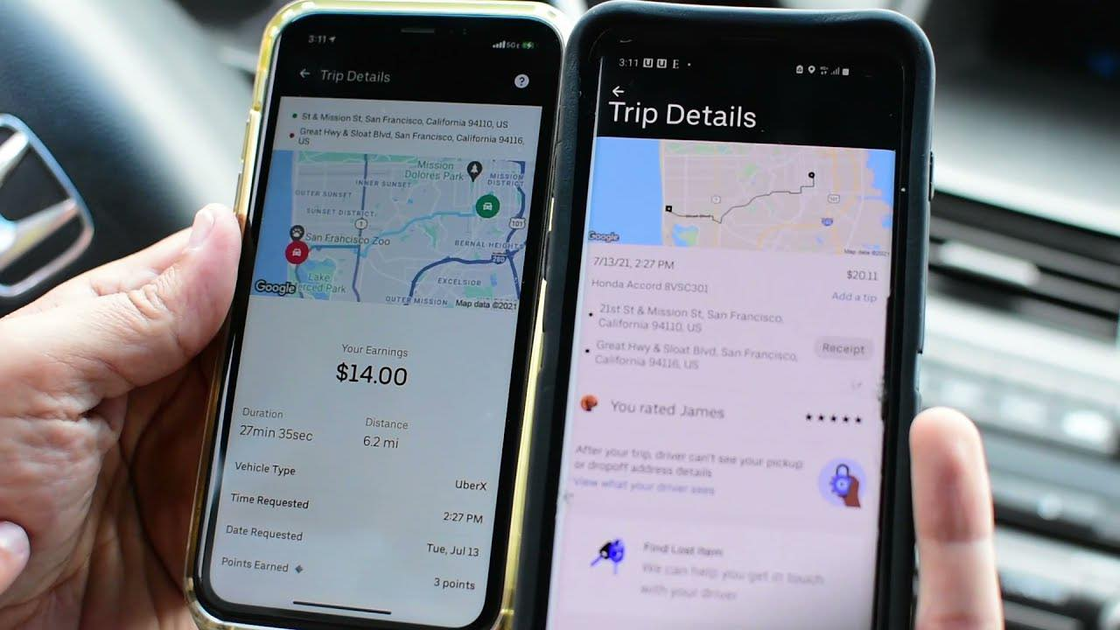
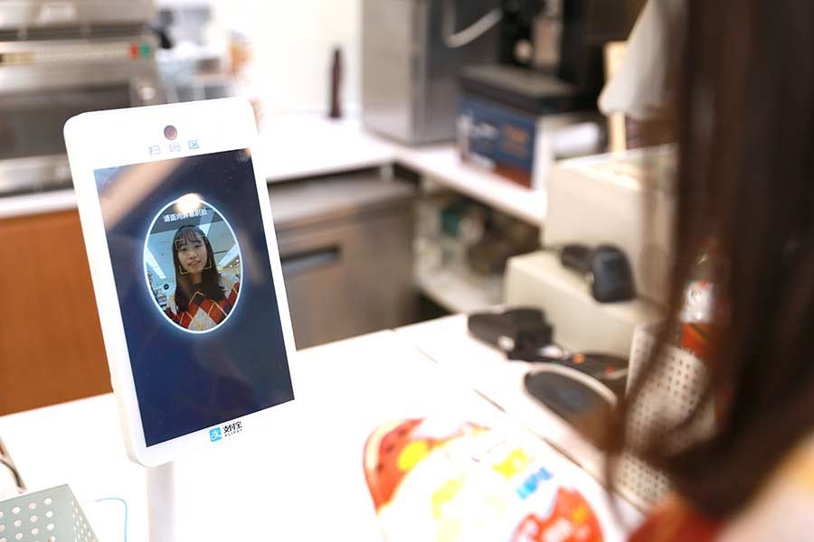
Types of future payments
1.Context-based payments
2.Biometric authentication
7

Slide 9
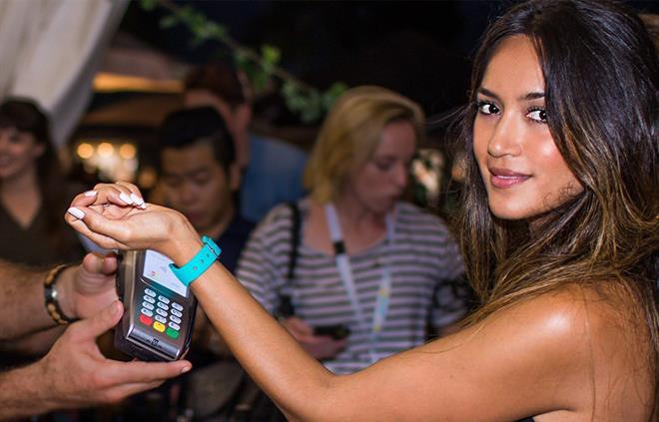
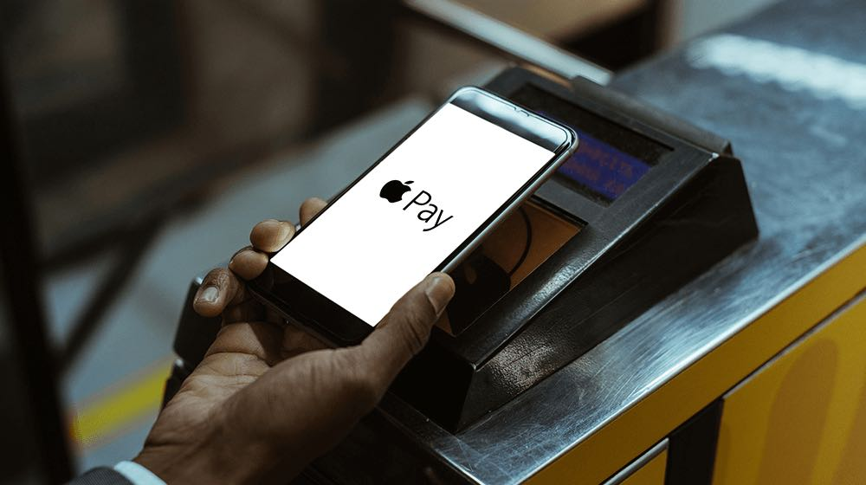
Types of future payments cont.
3.Rise of the wearable
4.Mobile apps
8

Slide 10
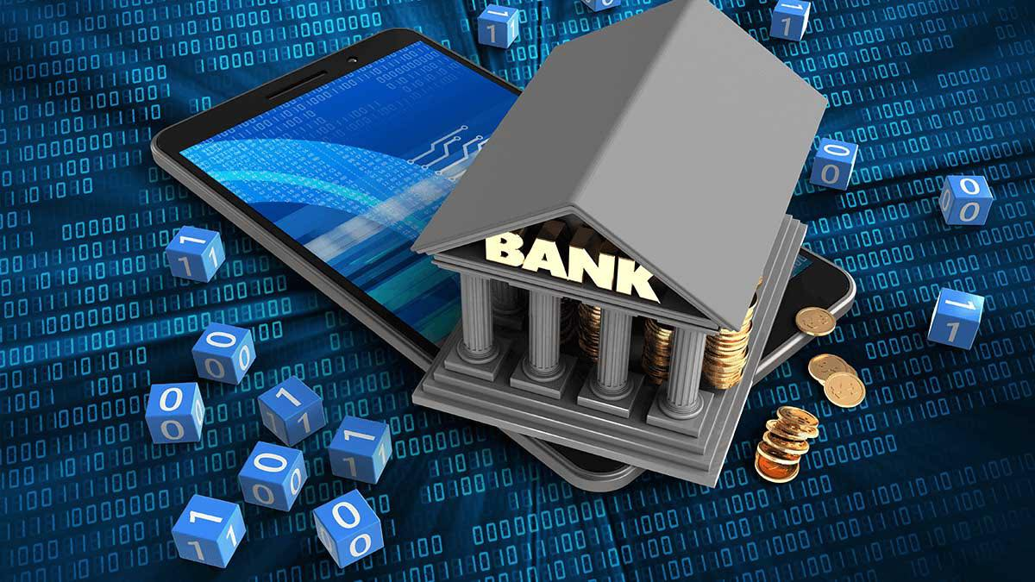
Definition of Digital banking
Digital banking is the new best thing that could have happened to mankind. In fact, not only has it provided a means of convenience for today’s banking times, it has also helped individuals to go paperless. Through Digital Banking, individuals can now easily make transactions, check their account balance or even make transfers just with a single click of a button on their smartphone, desk top or any other digital device.
9

Slide 11

Benefits of Digital Banking
The convenience of banking from the comforts of home
24*7 availability of access to banking function
Paperless banking
Enables set up of automatic payments for regular utility bills
Strengthens privacy and security for customers
10

Slide 12
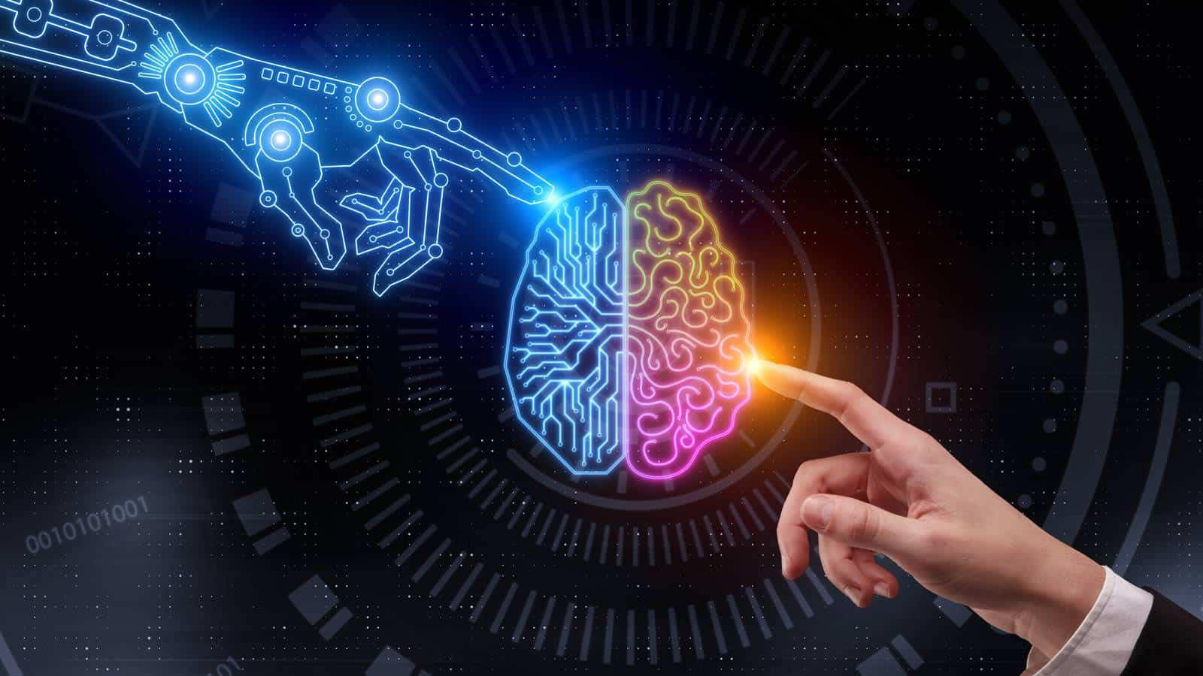
Future of Digital Banking
Research says, to be a fully digital bank, a bank must have The option to order currency Customizable standing options Card blocking feature Innovation toward safety vaults Accounts linked to tax exemptions status Integration with stock market investment channels Financial management analytics Grouping of accounts of different banks Easily accessible assistance.
11

Slide 13
Conclusion
People like Elon Musk, who see colonizing Mars and supersmart high-speed transport as a realizable vision. People like the engineers at Shimazu Corporation, who imagine building city structures in the oceans. People like the guys at NASA, who are launching space probes capable of sending us HD photographs of Pluto when, just a hundred years ago, we only just imagined it existed.
12

Slide 14
Refrebnce
4 payment trends of the future. Thales Group. (2021, January 18). Retrieved December 30, 2021, from. https://www.thalesgroup.com/en/markets/digital-identity-and-security/banking-payment/magazine/4-payment-trends-future.
Doyle, M. (2021, June 6). The Future of Money: The Digital Currency Revolution is here, and may sweep away 5,000 years of monetary history. The Globe and Mail. Retrieved December 30, 2021, from https://www.theglobeandmail.com/business/article-the-digital-currency-revolution-may-usurp-analog-money/
13

Slide 15
Thank you!
Do you have any questions?

