Slide 1
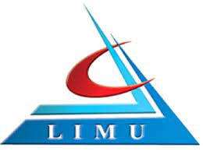


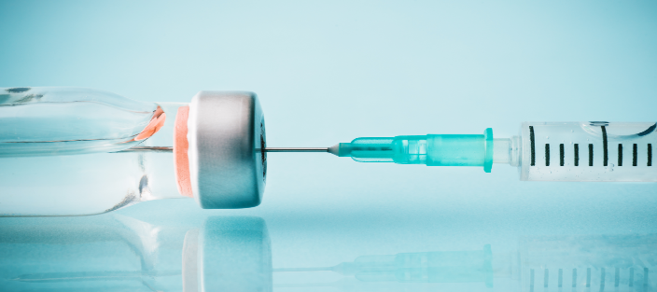
IMMUNAZTION LIVE ATTENUAETED VACCINE
NAME : DANA AHMAD
ID : 2903
BLOK : PTS

Slide 2

Objectives
Define the vaccine and their types .
Discuss the Live Attenuated Vaccine and their production methods .
List the Administration of Live Attenuated Vaccine .
Mention the Advantages and Disadvantages of the LAV .

Slide 3

Introduction
Vaccination is a simple ; safe ; and effective way of protecting you against harmful diseases ; before you come to contact with them ; it uses your body's natural defenses to build resistance to specific infections and makes your immune system stronger

Slide 4
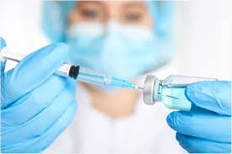
Types of vaccines …
1- Live Attenuated Vaccine
2- Inactive Vaccine
3- Subunit Vaccine
4- Recombinant Vaccine
5- Polysaccharide Vaccine
6- Toxoid Vaccine

Slide 5
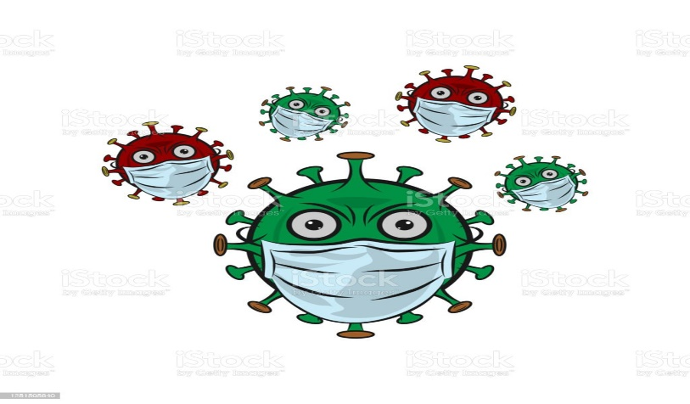
LIVE ATTENUATED VACCINE
_ IS the most common type of vaccine and derived from diseases causing pathogens ; that have been weekend under laboratory conditions but will cause vary mild or no disease .

Slide 6
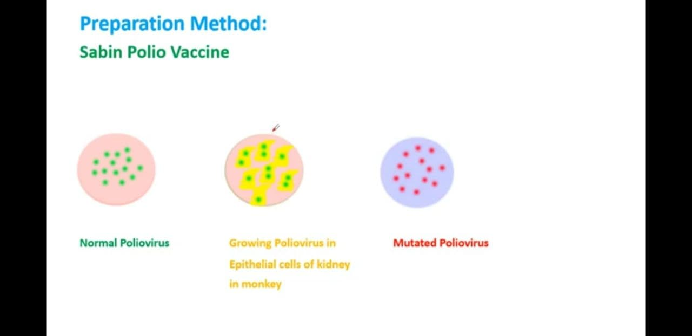

Slide 7


The Administration of LAV
_ Oral ( OPV . Rotavirus )
_ IM ( Hepatitis A.B )
_SC ( Yellow fever )
_ID ( BCG )

Slide 8

The Advantages of LAV…
_ Normally one or few doses are required .
_ Provides long-life immunity .
_ Generate Humoral ; cell mediated immunity .

Slide 9

The Disadvantages of LAV…
_ Reversion to virulent form
_poorly defined composition
_Risk to transmission

Slide 10
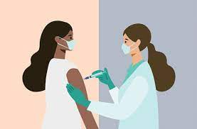
Conclusion
_The vaccine it is vary important for yourself , it makes your immune system strongly and protects you against the infectious diseases . Prevention you from a million of cases a diseases .

Slide 11
Reference
_Levinson Warren. Review of medical microbiology and immunology 23th ed . The McGraw _ Hill companies 2008
_ http;//www.WHO.int/health_topics/vaccine-and- immunization
_ http;//pubmed,nucbi,nlm;nih.gov.

Slide 12


